Slide 1
Hierarchical Planning
Group No. 3
Abhishek Mallik (113050019)
Avishek Dan (113050011)
Subhasish Saha (113050048)

Slide 2
Overview
Introduction
Motivation
Properties
ABSTRIPS
Observations
Hierarchical Task Network (HTN)
Application : Multi-agent Plan synergy
Way Forward : Using ontology
Conclusion
References

Slide 3
Planning
  Sequence of actions worked out beforehand
  In order to accomplish a task

Slide 4
Example : One level planner
Planning for ”Going to Goa this Cristmas”
    Switch on computer
    Start web browser
    Open Indian Railways website
    Select date
    Select class
    Select train
    ... so on
Practical problems are too complex to be solved at one level

Slide 5
How Complex ?
A captain of a cricket team plans the order of 5 bowlers in 2 days of a test match(180 overs).
  Number of possibilities : 5¹⁸⁰ = 25⁹⁰
  Much greater than 10⁸⁷ (approx. number of particles in the universe)

Slide 6
Hierarchy in Planning
Hierarchy of actions
  In terms of major action or minor action
Lower level activities would detail more precise steps for accomplishing the higher level tasks.
Ref : [1,2]

Slide 7
Example
Planning for ”Going to Goa this Cristmas”
  Major Steps :
    Hotel Booking
    Ticket Booking
    Reaching Goa
    Staying and enjoying there
    Coming Back
  Minor Steps :
    Take a taxi to reach station / airport
    Have candle light dinner on beach
    Take photos

Slide 8
Motivation
Reduces the size of search space
  Instead of having to try out a large number of possible plan ordering, plan hierarchies limit the ways in which an agent can select and order its primitive operators
Ref : [4]

Slide 9
Example
180 overs : 15 spells (12 overs each)
5 bowlers : 3 categories (2 pacer/2 spinner/1 pacer&1 spinner)
Top level possibilities : 3¹⁵
Total possibilities < 3*3¹⁵ (much less than 5¹⁸⁰)

Slide 10
Motivation contd...
If entire plan has to be synthesized at the level of most detailed actions, it would be impossibly long.
Natural to 'intelligent' agent
Ref : [1]

Slide 11
General Property
Postpone attempts to solve mere details, until major steps are in place.
Higher level plan may run into difficulties at a lower level, causing the need to return to higher level again to produce appropriately ordered sequence.
Ref : [1,2]

Slide 12
Planner
Identify a hierarchy of conditions
Construct a plan in levels, postponing details to the next level
Patch higher levels as details become visible
Demonstrated using ABSTRIPS
Ref : [1,2]

Slide 13
ABSTRIPS
Abstraction-Based STRIPS
Modified version of STRIPS that incorporates hierarchical planning
Ref : [1,2]

Slide 14
Hierarchy in ABSTRIPS
Hierarchy of conditions reflect the intrinsic difficulty of achieving various conditions.
Indicated by criticality value.
Ref : [2]

Slide 15
Criticality
A operation having minimum criticality can be trivially achievable, i.e., the operations having very less or no precondition.
  Example : Opening makemytrip.com
Similarly operation having many preconditions to satisfy will have higher criticality.

Slide 16
Patching in ABSTRIPS
Each level starts with the goal stack that includes the plan obtained in the higher levels.
The last item in the goal stack being the main goal.
Ref : [2]

Slide 17
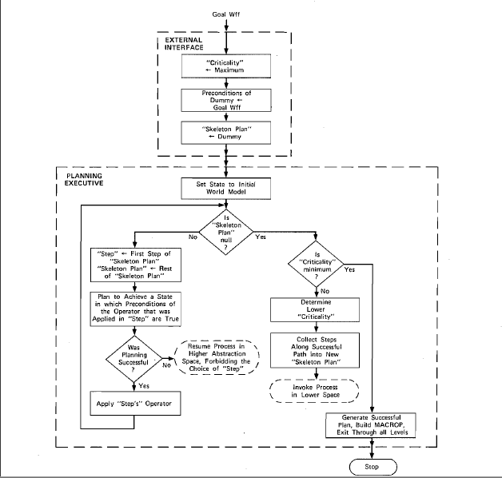
Ref : [1]

Slide 18
Example
Actions required for “Travelling to Goa”:
    Opening makemytrip.com (1)
    Finding flight (2)
    Buy Ticket (3)
    Get taxi(2)
    Reach airport(3)
    Pay-driver(1)
    Check in(1)
    Boarding plane(2)
    Reach Goa(3)

Slide 19
Example
1st level Plan :
  Buy Ticket (3), Reach airport(3), Reach Goa(3)
2nd level Plan :
  Finding flight (2), Buy Ticket (3), Get taxi(2), Reach airport(3), Boarding plane(2), Reach Goa(3)
3rd level Plan (final) :
  Opening makemytrip.com (1), Finding flight (2), Buy Ticket (3), Get taxi(2), Reach airport(3), Pay-driver(1), Check in(1), Boarding plane(2), Reach Goa(3)

Slide 20
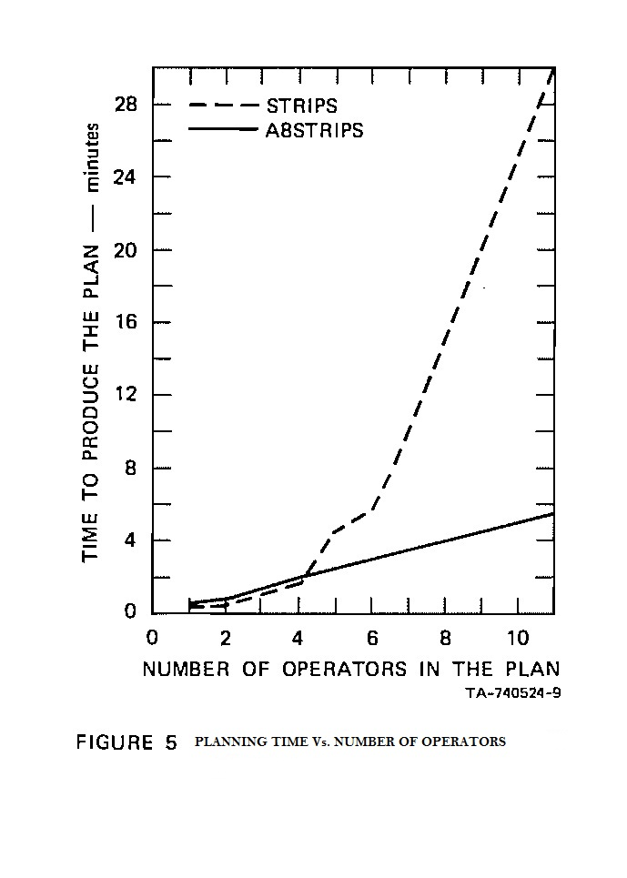
Observation
  As the number of operator increases, performance of hierarchical planning comes out to be much better than one level planning
Ref : [1]

Slide 21
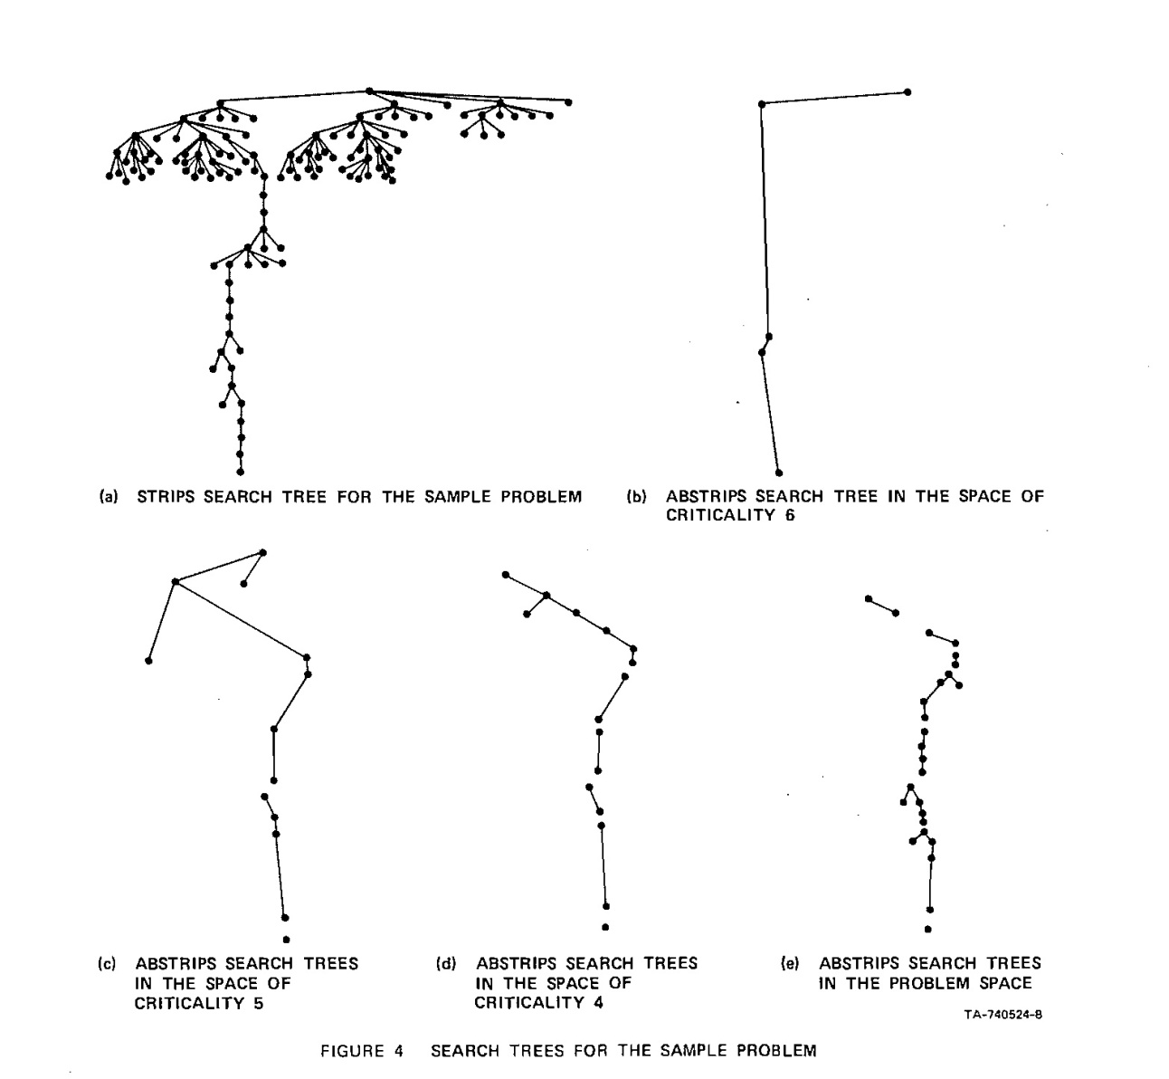
Observation contd…
Search trees for STRIPS and ABSTRIPS for a sample problem
Shows reduction in nodes explored
Ref : [1]

Slide 22
Hierarchical Task Network (HTN)
STRIPS style planning drawbacks:
  Compound Goal
    Ex. Round trip : Mumbai-Goa-Mumbai
  Intermediate Constraints
    Ex. Before(reach station, boarding train)
Most practical AI planners use HTN
    NOAH(1990), NONLIN(1990), SIPE(1988), DEVISER(1983), SOAP(2001), SOAP-2(2003)
Ref : [3,4]

Slide 23
Task Network
Collection of task and constraints on those tasks
((n₁, α₁) ,…, ((n_{m}, α_{m}) ,ϕ), where α₁ is task labeled with n₁ ,and boolean formula expressing constraints.
  Truth constraint : (n, p, n’) means p will be true immediately after n and immediately before n’.
  Temporal ordering constraint : n ≺ n’ means task n precedes n’.
  Variable binding constraint : ᴧ,ᴠ, =, ∼ etc.
Ref : [3]

Slide 24
Hierarchical Task Network
Hierarchy abstraction achieved through methods.
A method is a pair (α, d) , where
  α is the non-primitive task, and
  d is the task network to achieve the task α
Ref : [3]

Slide 25
HTN examples
((n₁:get-taxi), (n₂:ride(x, y)), .., (n₄:get-ticket), (n₅:travel(x, a(x)), (n₆:fly(a(x),a(y)) … , ((n₁≺n₂)..)ᴠ((n₄ ≺ n₆)ᴧ(n₅ ≺ n₆)…)
Task:
travel(powai, calangute)
Method: taxi-travel(powai, calangute)
Method: air-travel(powai, calangute)
get-taxi
ride(p,c)
pay-driver
get-ticket(S.C, Dabolim)
fly(S.C, Dabolim))
travel(D, c)
travel(p, S.C)

Slide 26
Application: Synergy between Agents
Discovering the synergy between the plans of multiple agents
In order to achieve the goal in reduced effort
Ref : [4]

Slide 27
Summary Information
Summary information encodes the hierarchy in planning.
We define a hierarchical plan step p as a tuple
  (pre, in, post, type, order, subplan, cost, duration)
    pre, in and post are conditions
    Type has one of the three values: primitive, or, and.
    Order is a set of temporal ordering constraints
    Primitive plans has no subplan
But initially these explicit condition information for non-primitive actions are not known.
This information is propagated from the primitive plan steps to the abstract plan step through a summary info.
Ref : [4]

Slide 28
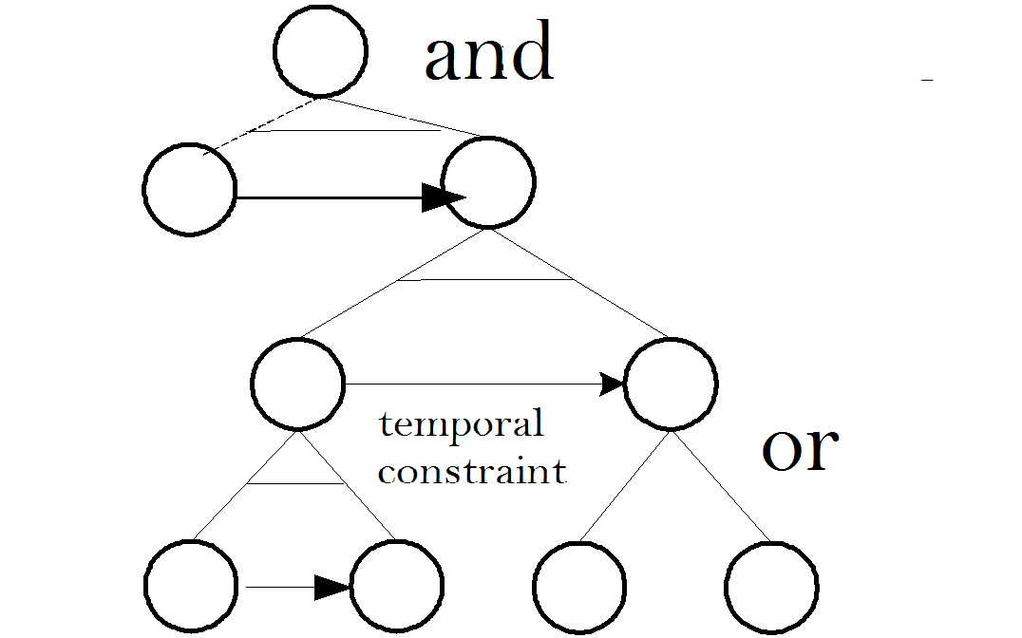
Summary Information
So, all the conditions, ordering constraints and cost for a non-primitive plan can be obtained from its those of its subplan.
  Introduction of ‘may’ and ‘must’ existential
Ref : [4]

Slide 29
May and Must existential
‘May’ and ‘Must’ are existential introduced due to hierarchical non-primitive representation of task.
May : ‘OR’ ing of tasks to non-primitive task introduces ‘may’
Must : ‘AND’ ing of tasks to non-primitive task introduces ‘must’
These existential is different from the concept of criticality

Slide 30
Plan merging
If ‘must’ post-condition of one plan includes ‘must’ post-condition of other plan, then they can be merged.
Since ‘may’ is at higher level of abstraction, its hierarchy has to be decomposed to the point of ‘must’ .
Inter-agent temporal constraints has to be established.
Ref : [4]

Slide 31
Top-down synergy
Plans at higher level of hierarchy achieves more effects than at a lower level.
A part of the plan can be pruned if its post-conditions do not overlap with any other plan’s post-condition.
Ref : [4]

Slide 32
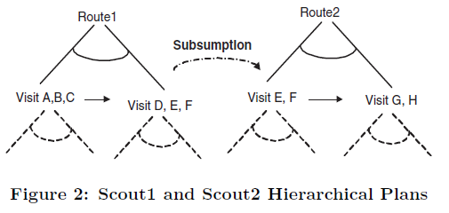
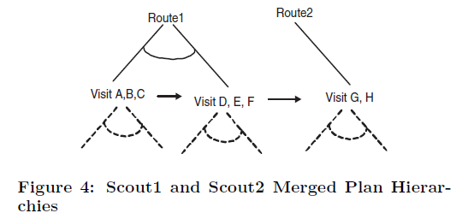
Example
‘Visit E,F’ of Scout2 is included in ‘Visit D,E,F’ of Scout1
Ref : [4]

Slide 33
Ontology and Hierarchical Planning
Hierarchical planning in real world requires modeling an efficient, semantic, and flexible knowledge representation for both planning and domain knowledge.
Ontology helps to conceptualize the hierarchy of operators and domain.
Ref : [5]

Slide 34
Example
To perform operation ‘Buy ticket’ agent has to understand concept of ‘Buy’ and ‘ticket’
Buy is an action, between seller and customer, involves finding a seller, customer should have money to buy etc.
Ticket is an object, which has some price, has particular owner, has some validity etc.
This conceptualizations are extremely important for planning in that domain.
Ref : [5]

Slide 35
Conclusion
For complex problems hierarchical planning is much more efficient than single level planning.
Improves performance as number of operator in the problem increases.
HTN planning gives more expressivity
Merging opens door to accomplish a complete plan from incomplete individual plans
Integration with ontology opens door for automatic planning
Reduces man machine gap.

Slide 36
References
E.D. Sacerdoti, Planning in a hierarchy of abstraction spaces, in: Proc. of the 3rd International Joint conference on Artificial Intelligence, 1973
Nils J. Nilsson: Principles of Artificial Intelligence, Springer 1982.
K. Erol, J. Hendler, and D. S. Nau. HTN planning: Complexity and expressivity. in: National Conference on Artificial Intelligence (AAAI), 1994
Jeffrey S. Cox and Edmund H. Durfee, ‘Discovering and Exploiting Synergy Between Hierarchical Planning Agents’, in: Second International Joint Conference On Autonomous Agents and
Multiagent Systems, 2003
Choi H J Kang D, ‘Hierarchical planning through operator and world abstraction using ontology for home service robots’ ,in: Advanced Communication Technology, 2009. ICACT 2009. 11th International Conference on, 2009

Slide 37
QUESTIONS

Slide 38
THANK YOU

