Slide 1

Is Borrower Defaulter?
The Largest Lending Company
By
Gaurav Singh
Vipul Narain
Pavithran PV
Abhinav Singh

Slide 2

Identify Risk of Loan Approval
Goal
Identify Safe & Risky Consumer
Reduce Credit Loss
Increase Profit
Approach : Exploratory Data Analysis
Load Loan Dataset, Data Cleanup
Identify Driving Factors/Variables for Defaulter using Univariate & Bivariate Analysis
Conclusion
Driving Factors and their effect on Consumer being Defaulter or not

Slide 3

Goal
Identify Safe & Risky Consumer
Identify the Consumer who did not Repay the the loan and are called Defaulters.
Use loan data which contains:
Charged-Off Consumers : Did not repay loan
Fully Paid Consumers : Repaid the loan
Current Consumers : Ongoing loan
Reduce Credit Loss
By identifying Defaulters Lending Company can avoid giving loan to them and reduce the Credit Loss.
Increase Profit
Identifying Safe Consumers will help in Lending Company to increase its Profit

Slide 4


Approach : Exploratory Data Analysis
Data Load
RAW DATASET
ROWS : 39717
COLUMNS : 111
SIZE : 33.6MB
loan.csv
Loading Loan Dataset
Data Cleanup & Understanding
Drop empty Columns
Drop Columns with Single Value
Get rid of rows with empty data
Standardizing Column Values
Lower Case Conversion of all values in a column
Removing unnecessary prefix like ‘%’ and ‘years’ etc.
Converting the Date columns to datetime
Standardizing Column Names
Columns renamed to identify their business meaning
Data Cleanup
+
Data Dictionary
CLEANED DATASET
ROWS : 36433
COLUMNS : 42
SIZE : 12.0MB

Slide 5
EDA : Univariate Categorical Analysis
Analysis Result(For Categorical Univariates)
Attribute Name | Analyzed Info
JobExperienceOfBorrower(Years) | Most of the borrowers have experience 10+ Years
HomeOwnershipStatusOfBorrower | Income is ‘not verified’ for most of the borrowers
loan_status | 83.5% borrowers => fully paid the loan 13.6% => Defaulters 2.9% => Current Consumers
NumberOfPayments(Months) | Loan for 36 months => 26377 Borrowers Loan for 60 months => 10056 Borrowers
purpose | Most borrowers took loan for “debt consolidation”
Ordered Categorical Variable
Job Experience of Borrower
Unordered Categorical Analysis
Status of Home Ownership of Borrower
RENT
MORTGAGE
OWN
OTHER
Income Verification Status
Not Verified
Verified
Source Verified
Loan Status
Fully Paid
Charged Off
Current
Number Of Payments(Month) : 36 Months, 60 Months
Purpose : The purpose why loan has been taken

Slide 6
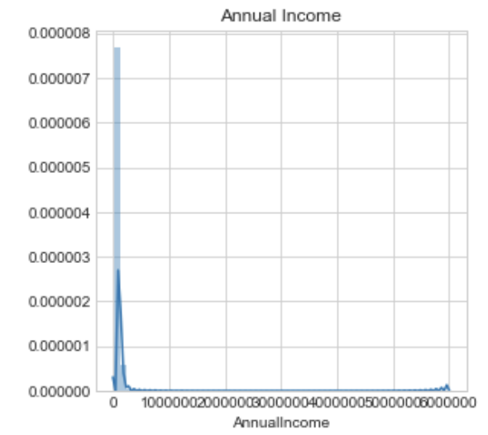
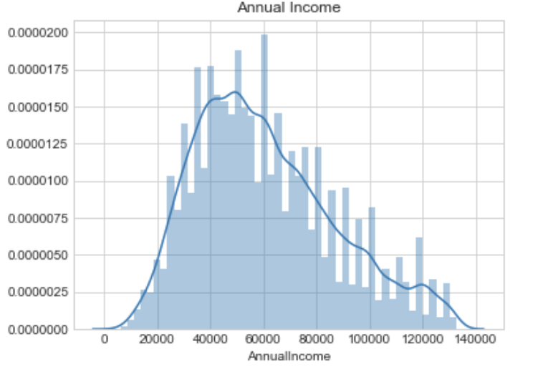
EDA : Univariate Numeric Data Analysis
Check whether Number Attributes are Normally Distributed or not
For all the Numeric Attributes Distribution has been drawn
Annual Income column is Positively Skewed, i.e. there are Outliers in positive side
Distribution Plot for relevant numeric columns
Central Tendency of Numeric Attributes
Get rid of Outliers
Before Removing Outliers
After Removing Outliers
Analysis Result(For Numeric Univariates)
After removing Outliers from Annual Income attribute, not only Annual Income distribution became Normal but all other Numeric attributes also become much more Normal Distribution

Slide 7
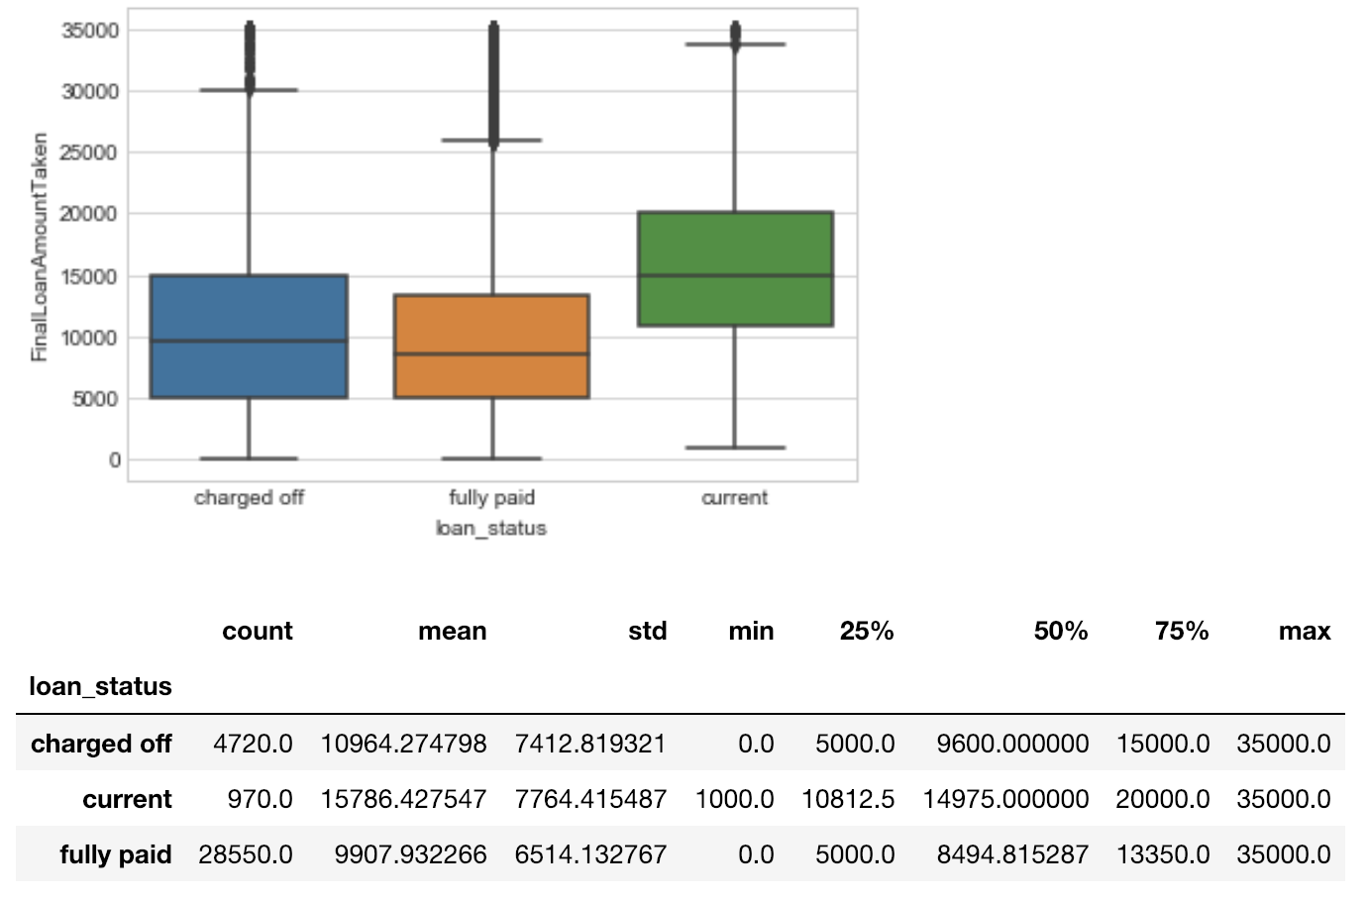
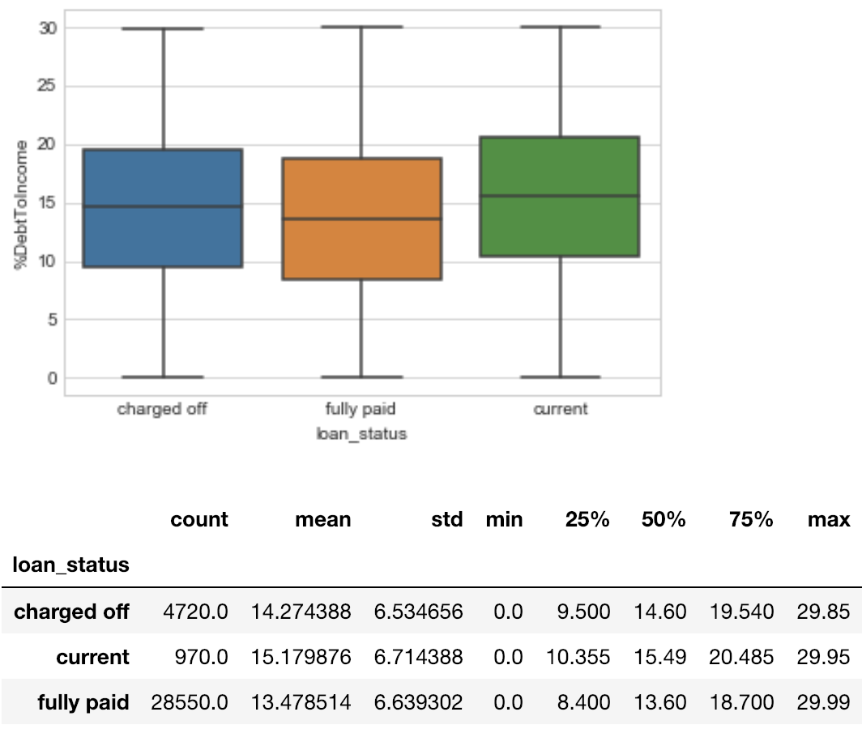
EDA : Segmented Univariate Analysis
Analysis Result
(Loan Status & Loan Amount Taken)
More the loan amount allocated more risk of consumer being a Defaulter
Analyzing Final Loan Amount Taken for Segmented Loan Status
Analyzing %Debt To Income Ratio for Segmented Loan Status
Analysis Result
(Loan Status & % Debt To Income Ratio)
Higher the %DebtToIncome Ratio, Higher is the chance of Loan Default

Slide 8
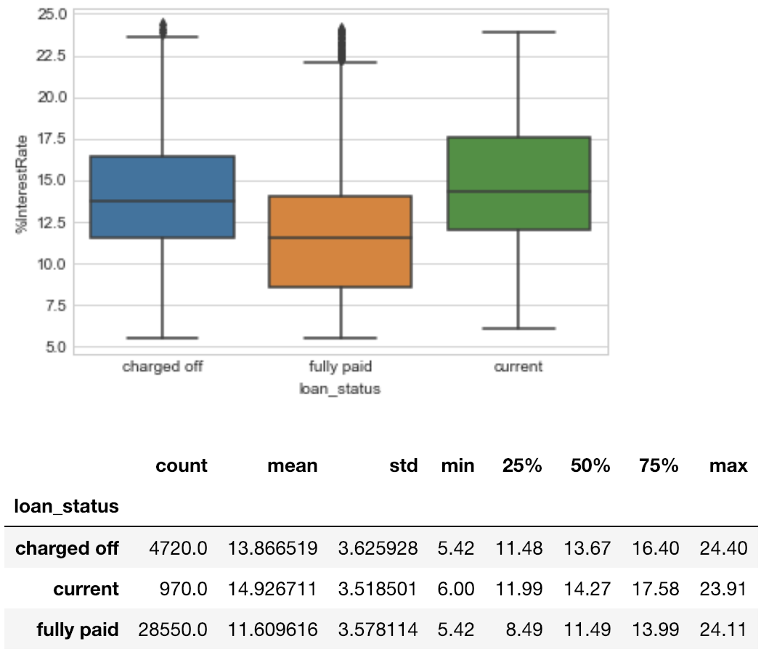
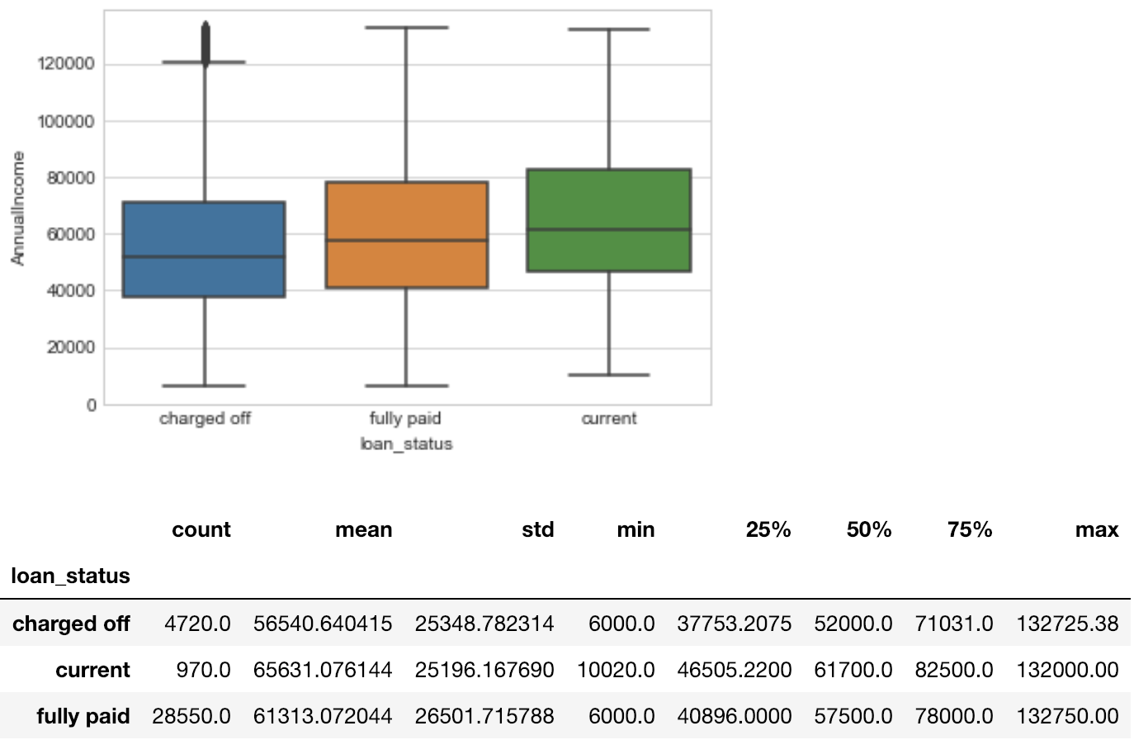
EDA : Segmented Univariate Analysis
Analysis Result
(Loan Status & % Interest Rate)
Higher the %InterestRate, Higher is the chance of Default
Analysing %InterestRate for Segmented Loan Status
Analysing Annual Income for Segmented Loan Status
Analysis Result
(Loan Status & Annual Income)
Lower the Annual Income, Higher is the chances of Default

Slide 9
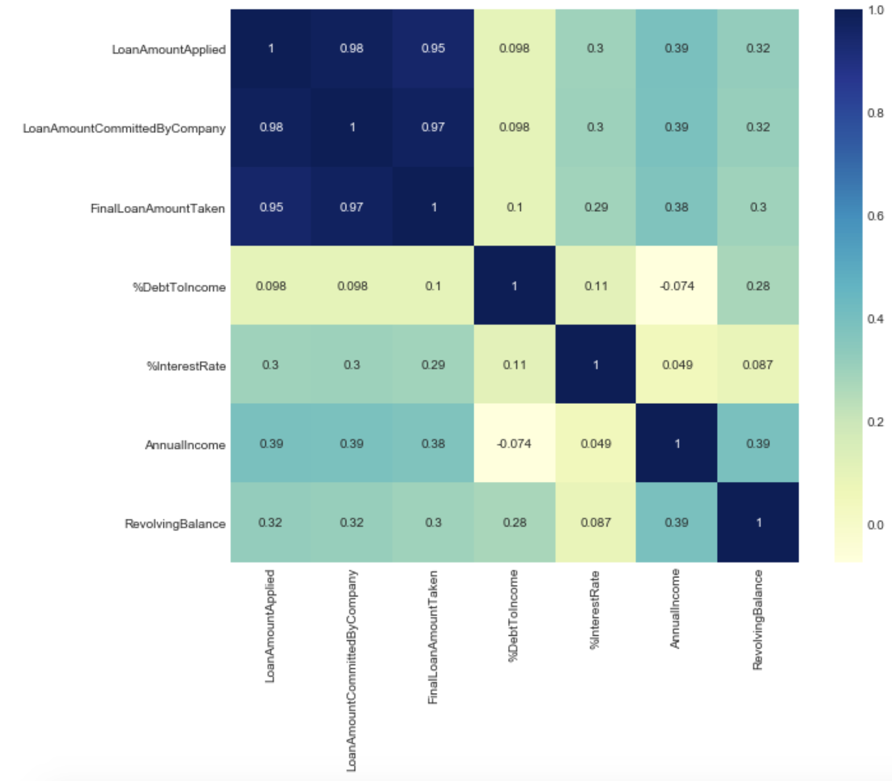
EDA : Bivariate Analysis-Numeric Variable
Analysis Result(Correlation b/w variables)
Annual Income is -ve correlated to %DebtToIncome, it is understood because %DebtToIncome is inversely proportional to Income
Annual Income is Moderately +ve correlated to RevolvingBalance & FinalLoanAmountTaken
'%DebtToIncome' is Moderately +ve correlated to RevolvingBalance
'%InterestRate' is Moderately +ve correlated to FinalLoanAmountTaken
Analysing %InterestRate for Segmented Loan Status
Analysing Annual Income for Segmented Loan Status

Slide 10
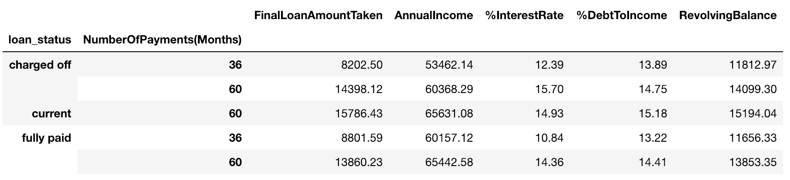
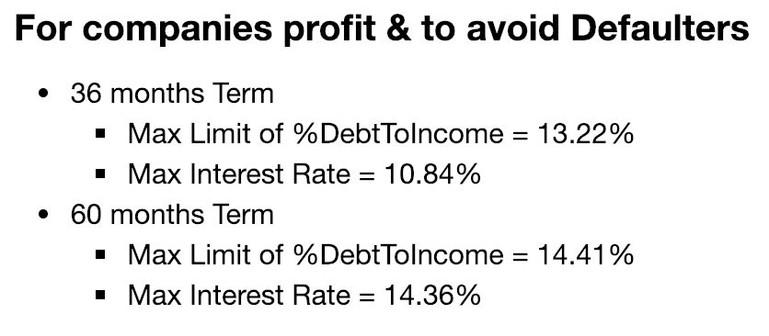
EDA : Bivariate Analysis-Categorical Variable
Analysis Result
(Loan Status, Loan Amount Taken & Numeric Values)
loan_status and NumberOfPayments(Months)
loan_status & JobExperienceOfBorrower(Years)
Analysis Result
(Loan Status, Job Experience in Years & Numeric Values)

Slide 11
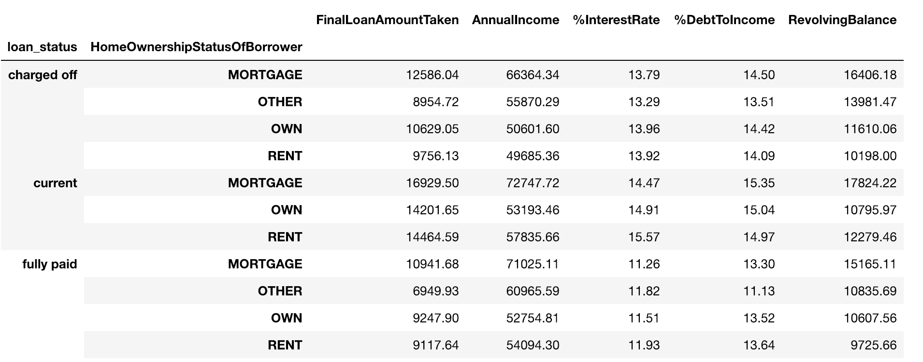
EDA : Bivariate Analysis-Categorical Variable
loan_status & HomeOwnershipStatusOfBorrower
Analysis Result
(Loan Status, Home Ownership Status & Numeric Values)

Slide 12
Conclusion : Driver Factors/Variables for Defaulter
High Level Analysis Result
Higher the %Interest Rate goes more, chances of Borrower being a Defaulter will increase
Higher the %DebtToIncome Ratio, chances of Borrower being a Defaulter will increase
Lower the Annual Income, chances of Borrower being a Defaulter will increase
%Interest Rate
% Debt To Income Ratio
Annual Income
Number of Payments (in Month)
Final Conclusion
If the Lending Company want to have less chances that Borrower will be a Defaulter and in tern reduce their Credit Loss, they have to limit % DebtToIncome ratio and %Interest Rate as follows:
In Terms of Number Of Payments by Month:
36 months Term
%DebtToIncome Ratio <= 13.22%
%Interest Rate <= 10.84%
60 months Term
%DebtToIncome Ratio <= 14.41%
%Interest Rate <= 14.36%
By above limitations, chances of having Safe Consumer increases and hence Credit Loss will be reduced.

