Slide 1
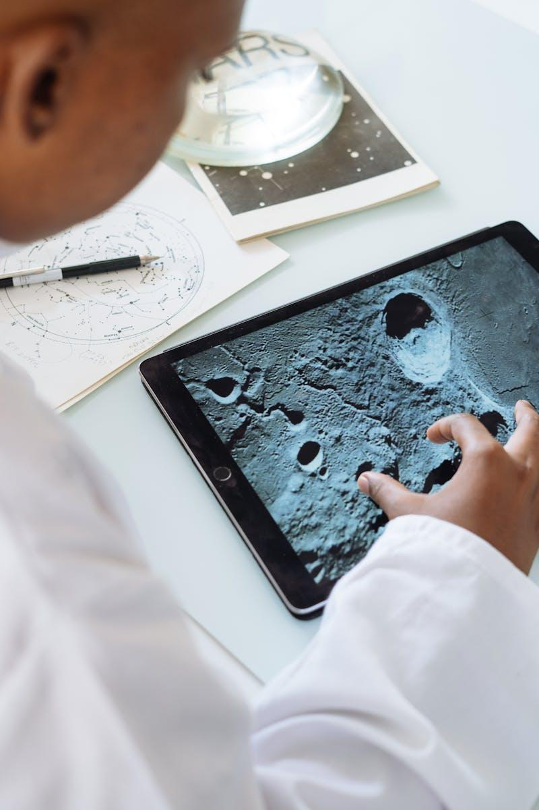
Research Paper Recommendation System And Subject Area Prediction Using Deep Learning
Enhancing Research Paper Discovery
Vipul
Kiran
Madan
Keerthan

Slide 2

Dataset Used
Dataset used : Arxiv dataset from Kaggle https://www.kaggle.com/datasets/Cornell-University/arxiv
The ArXiv dataset is a collection of Research Papers from arXiv.org. It is valuable in areas such as natural language processing and recommendation systems.
The size of the data is 56,182 rows, 3 columns.
Independent variables are:
Terms: The subject areas it belongs to.
Titles: The titles of the research papers.
Abstracts: Summaries of the research papers.
Photo by Pexels

Slide 3
Part 1 - Research Paper Recommendation System

Slide 4
Input, and Outputs
Input
Title of your Research Paper or Relevant Keyword/ Sentence.
Output
List of Top Recommended Research Papers in the Domain.
Photo by Pexels

Slide 5

Model
This system uses the Sentence Transformer model, MiniLM-L6-v2 for Research paper recommendation.
Here there is no model training
Data Collection And Preprocessing it
Text Vectorization using Transformer
Calculate cosine similarity scores between the embeddings of input_paper and all papers in the dataset
Retrieve the titles of the top similar papers
Photo by Pexels

Slide 6
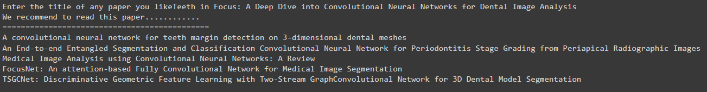
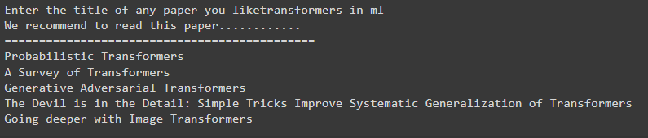
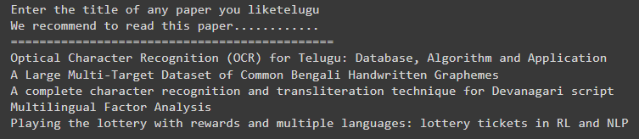
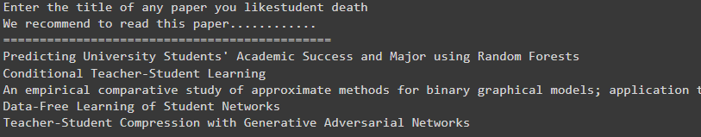
Results
Research Papers Recommendation system is successfully Recommending top 5 research papers related to it
Photo by Pexels

Slide 7
Part 2 – Subject Area Prediction

Slide 8
Input, and Outputs
Input
Abstract of your Research Paper or Any Relevant Sentence.
Output
Predicted Subject Area/ Domain of the Paper.
Photo by Pexels

Slide 9
Model
We employed a CNN model for achieving subject area prediction
However, due to lower accuracy, subsequent improvements were made by using MLP and LSTM models.
Photo by Pexels

Slide 10
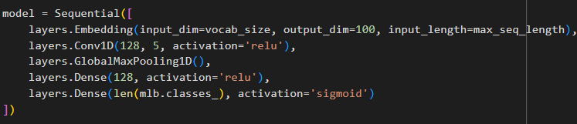
CNN USED

Slide 11
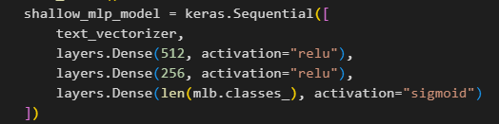
MLP USED

Slide 12
LSTM USED

Slide 13
Results
Accuracy of CNN model: 55%
Accuracy of MLP model: 65 %
Accuracy of LSTM model: 70 %
Photo by Pexels

Slide 14
Future work
Increase the dataset size, now it is 56,182 rows * 3 columns.
Increase the accuracy, now our highest is 70 % using lstm.

