Slide 1
Image Caption Generator Using CNN & LSTM
Mentor : Mr. Kailash Kumar
BY: Harshita Bhardwaj
Vipul Gupta
Umesh Pratap Singh
Priyanshu Upadhyay

Slide 2
Objective
The main aim of this project is to get a little bit of knowledge of deep learning techniques.
We use two techniques mainly CNN and LSTM for image classification. So, to make our image caption generator model, we will be merging these architectures. It is also called a CNN-RNN model.

Slide 3
Image Caption Generator
Image caption generator is a task that involves computer vision and natural language processing concepts to recognize the context of an image and describe them in a natural language like English.

Slide 4
Algorithm Used
For this project we are using deep learning methods :
1. Convolutional neural network
2. Long short term memory.

Slide 5
Convolutional neural network
A Convolutional Neural Network (ConvNet/CNN) is a Deep Learning algorithm which can take in an input image, assign importance (learnable weights and biases) to various aspects/objects in the image and be able to differentiate one from the other.
The pre-processing required in a ConvNet is much lower as compared to other classification algorithms

Slide 7
Long short term memory
LSTM is a type of RNN (recurrent neural network) which is well suited for sequence prediction problems.
Based on the previous text, we can predict what the next word will be.
It has proven itself effective from the traditional RNN by overcoming the limitations of RNN which had short term memory

Slide 9
Dataset
FLICKR8K DATASET
Flickr8k dataset is a public benchmark dataset for image to sentence description. This dataset consists of 8000 images with five captions for each image.
These images are extracted from diverse groups in Flickr website. Each caption provides a clear description of entities and events present in the image.
The dataset depicts a variety of events and scenarios and doesn't include images containing well-known people and places which makes the dataset more generic.
The dataset has 6000 images in training dataset, 1000 images in development dataset and 1000 images in test dataset.

Slide 10
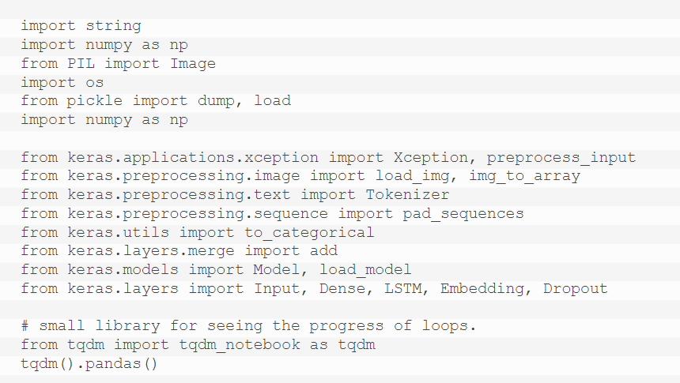
Proposed Work
First, we import all datasets.

Slide 11
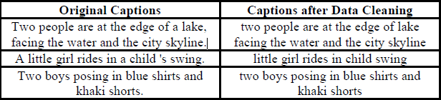
Getting and performing data cleaning

Slide 12
Extracting the feature vector from all images
This technique is also called transfer learning, we don’t have to do everything on our own, we use the pre-trained model that have been already trained on large datasets and extract the features from these models and use them for our tasks. We are using the Xception model which has been trained on imagenet dataset that had 1000 different classes to classify.

Slide 13
Loading dataset for Training the model
In our Flickr_8k_test folder, we have Flickr_8k.trainImages.txt file that contains a list of 6000 image names that we will use for training.
Tokenizing the vocabulary
Computers don’t understand English words, for computers, we will have to represent them with numbers. So, we will map each word of the vocabulary with a unique index value. Keras library provides us with the tokenizer function.

Slide 14
Create Data generator
We have to train our model on 6000 images and each image will contain 2048 length feature vector and caption is also represented as numbers. This amount of data is not possible to hold into memory so we will be using a generator method that will yield the input and output sequence
Defining the CNN-RNN model
To define the structure of the model, we will be using the Keras Model from Functional API. It will consist of three major parts:
Feature Extractor
Sequence Processor
Decoder

Slide 15
Training the model
To train the model, we will be using the 6000 training images by generating the input and output sequences in batches and fitting them to the model using model.fit_generator() method.

Slide 16
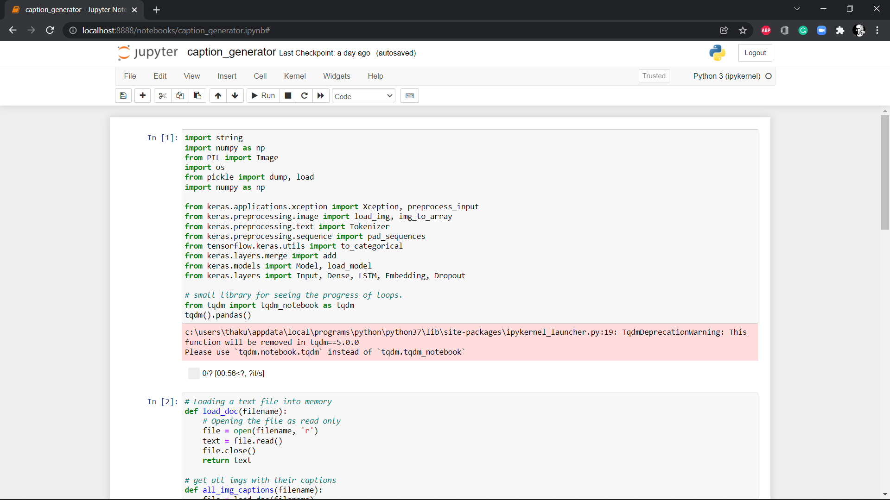
Implementation

Slide 17
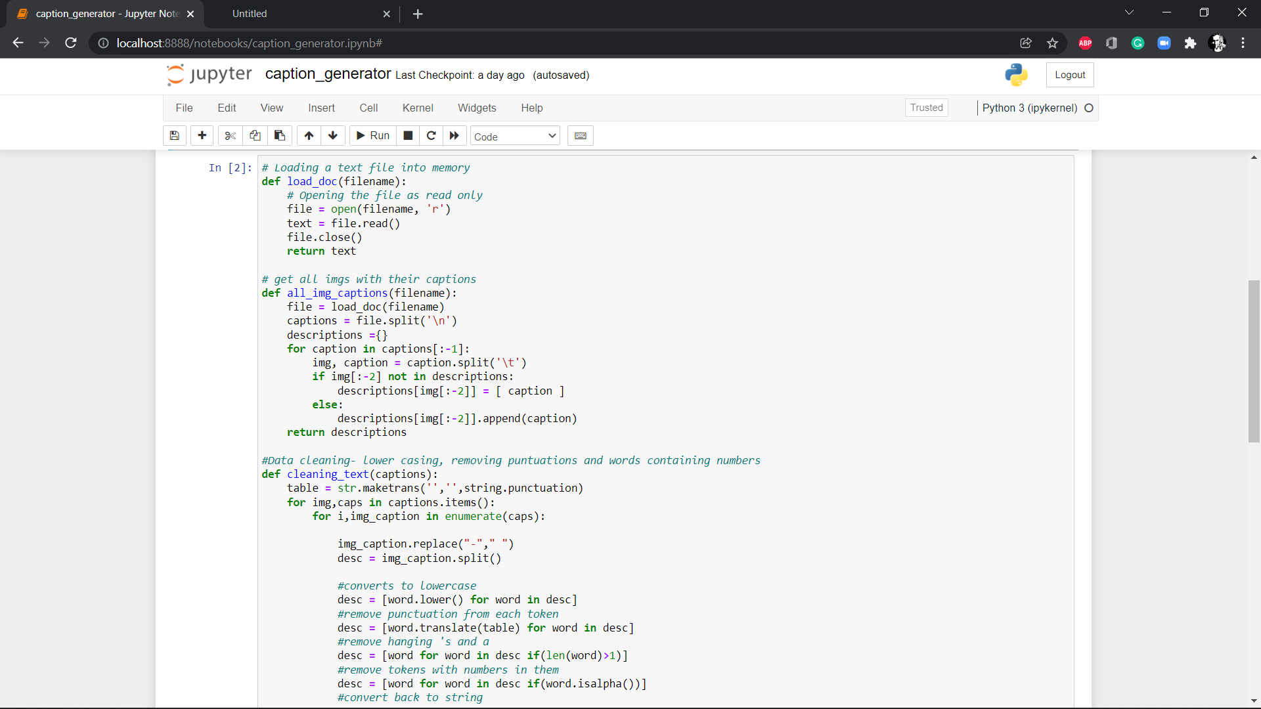

Slide 18
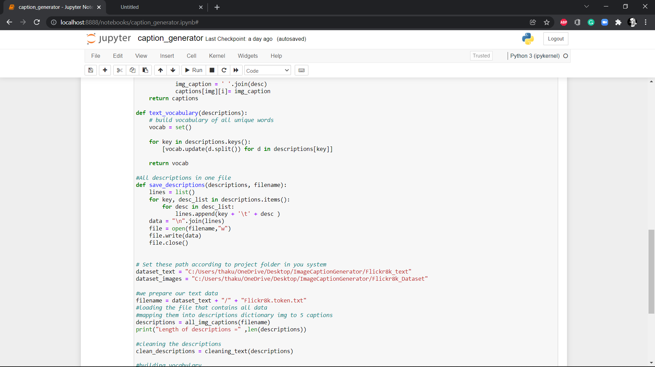

Slide 19
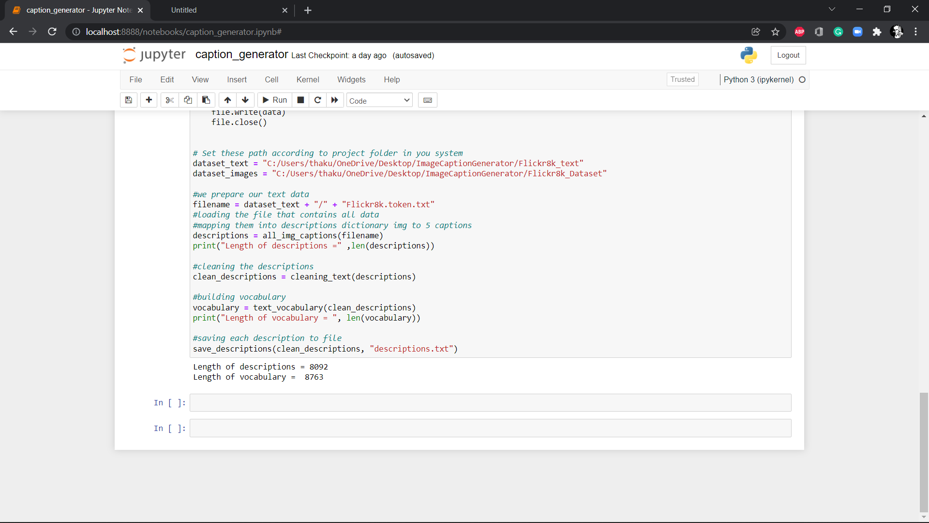

Slide 20
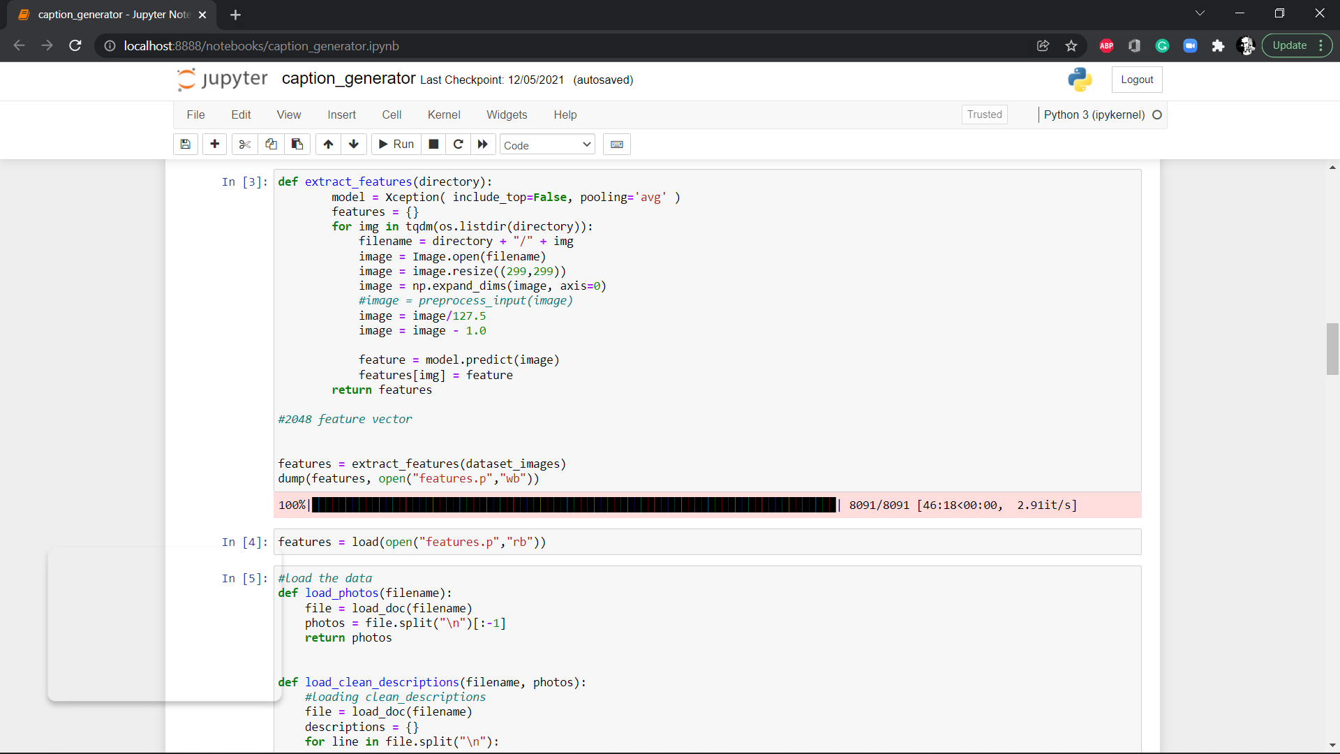
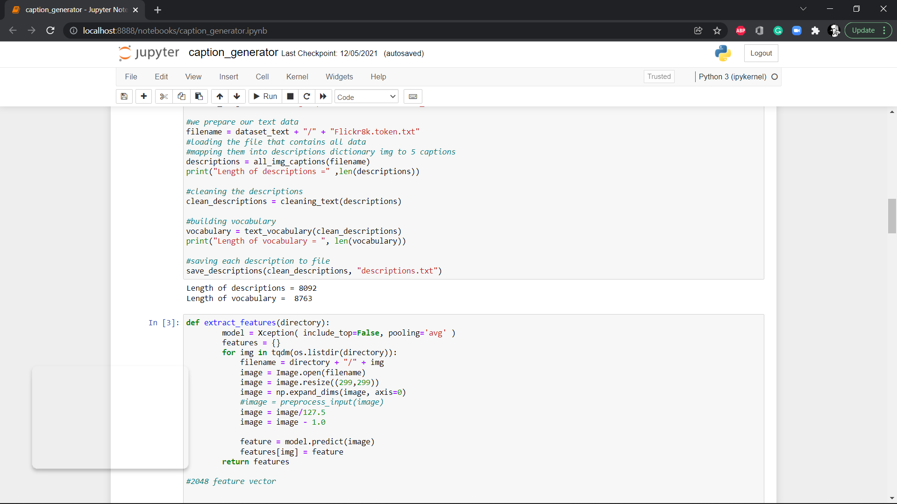

Slide 21
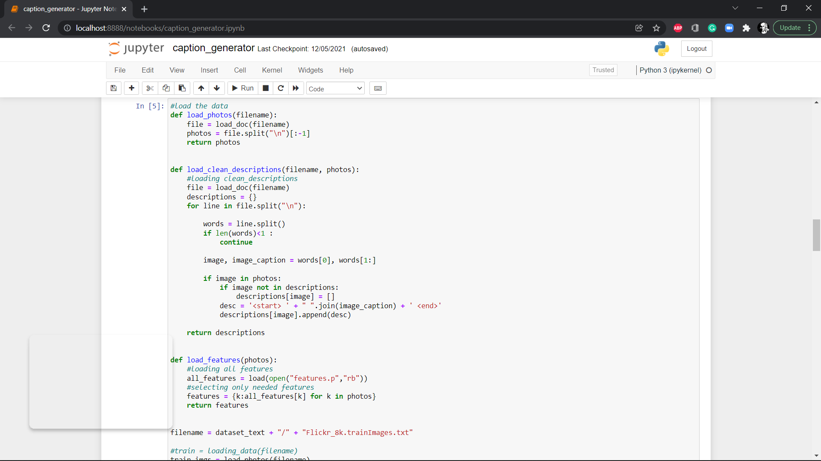

Slide 22
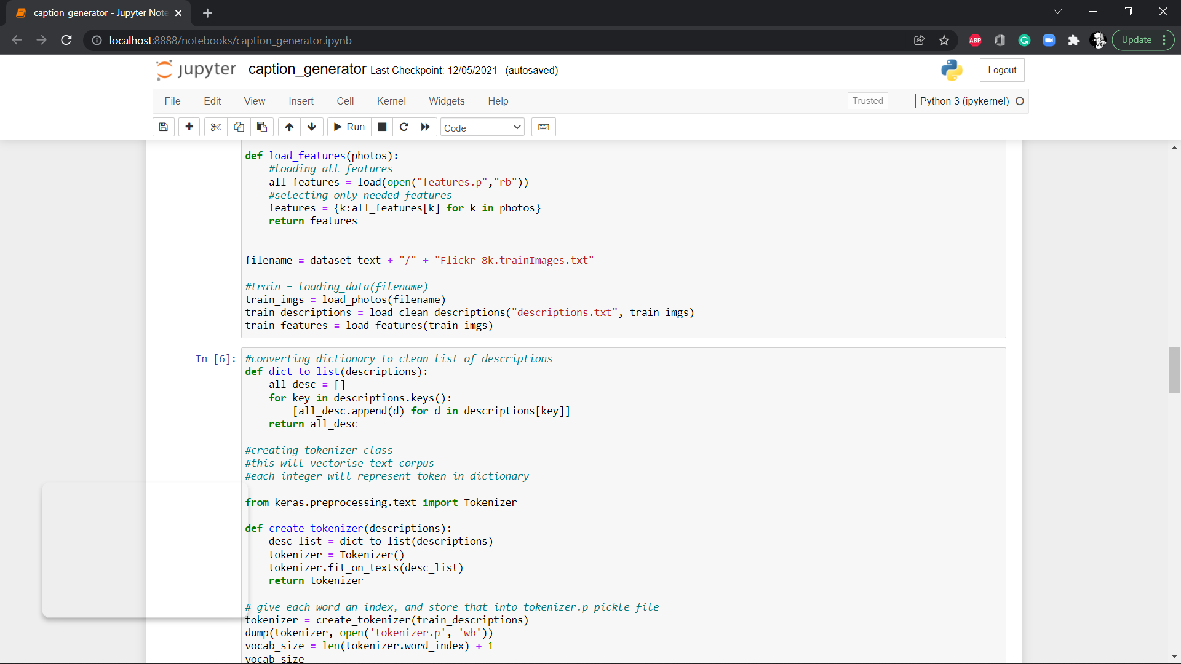

Slide 23
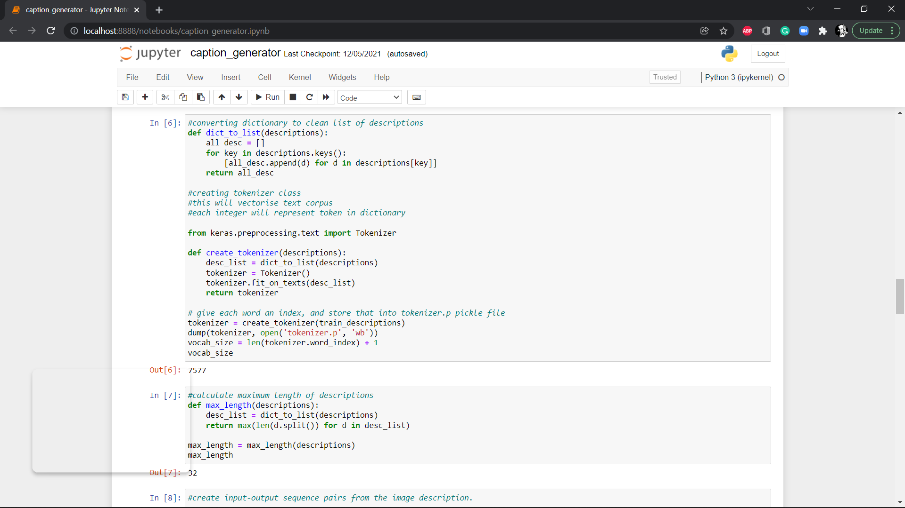

Slide 24
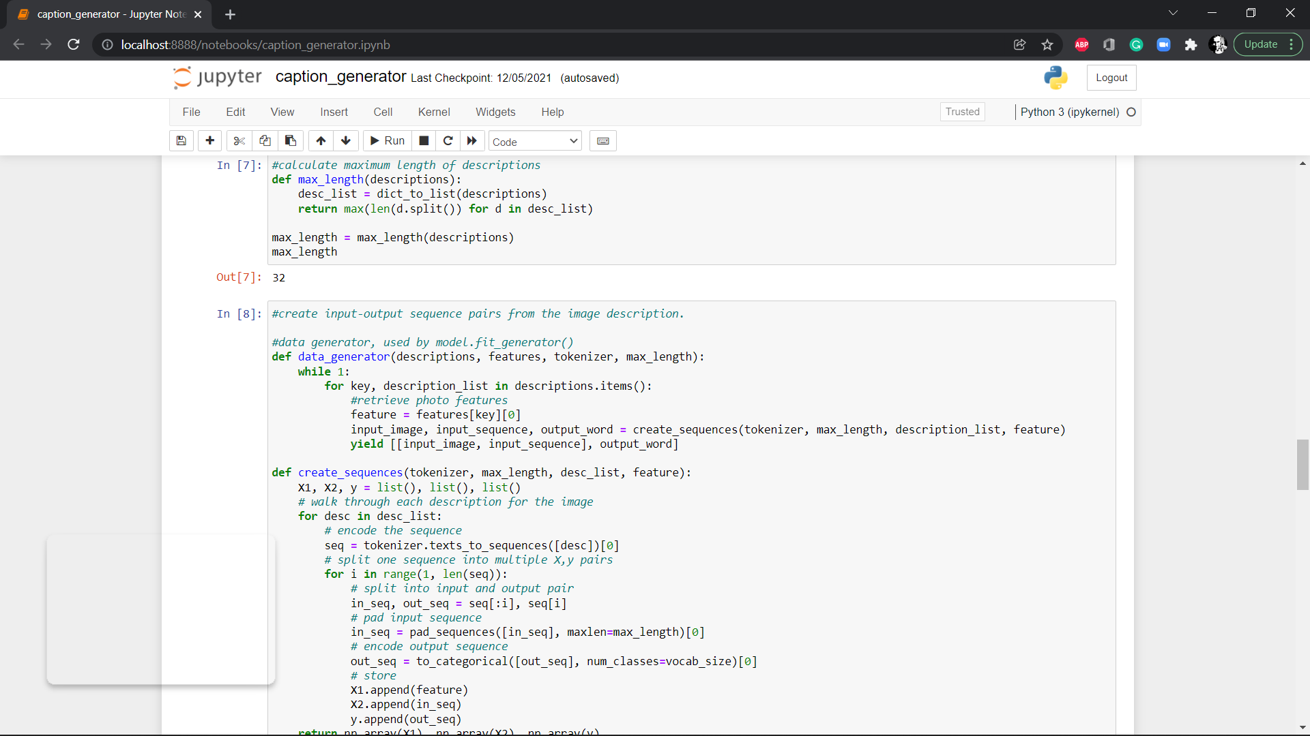

Slide 25
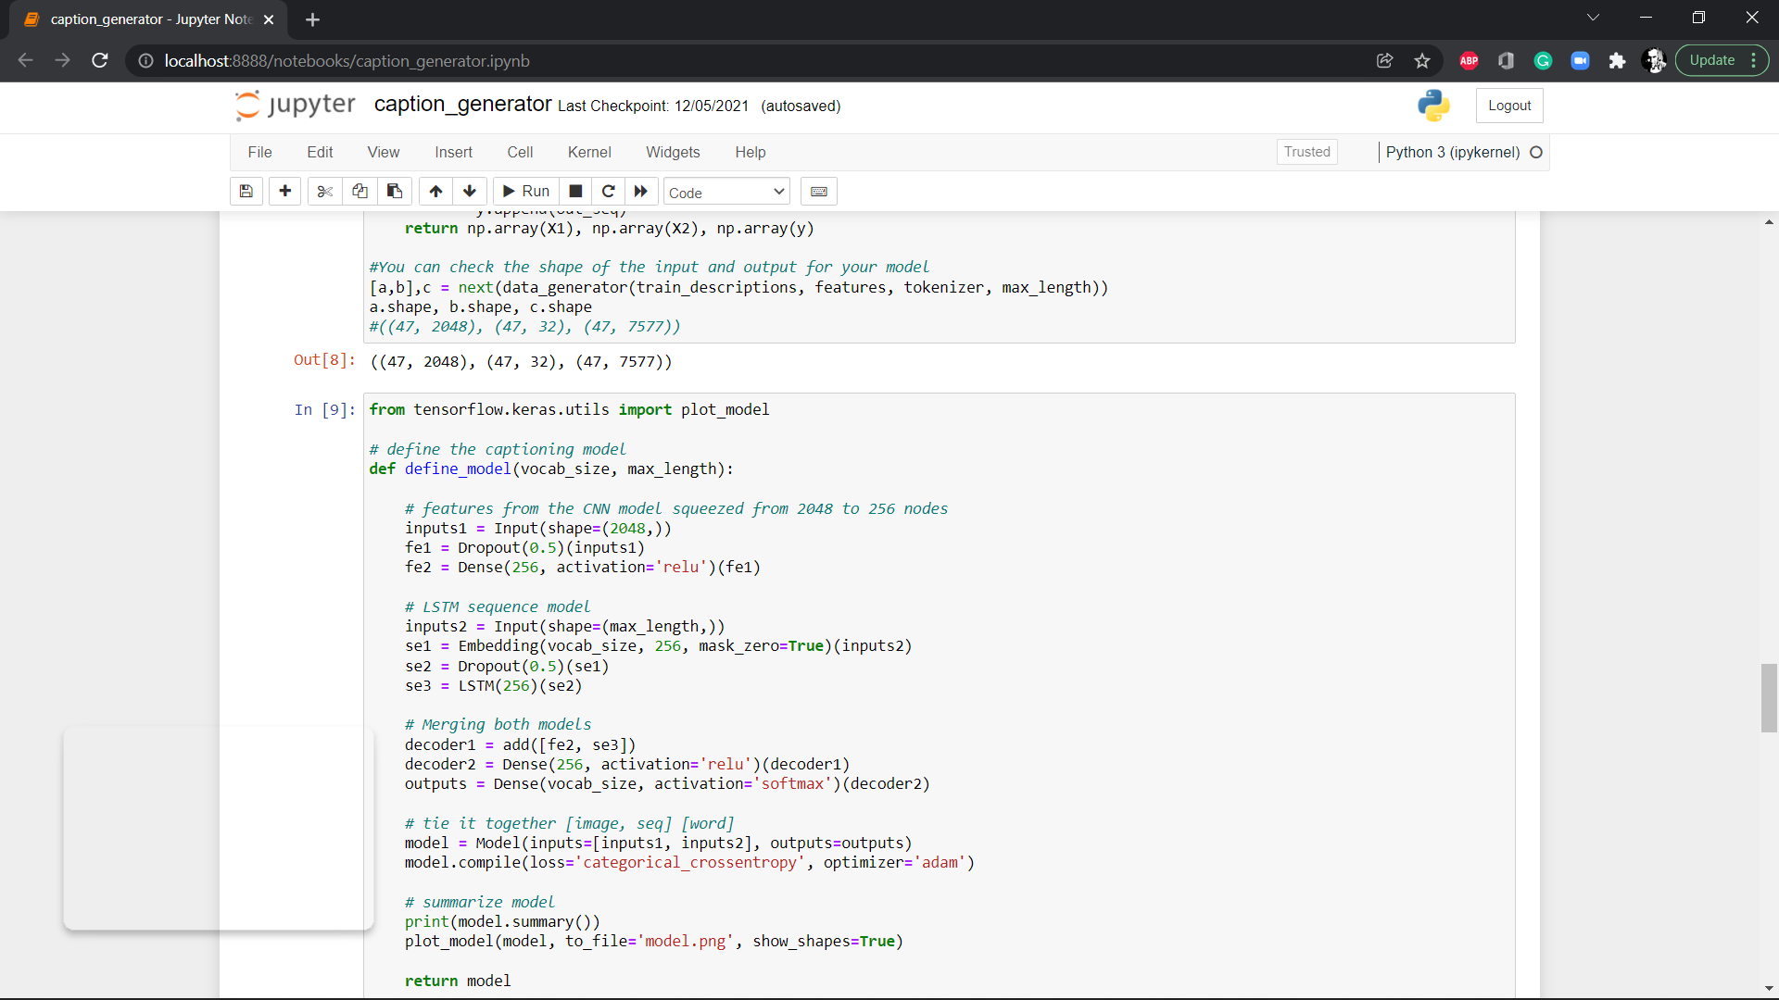

Slide 26
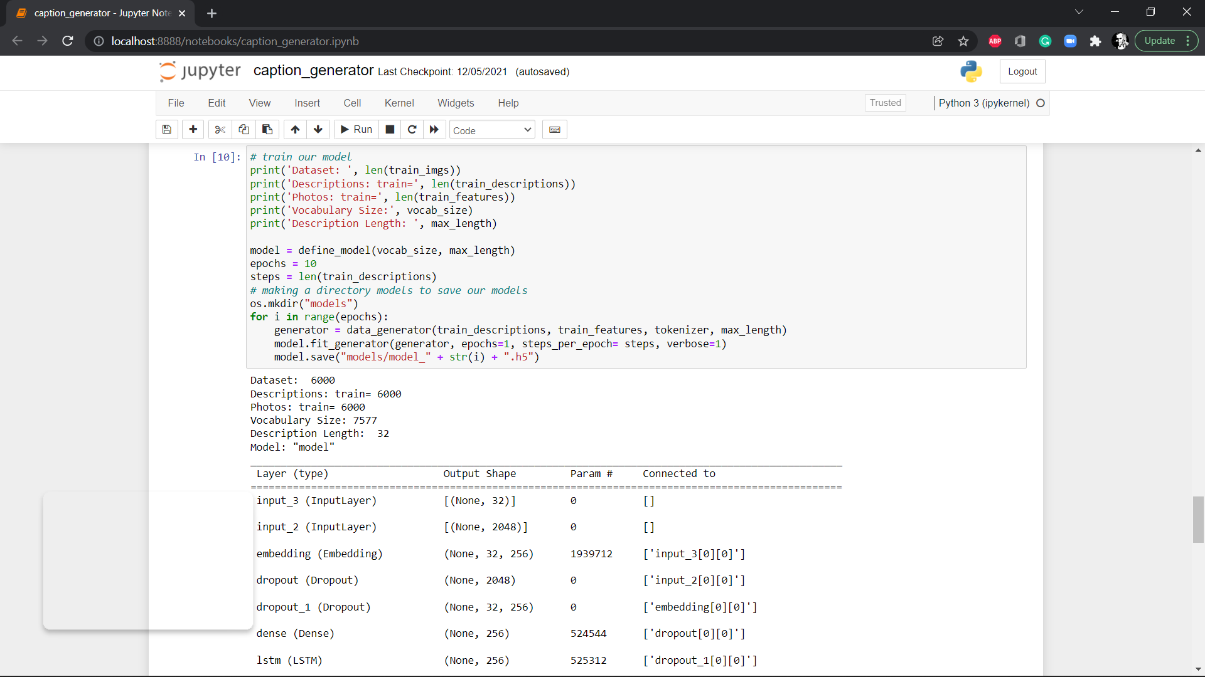

Slide 27
THANK YOU

