Slide 1
Image Caption Generator Using CNN & LSTM
Mentor : Mr. Kailash Kumar
BY: Harshita Bhardwaj
Vipul Gupta
Umesh Pratap Singh
Priyanshu Upadhyay

Slide 2
Overview
Image captioning is the process of generating textual description of an image.
It uses both natural language processing and computer vision to generate the captions.

Slide 3
Objective
The main aim of this project is to get a little bit of knowledge of deep learning techniques.
We use two techniques mainly CNN and LSTM for image classification. So, to make our image caption generator model, we will be merging these architectures. It is also called a CNN-RNN model.

Slide 4
Why this Project ?
Every day, we encounter a large number of images from various sources such as the internet, news articles, document diagrams and advertisements.
These sources contain images that viewers would have to interpret themselves.
Most images do not have a description, but the human can largely understand them without their detailed captions.
Machine needs to interpret some form of image captions if humans need automatic image captions from it.

Slide 5
Algorithm Used
For this project we are using deep learning methods :
1. Convolutional neural network
2. Long short term memory.

Slide 6
Convolutional neural network
A Convolutional Neural Network (ConvNet/CNN) is a Deep Learning algorithm which can take in an input image, assign importance (learnable weights and biases) to various aspects/objects in the image and be able to differentiate one from the other.
The pre-processing required in a ConvNet is much lower as compared to other classification algorithms

Slide 8
Long short term memory
LSTM is a type of RNN (recurrent neural network) which is well suited for sequence prediction problems.
Based on the previous text, we can predict what the next word will be.
It has proven itself effective from the traditional RNN by overcoming the limitations of RNN which had short term memory

Slide 10
Dataset
FLICKR8K DATASET
Flickr8k dataset is a public benchmark dataset for image to sentence description. This dataset consists of 8000 images with five captions for each image.
These images are extracted from diverse groups in Flickr website. Each caption provides a clear description of entities and events present in the image.
The dataset depicts a variety of events and scenarios and doesn't include images containing well-known people and places which makes the dataset more generic.
The dataset has 6000 images in training dataset, 1000 images in development dataset and 1000 images in test dataset.

Slide 11
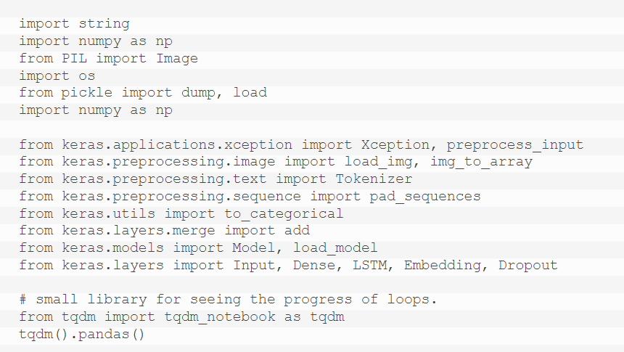
Proposed Work
First, we import all datasets.

Slide 12
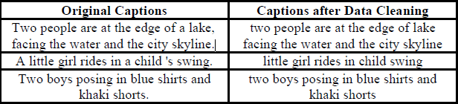
Getting and performing data cleaning

Slide 13
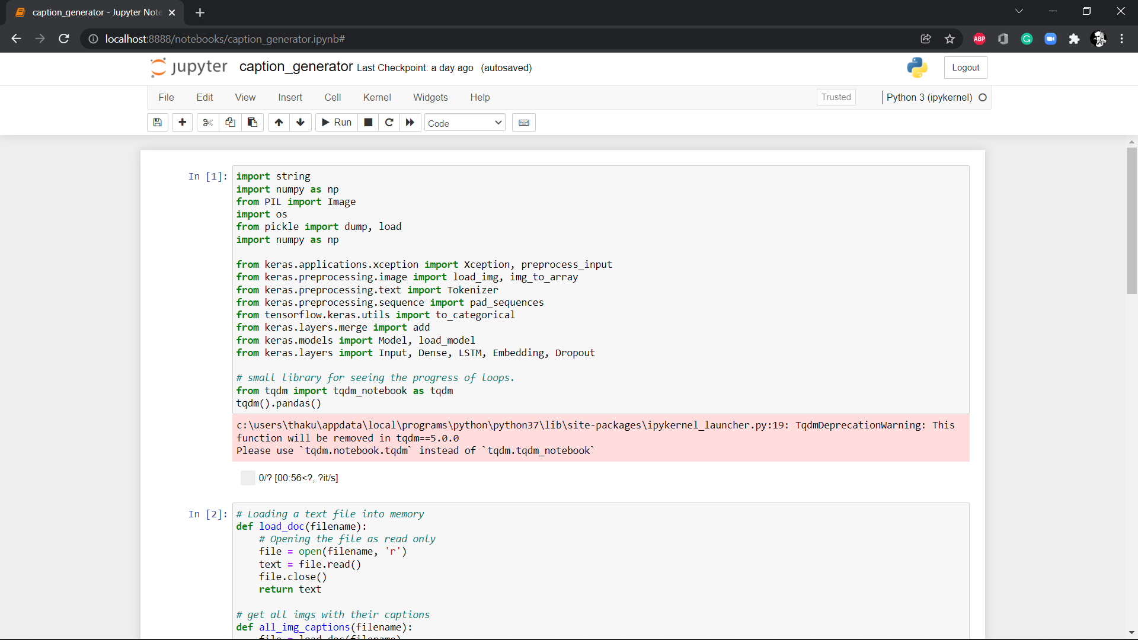
Implementation

Slide 14
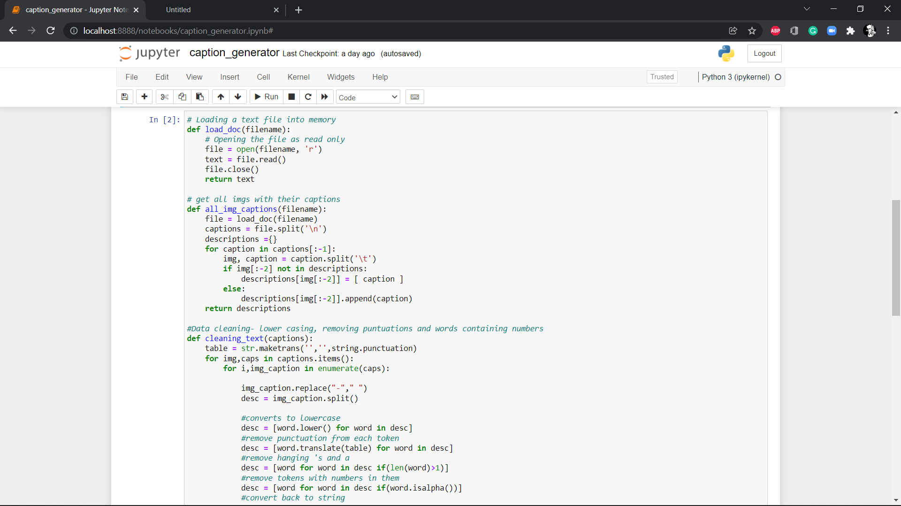

Slide 15
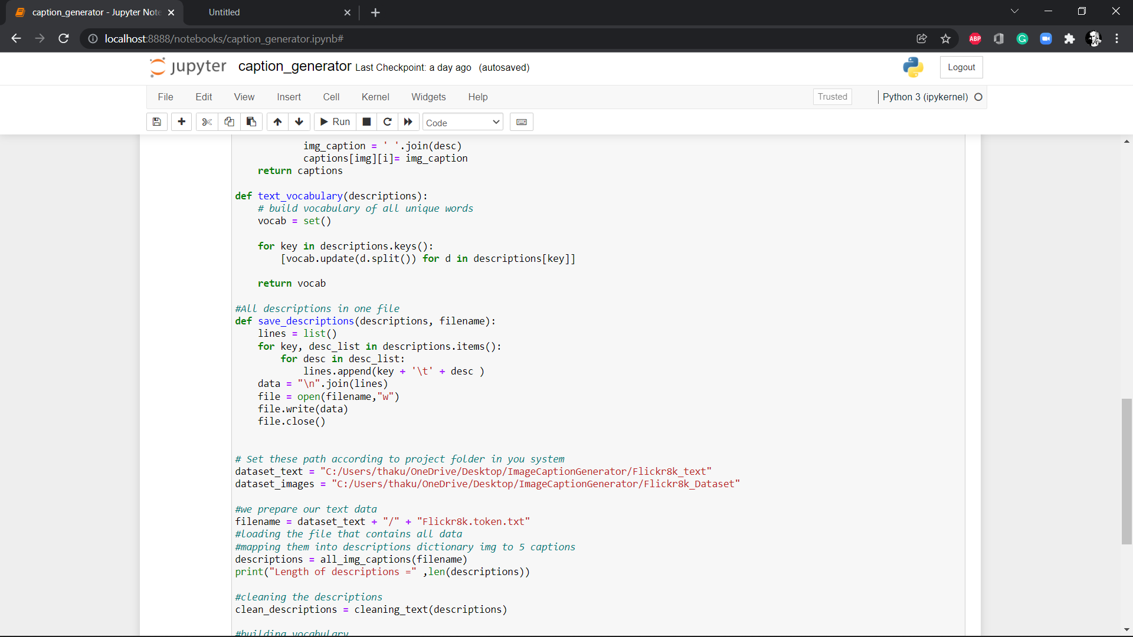

Slide 16
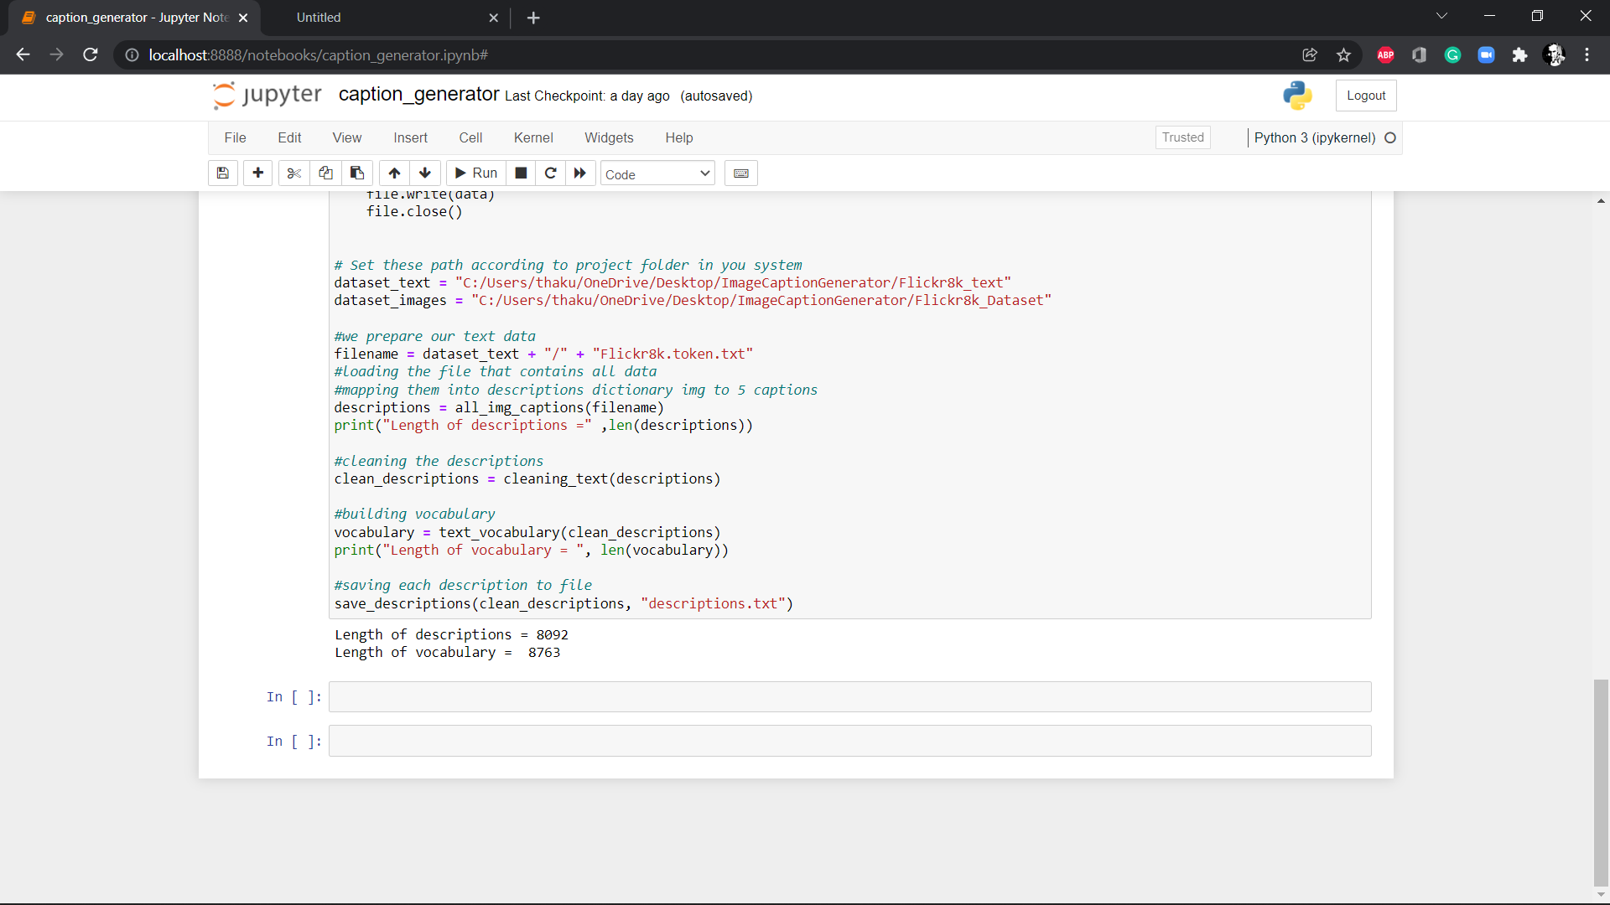

Slide 17
THANK YOU

