Slide 1

UV Whatsapp
Mini Project-ReactApp
Mentor: Mr. Pankaj Kapoor
Group members:
Harshita BharadwAj
Umesh PrataP SingH
Vipul

Slide 2
OBJECTIVE
The main objective of this project is to create a React App for Practical implementation of Rect.js .
In this Web App the user will be able to signin with google and can create public groups to chat with other people .

Slide 3
MOTIVATION
As social media is trending nowadays , there are various social connecting platforms,hence there are lot of chances to improve this connection.Inorder to improve something it is important to know what the thing is .Hence creating a chatApp is a initiave .
The goal of the webApp is to connect people socially .

Slide 4
TECHNOLOGY AND TOOLS USED
ReactJs
Firebase
HtmlL5
CSS3
JavaScript
Github
Visual Studio Code

Slide 5
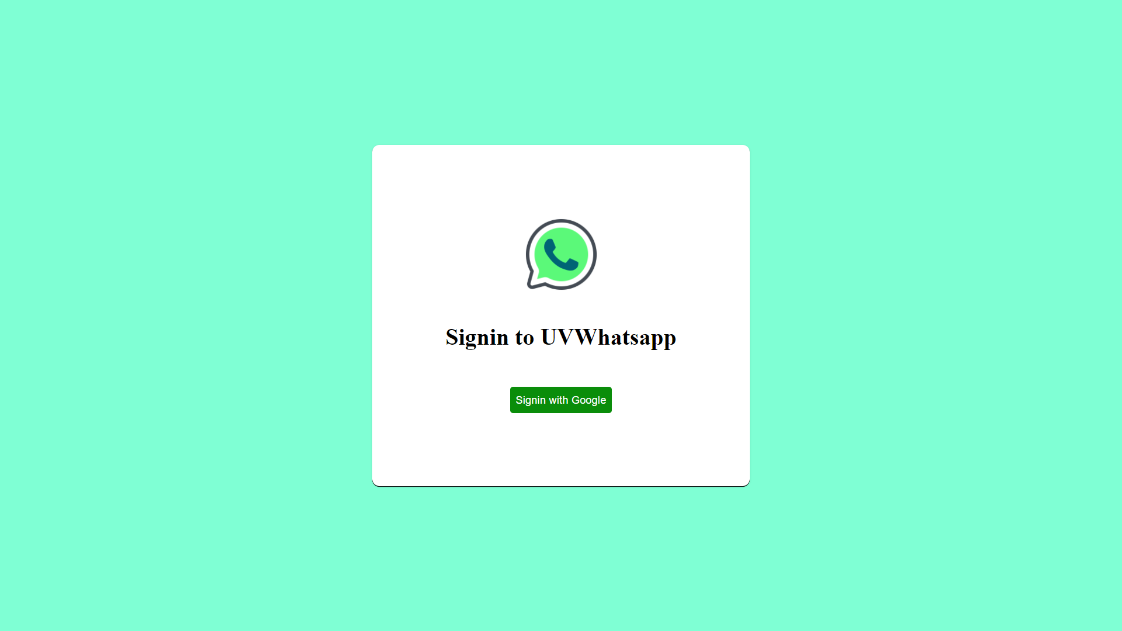
LANDING USER INTERFACE
This is the page first webpage that the user will see.

Slide 6
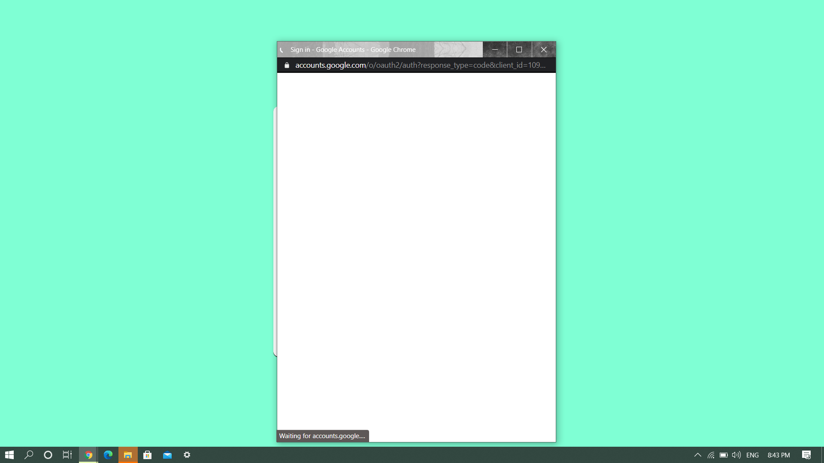
SIGNIN PROCESS
User will be able to sign in the webapp using signin with google option

Slide 7
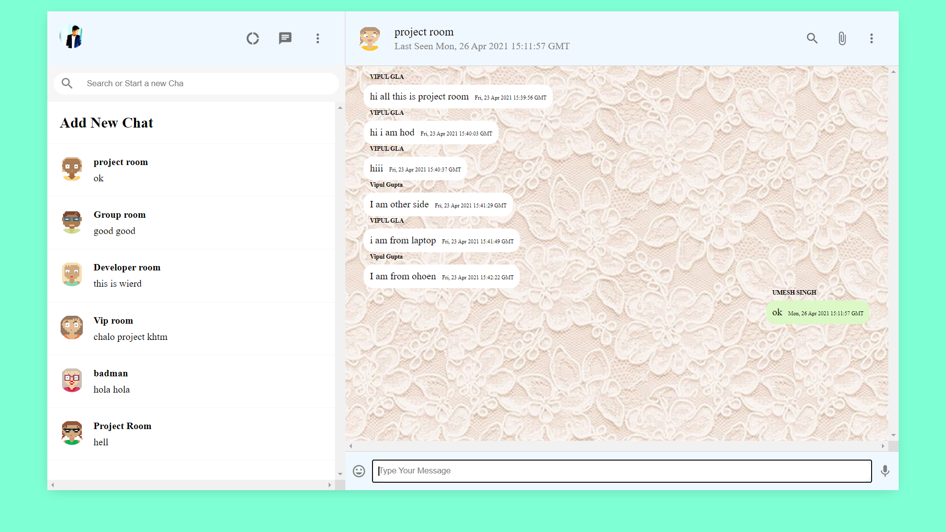
MAIN USER INTERFACE
This is the main webpage that contains all the available groups which user can use for group chat.

Slide 8
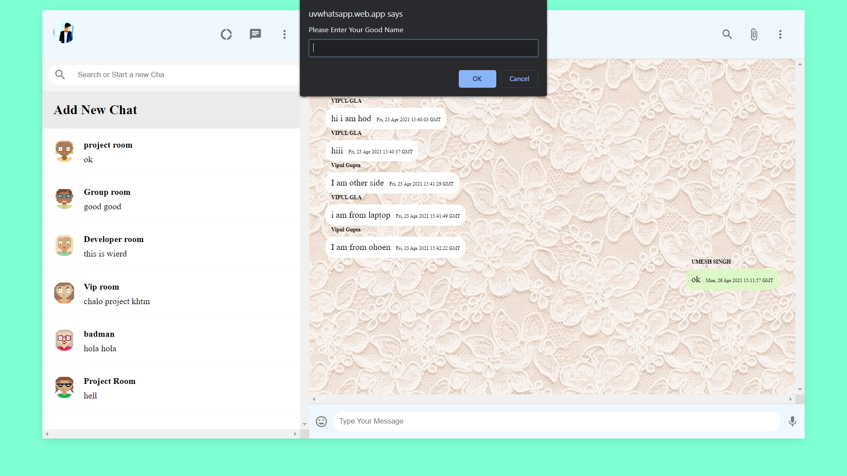
CREATE NEW GROUP
User can create a new chat room.

Slide 9
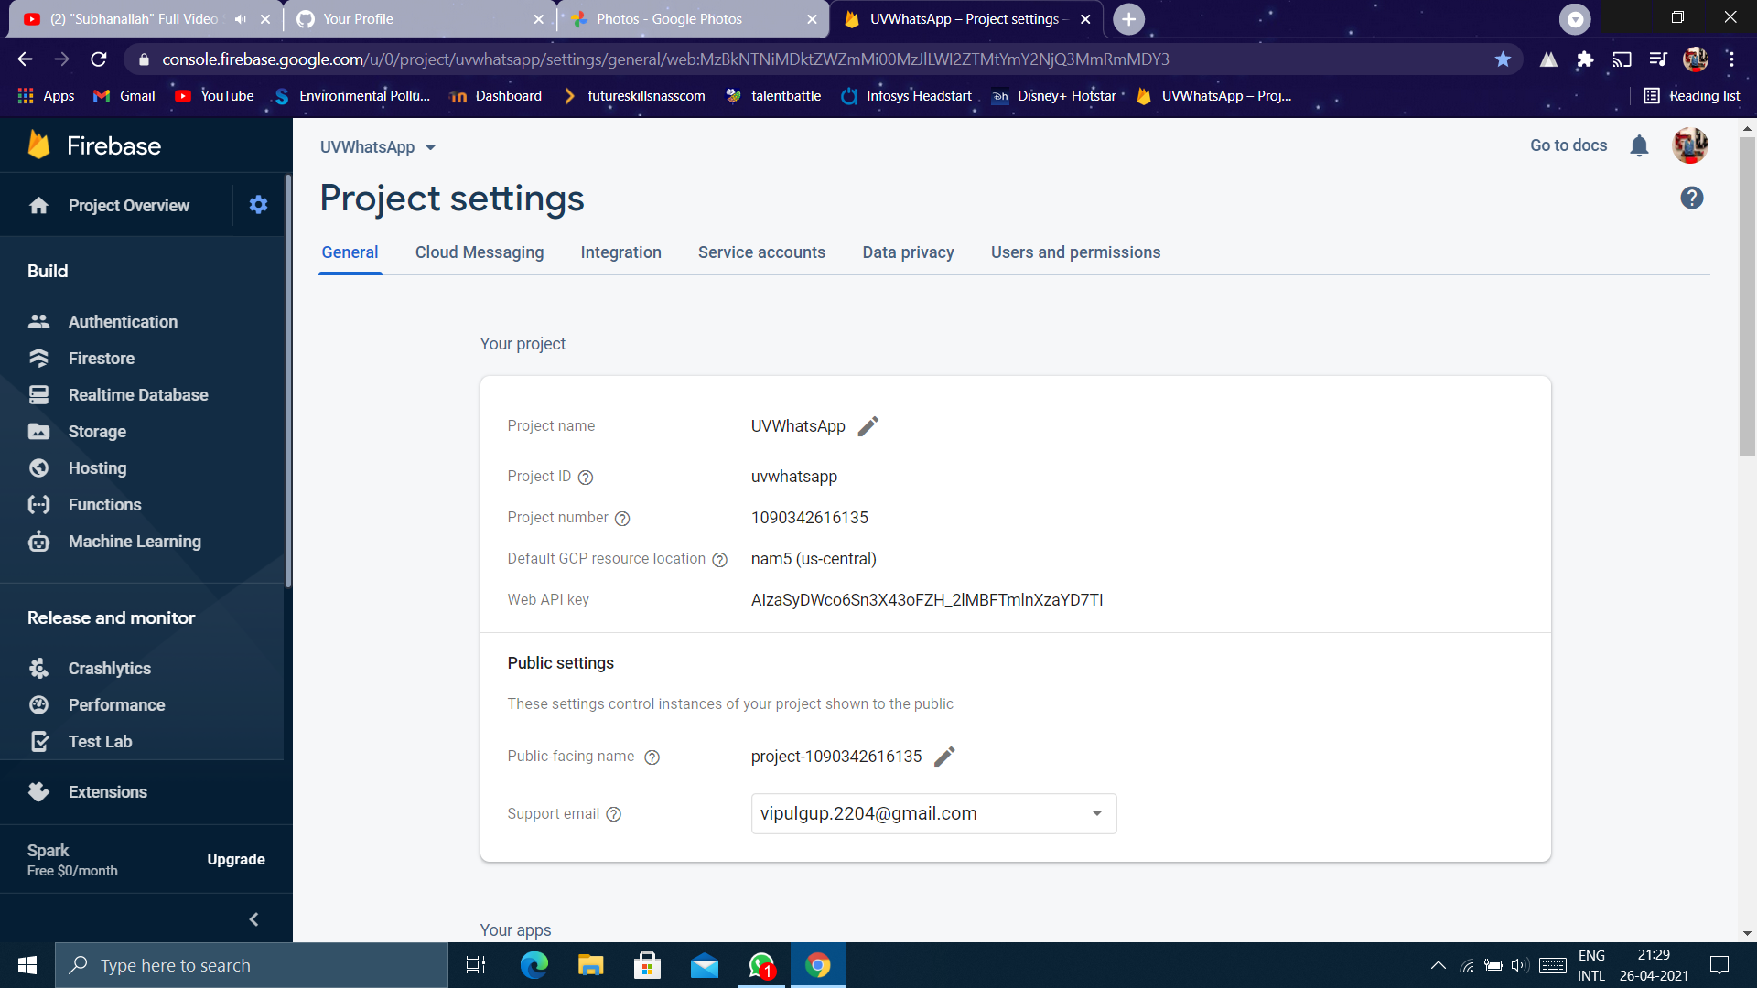
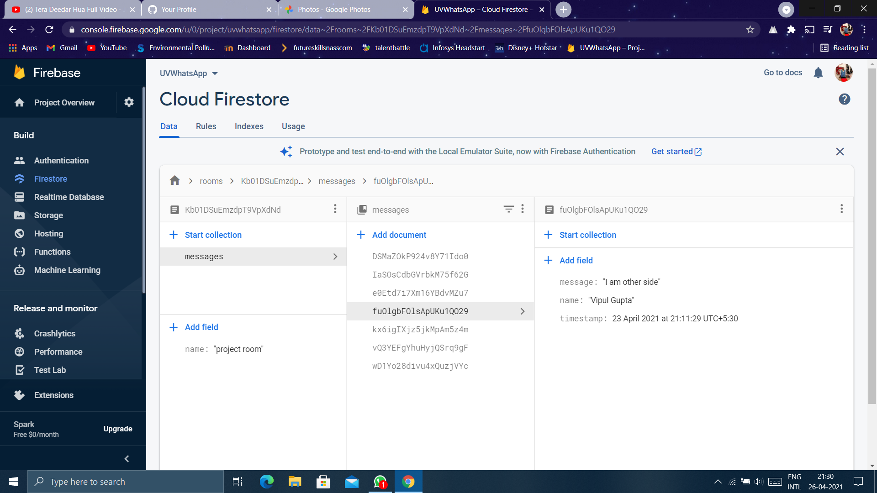
FIREBASE

Slide 10
REFERENCES
https://www.youtube.com/watch?v=pUxrDcITyjg&t=12503s
https://www.beta-labs.in/

Slide 11
REPOSITORY AND LINK
https://github.com/vipulgupta22/UV_Whatsapp
LIVE AT:
https://uvwhatsapp.web.app/

Slide 12
Thank You

