Slide 1



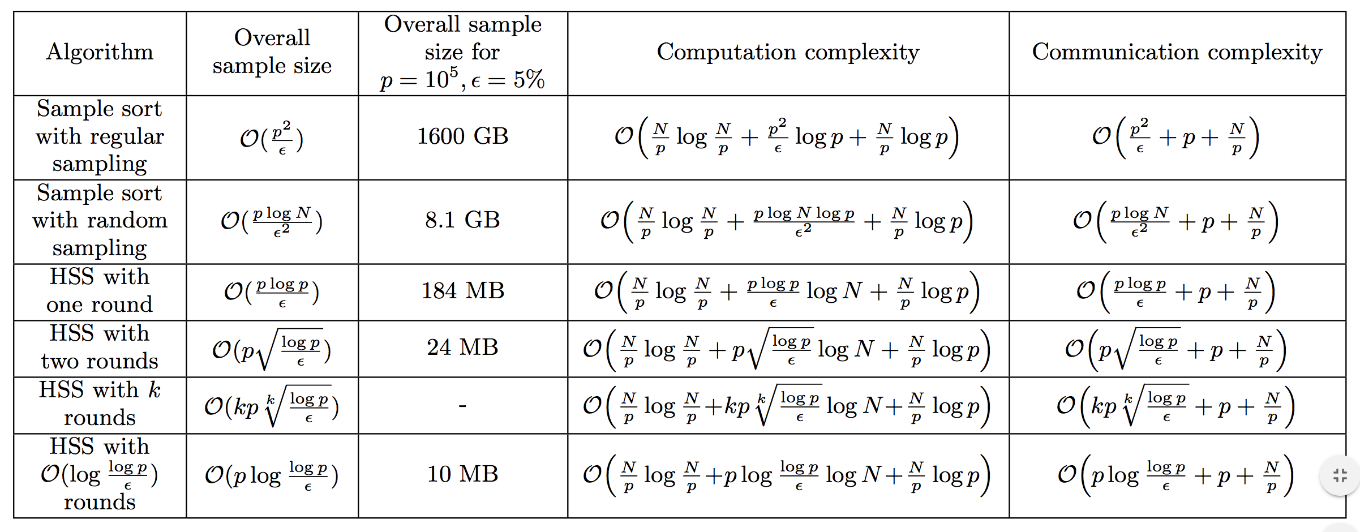
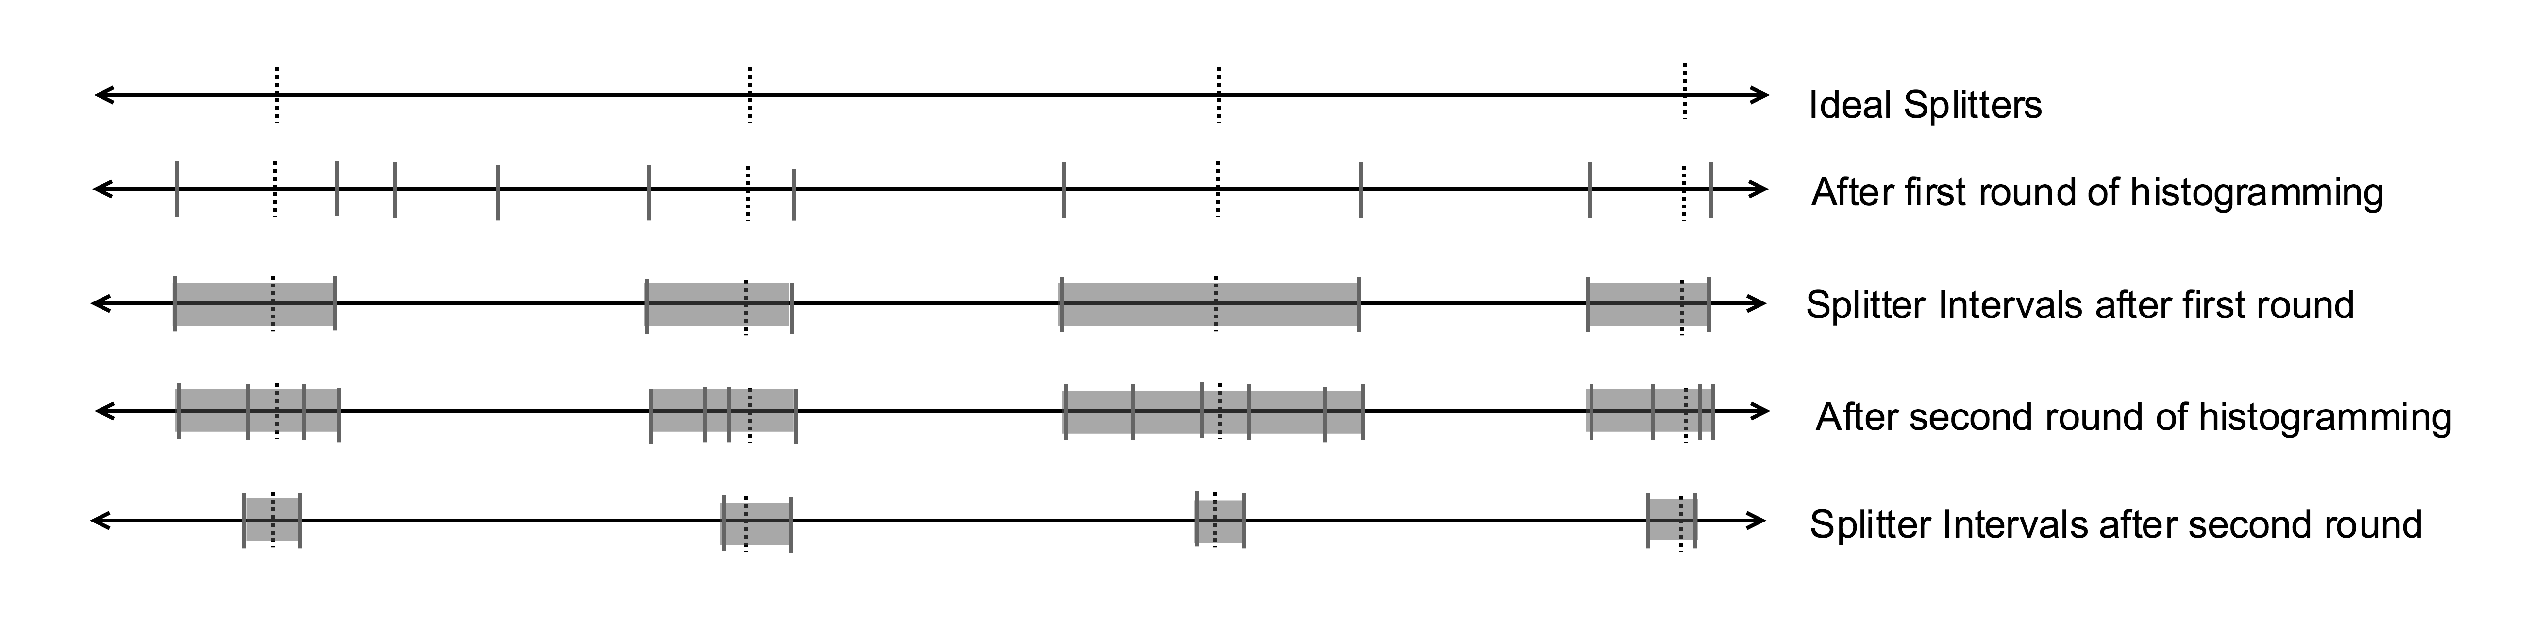
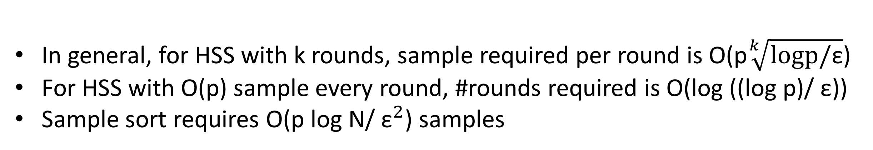
Histogram Sort with Sampling (HSS)
Vipul Harsh, Laxmikant Kale {vharsh2, kale}@illinois.edu
Massively parallel applications use
parallel sorting
Problems with existing algorithms
HSS is theoretically more efficient than sample sort
Sample sort: Pick a sample from the input, choose (p-1) splitters from the sample. Variants: Regular sampling, random sampling. Problem: Required sample size is too large for good splitting
Histogram sort: Maintain a set of candidate splitters, obtain their rank in the local input by performing histogramming rounds. Refine candidate keys every round till a given threshold. Problem: Required number of histogramming rounds could be large depending upon the input distribution
Charm N-body GrAvity solver
Cosmological N-body simulations
Parallel sorting in every iteration
Cosmology code based on Chombo
Global sorting every step for load balancing and locality
CHARM
Table 1: Running time complexity and comparison of required sample sizes of HSS and sample sort.
Parallel sorting: Goals
Our approach: Histogram sort with sampling (HSS)
Load balance after sorting
Optimal data movement
Generality: should work for any inputs
Scalability and performance for massive clusters
Key Idea: Sample keys before every histogramming round. Use information from previous rounds to sample intelligently.
By performing histogramming on the sample, HSS reduces the sample size requirements of sample sort by multiple orders of magnitude.
HSS in practice
Histogramming takes very little fraction of the running time, which is dominated by local sorting and data exchange, both of which are inherent costs!
Overview: HSS maintains ''splitter intervals'' for all splitter keys. A splitter interval marks the nearest key seen so far, both smaller (left) and greater (right) than the ideal splitter. ε is the maximum load imbalance permitted by the application.
Fig 2: HSS vs Sample sort: sample size required for splitting, ε = 5%
p (x 1000) | sample size/round (x p) | Number of rounds | Bound on number of rounds
4 | 5 | 4 | 8
8 | 5 | 4 | 8
16 | 5 | 4 | 8
32 | 5 | 4 | 8
Fig 3: HSS on Mira(ALCF) BG/Q. Each processor had 1 million 8 byte keys with a 4 byte payload with each key
Parallel sorting : Skeleton for
many algorithms
p processors, N/p keys in each processor
Determine (p-1) splitter keys to partition the keys into p buckets, one for each processor. Make these splitters available to all processors.
Send all keys to destination processor depending on the which bucket if falls in.
E.g. sample sort, histogram sort
Table 2: Number of rounds required for determining all splitters (experimentally)
Conclusion
HSS combines histogramming and sampling to achieve fast splitter determination
HSS is extremely practical for massively parallel applications
Future Work
  Integration in real applications; ChaNGa
Details:vharsh2.web.engr.illinois.edu/projects/parsort/prelimreport.pdf
Acknowledgements: Edgar Solomnik, Omkar Thakoor, Umang Mathur
Fig 1: Figure illustrating HSS with multiple rounds. After first round, samples are picked only from the splitter intervals. Notice how the splitter intervals shrink as the algorithm progresses.
In general, for HSS with k rounds, sample required per round is O(p$\sqrt[k]{logp/\text{ε}}$)
For HSS with O(p) sample every round, #rounds required is O(log ((log p)/ ε))
Sample sort requires O(p log N/ ${\text{ε}}^{2}$) samples

