Slide 1



Automatically surfacing opportunities for improvement in Internet-scale services
Vipul Harsh, Sayan Sinha, Henry Milner, Haijie Wu, Aditya B. Prakash Vyas Sekar, Hui Zhang

Slide 2














The long-tail of experience issues in Internet services
Expensive observability tools don’t reveal these problems
A popular web-service
???
…
Product/Engg lead
“Sign-up is slow”
“I can’t pay via my bank”
“It crashes when I try to update my address”

Slide 3
Real example: Complex payment failure
payment incomplete within T sec
User clicks on buy plan
A media app
CORS error
Timeout
Error
t
t + T
“Payment never works”
Events in a failed user session

Slide 4
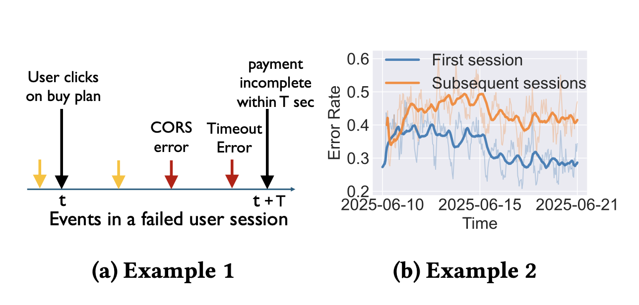
Real example: Returning users face errors
A media app
“Quality has worsened”

Slide 5

Goal: Surfacing problematic user-session patterns
User-session patterns are defined by
user attributes
sequence of user-actions
the APIs they hit
state of the backend at that time etc.
User clicks on buy plan
payment incomplete within T sec
CORS error
Timeout
Error
Opportunities
for improvement
t
t + T
Telemetry
Opportunity Finder

Slide 6
Requirements for opportunity finder
R1: Expressive
R2: Automated
R3: Scalable
User clicks on buy plan
payment incomplete within T sec
CORS error
Timeout
Error
Opportunities
for improvement
t
t + T
Telemetry
Opportunity Finder

Slide 7

Case for uncovering “derived” session patterns
Limited to
“static” session patterns
(e.g., region=DC)
static attributes
e.g., region, deviceVersion
Events, sessions
Derived session
attributes : F(...) e.g., second time session?,
e.g., has event sequence P
Events, sessions
User clicks on buy plan
payment incomplete within T sec
CORS error
Timeout
Error
t
t + T
Events in a failed user session

Slide 8
Key technical challenges for Opportunity Finder
What derived Fs would be useful?
How to compute those derived Fs efficiently?
Test hypotheses based on derived Fs
Notes:
Increase font

Slide 9
Idea #1: LLM-assisted derived attribute generation
Human prompt
Auxiliary sources
e.g., user reviews
What derived Fs would be useful?
How to compute those derived Fs efficiently?
Test hypotheses based on derived Fs
Attribute templates
…
Notes:
Increase font

Slide 10
Idea #2: Efficient stateful processing to compute Fs
What derived Fs would be useful?
How to compute those derived Fs efficiently?
Test hypotheses based on derived Fs
Notes:
Increase font

Slide 11
Idea #3: Mixture of Experts for validation
Opportunities for improvement
What derived Fs would be useful?
How to compute those derived Fs efficiently?
Test hypotheses based on derived Fs
Notes:
Increase font

Slide 12
Proof of concept: Surfaces subtle opportunities!
4 media apps
Proof of concept opportunity Finder
sequence of user events
user lifecycle patterns e.g. first time vs repeat
New UI version of subscription page leads to failures
Gradual increase in login errors for second time users
… (see paper)
Notes:
Add slide numbers

Slide 13
Conclusions: opportunity finder for internet-scale services
Unexplored problem of surfacing long-tail user experience issues
Classical approaches (e.g., O11y, Product Analytics) based on static attributes don’t work
Insight: test hypotheses using on-the-fly derived attributes
LLM-assisted hypotheses + Scalable stateful data processing + Mixture of experts validation
Preliminary proof of concept: Surfaced interesting insights in 4 real media apps
Open challenges and extensions: leverage user reviews, source code for attributes generation, designing stateful data processing engine, UIs for visual hypotheses exploration
Thank you!
vharsh@conviva.com

