Slide 1
E-POLLING
MADE BY
TARUN TREHAN 377/COE/12
VARUN BATRA 387/COE/12
VIPUL KHULLAR 393/COE/12

Slide 2
TABLE OF CONTENTS
Purpose of the project
Scope of the project
Detailed requirement specification
High level design
Future plan

Slide 3
Purpose of the project
Online National Polling –is an E-Polling system which maintains the records of voters, candidates, parties, Election commission.
E-Polling will help all the people who cannot vote due to many reason but they want to vote, become part of government. It will allow people to vote from any part of the country and exercise their fundamental right.

Slide 4
Objective
Applet enables the users to interact with the candidates and access other facilities provided in the website easily with the help of a luring graphical windowing environment.
User can enter biographical information, personal details.
E-Polling provides a facility for online registration of the citizens, after completing the registration process they are eligible for that any voting taking place in there area.

Slide 5
Any person who is eligible for voting i.e. as per election commission criteria can easily register using this system.
Unique username and password will be provided by the user To avoid cheating the system uses aadhar card id to the users.
After completing the procedure results are automatically calculated by the system.

Slide 6
Site and database are maintained by administrator.
System has user friendly environment which is easy to use.

Slide 7
Scope of the project
It will provide all people a way to became a part of the democracy.
To make people vote without making any efforts.
To give quick and efficient results.
To have a control check on rigging and other malpractices during voting.
Improve voter turnout in urban areas.

Slide 8
Detailed requirement
This includes the tools that we will use in constructing the project and the form of technology that we have used in the project, and we have the following technology used in implementation of project:-
Java
Netbeans IDE/Eclipse
MySQL
JDBC driver

Slide 9
Java
Java is a programming language originally developed by Sun microsystems.
The Java Runtime Environment (JRE), is the software require to run any application.
A Java Virtual Machine (JVM) is a set of computer software programs and data structures which implements a specific virtual machine model.

Slide 10
We have preferred Java because:
Get started quickly:
Although Java is a powerful object-oriented language, it's easy to learn, especially for programmers already familiar with C or C++.
Write less code:
Comparisons of program metrics suggest that a program written in Java can be four times smaller than the same program in C++.

Slide 11
Write better code:
The Java language encourages good coding practices and its garbage collection helps you avoid memory leaks.
Develop programs faster:
Your development time may be as much as twice as fast versus writing the same program in C++.

Slide 12
My SQL
MySQL "My S-Q-L",officially, but also called "My Sequel") is (as of March 2014) the world's second most widely used open-source relational database management system (RDBMS) It is named after co-founder Michael Widenius's daughter, My. The SQL phrase stands for Structured Query Language.
The MySQL development project has made its source code available under the terms of the GNU General Public License, as well as under a variety of proprietary agreements. MySQL was owned and sponsored by a single for-profit firm, the Swedishcompany MySQL AB, now owned by Oracle Corporation.^{[13]}
MySQL is a popular choice of database for use in web applications, and is a central component of the widely used LAMP open source web application software stack .LAMP is an acronym for "Linux, Apache, MySQL,Perl/PHP/Python." Free-software-open source projects that require a full-featured database management system often use MySQL.

Slide 13
We are using My SQL because :-
It’s a user friendly database management system.
We are using it to store details of voters, parties and constituencies.
Insertion,modification and deletion in a table can be done efficiently using MySQL.

Slide 14
JDBC
Java database connectivity (JDBC) is the JavaSoft specification of a standard application programming interface (API) that allows Java programs to access database management systems. The JDBC API consists of a set of interfaces and classes written in the Java programming language.
Using these standard interfaces and classes, programmers can write applications that connect to databases, send queries written in structured query language (SQL), and process the results.
The JDBC API is consistent with the style of the core Java interfaces and classes, such as java.lang and java.awt. The following table describes the interfaces, classes, and exceptions (classes thrown as exceptions) that make up the JDBC API. In the table, interfaces belonging to the javax.sql package are extensions to the standard JDBC interfaces and are contained in the Java 2 SDK, Enterprise Edition.

Slide 15
Design of the project
Specific Requirements

Slide 16
Citizens
Sign up:
In order to apply for a new voter id card, an end user must sign up by filling the sign up form and get it approved by Electoral Registration Officer
Sign in:
After getting the username and password, end users can log on to their account and can access the website.
Open profile:
End user can open his/her profile which contains the personal details which he/she provided during sign up.

Slide 17
View profile:
End user can view his/her profile which contains the personal details which he/she provided during signup.
Update profile:
End user can update his/her profile which contains the personal details which he/she provided during sign up if any update required.
Polling:
End user with a voter id and password must take part in polling either online or manually selecting their representatives.

Slide 18
Registered citizens sign in
Has already voted?
Voting is resticted
Voter id and password received from citizen
Citizen selects a candidate from list of candidates
Register his /her vote
Update polling database

Slide 19
Administrator
Verify details:
Admin authenticates all the end users and officers by checking their username and password.
Provides login account:
After getting the sign up details from the end user, Admin provides the username and password to the end user that should be kept for future login and also admin checks for uniqueness.
Maintains system server:
Admin maintains the centralized system server which controls the client computers

Slide 20
Maintains database:
Admin maintains the entire database and he is the only authorized person to add/remove/edit employee records and end user records provided he has to get the order from the highest designation officer.
Add rules and acts:
Admin adds the rules and regulations that should be followed during the polling and also mentions the necessary qualifications for a person to apply for a new voter id card or to file a nomination.

Slide 21
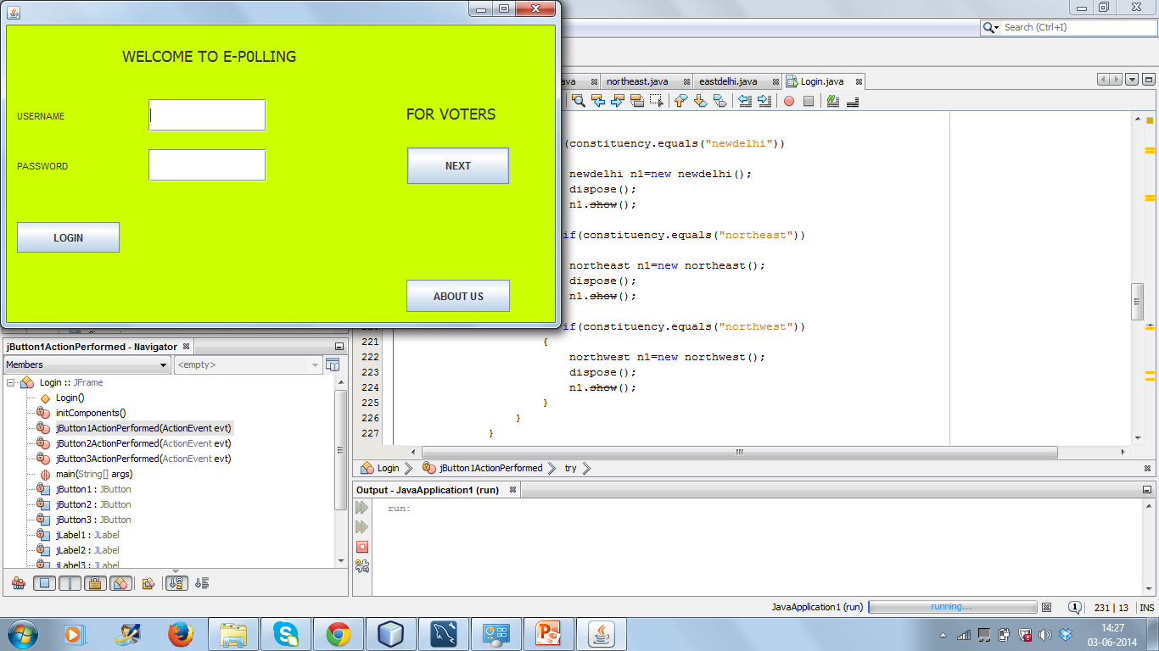
SCREEN-SHOTS

Slide 22
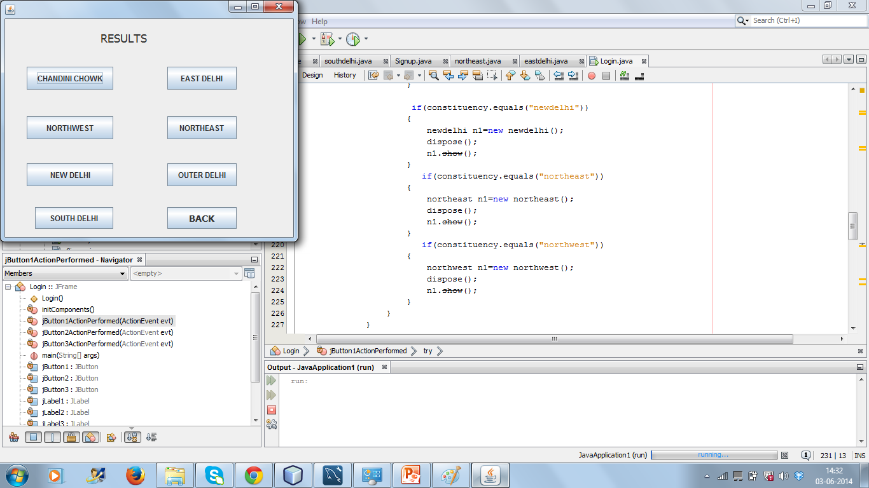

Slide 23
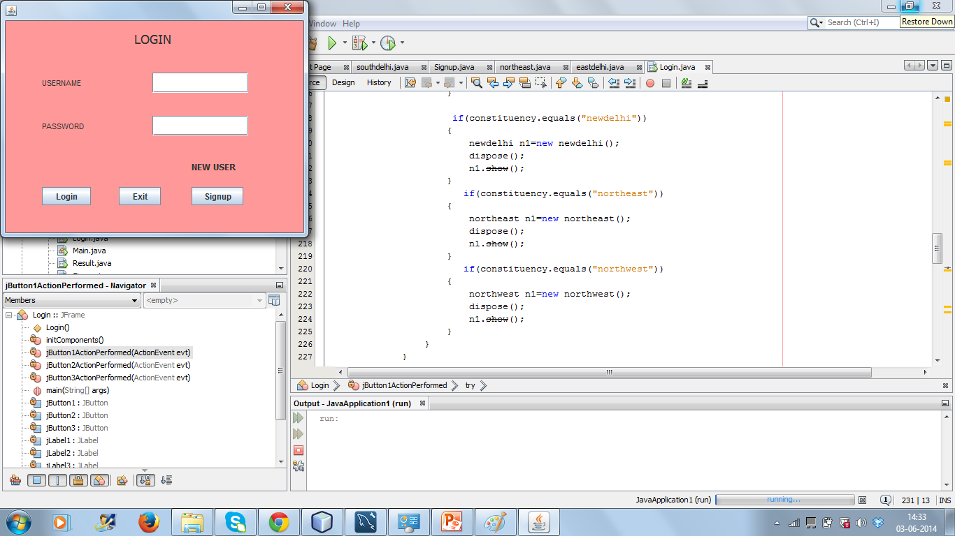

Slide 25
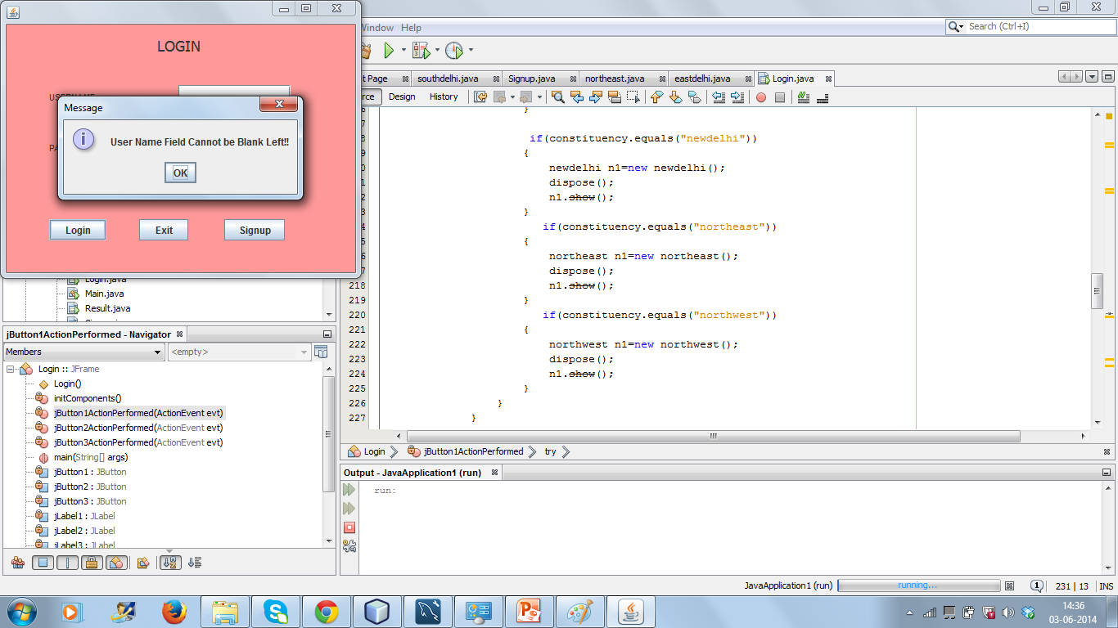

Slide 26
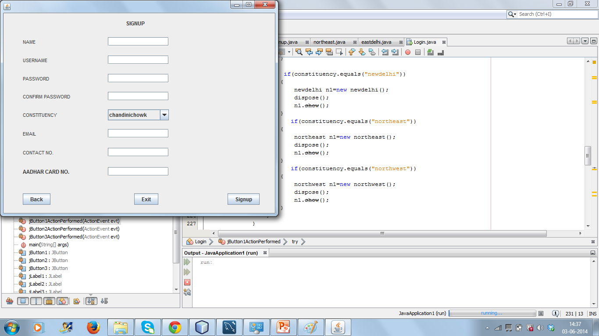

Slide 27
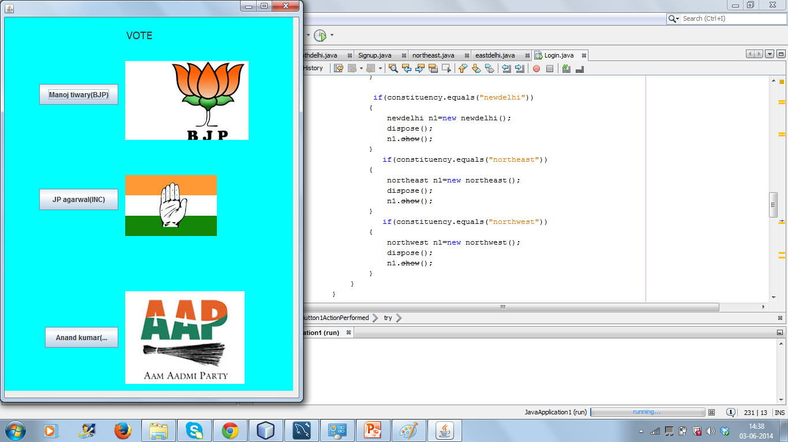

Slide 28
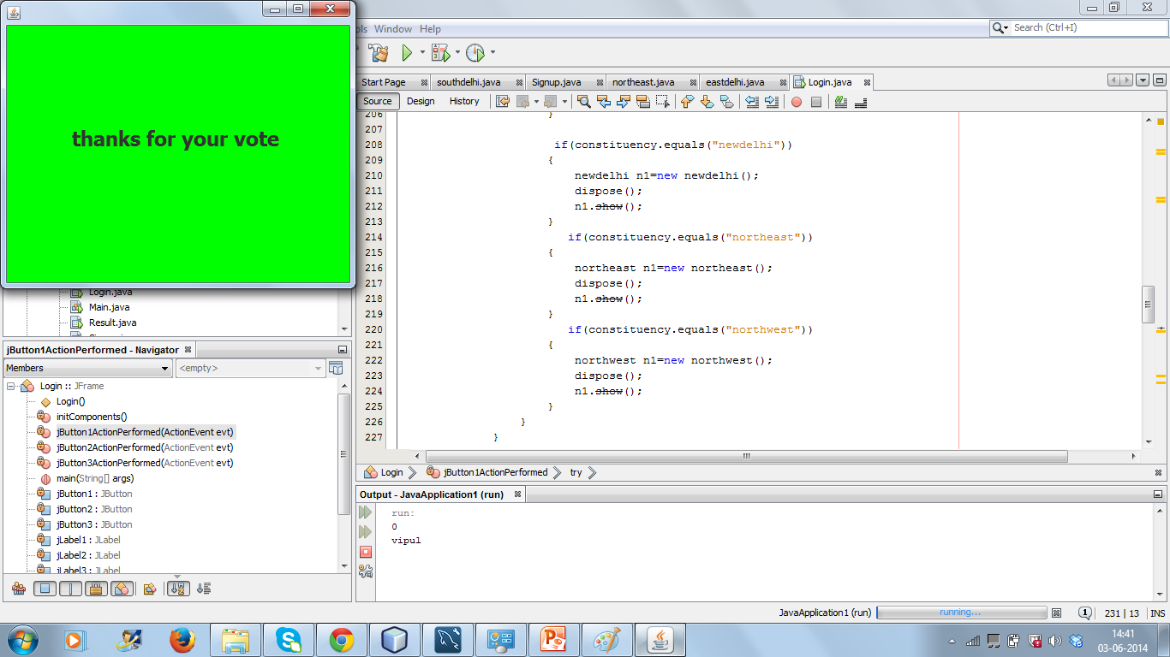

Slide 29
