Slide 1
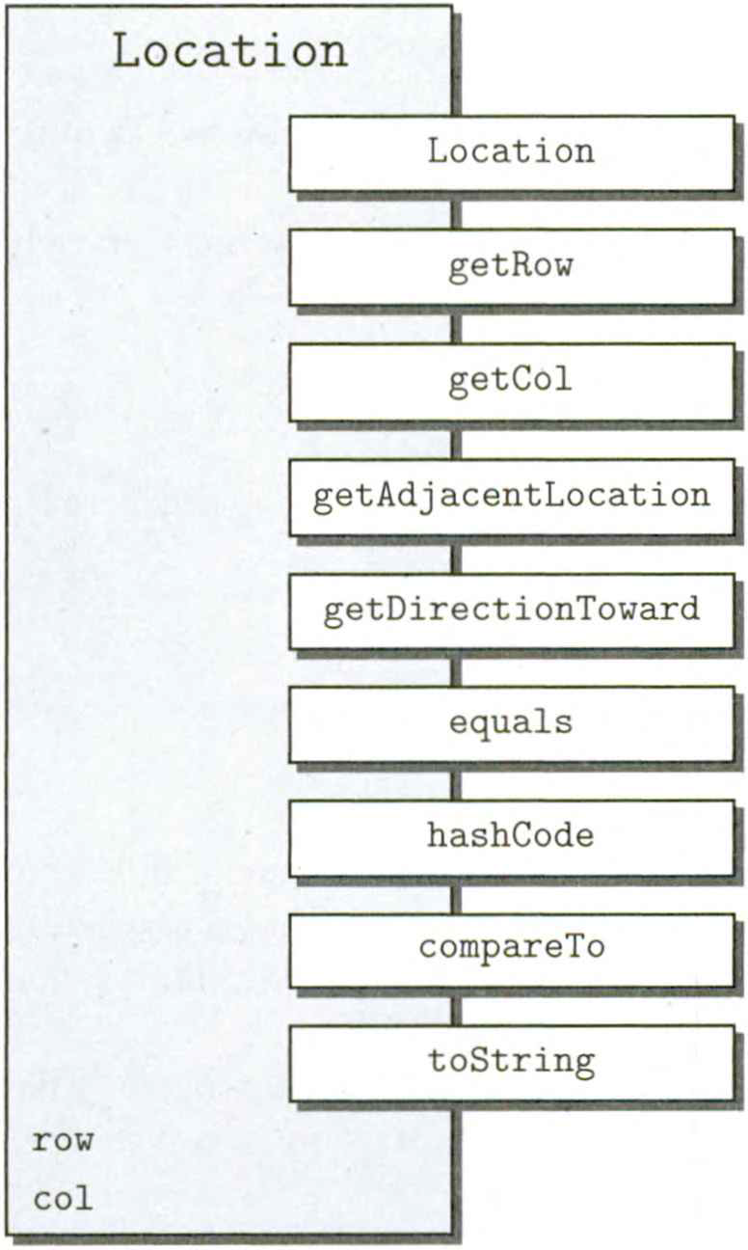
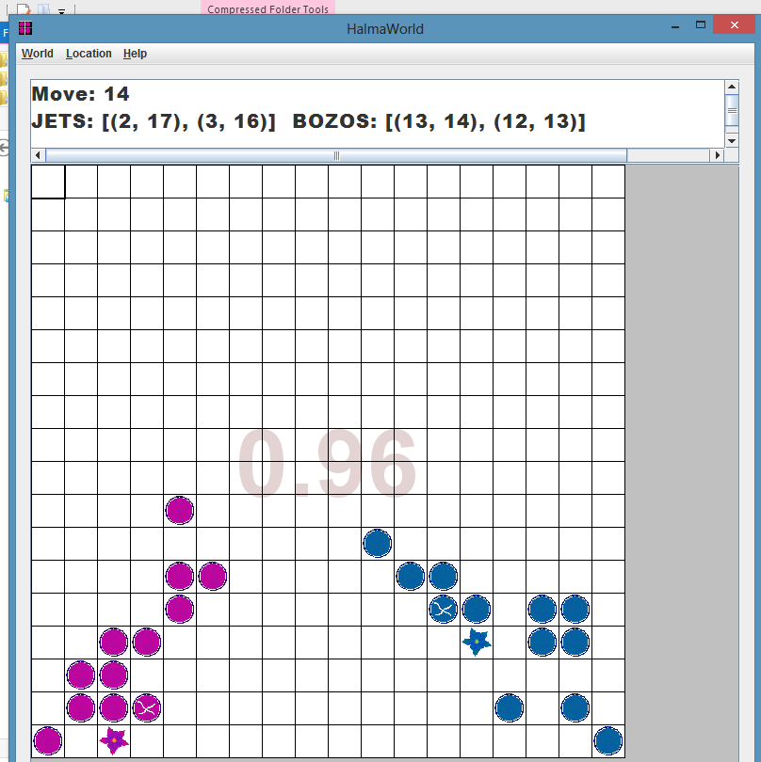
HalmaWorld & Location

Slide 2
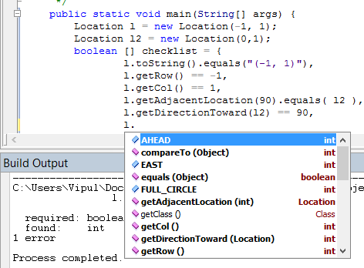

Slide 3
Stepwise Checklist for ( 3 , 0 )
Method | Received | Expected
new Location() | (3,0) | (3,0)
getRow() | 3 | 0
getCol() | 0 | 3
Equals( (3,0) ) | true | true
Great learning tool
Important for validation
Tests against documentation

Slide 4
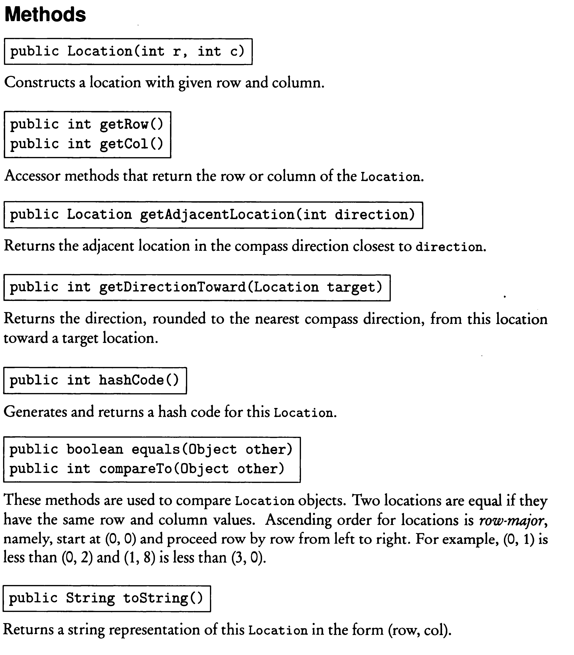

Slide 5
Automated Checklist for ( 0 , 0 )
public static void main(String[] args) {
Location loc = new Location(0, 0);
Location l2 = new Location(0, 1);
//------------------------------------------------------------
boolean [] checklist = {
loc.toString().equals("(0, 0)"),
loc.getRow() == 0,
loc.getCol() == 0,
loc.getAdjacentLocation(Location.EAST).equals( l2 ),
loc.getDirectionToward( l2 ) == 90,
loc.hashCode() != 0,
loc.compareTo( new Location(0,1) ) == -1,
loc.compareTo( new Location(100,0) ) == -100,
};
//----------------------------------------------------------------
  for (boolean testResult : checklist)
  System.out.println(testRestult);

Slide 6
Automated Checklist for ( 0 , 0 )
Expected | Received
true true true true true false true →true | true true true true true false true →false
this.compareTo( new Location(100,0) )
Returns -1
Not -100 as expected

Slide 7
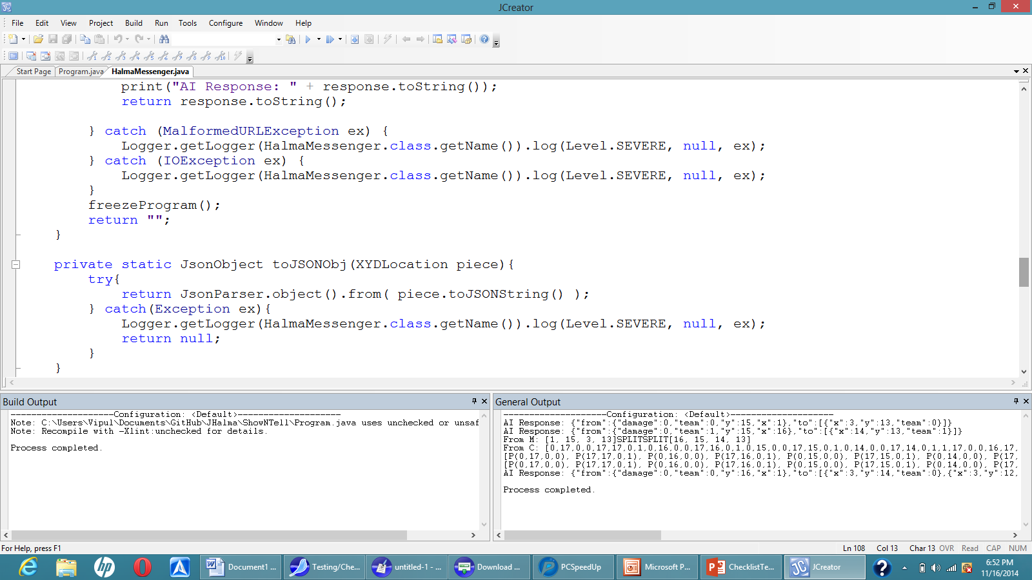
White-Box Checklist Testing

Slide 8
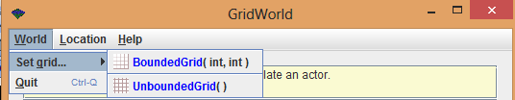
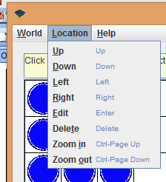
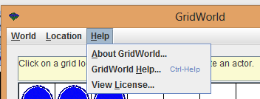
GridWorld Menu
A UI to develop grid-based games such as chess, checkers, battleship, or pacman.
Probabilities can either be measured by logging user mouse behavior or estimated by surveying users or expert developers.

Slide 9
Graphical
Idle
0.5 0.2 0.3
Input Type:
Help Menu
0.2 0.3 0.3 0.2
Hover
Click
Auto
World
0.2 0.7 0.1
0.5 Location
0.5
Quit
Direction
0.8 0.2
0.1
Set Grid
0.3 0.6
0.2 Help
0.8
0.3 About
0.7
0.4 License
0.6
UnboundedGrid
0.8 0.2
BoundedGrid
0.3 0.7
1.0 Popup
1.0
Redraw Grid

Slide 10
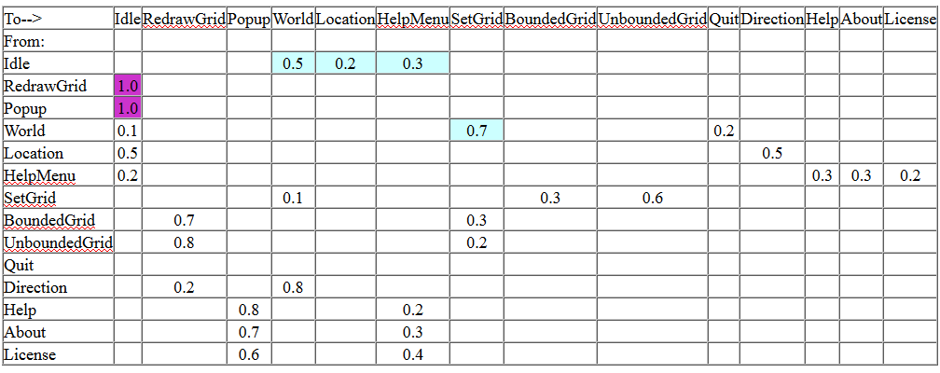
Tabular (Matrix)
HW3 Vipul Kohli 4 of 5
Input type:
White = Click Sky = Hover Purple = Auto

Slide 11
Flat Musa OP (Threshold P = 0.050)
HW3 Vipul Kohli 5 of 5
Redraw/Popup Path | Probability
Idle/World/SetGrid/BoundedGrid/RedrawGrid | 0.5 * 0.7 * 0.6 * 0.7 = 0.147
Idle/World/SetGrid/UnboundedGrid/RedrawGrid | 0.5 * 0.7 * 0.3 * 0.8 = 0.084
Idle/HelpMenu/Help/Help/Popup | 0.3 * 0.3 * 0.8 = 0.072
Idle/HelpMenu/Help/About/Popup | 0.3 * 0.3 * 0.8 = 0.063
The Redraw/Popup paths are most meaningful practically.
The path determines the type of grid drawn or popup displayed.

Slide 12
ChameleonCritter
Changes color randomly to one of the objects around it per step

Slide 13
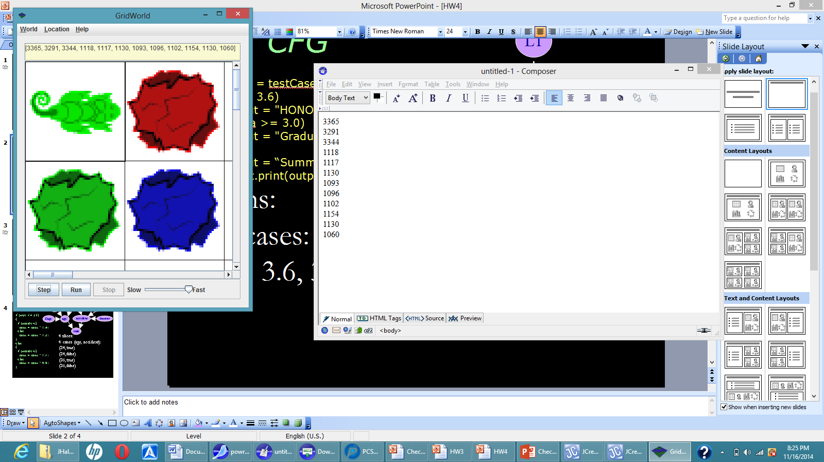
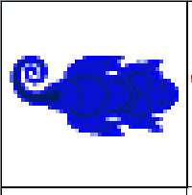
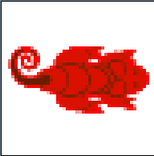

Slide 14
Theoretical Musa-2 OP
0.3333
0.3333
0.3333
0.3333*0.3333 = 0.1111

Slide 15
10K Experimental Musa-2 OP
3365
3291
3344
1118 1117 1130 1093 1096 1102 1154 1130 1060

Slide 16
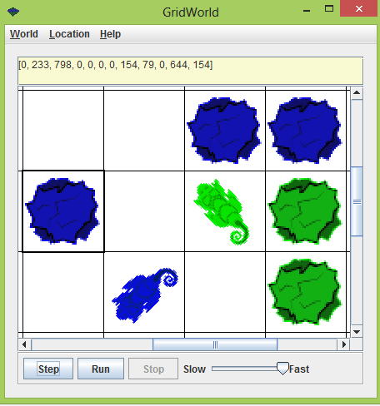
DDG Testing
Blue
Green
Blue
Chameleon1
Chameleon2
77.4% Blue
22.5% Green

Slide 17
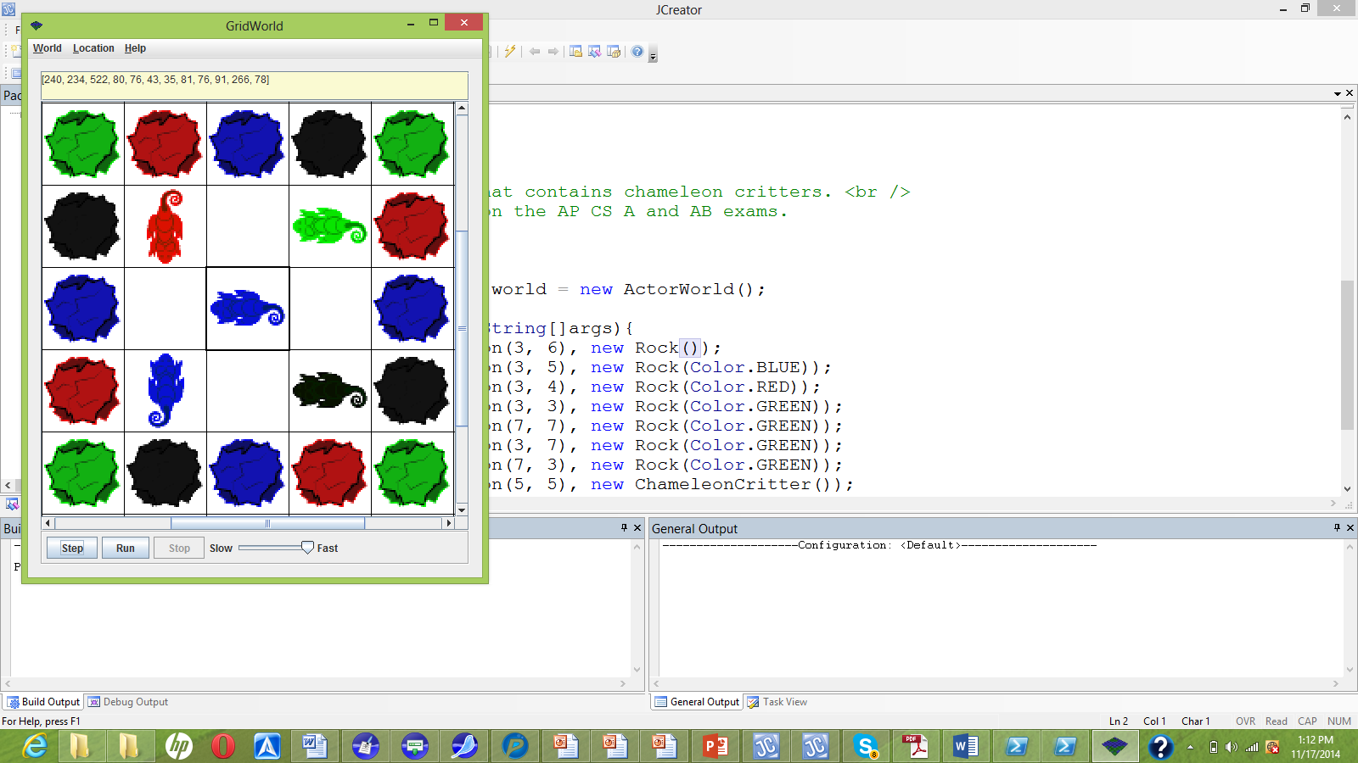
20 rocks
4 of each color
Equal probability?

Slide 18
Shared Dependencies
40% chance of blue
Blue Shared dependency
Corn2
Corn3
Corn1
Corn4
Center

