Slide 1
Testing GridWorld
Product name
Line of codes | 856
project part | 7314
Language | Java
Abdullah and Vipul

Slide 2
Contents
BB/WB Checklist
BB Partition Testing
BB FSM Markov Chain
BB Boundary
BB DDG
Analysis

Slide 3
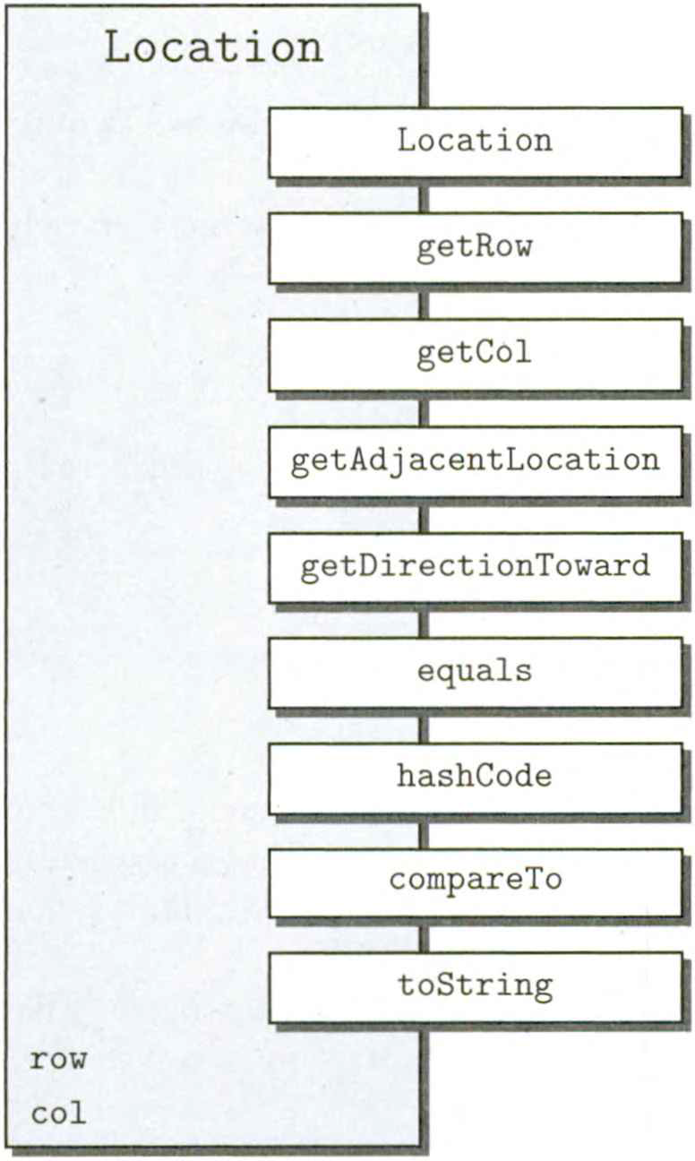
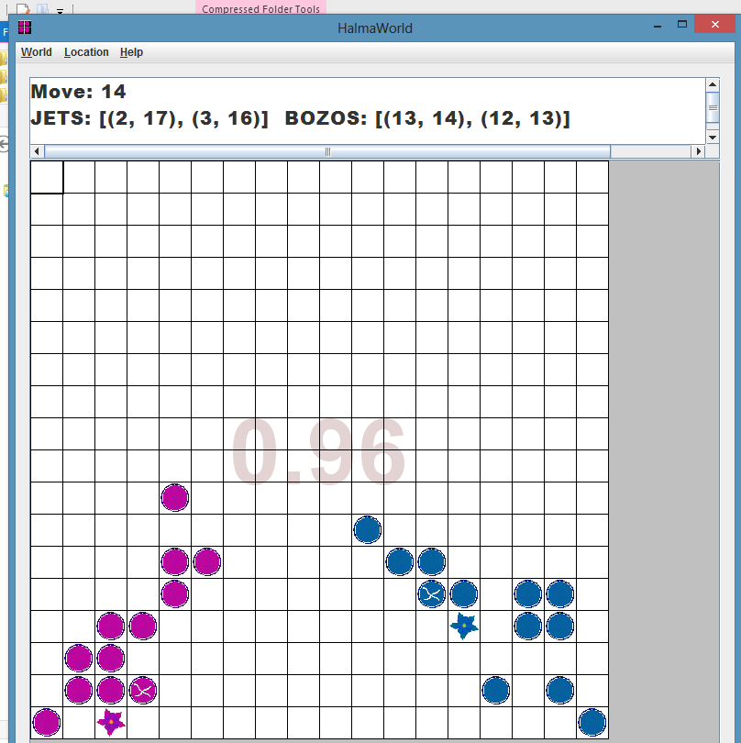
HalmaWorld & Location

Slide 4
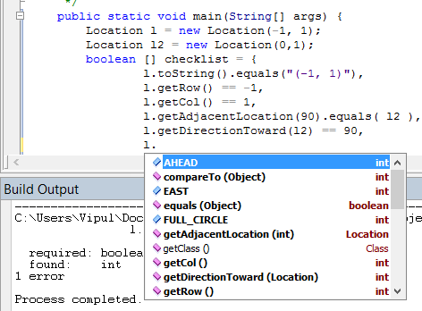

Slide 5
Stepwise Checklist for ( 3 , 0 )
Method | Received | Expected
new Location() | (3,0) | (3,0)
getRow() | 3 | 0
getCol() | 0 | 3
Equals( (3,0) ) | true | true
Great learning tool
Important for validation
Check documentation for unexpected results

Slide 6
Automated Checklist for ( 0 , 0 )
public static void main(String[] args) {
Location loc = new Location(0, 0);
Location l2 = new Location(0, 1);
//------------------------------------------------------------
boolean [] checklist = {
loc.toString().equals("(0, 0)"),
loc.getRow() == 0,
loc.getCol() == 0,
loc.getAdjacentLocation(Location.EAST).equals( l2 ),
loc.getDirectionToward( l2 ) == 90,
loc.hashCode() != 0,
loc.compareTo( new Location(0,1) ) == -1,
loc.compareTo( new Location(100,0) ) == -100,
};
//----------------------------------------------------------------
  for (boolean testResult : checklist)
  System.out.println(testRestult);

Slide 7
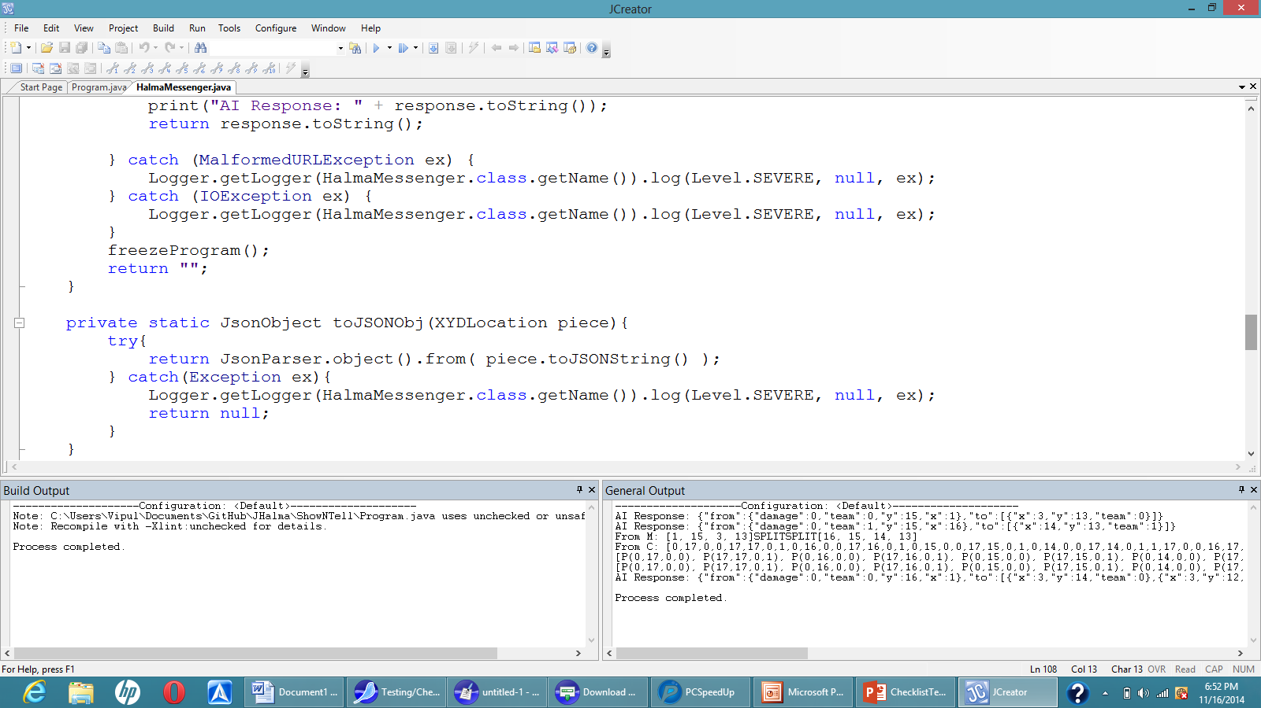
White-Box Checklist Testing

Slide 8
Math.sin(x) in Java
0 | 0.0 ✓
30 | 0.49999999999999994 ✘
-30 | -0.49999999999999994 ✘
90 | 1.0 ✓
-90 | -1.0 ✓
1.0E-8 | 1.7453292519943295E-10 ✓
180.00000001 | -1.7453271016612275E-10✘

Slide 9
Finite state machine testing
We made FSM with Markov chain to the Grid World. We built Markov OP which helped us to identify the most important areas in the system from a user perspective. Finally we got a functional OP to the system in order to test the frequently used regions
Defects found : 2
Test cases: 21
People involved: 1
Effort: 18 hrs

Slide 10
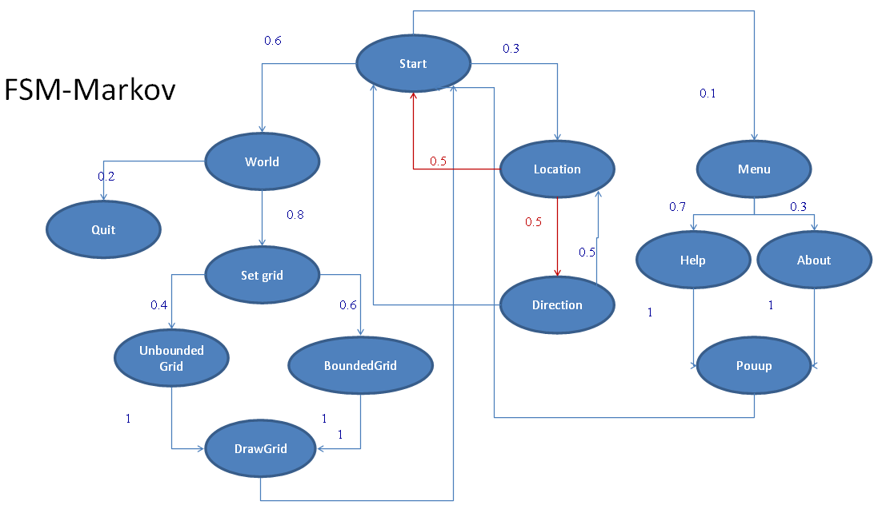

Slide 11
GridWorld Functional OP
High | Medium | Low
BoundedGrid | UnboundedGrid | Menu
DrawGrid | Location | Help
 | Color | About
 | Remove actor
 | Move actor to a new location
Redraw/Popup Path | Probability
Idle/World/SetGrid/BoundedGrid/RedrawGrid | 0.5 * 0.7 * 0.6 * 0.7 = 0.147
Idle/World/SetGrid/UnboundedGrid/RedrawGrid | 0.5 * 0.7 * 0.3 * 0.8 = 0.084
Idle/HelpMenu/Help/Help/Popup | 0.3 * 0.3 * 0.8 = 0.072
Idle/HelpMenu/Help/About/Popup | 0.3 * 0.3 * 0.8 = 0.063

Slide 12
Boundary testing
Boundaries play an important role in the GridWorld, so boundary testing is necessary for the most important features based on the functional OP.
We tested BoundedGrid and draw an actor
BoxBug & SpiralBug
EPC
Weak Nx1
Weak 1x1

Slide 13
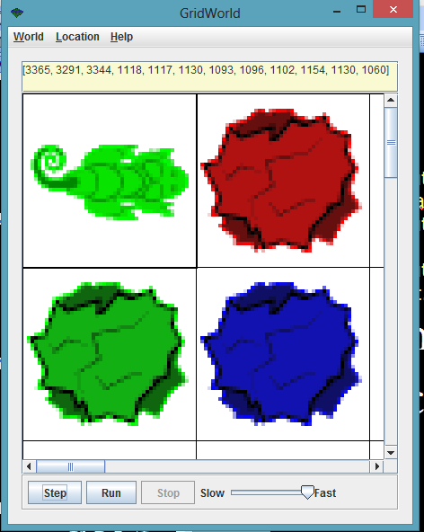
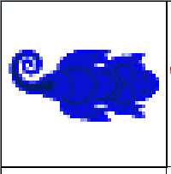
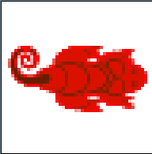

Slide 14
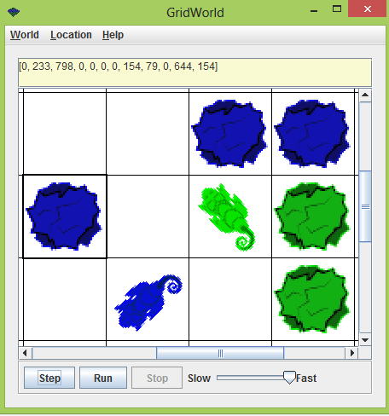
DDG Testing
Blue
Green
Blue
Chameleon1
Chameleon2
77.4% Blue
22.5% Green

Slide 15
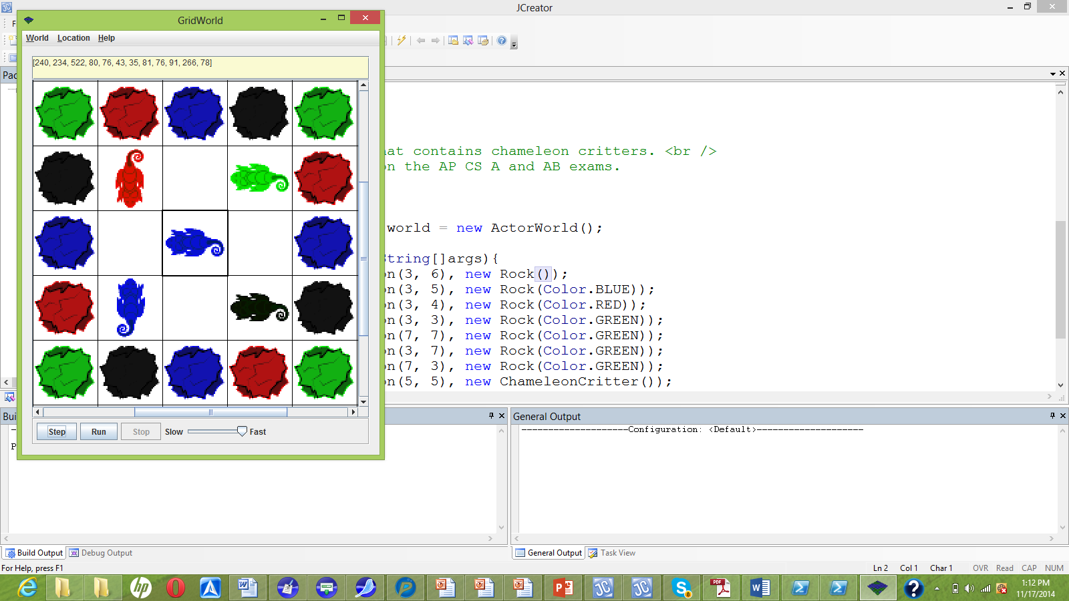
20 rocks
4 of each color
Equal probability?

Slide 16
Shared Dependencies
40% chance of blue
Blue Shared dependency
Corn2
Corn3
Corn1
Corn4
Center

Slide 17
Effort comparison
Effort
  Checklist Testing 20%
  Finite state machine testing 30%
  Boundary testing 20%
  DDG testing 10%

Slide 18
Technique Analysis
Checklist & FSM testing best
  System meets specifications
  Tested most critical areas
  Reduced chance of encountering defects

Slide 19
Educational benefits
In this project we tried to do what we have learned in our class by testing a real software hands-on. We used different testing techniques. We also learned the limitation for every testing technique we have used in our project.
Followup Actions
Attempt to remove defects which is most likely to trouble the user.

