Slide 1
Homework 3
Problem 10.6 & Extensions
Vipul Kohli
CSE 7314 (Fall 2014)

Slide 2
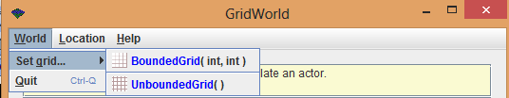
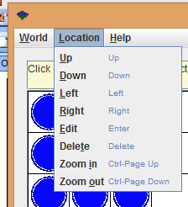
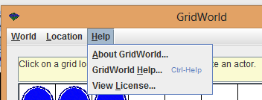
GridWorld Menu
HW3 Vipul Kohli 2 of 5
A UI to develop grid-based games such as chess, checkers, battleship, or pacman.
Probabilities can either be measured by logging user mouse behavior or estimated by surveying users or expert developers.

Slide 3
Graphical
Idle
0.5 0.2 0.3
HW3 Vipul Kohli 3 of 5
Input Type:
Help Menu
0.2 0.3 0.3 0.2
Hover
Click
Auto
World
0.2 0.7 0.1
0.5 Location
0.5
Quit
Direction
0.8 0.2
0.1
Set Grid
0.3 0.6
0.2 Help
0.8
0.3 About
0.7
0.4 License
0.6
UnboundedGrid
0.8 0.2
BoundedGrid
0.3 0.7
1.0 Popup
1.0
Redraw Grid

Slide 4
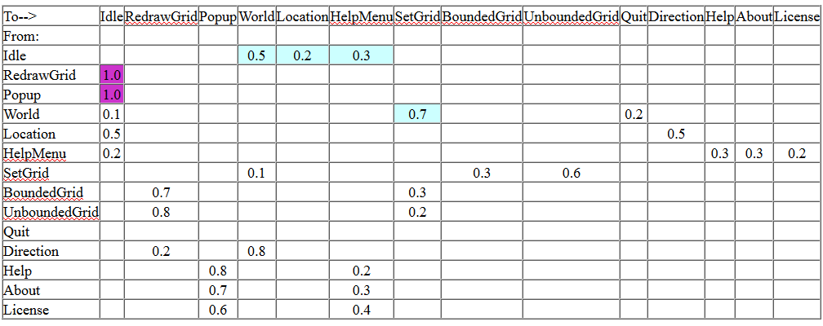
Tabular (Matrix)
HW3 Vipul Kohli 4 of 5
Input type:
White = Click Sky = Hover Purple = Auto

Slide 5
Flat Musa OP (Threshold P = 0.050)
HW3 Vipul Kohli 5 of 5
Redraw/Popup Path | Probability
Idle/World/SetGrid/BoundedGrid/RedrawGrid | 0.5 * 0.7 * 0.6 * 0.7 = 0.147
Idle/World/SetGrid/UnboundedGrid/RedrawGrid | 0.5 * 0.7 * 0.3 * 0.8 = 0.084
Idle/HelpMenu/Help/Help/Popup | 0.3 * 0.3 * 0.8 = 0.072
Idle/HelpMenu/Help/About/Popup | 0.3 * 0.3 * 0.8 = 0.063
The Redraw/Popup paths are most meaningful practically.
The path determines the type of grid drawn or popup displayed.

