Slide 1



Backstage

Slide 2

What is Backstage?
Why we need Backstage?
How we can fix the issue?
History
Tech-stack
Getting started with Backstage
Requirement for Backstage app
Creation of Backstage app
What is Plugin
What is Backstage Plugin
Who else use backstage
Infrastructure Onboarding
Q&A
Contents

Slide 3
What is Backstage?
Single page application
Open source
Developer Portal
Resource overview
Resource creation
Reduce load on developer

Slide 4
Why do we need Backstage? The Problem.
Large infrastructure
Management
Maintenance

Slide 5
How we can fix the issue? The Solution.
Single consistent UI
One front-end for all our infrastructure.

Slide 6
History of Backstage
Backstage was born out of necessity at Spotify
First built by Spotify and then donated to the CNCF
Backstage is currently in the Sandbox phase

Slide 7
Tech Stack
Node.js
TypeScript
React
Yarn
Lerna

Slide 8
Getting started with Backstage
There are two different ways to get started with Backstage:
Recommended: Create a standalone app
Contributors: Clone the Backstage repository from GitHub
Creating a standalone app makes it simpler to customize the application for our needs and stay up to date with the project.

Slide 9
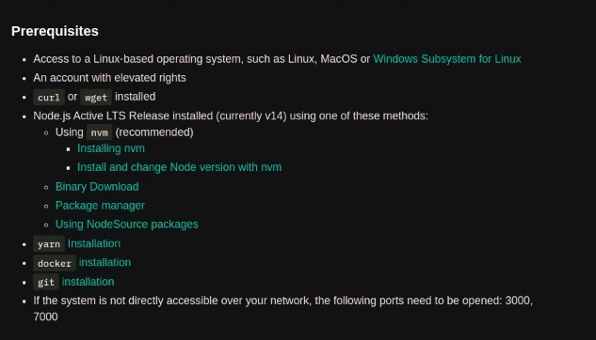
Requirements for Backstage app

Slide 10
Creation of Backstage App
A Backstage App is a monorepo setup with lerna
Required Environment : i) Node.js Active LTS Release
ii) yarn
creating app package with npx : npx @backstage/create-app
name of the app and a database for the backend selection
General folder structure
Frontend and backend can run separately

Slide 11
What is plugin?
a software add on
installed in a program enhancing it's capabilities
applications may support plugins to
enable third-party developers to extend an application
support easily adding new features
reduce the size of an application by not loading unused features
separate source code from an application because of incompatible software licenses.
Example : i) Adobe flash player ii) Unity Web player

Slide 12
What is Backstage plugin?
Backstage is a single-page application composed of a set of plugins
Existing plugins : i) API Docs ii) CircleCI ii) Jenkins
Create New Plugin:
i) yarn install ( for installing all dependencies )
ii) and run backstage-cli create-plugin from the root of your project

Slide 13
Who else use Backstage
Companies that use backstage:
Spotify
Netflix
Fiverr
Expedia Group
American Express
Ruangguru
Zepto
Etc...

Slide 14
Infrastructure Onboarding
Requirement:
YAML file
Source control system

Slide 15
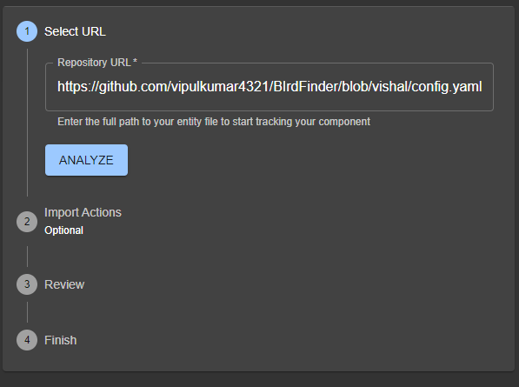
Infrastructure Onboarding
Onboarding:
Demo

Slide 16



Thank You!

