Slide 1
Student Election System
Name: Vipul Nayak
USN: 4MT21CS182
Subject: Computer Networks Laboratory

Slide 2
Objectives
Candidates and Constants: - Four candidates (Ganesh, Mahesh, Rathan, Abhishek) and two special options (NOTA - None of the Above, SPOILEDVOTES - Error) are defined as constants. - Initial vote counts, an array to track whether a student has voted, and other variables are declared.
Methods: - castVote(): Takes user input to cast a vote for one of the candidates or special options. - votesCount(): Displays the voting statistics, showing the number of votes for each candidate and special options. - getLeadingCandidate(): Determines and prints the winning candidate or if there's a tie, not enough votes, or spoiled votes.
Main Method: - A loop runs for 200 voters (simulated by the variable i). - Users are prompted to enter the last three digits of their USN (University Serial Number). - If a voter hasn't voted yet (!voted[usn]), they can cast a vote; otherwise, a message indicates that they've already voted.
CSE Department Access: - After the voting process, there's an attempt to access the election results by entering a password. - If the correct password (456) is entered, the voting statistics and the leading candidate are displayed. - If the password is entered incorrectly, the user has three attempts before reaching the limit.
Note: - The code has some limitations, such as using a fixed array size for tracking voted students, which might not be scalable. - It's a basic simulation and doesn't cover more advanced scenarios like recounting, tied votes resolution, or detailed voter authentication.

Slide 3
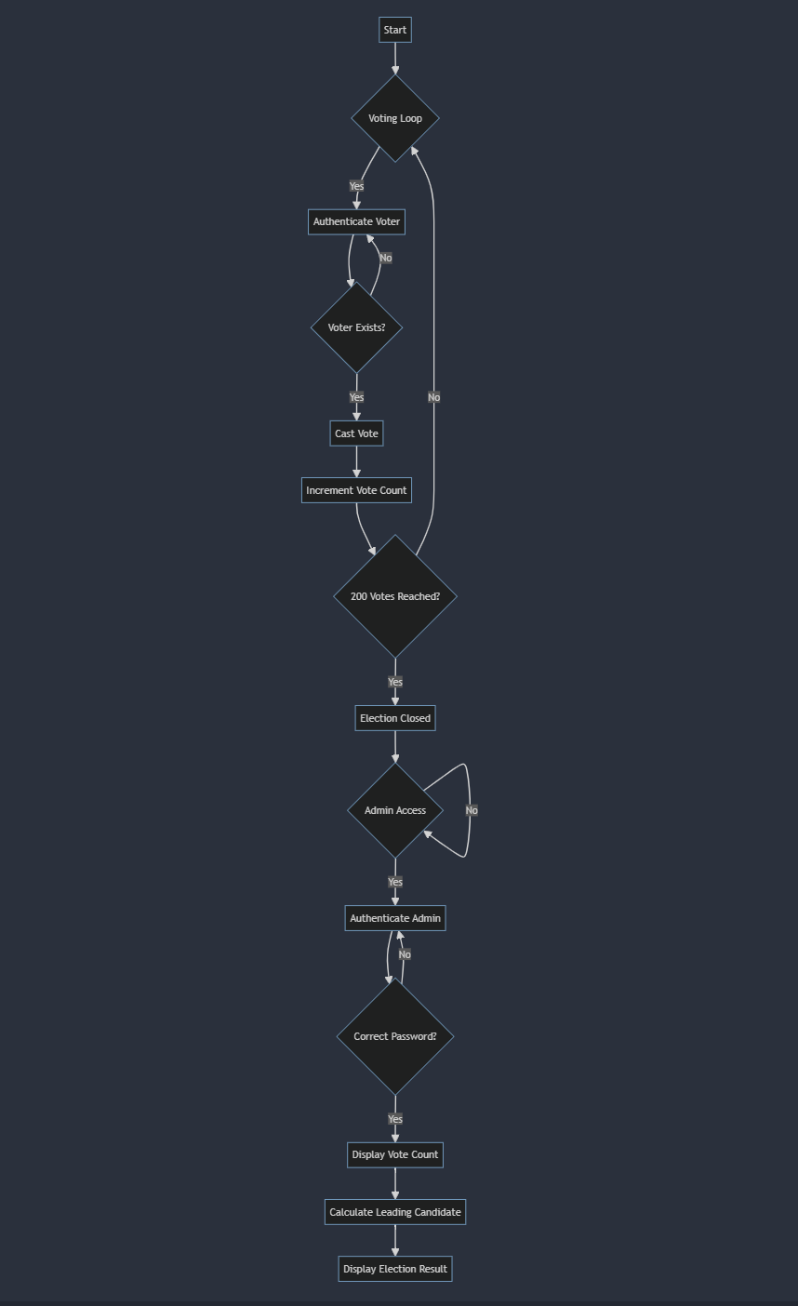
Flow Diagram

Slide 4
Applications
Educational Simulations
Training Tool for Election Volunteers
Mock Elections
Code Understanding and Modification
Small Community Elections
Security and Access Control Practice
Understanding Arrays and Data Tracking
Building Blocks for Larger Election Systems

Slide 5
Snippets

