Slide 1


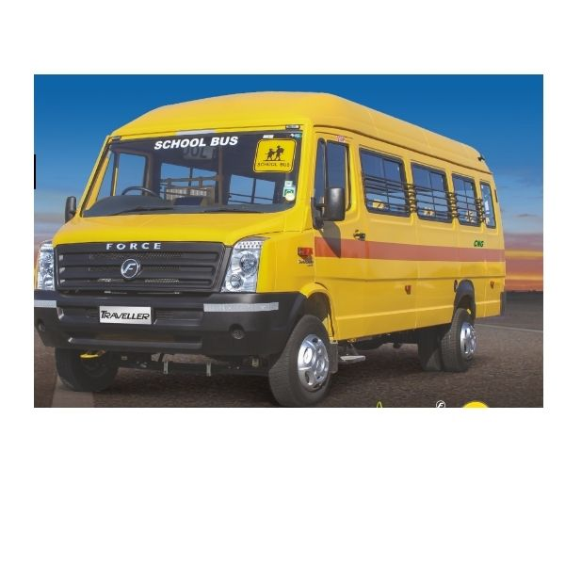
CAMPUS SHUTTLE TRACKER SYSTEM
Based on Cloud Computing

Slide 2
DEPARTMENT OF COMPUTER SCIENCE AND ENGINEERING
2024 - 25
PROJECT ON
“Campus Shuttle Tracker System”
PRESENTED BY
Mr. Vipul Manilal Patel.
Mr. Nishant Nitin Bodare
Mr. Swapnil Shrikant Yadav
Mr. Utkarsh Mohan Yadav
UNDER THE GUIDANCE OF:- Mrs S. A. Waghmare

Slide 3

Conents
Introduction
Literature Review
Problem Identification
Block Diagram
Scope of Project
Objective
Proposed Work
Motivation for Work
Expected Outcome
References

Slide 4
Introduction
The Campus Shuttle Tracker System is a comprehensive solution designed to improve campus transportation.
It offers real-time bus tracking, enabling students to monitor bus locations and estimated arrival times, enhancing time management.
The system integrates an attendance management feature using RFID technology, ensuring accurate and automated attendance tracking.
It also includes a fuel monitoring module to track consumption and generate digital refueling requests, optimizing shuttle maintenance.
The secure online payment gateway facilitates fee collection and digital bus passes.
With a user-friendly interface, the system prioritizes security, convenience, and efficiency, providing a seamless experience for students and administrators alike.

Slide 5
Literature Review
The authors Komal Satish Agarwal et al proposed RFID Based Intelligent Bus Management and Monitoring System. They concluded that by implementing this system various problems like underutilization of bus fleet and long waiting time at the bus stops will be reduced. It can improve the quality of the public transportation service effectively [1].
The authors M.A.HANNAN et al, proposed the Intelligent Bus Monitoring and Management System. The experimental results show that the system is intelligent enough and able to provide important information to the authorities for monitoring and management of the bus system [2].
The authors Anuradha Vishwakarma et al, proposed GPS and RFID Based Intelligent Bus Tracking and Management System. In their proposed model they have developed AISFBRM- the autonomous informative services for bus route map that is flexible, affordable, customizable and accurate [3].

Slide 6
Problem Identification
Inefficient Route Planning
Lack of Real-Time Location
Overcrowding and Underutilization
Student Safety and Accountability
Environmental Impact and Sustainability
Limited Scalability and Flexibility
No Attendance Management
Offline Fees Payment

Slide 7
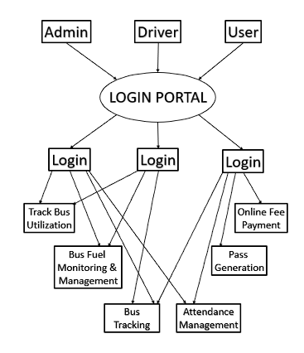
Block Diagram

Slide 8
Scope of Project
The Campus Shuttle Tracker System aims to modernize and optimize the transportation system on a college campus, addressing the various operational challenges faced by the institution.
The scope of the project encompasses the development, implementation, and management of a digital platform that integrates multiple functionalities to streamline the management of the college bus fleet and improve the overall experience for students and staff.

Slide 9

Objective
To allow students and staff to track the bus location.
To manage the allocation of bus routes and students.
To record fuel efficiency and create request form for refueling.
To collect bus fees online and generate pass accordingly.
Students Attendance using RFID technology

Slide 10
Proposed Work
The project aims to develop a comprehensive, automated solution for managing the transportation needs of a college campus.
The proposed work will focus on the design, development, implementation, and deployment of various components that will streamline the operation of the college's bus fleet, enhance user experience, improve resource utilization, and ensure timely transportation for students and staff.

Slide 11
Motivation of Work
The motivation behind developing a Campus Shuttle Tracker System from the growing need to address the challenges faced by educational institutions in managing their campus transportation services efficiently and effectively.
College campuses, often diverse in terms of student demographics and locations, require a robust system to manage transportation logistics that can cater to large volumes of students and faculty while minimizing operational inefficiencies.

Slide 12
Expected Outcome
The project is expected to enhance campus transportation by optimizing bus schedules and routes, reducing wait times, and minimizing overcrowding. Students will benefit from real-time bus tracking and improving their overall travel experience.
The system will also streamline attendance management by automating it through the Student portal from App. Administrators will gain access to detailed analytics for better decision-making and resource utilization.
Overall, the project will increase operational efficiency, reduce fuel costs, promote sustainability, and provide a more reliable, user friendly transportation experience for both students and staff.
It will also track the vehicle fuel efficiency by collecting the data of refueling and bus running.

Slide 13




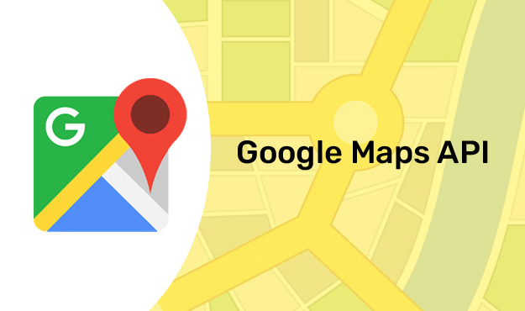

Technology Used
User interface for Mobile application (Java / Kotlin / Flutter)
Database for student’s and bus details (SQL)
Cloud Services for real-time data processing ( Web Hosting)
GPS and Google Maps for tracking bus (API based – Google Map)

Slide 14





References
Komal Satish Agarwal, Kranthi Drive “RFID Based Intelligent Bus Management and Monitoring System”. International Journal of Engineering & Technology, ISSN: 2278-0181, Vol.3 Issue 7, July 2014.
M.A. Hannan, A.M.Mustapha, A. Hussain, H.Basri “Intelligent Bus Monitoring and Management System”. World Congress on Engineering and Computer Science 2012 Vol II, October 24-26.
Anuradha Vishwakarma, Agarja Jaiswal, Ashwini Neware, Shruthi Ghime, Antara Marathe, Reshmi Deshmukh “ GPS and RFID Based Intelligent Bus Tracking and Management System ”. International Research journal of Engineering and Technolgy,Vol. 03, Issue: 03, March-2016.

Slide 15

Thank You
Presentation By: Vipul Manilal Patel

