Slide 1

Foxconn Admits Employing Under Age Interns - BBC
Group No – 4
Vipul Patil
Vijeth Satish Reddy
Hitesh Soneta
Chinmay Sawant
Case Study:

Slide 2




Introduction
Vipul
Vijeth
Hitesh
Chinmay

Slide 3
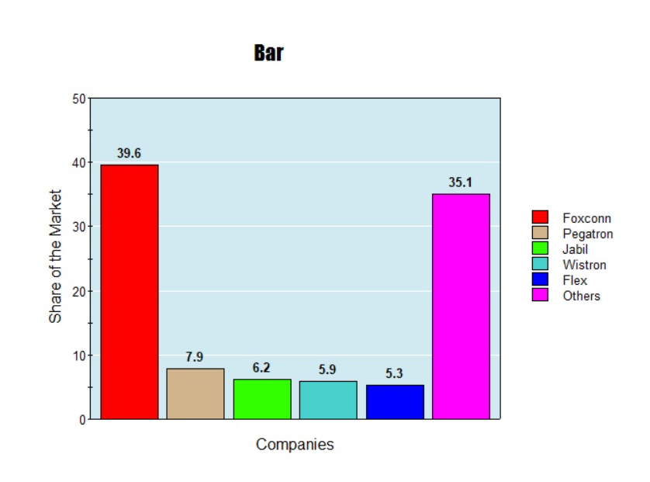
Background
Foxconn is the leading Manufacturer of Electronic Consumer Products.
Foxconn faced allegations from China labor Watch regarding underage Interns.
Underage interns were sent to Foxconn by schools, but Foxconn did not check IDs of young Interns.
China Labor Watch calls for government intervention to improve the school intern system.

Slide 4
Main Issue
01
The primary concern is the employment of underage interns by Foxconn, a major electronics manufacturer, due to insufficient age verification.
Underage Labor
02
The enforcement of labor regulations in China is complex and has been inconsistent for years.
Regulatory Enforcement Challenges

