Slide 1
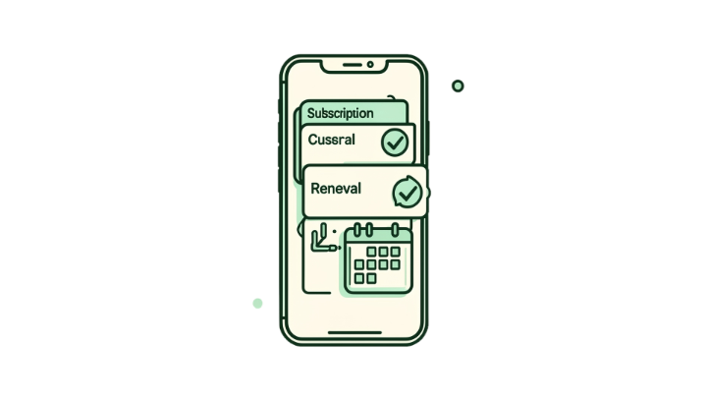
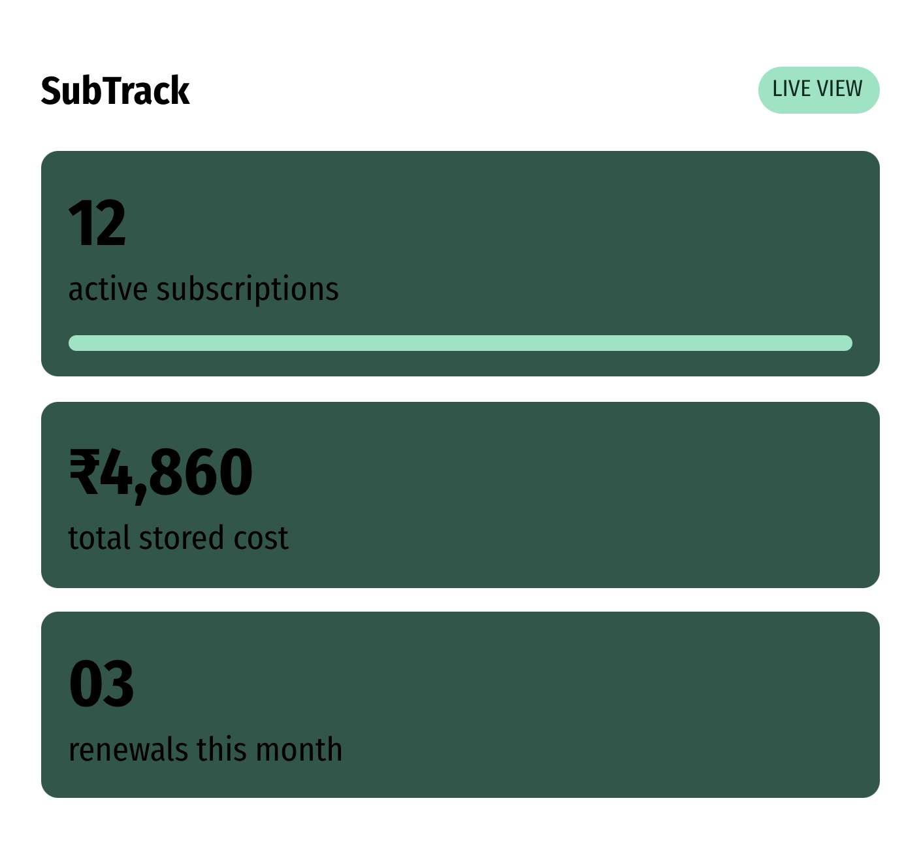
SUBSCRIPTION MANAGEMENT · PROJECT OVERVIEW
Subscription
Management
Dashboard
A MERN-powered platform for managing subscriptions, renewal dates, and recurring expenses.
STACK
TEAM
MongoDB · Express.js
React.js · Node.js
[vipul preetham] · [yellappanaidu] · [sri varshith] · [sai charan reddy]

Slide 2



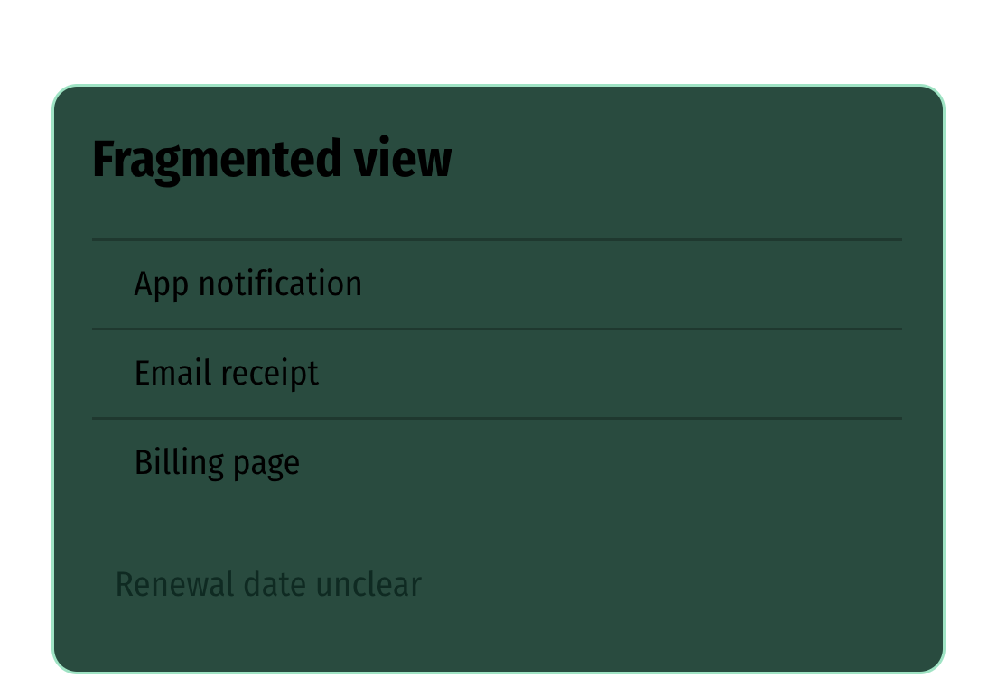



THE PROBLEM · FRAGMENTED INFORMATION
Subscriptions are easy to lose track of
The details exist. The visibility does not.
Scattered details
Missed renewals
Details are scattered across apps, emails, and billing pages.
Renewal dates are easy to miss.
Hidden total
Manual upkeep
Recurring spending is hard to see as one total.
Manual tracking takes time and regular upkeep.
CENTRALIZED MANAGEMENT TURNS FRAGMENTED INFORMATION INTO A CLEAR VIEW.
Technical stakes: responsive UX, reliable MongoDB records, REST APIs, CRUD operations, accurate dates, and protected user data.

Slide 3
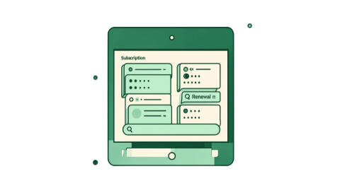
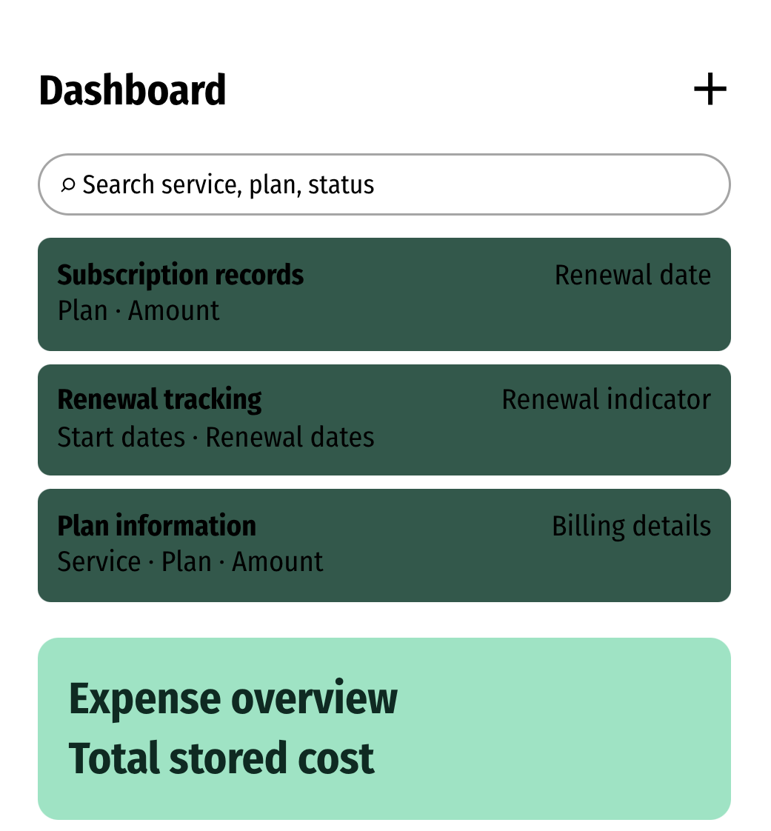
THE PRODUCT · ONE CENTRAL VIEW
One dashboard, every subscription
A card-based dashboard makes the record easy to scan, search, and manage.
RECORDS
DATES
Subscription records
Renewal tracking
Add, view, update, and delete.
Store start dates and renewal dates.
COST
DETAILS
Expense overview
Plan information
Show amounts and total stored cost.
Organize service, plan, amount, and billing details.
FIND
ACCESS
Search and filtering
Secure access
Find by service, plan, or renewal status.
Authentication and role-based access only if implemented.
SECURE ACCESS, AUTHENTICATION, AND ROLE-BASED ACCESS REMAIN CONDITIONAL ON IMPLEMENTATION.
PLANNED ONLY IF UNVERIFIED

Slide 4


ARCHITECTURE · REQUEST TO UI
From user input to dashboard
One subscription travels through five clear stages.
01
02
03
04
05
User input
Validate
API operation
Persist
Refresh view
User enters subscription details in React.js:
Netflix · Standard · ₹499 · 10 October 2026 · 10 November 2026.
React.js validates the form and sends an HTTP request.
Node.js + Express.js validate the request and run the operation.
MongoDB stores or retrieves the subscription record.
The API response updates the React.js dashboard.
Architecture: User → React.js frontend → REST API → Node.js + Express.js backend → MongoDB → updated dashboard.
CRUD: CREATE · READ · UPDATE · DELETE

Slide 5
ALGORITHM PANEL
TECHNICAL DESIGN · MODULAR MERN
Renewal scan
Identify renewals between today and the next seven days.
MERN makes the workflow modular
M
E
Total calculation
Sum comparable subscription amounts.
MongoDB
Express.js
Stores services, plans, amounts, start dates, and renewal dates.
Defines REST endpoints and handles HTTP requests.
Sorting
Sort renewal dates when needed.
R
N
React.js
Node.js
COMPLEXITY
Builds the dashboard, forms, cards, and data views.
Runs the backend JavaScript and request handling.
Renewal scan O(N)
Total calculation O(N)
Sorting O(N log N)
ONLY MENTION MONGOOSE, JWT, OR OTHER ADDITIONS IF ACTUALLY USED.

Slide 6
DEMO FLOW · VALIDATE THE JOURNEY
SCREENSHOT AREA 01
SCREENSHOT AREA 02
Demo the journey from entry to smart tracking
Main Dashboard
Add/Edit Form
Show the central view of records, renewal indicators, and expense summary.
Show entry and editing states for service, plan, amount, and dates.
01
Add
Add a subscription.
02
View
View saved records.
03
Update
SCREENSHOT AREA 03
Subscription List with Renewal Dates
Update plan, amount, or renewal date.
Show records ordered or filtered by renewal status.
04
Delete
Delete a record and confirm the dashboard refresh.
05
Track
Track upcoming renewals only if implemented.
SAMPLE DATA: NETFLIX · STANDARD · ₹499 · 10 OCTOBER 2026 → 10 NOVEMBER 2026.
IF TESTING IS INCOMPLETE
Show a validation checklist instead of invented metrics.

Slide 7

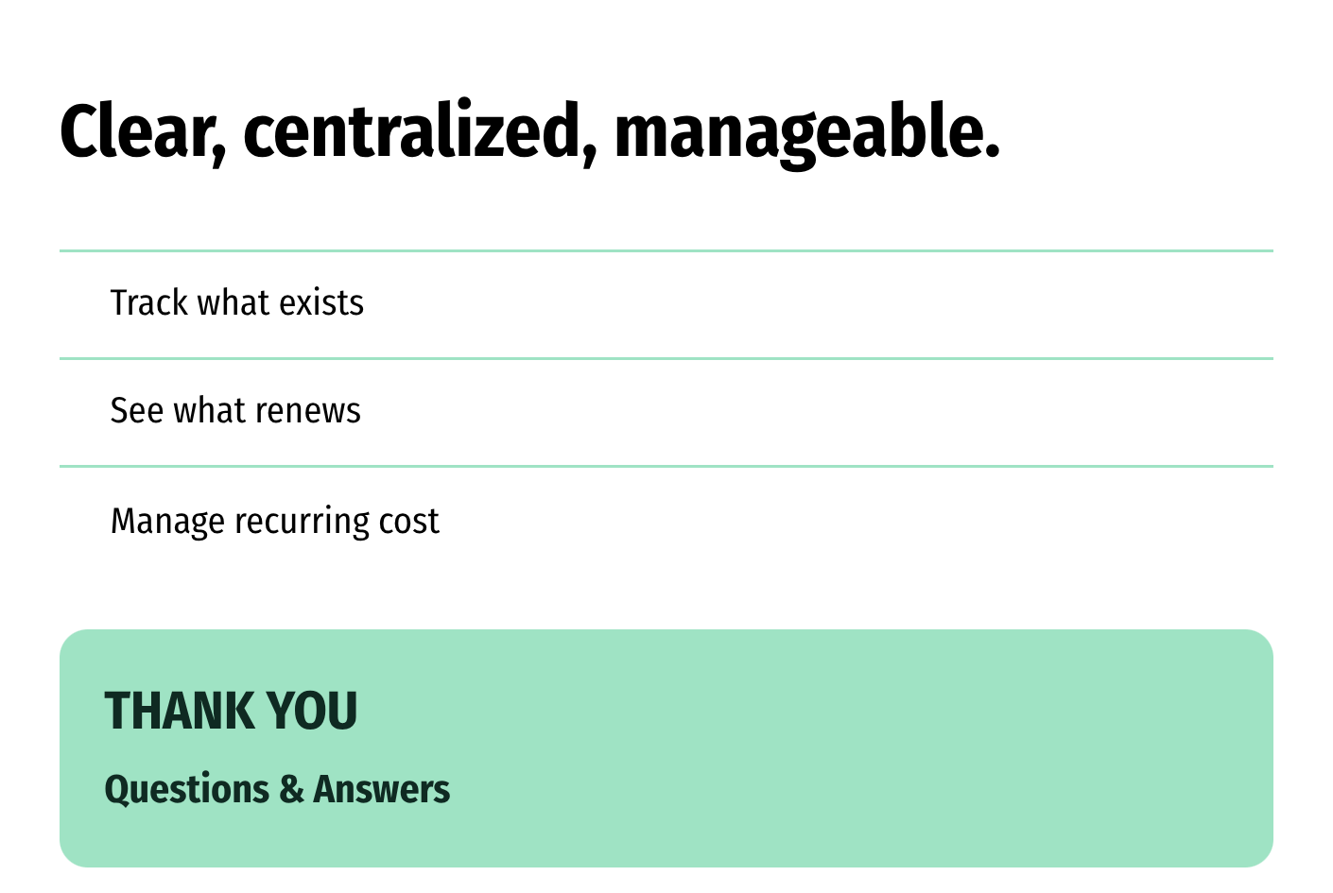
CLOSING VIEW · VERIFIED NOW, SMARTER NEXT
Make subscription management smarter
CURRENT ACHIEVEMENT
Show only implemented and verified items: MERN architecture, MongoDB storage, REST integration, CRUD operations, and dashboard interface.
FUTURE
Automated renewal reminders, spending analytics, secure authentication, smart subscription insights, multi-currency support, and recurring billing intervals.
SCALE
Indexes, pagination, caching, cloud deployment, and user-level authorization.

