Slide 1
SUDOKU
SOLVER ARENA
See how the algorithm thinks, not just the final answer.
Sai Charan Reddy – 25MVCSMR0029
Yellappa Naidu – 25MVCSMR0046
Sri Varshith – 25MVCSMR0059
Vipul Preetham – 25MVCSMR0087
V

Slide 2





The challenge is the reasoning layer.
01 · THE GAP
The Challenge
CONSTRAINT MANAGEMENT
SEARCH EXPLOSION
Too many choices create a branching search space.
Every candidate must respect row, column, and 3×3 box rules.
Traditional solvers show input and final answer while hiding decisions, candidate checks, contradictions, and backtracking.
ROLLBACK
EXPLAINABILITY
A wrong choice must be undone without losing the valid path.
The solver should make its decisions inspectable, not invisible.
02

Slide 3
02 · OUR INNOVATION
Our Innovation
Record and replay every major solving action
Visualize row, column, and 3×3 box checks
Replay failed decisions and backtracking
Compare Basic Backtracking with Backtracking using decisions, backtracks, checks, depth, and time
03

Slide 4

03 · HOW IT WORKS
Follow one choice through the solver.
Input and validate the puzzle.
1
Select an empty cell and generate candidates.
2
Check row, column, and 3×3 box constraints.
3
Place a valid value; on contradiction, undo and try another.
4
Continue until solved or proven unsolvable.
5
LIVE REPLAY
r4c5 → {2, 6, 8} → try 6 → contradiction → undo → try 8.
04

Slide 5
TECHNOLOGY & ALGORITHM
Technology & Algorithm
PYTHON 3
Streamlit
Core Language- Pure –function, Backtracking Solver, No External Solver libraries
Reactive web UI – grid input,controls,and live place holders for the running solve
Core logic module
Step replay engine
find_empty(), isvalid(),find_conflicts(), solve_with_steps()—isolated from the UI layer
Recorded step log is replayed through st.empty(),palceholders with adjustable delay and sampling
05

Slide 6
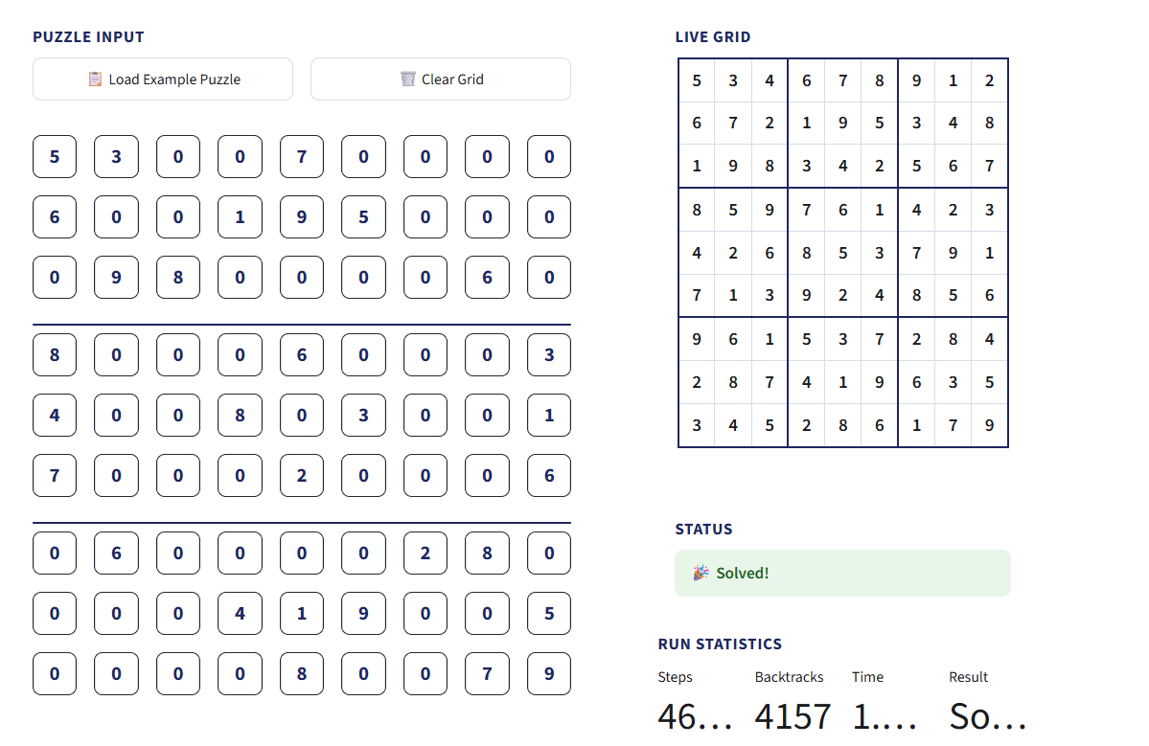
05 · DEMO & IMPACT
MAKE THE
SEARCH
VISIBLE.
Interactive learning, transparency, strategy comparison, hands-on demonstration.
STEPS
BACKTRACKS
CONSTRAINT CHECKS
EXECUTION TIME
[Measured during demo]
[Measured during demo]
[Measured during demo]
[Measured during demo]
06

Slide 7
06 · THE NEXT PLATFORM
From Sudoku Solver to Algorithm Learning Platform
The same event-driven architecture can make other constraint-solving algorithms inspectable.
TODAY
ROADMAP
ARCHITECTURE
SOLVER EXPERIENCE
LEARNING SURFACE
SCALABLE CORE
Interactive input, validation, backtracking, constraint checks, replay, metrics, and comparison.
Advanced heuristics → richer visualizations → learning mode → broader constraint-solving algorithms.
Algorithm Engine → Event Recorder → Visualization Layer.
“We don’t just solve the puzzle — we visualize the decisions that lead to the solution.”
THANK YOU · QUESTIONS?
07

