Slide 1

GUI Based Game
Submitted by: roll no. Reg no.
KARTIKEY JAISWAL 65 11909035
VIPUL SAMANT 67 11916634
SAGAR SHARMA 50 11912711

Slide 2
AT THE STARTING THE BALL WILL GO TO RANDOM PLAYER. WHEN THE BALL HITS THE SIDE BOUNDARY, THE OPPoSITION GETS THE ONE POINT AND SAME CONTINUES….
Main logic behind the project
AS THE OTHER PLAYER IS ROBOT ITSELF, SO SHOW SOME SKILLS AND BEAT THE PLAYER…..
LETS GO……

Slide 3
LIBRARY AND IMPORTANT
FUNCTION
USED IN OUR PROjECT

Slide 4

PYGAME
Pygame is a cross-platform set of Python modules designed for writing video games. It includes computer graphics and sound libraries designed to be used with the Python programming language.
It i.s used to develop 2-D games

Slide 5
What is sys ?
The sys module provides functions and variables used to manipulate different parts of the Python runtime environment. This module provides access to some variables used or maintained by the interpreter and to functions that interact strongly with the interpreter.

Slide 6
What is th use of sys ?
Like all the other modules, the sys module has to be imported with the import statement, i.e. The sys module provides information about constants, functions and methods of the Python interpreter.

Slide 7
RANDOM
Generate pseudo-random numbers.
Functions in the random module depend on a pseudo-random number generator function random(), which generates a random float number between 0.0 and 1.0. random. random(): Generates a random float number between 0.0 to 1.0.

Slide 8
CLASS
Python classes provide all the standard features of Object Oriented Programming: the class inheritance mechanism allows multiple base classes, a derived class can override any methods of its base class or classes, and a method can call the method of a base class with the same name.
In our project we have made several classes like class for block, class for player paddle and opponent paddle , class for ball and class for game manager.

Slide 9
Important points about our project
The ball , paddle of player and the opponent have been made in paint by us separately.
After making the above images we have imported the images to our project.
For example the code for importing image of ball in our game is:
ball = Ball('Ball.png', screen_width / 2, screen_height / 2, 4, 4, paddle_group) # object of Ball class ball_sprite = pygame.sprite.GroupSingle() ball_sprite.add(ball)

Slide 10
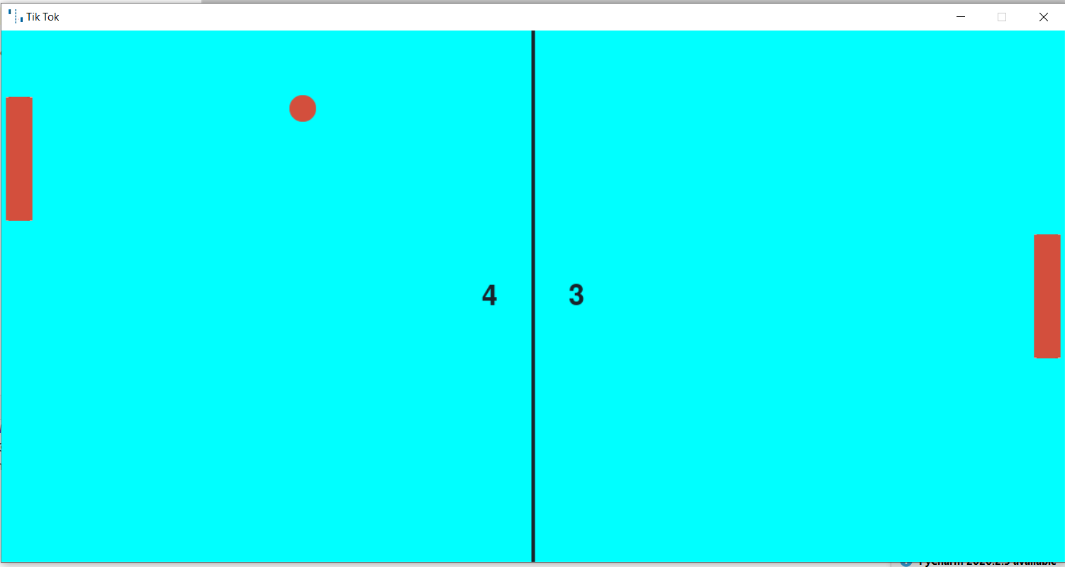
Output screen of the project

