Slide 1

Employee Advancement Forecast
Predicting Employee Promotions Based on Various Factors

Slide 2
Motivation behind the project
In today’s competitive business landscape, talent management is crucial for organizational success. Here’s why implementing an Employee Promotion Prediction system can be a game-changer:
Enhance Employee Engagement and Retention: Predicting promotions helps identify high-potential employees who are ready for the next step in their careers,
Data-Driven Decisions: Traditional promotion processes often rely on subjective evaluations. A predictive model utilizes data to provide objective insights
Optimize Workforce Planning: By forecasting promotions, organizations can proactively plan for future leadership needs and skill gaps.
Identify Talent Early
Increase Fairness and Transparency
Boost Organizational Performance: A motivated and well-placed workforce directly contributes to the organization’s growth and success.
🌟 Embrace the Future of Talent Management

Slide 3

Introduction
Problem statement/Objective: To analyse various factors contributing to employee promotions and predict which employees will be promoted.
Dataset: Includes 54,808 entries with 14 attributes such as Employee ID, Department, Region, Education, etc.

Slide 4
Employee_Id - ID's of all Employees
Department - department of the employee.
Region - region as designated by the company
Education - qualification of the employee
Gender - gender of the employee
Recruitment channel - means via which employee was recruited
No of trainings - total number of trainings undergone by the employee
Age - age of the employee
Previous year ratings - previous year performance ratings of the employee
Length of service - total years worked for the company
KPIs met(1 if >80%) - total KPIs met in the tenure
Average training score - average score on trainings
Awards won - Awards won if any
is_promoted - Binary(0 = No | 1=Yes) The target column is the is_promoted column.

Slide 5
Data Collection and Understanding
Imported necessary libraries: pandas, numpy, sklearn, seaborn, etc.
Initial dataset exploration: 54,808 rows and 14 columns
The target column is the is_promoted column.
Only the education and previous_year_rating columns have Null values in them.

Slide 6
Handling Missing Values
Columns with missing values: education and previous_year_rating
Filled missing 'previous_year_rating' with 0, assuming they are new employees.
Filled missing 'education' with the mode of the education level per department.
It is odd that the education column has so many Null values.
Qualifications mean a great deal and hence it is imperative the Null values are analyzed. Out of the total 2409 missing rows, 122 of those employees have received a promotion, thus the Null values have to be imputed.

Slide 7
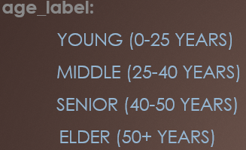
Exploratory Data Analysis (EDA)
Univariate analysis: Distribution plots for numerical columns.
Outlier treatment using IQR method for 'age' and 'length_of_service‘
Binning:
total_score: Low (0-65)
Mediocre (65-145)
High (145+)
service_catg: New (0-2 years)
Established (2-7 years)
Experienced (7-10 years)
Veteran (10+ years)

Slide 8
Key Findings from EDA
Factors contributing to promotions:
Performance (KPIs and awards)
Total Score (combination of no_of_trainings and avg_training_score)
Age and Length of Service
Previous Year Rating
Non-contributing factors: Department and Education

Slide 9
Data Preparation
Selected important features: performance, age, length_of_service, previous_year_rating, total_score.
Removed redundant columns.
Converted 'performance' to boolean.
Used MinMaxScaler for feature scaling.
Splitted dataset into training and testing sets (80:20 ratio).
Applied RandomOverSampler to address class imbalance.

Slide 10
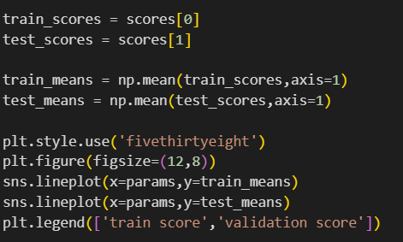
Model Building
Selected GradientBoostingClassifier as the model due to its robustness and high accuracy.
Cross-validation results:
Test Accuracy: 87.8%
Precision: 88.9%
Recall: 87.8%
F1 Score: 88.8%

Slide 11
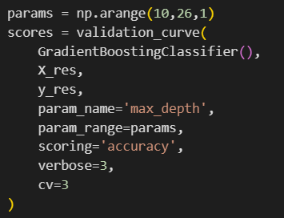
Hyperparameter Tuning
Conducted validation curves and GridSearchCV to find the best parameters.
Best parameters found:
max_depth: 20
learning_rate: 0.4
n_estimators: 300

Slide 12
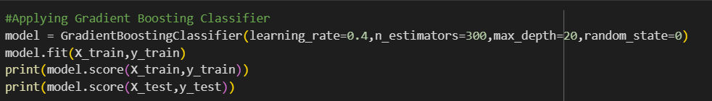
Final Model Performance
Trained final model with optimal parameters.
Test set accuracy: 95.7%
Precision and recall from classification report:
Precision: 100% for class 1 and 91% for class 0
Recall: 92% for class 1 and 100% for class 0
F1 Score: 96%
Ready to predict promotions based on various factors.

Slide 13
Challenges faced
Data Quality
Missing values
Imbalanced Dataset
Model Training
Algorithm Selection: Choosing the right machine learning algorithm that balances bias and variance while offering robust performance.
Evaluation Metrics: Ensuring the chosen metrics reflect the true performance of the model.
Deployment Challenges (Scalability): Ensuring the model can handle real-time data and large datasets efficiently.
Data Privacy and Ethics: Handling sensitive employee data responsibly and in compliance with privacy laws and corporate policies.
Continuous Improvement: model updating

Slide 14
Conclusions
No single factor determines promotion; a combination of several factors is responsible.
Key influential factors include performance, age, length of service, previous year rating, and total score.
GradientBoostingClassifier with Hyperparameter tuning yields excellent predictive performance.

