Slide 1
Market Basket Analysis
Problem Statement:
The goal of this project is to conduct a Market Basket Analysis for an online retailer specializing in novelty gifts. The retailer wants to leverage historical transaction data to identify patterns and associations between purchased items, which can be used for cross-promotional strategies and inventory management.
What is Market Basket Analysis?
Market basket analysis is a data mining technique that analyzes patterns of co-occurrence and determines the strength of the link between products purchased together.
We also refer to it as frequent itemset mining or association analysis.
It leverages these patterns recognized in any retail setting to understand the behavior of the customer by identifying the relationships between the items bought by them.
To put it simply, market basket analysis helps the retailers know about the products frequently bought together so as to keep those items always available in their inventory.

Slide 2
Data Understanding and Preparation
Inspect the retail dataset to understand its structure and contents.
Perform data cleaning and preprocessing to ensure the dataset is suitable for analysis.
Source: Online retail dataset
Columns: InvoiceNo, StockCode, Description
Size: 224,372 entries and 3 columns after data cleaning

Slide 3
Data Cleaning
Stripped extra spaces in the ‘Description’ column
Dropped rows without any invoice number
Removed credit transactions
Dropped duplicates and missing/null values

Slide 4
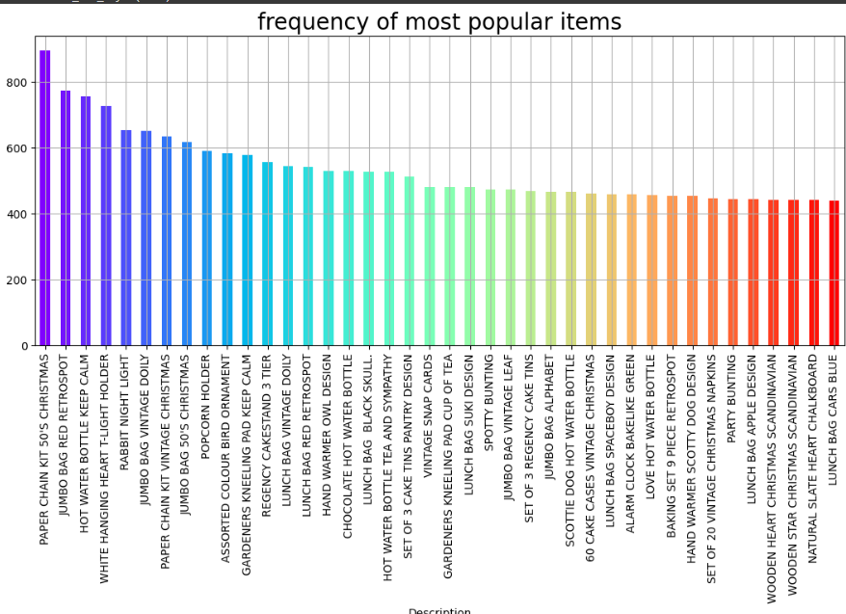
Exploratory Data Analysis
Frequency of Most Popular Items:
Include a bar chart of the top 40 most frequent items.

Slide 5
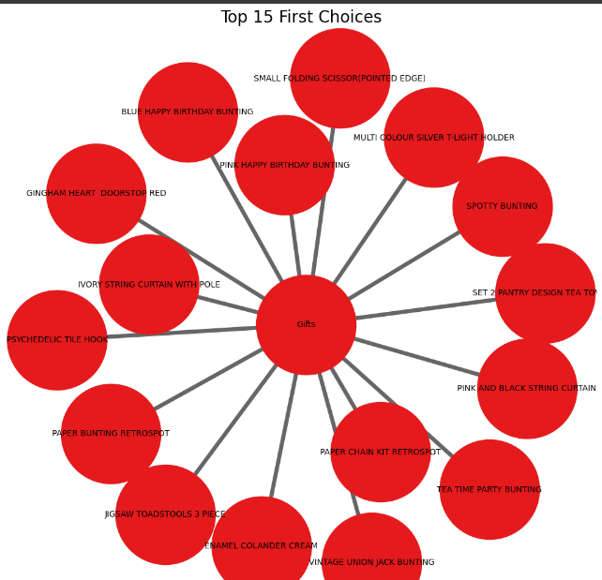
Top 15 choices

Slide 6
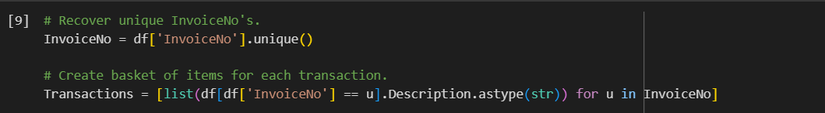
Transaction Creation
Created a list of transactions for each unique InvoiceNo
Example Transaction:
['IVORY STRING CURTAIN WITH POLE', 'PINK AND BLACK STRING CURTAIN', ...]

Slide 7
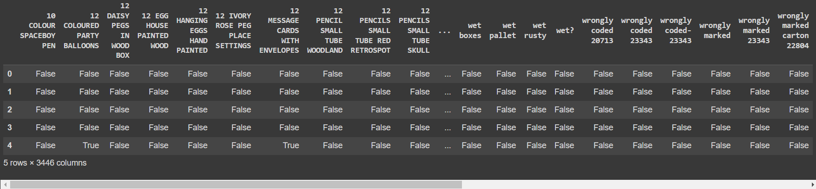
One-Hot Encoding
Transformed the transaction data using TransactionEncoder from mlxtend

Slide 8
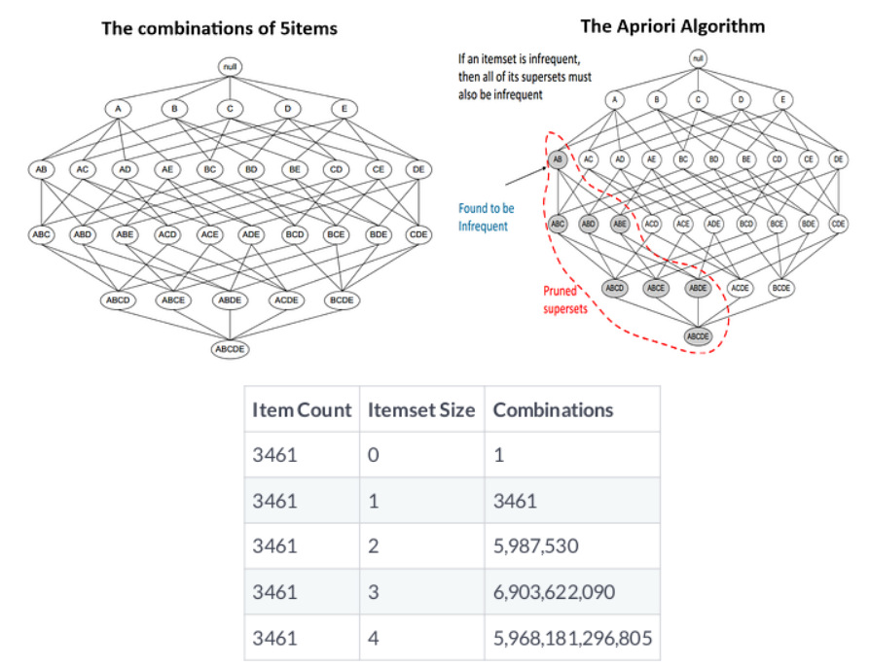
Apriori Algorithm
Apriori algorithm offers alternative. Doesn't require enumeration of all itemsets. Sensible rule for pruning.
The Apriori principle:
Subsets of frequent sets are frequent.
Retain sets known to be frequent.
Prune sets not known to be frequent. Ex:
Candles = Infrequent
{Candles, Signs} = Infrequent
{Candles, Signs} = Infrequent
{Candles, Signs Boxes} = Infrequent
{Candles, Signs, Boxes} = Infrequent
{Candles, Signs, Boxes, Bags} = Infrequent

Slide 9


Metrics and Pruning
Metrics are statistical measures used to evaluate the strength and significance of relationships between items in market basket analysis.
Three key metrics are commonly used:
Support: Indicates how frequently an itemset (combination of items) appears in transactions. A higher support value suggests a more common purchase pattern. The support metric measures the share of transactions that contain an itemset.
Confidence: Measures the probability of buying the consequent item (B) given that the antecedent item (A) is already purchased. A high confidence value suggests a strong association between the items. Confidencegives us the probabilitywe will purchase 𝑌given we have purchased 𝑋.

Slide 10

Lift: Goes beyond confidence by considering the "unexpectedness" of the association. It compares the observed co-occurrence of items to what would be expected by random chance. A lift value greater than 1 indicates a positive synergy, meaning the presence of item A increases the likelihood of buying item B more than expected by chance
Lift provides another metric for evaluating the relationship between items.
Numerator: Proportion of transactions that contain 𝑋and 𝑌.
Denominator: Proportion if 𝑋and 𝑌are assigned randomly and independently to transactions.
Pruning is a technique used to streamline the analysis process in market basket analysis.
It involves filtering out irrelevant or weak itemsets during the identification of frequent itemsets.
Pruning can be based on:
Minimum support threshold: Discarding itemsets that fall below a certain level of frequency.
Confidence threshold: Eliminating rules with a confidence value below a set minimum, indicating a weak association.
Lift threshold: Focusing on rules with a lift value greater than 1, suggesting a statistically significant co-occurrence.

Slide 11
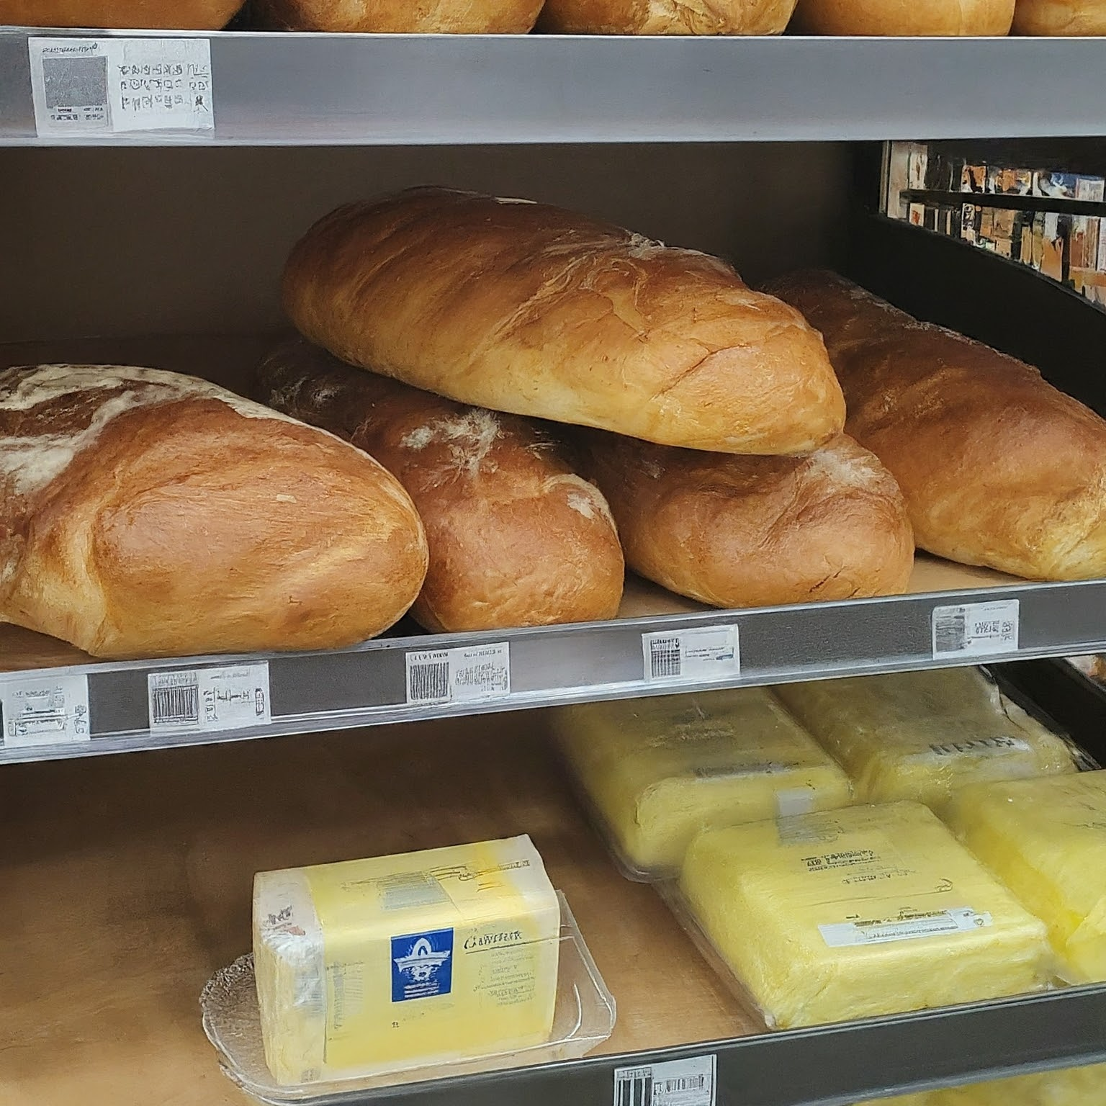
Antecedents and Consequents: The Building Blocks of Association Rules
Antecedent (A): This represents the item or condition that comes first in the association rule. It's the "trigger" or the starting point of the relationship. In the grocery store example (image), bread would be the antecedent.
Consequent (B): This represents the item that is likely to be purchased following the antecedent. It's the "outcome" or the result of the association.In the example, butter would be the consequent.
Understanding the Flow
Imagine a customer walks into a store. The antecedent represents the initial purchase decision (e.g., buying bread).
The association rule then suggests that if they buy the antecedent (bread), they are also likely to buy the consequent (butter).
By analyzing many transactions, we can identify frequent patterns of antecedents and consequents, revealing customer buying habits.

Slide 12
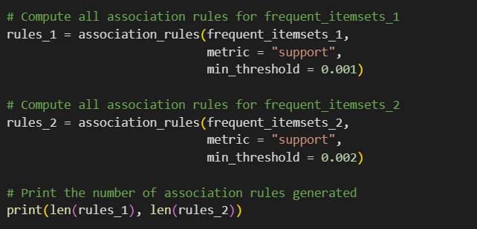
Association Rules
Computing rules from Apriori results.
Reducing number of association rules.
Generating association rules

Slide 13
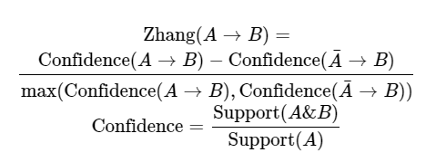
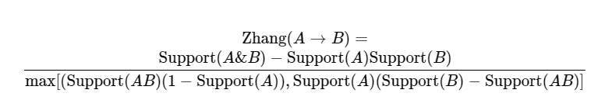
Zhang's rule
Introduced by Zhang(in 2000) Defining Zhang's metric
Takes values between −1−1 and +1+1
Focuses on both +ve and –ve association b/w items
Value of +1+1 indicates perfect association
Value of −1−1 indicates perfect dissociation
Comprehensive and interpretable
Constructed using support
Using only Support

Slide 14
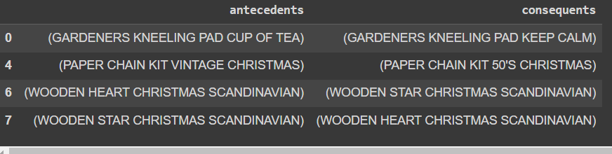
The result
Applying the Apriori algorithm with a minimum support threshold of 0.04
Recovering association rules using a minium support threshold of 0.01
Applying a 0.002 antecedent support threshold, 0.01 confidence threshold, and 2.50 lift threshold

