Slide 1
+
HOSPITAL MANAGEMENT SYSTEM
City Care Hospital
An appointment, collision-validation and billing platform built on Spring Boot and Angular
Team
Mustafa — Tech Lead / Architecture · Rahul, Sneha — Backend (Spring Boot, JPA, Security)
Aditya, Priya — Frontend (Angular 17) · Faiz — Quality Assurance
Sprint 1–3 · 01 Jun 2026 – 10 Jul 2026 · Final project walkthrough
Notes:
Introduce the team and the scope: a working HMS covering public browsing, patient self-service, appointment booking with collision prevention, card payment with receipts, and an admin console. Three two-week sprints, 40 tasks, 338 estimated hours.

Slide 2
PROBLEM STATEMENT / CASE STUDY
The front desk is the bottleneck
City Care runs a 60-bed multi-speciality OPD in South Mumbai. Appointments are taken over the phone and written into a paper register at the front desk.
1
Double bookings
2
Room clashes
3
No status visibility
Two receptionists on two phones book the same consultant into the same 11:00 slot. The clash surfaces only when both patients arrive.
Consultation rooms are assigned from memory, so a procedure and a consultation land in the same room.
Patients phone back repeatedly to ask whether their request was confirmed. Nothing is written down for them.
4
Cash-only billing
5
No refund trail
6
No usable records
Fees are collected at the counter with a handwritten slip. Reconciliation at month end takes two days.
Cancellations are settled informally, with nothing recorded against the appointment.
Finding a patient's history means paging through the register by date.
Case study source: front-desk observation over one week — 11 double bookings, 4 room clashes, 27 status call-backs.
City Care Hospital Management System
2
Notes:
Anchor the project in the observed problem, not in technology. Every objective on the next slide traces back to one of these six pain points.

Slide 3
OBJECTIVES
What the system had to achieve
1
Prevent every double booking
2
Prevent room conflicts
Reject any request that overlaps an existing PENDING or APPROVED appointment for the same doctor — enforced in the service layer and again by a database constraint.
Apply the same overlap rule to rooms, and re-check it when the front desk reassigns a room at approval time.
3
Give patients live status
4
Take payment and issue a receipt
PENDING / APPROVED / REJECTED visible on the patient's own dashboard, with the admin's remarks attached.
Card capture with a printable receipt; store only the last four digits, the holder name and a transaction reference.
5
Automate the refund trail
6
Give the desk one console
Cancelling a paid appointment initiates the refund and writes the explanation into the remarks automatically.
Approve/reject queue plus CRUD, search and bulk actions for doctors, departments, rooms, patients and appointments.
City Care Hospital Management System
3
Notes:
Six objectives, each traceable to a pain point. The first two are the acceptance criteria the whole build was judged on.

Slide 4
ARCHITECTURE DIAGRAM
Three tiers, one contract
Presentation — Angular 17
Application — Spring Boot 3.3
Data — PostgreSQL / MySQL
Standalone components, signals
Route guards (auth / admin)
HTTP token interceptor
Popup service for every outcome
Native CSS theme, no framework
Print stylesheet for receipts
REST controllers + DTO records
AppointmentService (collision)
PaymentService abstraction
Spring Security + JWT filter
Hibernate Validator on every DTO
@RestControllerAdvice handler
Spring Data JPA repositories
7 tables, FK-constrained
Overlap indexes on appointments
EXCLUDE USING gist guards
CHECK constraints on formats
Seeder for first-run data
JSON over HTTPS · Bearer JWT
JPA / Hibernate · transactional
City Care Hospital Management System
4
Notes:
Stateless API — no server session. The browser holds the JWT; every request re-authenticates through the filter. The database is the last line of defence for overlap, not the only one.

Slide 5
TOOLS AND VERSIONS
Tech stack
Backend
Java 17 · Spring Boot 3.3.4 · Spring Data JPA · Spring Security · Hibernate Validator · jjwt 0.12 · Lombok · Maven
Frontend
Angular 17.3 standalone components · TypeScript 5.4 · RxJS 7.8 · signals · plain HTML forms and tables · hand-written CSS (no Bootstrap, Tailwind or Material)
Database
PostgreSQL 15 primary (btree_gist EXCLUDE constraints) · MySQL 8 supported · schema.sql plus JPA ddl-auto
Security
BCrypt-capable encoder behind a config flag · stateless JWT · role-based URL rules · CORS locked to the SPA origin
Tooling & QA
Git · Maven wrapper · npm · Postman collection · manual regression pack · LibreOffice for receipt print checks
City Care Hospital Management System
5
Notes:
The no-CSS-framework constraint was a client requirement, not an oversight — the theme is one 415-line stylesheet driven by CSS custom properties.

Slide 6
WHAT THE SYSTEM DOES
Key features
Public browsing
Patient self-service
Collision validation
Slot picker
Doctors, specialities, experience and departments visible without logging in; search and department filter.
Register, edit profile, book, cancel, pay and print receipts from one dashboard.
Doctor and room overlap rejected with 409 at booking and again at approval.
Slots generated from each doctor's hours and slot length; booked and past slots marked.
Approval workflow
Card payment + receipt
Admin console
Ward status
Front-desk queue with inline approve / reject; rejection remarks are mandatory.
Luhn-checked capture, masked number, printable receipt, automatic refund on cancellation.
CRUD, search by ID / date / speciality, multi-select bulk delete across six tabs.
Patients marked admitted or discharged, with auto-discharge once the last visit ends.
City Care Hospital Management System
6
Notes:
Eight features, but the two that define the project are collision validation and the payment/refund trail — everything else is standard CRUD.

Slide 7
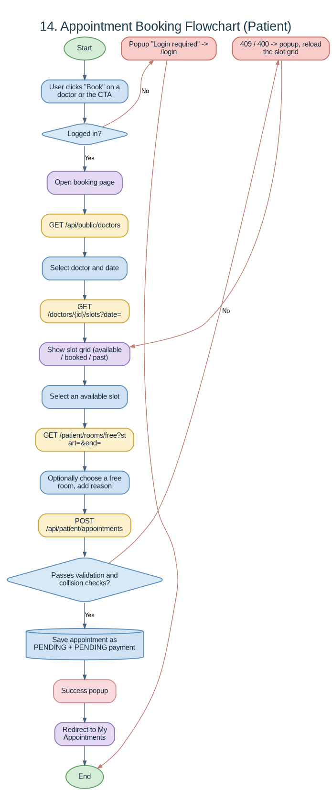
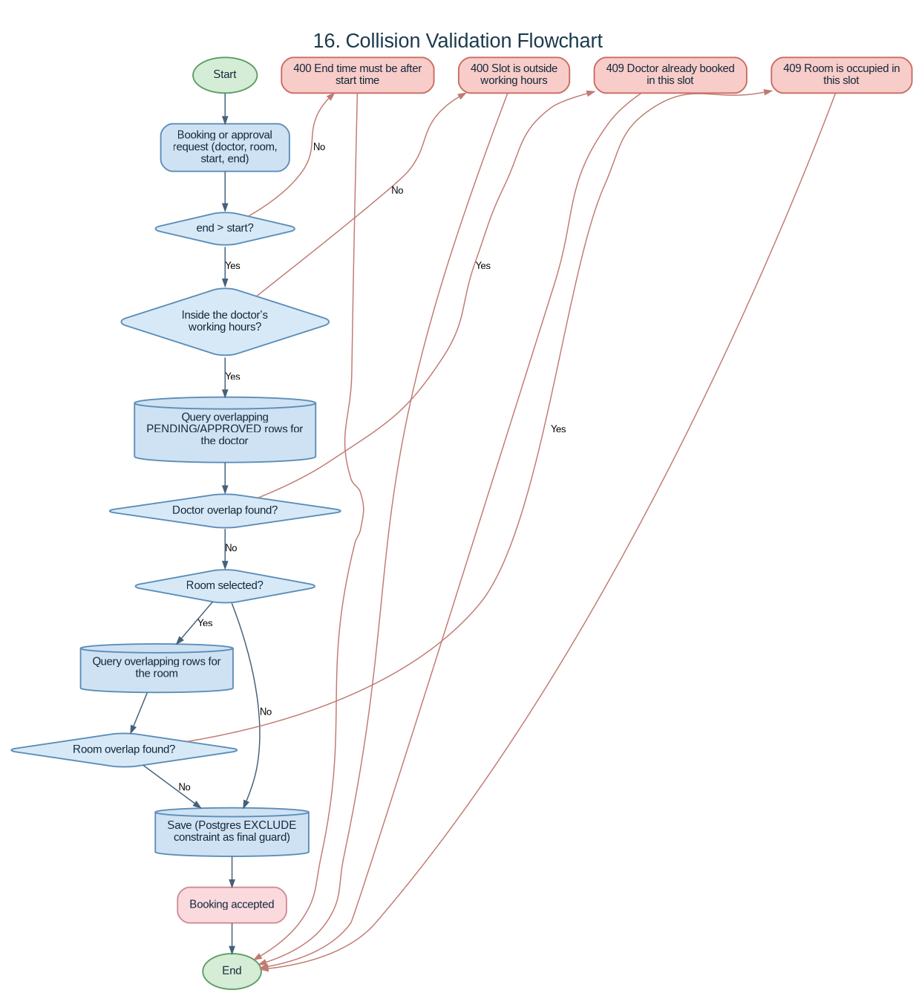
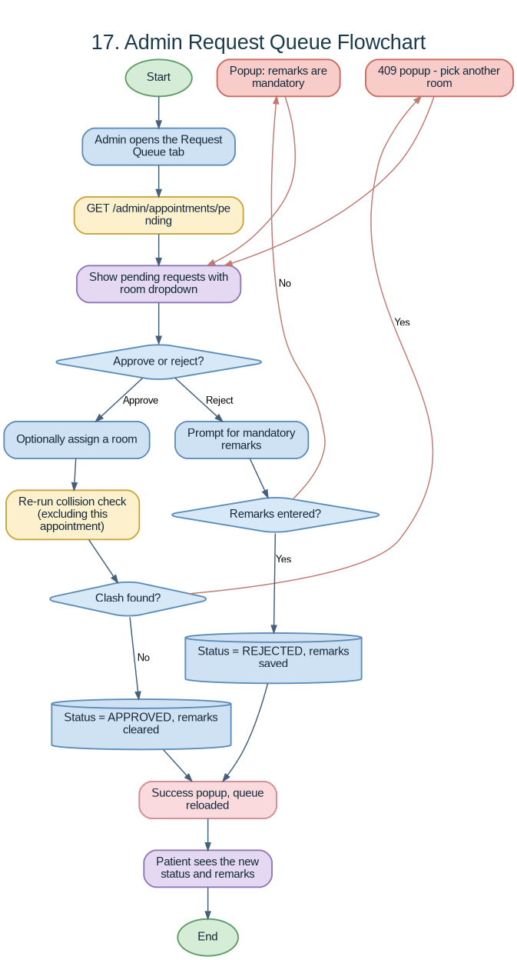
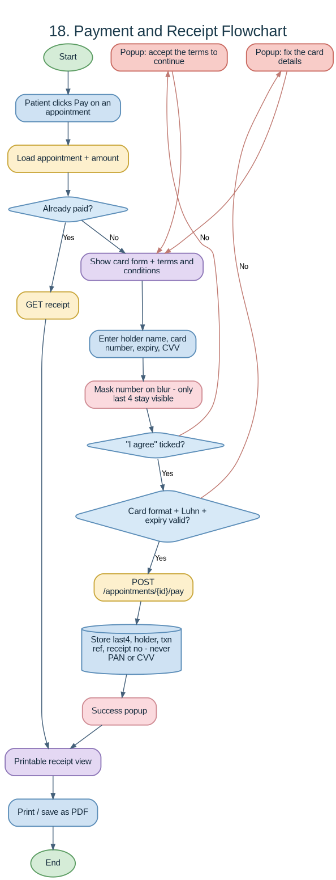
PROCESS WALKTHROUGH
Module flow — booking to receipt
Booking
Collision check
Approval queue
Payment & receipt
Notes:
Full-size versions of these and eleven more flowcharts ship in artifacts/flowcharts and in the flowchart pack PDF.

Slide 8
THREE TWO-WEEK SPRINTS
Sprint summary
Sprint 1 — Foundation & authentication
12 tasks · 100 h est · 103 h actual
Schema, JPA entities, JWT security, registration, public browsing, seed data.
Sprint 2 — Booking, collision & payment
13 tasks · 114 h est · 121 h actual
Slot generation, collision service, booking flow, card payment, receipt, refund.
Sprint 3 — Admin console, search & UI
15 tasks · 124 h est · 127 h actual
Approval queue, CRUD, search, bulk delete, ward status, CSS theme, artefacts.
40 tasks · 338 h estimated · 351 h actual · +3.8% variance · all tasks Done
City Care Hospital Management System
8
Notes:
Estimates held within 4%. The over-run sits mostly in Sprint 2, where the collision concurrency test took longer than planned.

Slide 9
SPRINT PROGRESS
Burndown — ideal vs actual
Reading the chart
Grey dashed = ideal burn at 12.4 h/day. Solid blue = effort actually closed, taken from the daily stand-up.
Day 1–2 lag
Admin CRUD scaffolding produced nothing closable until day 3, so the line starts above ideal.
Recovery
Reused form and table patterns let days 7–10 close 60 h and finish the sprint on zero.
City Care Hospital Management System
9
Notes:
Data source: SprintBacklog.xlsx, extracted into BurnDownChart.xlsx. Sprint 1 and 2 charts are in the same workbook.

Slide 10
NFR IMPLEMENTATION
Non-functional requirements
NFR-01
Security
NFR-02
Data integrity
Stateless JWT, role-based URL rules, CORS pinned to the SPA origin, card PAN and CVV never persisted.
FK constraints, CHECK constraints on mobile and card format, EXCLUDE USING gist against overlapping appointments.
NFR-03
Usability
NFR-04
Portability
Every action ends in a success or error popup carrying the exact rule that failed; mandatory fields marked.
No CSS framework, no web fonts, no build-time asset pipeline; one stylesheet with CSS custom properties.
NFR-05
Accessibility
NFR-06
Printability
Visible focus rings, labelled inputs, aria-labels on checkbox columns, prefers-reduced-motion respected.
Dedicated print stylesheet — header, nav, footer and dialogs hidden so only the receipt prints.
NFR-07
Responsiveness
NFR-08
Maintainability
Single-column layout and horizontally scrollable tables below 760 px.
Validation rules declared once per side and shared (ValidationPatterns.java, validators.ts).
City Care Hospital Management System
10
Notes:
NFR-01 carries a known exception: password hashing sits behind a config flag and is currently set to plain text at the client's request. It is listed on the challenges slide.

Slide 11
TEST SUMMARY
Quality and defects
148
38
36
94.7%
test cases executed
defects raised
defects closed
closure rate
By type — representative defects
Functional
18
Slot boundary off-by-one; approval ignored reassigned room
UI
11
Navbar crowding at 768 px; receipt font changed on tap
Security
5
Patient could request another patient's receipt
Performance
4
Patient list re-queried appointments per row
2 open defects, both Low: navbar wrap at 320 px and a receipt print margin in Firefox.
City Care Hospital Management System
11
Notes:
The security defect is worth calling out in the demo: receipts were readable by ID until the endpoint started checking ownership.

Slide 12
RETROSPECTIVE
Challenges and learning
Concurrent bookings slipped past the service check
1
Two simultaneous requests both passed the overlap query before either committed. Learning: a service-layer check is necessary but not sufficient — the EXCLUDE constraint in PostgreSQL is what actually makes it safe.
Plain-text password storage was requested
2
The client asked for readable passwords. Learning: implement it behind a config flag rather than deleting the hashing path, and document the risk in the README so the decision stays visible and reversible.
Mobile browsers restyled the receipt
3
Tapping a phone number changed its font because iOS auto-linked it. Learning: format-detection meta plus explicit font inheritance; test print artefacts on a real handset.
No CSS framework, by requirement
4
Building tables, tabs, dialogs and print styles by hand. Learning: CSS custom properties gave one-line retheming, and the stylesheet stayed at ~400 lines.
Validation drifted between layers
5
Client and server disagreed on the mobile rule. Learning: declare each rule once per side, side by side, and review them as a pair.
City Care Hospital Management System
12
Notes:
Lead with the concurrency finding — it is the most transferable lesson in the project.

Slide 13
CONCLUSION & DEMO SNAPSHOTS
Demo walkthrough
screenshot
screenshot
screenshot
screenshot
1
Browse & book
2
Collision proof
3
Approve & assign
4
Pay & print
Landing page → filter by department → Book → slot picker → request submitted as PENDING.
Try the same doctor and slot from a second account → 409 with a plain-English message.
Admin queue → assign room C-102 → Approve → patient's dashboard flips to APPROVED.
Pay → masked card → accept terms → receipt with last four digits → print preview.
Replace the dashed frames with live screenshots captured during the demo run (admin@hms.local / Admin@123 for the console).
Where the project stands
All 17 user stories delivered and accepted across three sprints. Two low-severity defects remain open. Next: doctor self-service portal, email and SMS notifications, and a real payment gateway behind the existing PaymentService interface.
City Care Hospital Management System
13
Notes:
Close on the two open defects and the roadmap — it shows the team knows what is unfinished.

Slide 14
Thank you
Questions and live demo
Repository: hospital-management-system.zip · Artefacts: sprint backlog, burndown, user manual, 25-chart flowchart pack
Notes:
Hand over the artefact folder and offer to walk through any flowchart on request.

