Slide 1
Unit-1 Introduction (Lecture-1)
Hema Kashyap

Slide 2
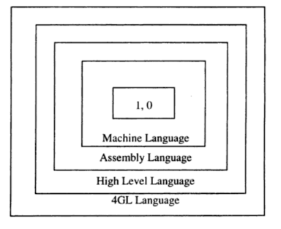
Introduction to Programming Language
Any notation for the description of algorithm and data structures may be termed a Programming Language
Different Levels of Programming Languages
Machine Language
Assembly Language
High Level Language
4GL Language

Slide 3
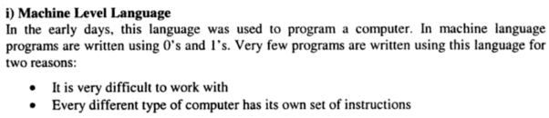
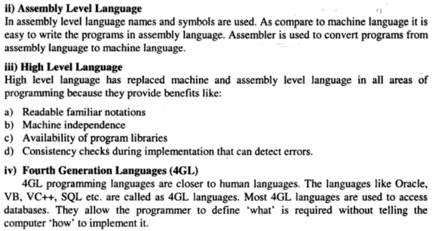

Slide 4
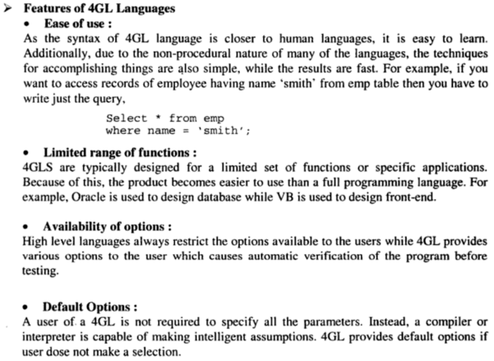

Slide 5
Language Development
Numerically based languages
Computing mathematical expressions
FORTRAN, Algol, Pascal, PL/1, BASIC, C, C++
Business languages
COBOL (Common Business Oriented Language) English-like notation
Artificial intelligence languages
Tree search; Rule-based paradigm
LISP (LISt Processing)
PROLOG (PROgramming in LOGic)
System languages
C, C++
Script languages: AWK, Perl, TCL/TK
Web programming:
HTML, XML, Java,
Microsoft *.NET family

Slide 6
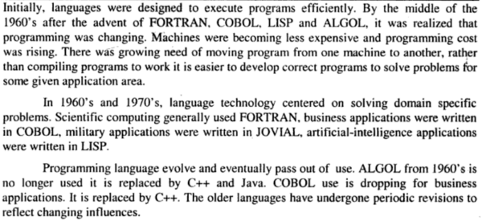
Role of Programming Language

Slide 7
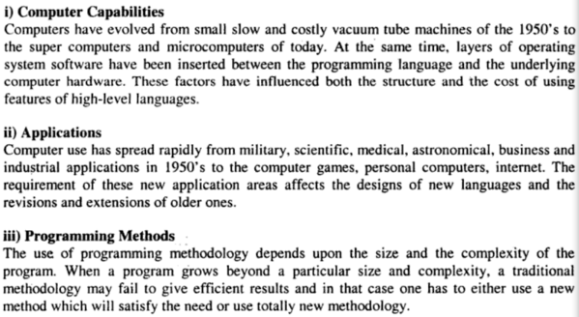
Influences on Evolution of Language Designs

Slide 8
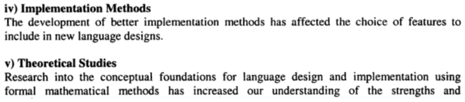
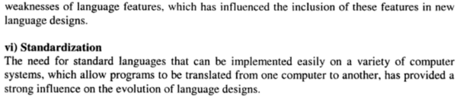

Slide 9
Language design must:
Allow program solution to match problem structure
Allow for world-wide use
Be easy to prove correctness of solutions

