Slide 1
summary
TBD

Slide 2
Introduction
Data science and Marketing are two of the key driving forces that help companies create value and stay on top in today’s fast-paced economy.
This study identifies the business value of consumer reviews and management responses to hotel performance. The results show that overall rating, attribute ratings of purchase value, location and cleanliness, variation and volume of consumer reviews, and the number of management responses are significantly associated with hotel performance. In addition, variation and volume of consumer reviews moderate the relationship between overall rating and hotel performance.
word-of-mouth (eWOM)
According to findings from a joint research by PowerReviews and the E-tailing Group, about 22% of respondents said that they “always” read consumer reviews before making a purchase, 43% of respondents said that they check consumer ratings and reviews “most of the time”, and about 68% read “at least four reviews” before making a purchase

Slide 3
Introduction (draft-2)
Management responses that can address service-related issues and recover the service failure will likely increase the consumer's likelihood of recommending the hotel (Barsky and Frame, 2009).

Slide 4
Project Planning and Management
“Decide what you want and then act as if you already had it” Jim Rohn
Managing the backlogs
Using kanban to create and track progress
Complete documentation on Word (TBD)

Slide 5
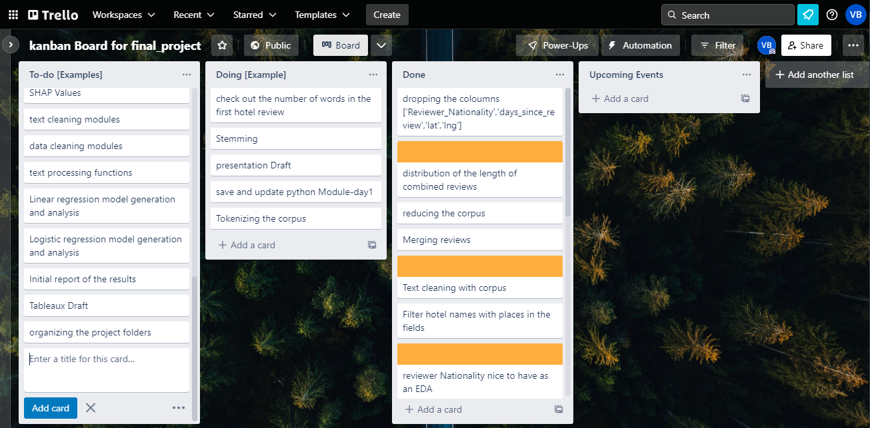
Project Planning and Management

Slide 6
Data cleaning

Slide 7
Data exploration

Slide 8
Word cleaning and processing

Slide 9
Creating models
We use a linear regression model to examine the relationships among consumer reviews, management responses, and hotel performance. The dependent variable is RevPAR, which has been used in the hospitality industry as a measure of hotel performance because it captures the supply-and-demand dynamics in one index (Ismail et al., 2002). The independent variables include consumer review factors, namely, overall rating, attribute ratings, review variation, review volume as well as the number of

Slide 10
Quantitative Analysis

Slide 11
Quantitative Analysis - conclusion
The effectiveness of certain Models
How successfully were able to predict the rating based on they key words
How successfully were able to classify the rating based on they key words
purchase probability elasticity, brand choice own price elasticity, brand choice cross-price elasticity, and purchase quantity elasticity

Slide 12
Qualitative Analysis

Slide 13
Qualitative Analysis -Conclusion
Based on certain data points and conclusions from Quantitative analysis, we can improve certain services or products for the customers to get reviews

Slide 14
Next steps
Predicting the purchase behaviour using deep learning
Perform K-means clustering with a customer analytics focus;
Combine PCA and K-means for even more professional customer segmentation;
Be able to optimize your neural networks to enhance results
Use email automation once guests checkout
Encourage feedback with chatbots once checking in and checking out
Train staff to go above and beyond for guests

Slide 15
Sources:
https://www.sciencedirect.com/science/article/abs/pii/S027843191400125X

