Slide 1
summary
TBD

Slide 2
Introduction
Data science and Marketing are two of the key driving forces that help companies create value and stay on top in today’s fast-paced economy.

Slide 3
Project Planning and Management
“Decide what you want and then act as if you already had it” Jim Rohn
Managing the backlogs
Using kanban to create and track progress
Complete documentation on Word (TBD)

Slide 4
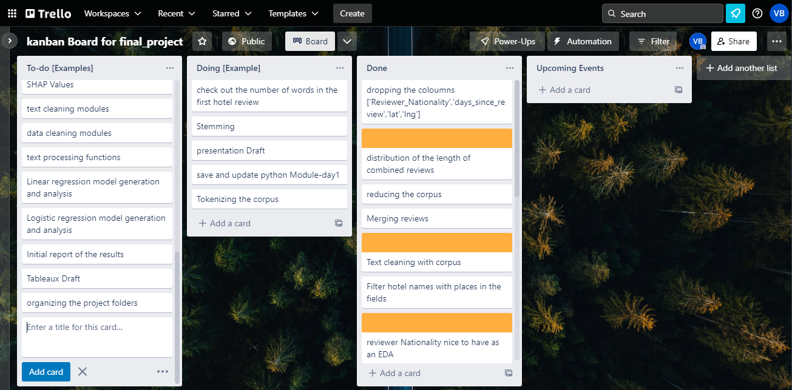
Project Planning and Management

Slide 5
Data cleaning

Slide 6
Data exploration

Slide 7
Word cleaning and processing

Slide 8
Creating models

Slide 9
Quantitative Analysis

Slide 10
Quantitative Analysis - conclusion
The effectiveness of certain Models
How successfully were able to predict the rating based on they key words
How successfully were able to classify the rating based on they key words
purchase probability elasticity, brand choice own price elasticity, brand choice cross-price elasticity, and purchase quantity elasticity

Slide 11
Qualitative Analysis

Slide 12
Qualitative Analysis -Conclusion
Based on certain data points and conclusions from Quantitative analysis, we can improve certain services or products for the customers to get reviews

Slide 13
Next steps
Predicting the purchase behaviour using deep learning
Perform K-means clustering with a customer analytics focus;
Combine PCA and K-means for even more professional customer segmentation;
Be able to optimize your neural networks to enhance results

