Slide 1
Business Objective: To Generate a Model that predicts the body fat percentage of an athlete
Presented by,
Mr Vipul Ballupet Swamy

Slide 2
Project Goals
Key Business metrics
Gather the relevant datasets
Cleaning the data
Exploring the data(i)
Exploring the data(ii) - feature Engineering
Conclusion and Pending tasks to achieve our big Goal in final project

Slide 3
1. Key Business metrics
A Northstar metric* - Body fat percentage
Determines:
1.heart health
2.potential health risks
3.physical fitness abilities
A Northstar metric is a single most important parameter that determines the overall performance of the Business

Slide 4
2. Gathering the data set
Scouting for the data set to meet the business objective
The dataset is constructed using the circumferential data
The dataset is accounting more than 200 athletes in the age group of 22-81 years
Predict the body fat percentage from the input independent variables

Slide 5
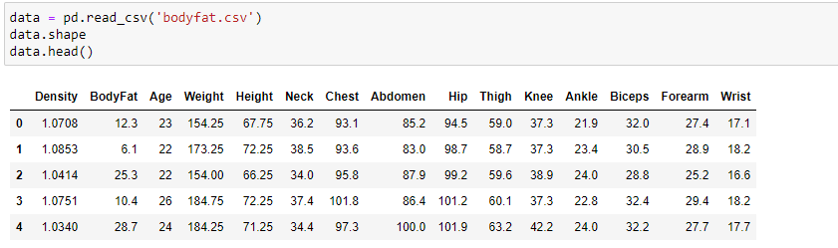

Slide 6
3. Cleaning the data
Renaming the title with lowercase
Converting from imperial system to metric system (from pounds, metres → kg, cm)
Finding out the discrete and continuous values
Finding out the percentage of null and missing values

Slide 7
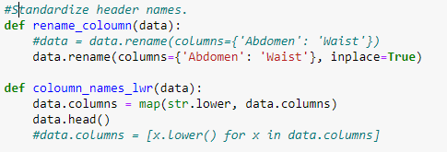



Slide 8
4. Exploring the data(i)
Checking for multicollinearity
Plotting the scatter plots between the required features and Target label

Slide 9
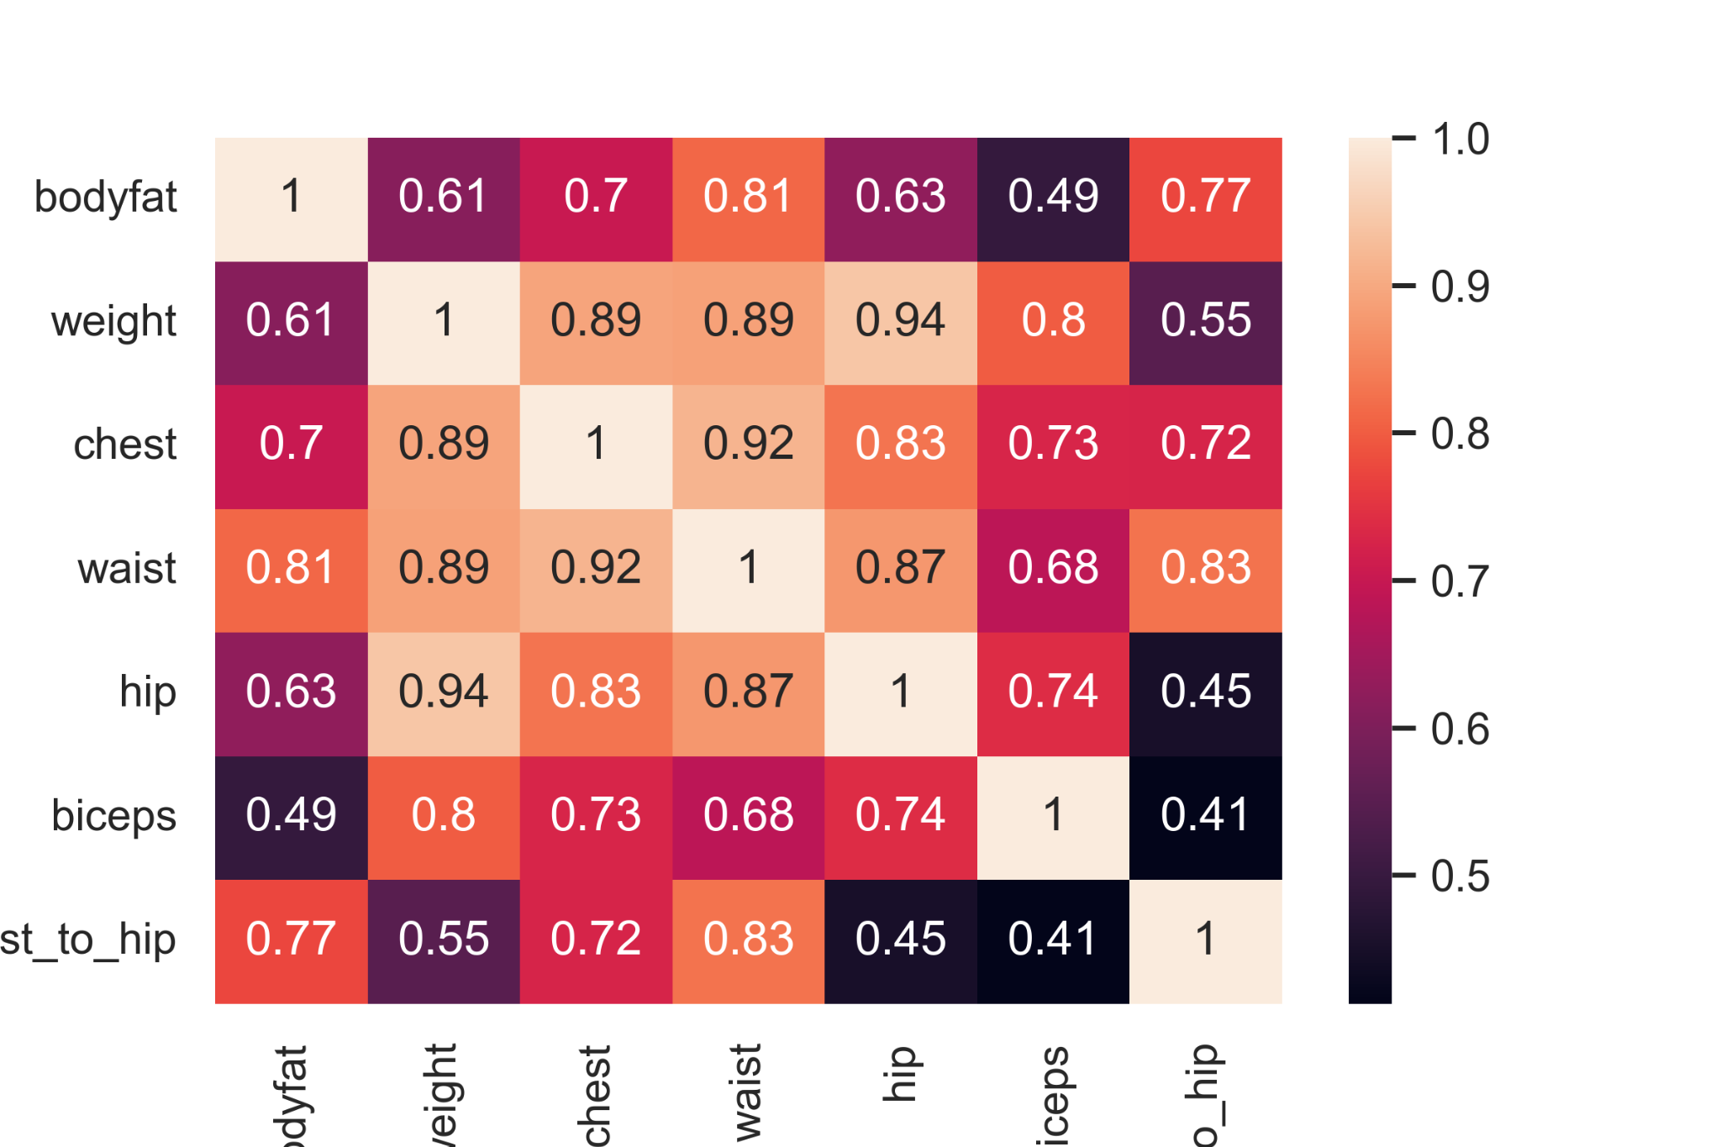
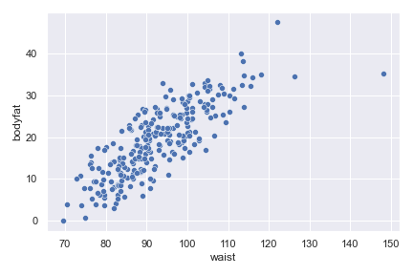

Slide 10
5. Exploring the data(ii)
Waist(abdomen) circumference has high correlation to the body fat %
WHR -waist to Hip ratio is a major contributor that determines an athlete’s overall health[1], heart health[2], weight related health risks[3] and body Physique[4]
Both possibilities (waist and WHR) are explored to check the scatter
Feature engineering

Slide 11
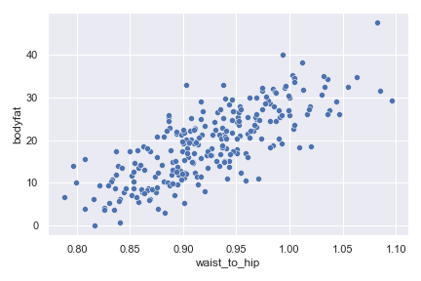


Slide 12
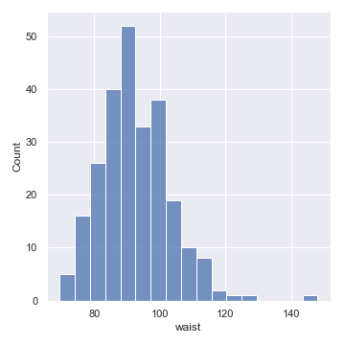
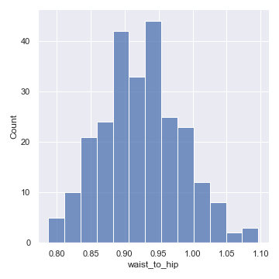
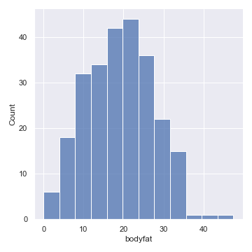
Distribution of these data with WHR values
I need more data sets in order to perform transformation on the fit models..

Slide 13
6. Conclusion and Next steps
Waist , and waist to Hip ratio are the major contributors to Athletic fitness, over all performance and cardiovascular health
With more and improved data sets we will be able to successfully predict the body fat percentage
Interview physical fitness trainers for more insights → steps/day?sleep cycles?
Train and export Unsupervised training model
Inform the athletes about potential Health issues based on their Body fat %

Slide 14
References
[1] https://www.medicalnewstoday.com/articles/319439#how-to-improve-waist-to-hip-ratio
[2] https://www.medicalnewstoday.com/articles/237191
[3] https://www.medicalnewstoday.com/articles/323446
[4] https://www.brianmac.co.uk/whrt.htm

