Slide 1

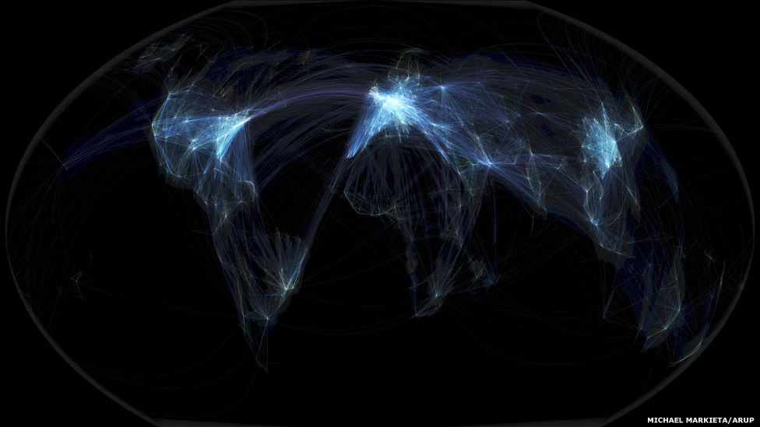
Airline Routing Tool for the Network Data Planners
Presented by,
Vipul Ballupet Swamy
Consultant for ZeroG

Slide 2
Contents
1. Introduction
Project Objective
North Star Tool Concept
Project Constraints
2. Budget Breakdown
3. Project Plan
Asana-based Milestone Matrix
RACI Phase 1
Project Phases
4. Risk Management & Mitigation Measures
5. Conclusion and Next Steps

Slide 3
Project Objectives
Client Pain Points
Use multiple spreadsheets for network planning
Takes days to understand the commercial impact
Effective and intuitive Tool
Establish transparency on available data, easily integrate new data source
Take well-informed decisions on adding / cancelling flights
Optimize overall commercial performance through a unified, centralized and data-driven team approach
Business KPIs
Revenue per Mile (RPM)
Available Seat Mile (ASM)
Gross profit margin = (Bookings per route - Operation cost per route) / Bookings per Route

Slide 4
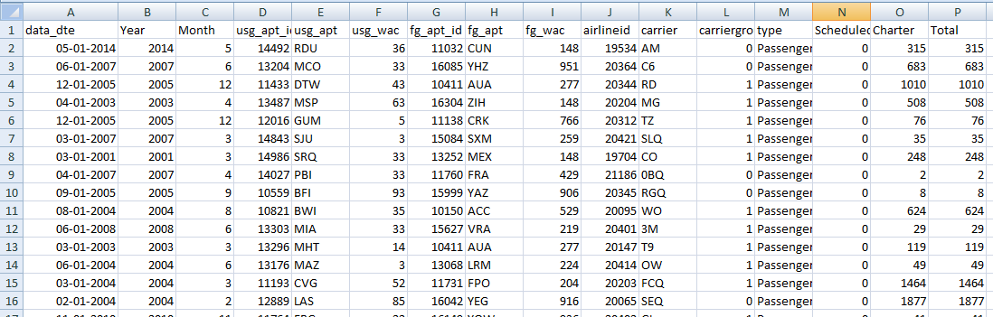
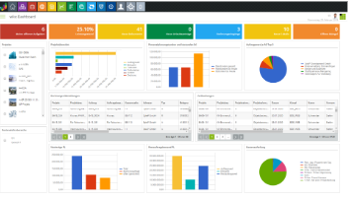
North Star Tool Concept
“We aim to Design or Equip the client with the Tool to Improve their Financial Performance (Revenue) to Thrive in the Marketplace with effective Root Planning”
Visual Tool to calculate KPI’s like Gross Profit Margin, Load Factor
Fleet Data, Operational Cost Data, Airport Data,
Tax Data

Slide 5
Project constraints
Scope Summary | Available Data
Budget: $500K Timeline: 6 Months Framework : SCRUM Resources: Project Manager x1 Data Engineer x1 Data Scientist x2 Business Data Analyst x1 | Fleet data Operational cost data Airport data Tax data IATA data (new Source)
Milestones | Deliverables
Cloud Integration Beta Release Field Testing | Predictive ML based Forecasting Engine Beta version - IAAS Platform Pilot platform with an Intuitive visual - Dashboard

Slide 6
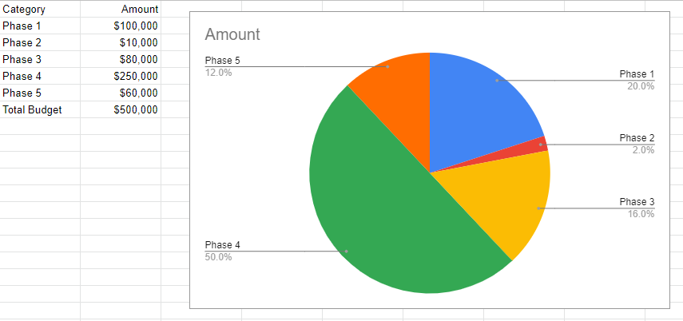
Budget Breakdown

Slide 7
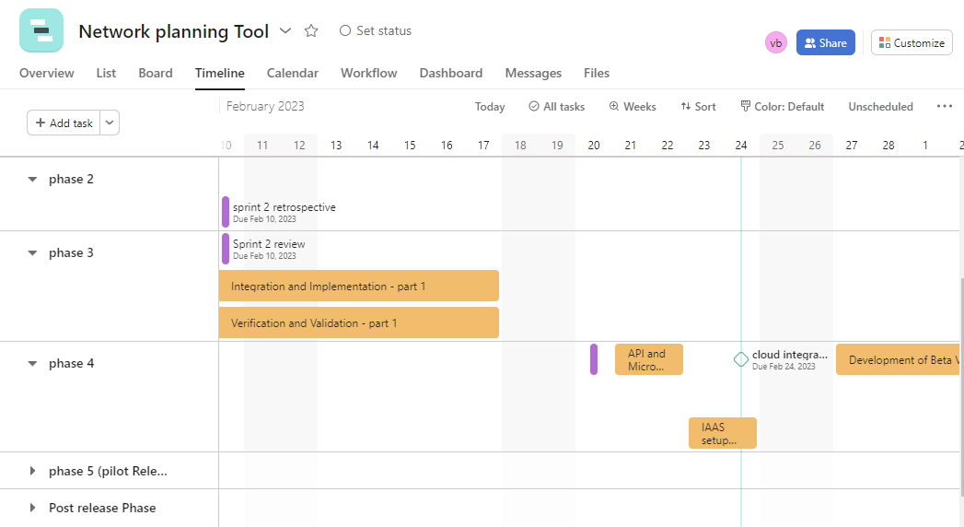
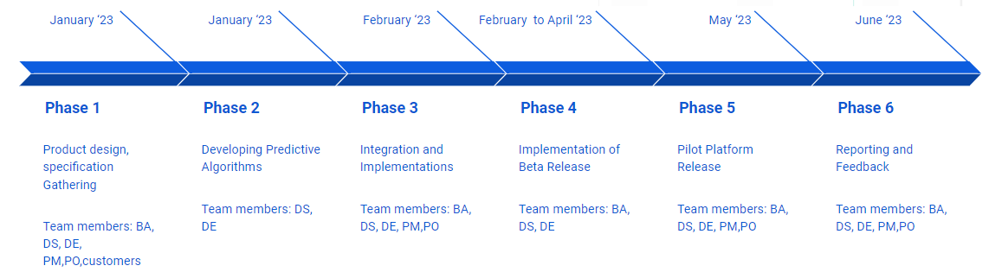
Project Plan: Asana-based Milestone Matrix
Project Duration : 6 Months
Start Date: 2. January 2023
End date: 9. June 2023 + Buffer 15 days
Total Sprints: 11sprints

Slide 8
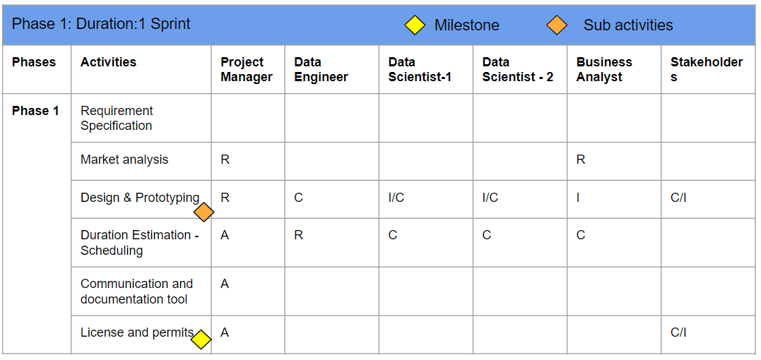
Responsibility, Accountability, Consulting, Informed - RACI

Slide 9


Project Phases
Phase 2
1 sprint
Data Analysis: Gathering, Cleaning
Phase 3
3 sprints
Data exploration, Model creation
Staging servers Integration
UX Visualization Development
Concept Validation
ML Based forecasting Engine Implementation
Validation and Verification
Artifacts:
Product Backlog
Sprint Backlog
Product Increment
Released product
Project Plan
Product Road Map
Meetings and Events:
Daily scrum meeting - 15 minutes
Sprint planning - 4 hr/sprint
Sprint review - 2 hr/sprint
Sprint Retrospective - 1.5 hr/sprint
Backlog Refinement - 2 hr/Sprint

Slide 10
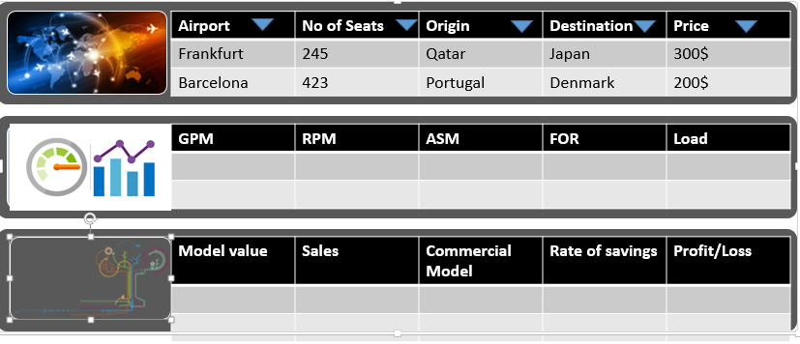
Project Phases
IaaS Setup on Cloud
API and Micro-services Integration
Implementation and Release of Beta version
Automated data preparation, blending, and analytics
Phase 4
1 sprint
Phase 5
2 sprints
Pilot platform release
Phase 6
2 sprints
Post Release Phase
Field testing
Project Closing
Documentation
Reporting
Feedback

Slide 11
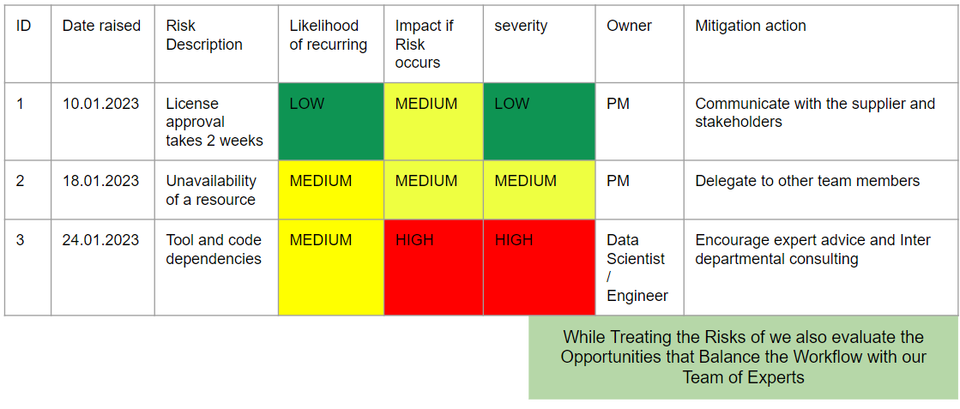
Risk Management & Mitigation Measures

Slide 12
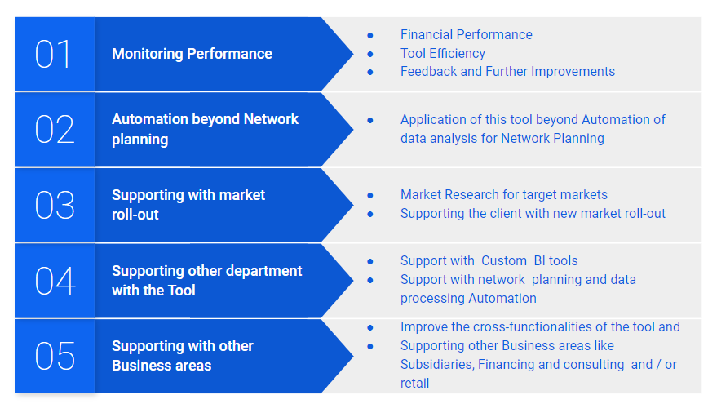
Conclusion and Next steps

Slide 13
Thank you

