Slide 1
BUSINESS STRATEGY FOR SWEET EUGENE’S
PERFORMED COFFEE INDUSTRY ANALYSIS
USING PORTER’S 5 FORCES ANALYSIS
CAPTURED CUSTOMER FEEDBACK THROUGH SURVEYS
APPLIED VRINE FRAMEWORK
FOR INTERNAL RESOURCES
PROVIDED PROJECT SUPPORT
PROVIDED RECOMMENDATIONS TO CLIENT
IDENTIFIED BUSINESS PROBLEMS ANALYSIS THROUGH CLIENT INTERVIEWS/MEETINGS
POTENTIAL LOCATIONS FOR EXPANSION
IMPROVEMENTS FOR OPERATIONAL EFFICIENCY
CUSTOMER OUTREACH THROUGH SMART MARKETING

Slide 2
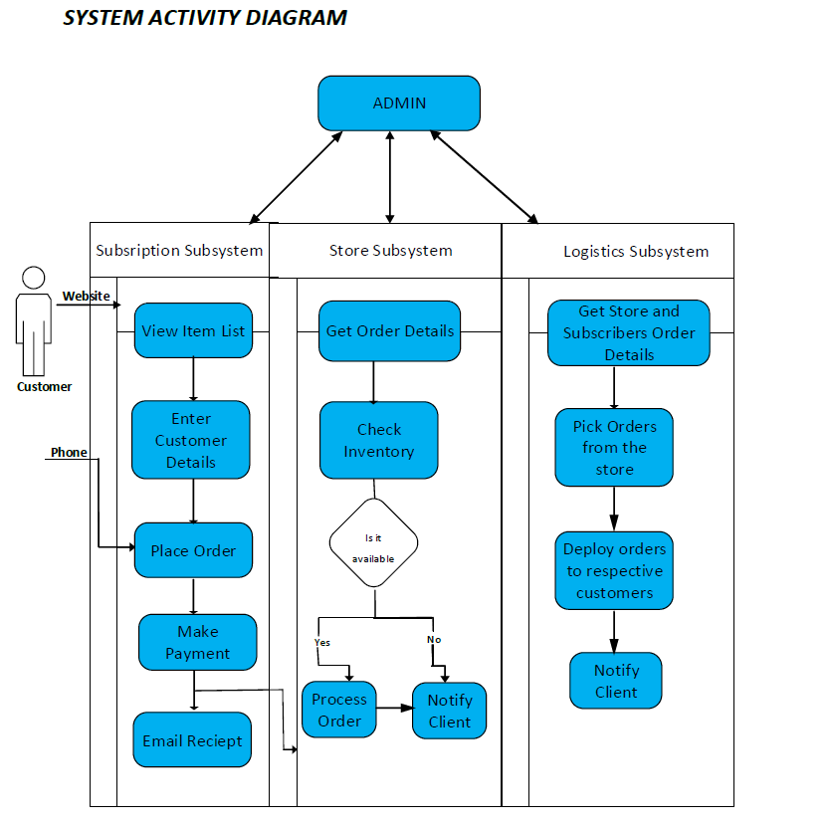
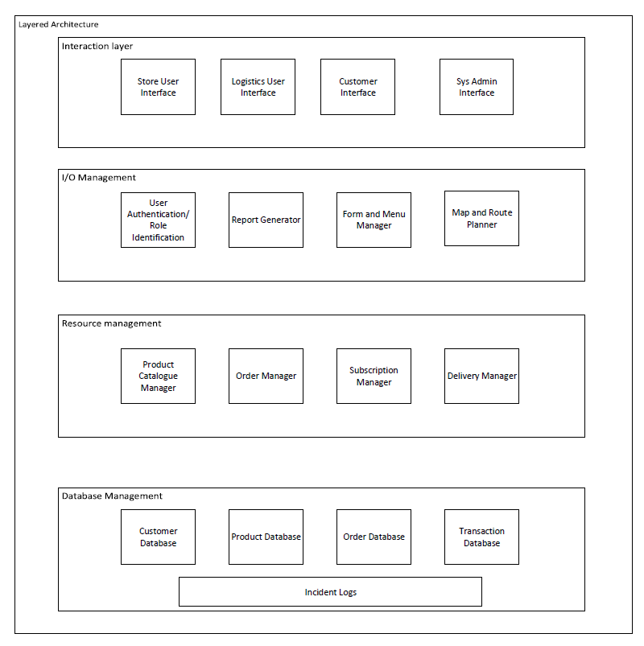
SYSTEM ANALYSIS AND DESIGN - A GLIMPSE OF THE SYSTEM
SYSTEM DIAGRAM
ARCHITECTURE DIAGRAM

Slide 3
PROJECT MANAGEMENT - ERP IMPLEMENTATION
TOPICS COVERED
PROJECT CHARTER
STAKEHOLDER ANALYSIS
WORK BREAKDOWN
STRUCTURE
QUALITY ASSESSMENT
PLAN
ORGANIZATION HEIRARCHY AND COMMUNICATION
PLAN
Project Purpose or Justification:
Mallya Breweries is currently in need of an ERP system to address pitfalls in current IT landscape. The current IT landscape consists of multiple IT systems of varying mediums for bookkeeping, recipe/brew logs, customer info, quantity info, and publicly-facing client-side information exchange. The information silos currently formed slow down management decisions and create process flow interruptions.
Project Description:
The ERP system proposed will eliminate information silos within the company and consolidate all information regarding current day-to-day activities into a pre-defined area easily accessible by upper management. Upper management will then be able to call individual ERP modules that return specific information related to functional areas of accounting, brewing status, and inventory levels.

Slide 4
BUSINESS INFORMATION SECURITY FOR AMC HOSPITAL – PERFORMED QUALITATIVE AND QUANTITATIVE RISK ANALYSIS
QUALITATIVE RISK ANALYSIS
PERFORMED CRITERIA SELECTION TO PRIORITIZE ASSETS
PERFOMED ASSET CLASSIFICATION
DID FAULT TREEE ANALYSIS AND CREATED RISK METRICS
IDENTIFIED POTENTIAL VULNERABILITIES AND THREATS
QUANTITATIVE RISK ANALYSIS
DID ASSET IDENTICIATION AND CALCULATED ASSET VALUE
IDENTIFIED COUNTER MEASURES AND COST OF COUNTER MEASURES
CALCULATED ALE BEFORE APPLYING COUNTER MEASURES
CALCULATED ALE AFTER APPLYING COUNTER MEASURES

Slide 5

STRATEGIC PLANNING MODELS - TECHNOLOGIES IMPACTING RETAIL INDUSTRY
Direct
-to-
Consumer
Mobile Applications
IDENTIFY TRENDING TECHNOLOGIES SHAPING RETAIL INDUSTRY
HIGHLIGHT BENEFITS TO BUSINESS THROUGH EACH TECHNOLOGY
Electronic Tracking and Product Mapping
Warehouse Technologies
ADDRESS IMPLEMENTATION CHALLENGES
SHORTLIST POTENTIAL VENDORS LIST
The Rise of e-retailing platforms
Retail Electronic Payment Systems
SHARE OVERALL SUMMARY AND FUTURE ROADMAP

Slide 6
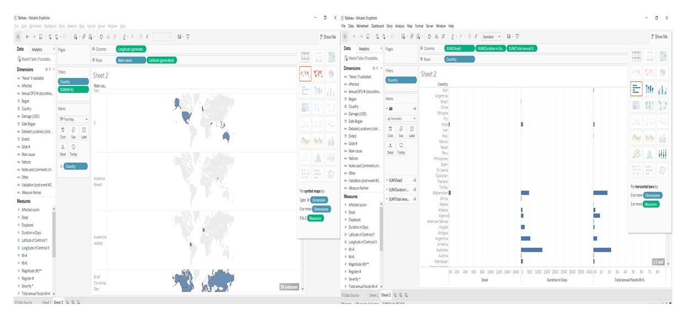
FLOOD DATA VISUALIZATION AND ANALYSIS USING TABLEAU

Slide 7
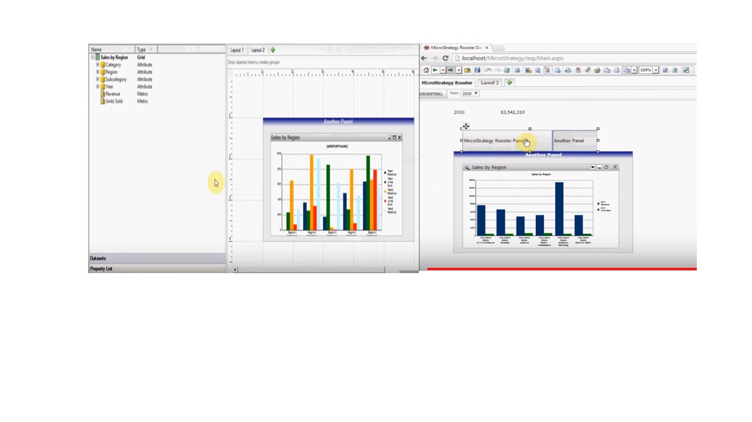
MICROSTRATEGY- Creating Layouts and Panels to Generate Dashboards

