Slide 1
CTP
ATC

Slide 2
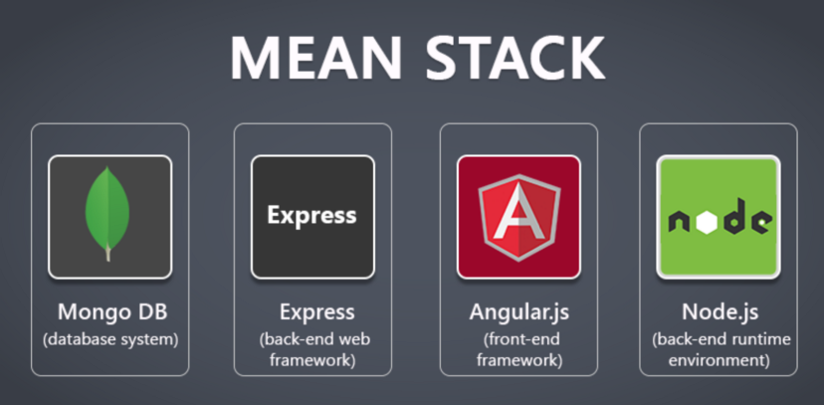
UI: Stack
Ref: https://medium.com/@sumit.rajgure123/build-your-first-web-application-using-mongodb-express-angular-and-nodejs-mean-f46f6606f13

Slide 3
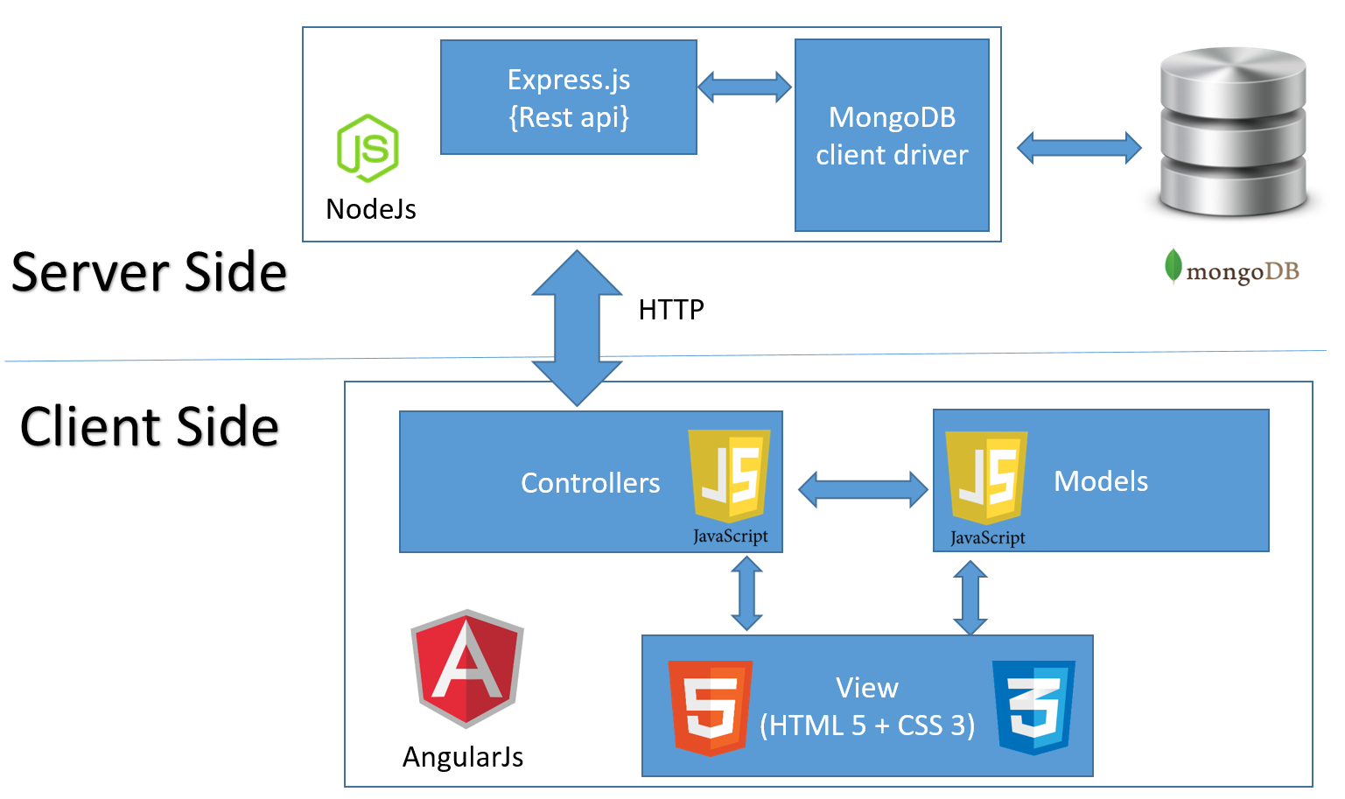
UI: High Level Architecture
Ref: http://oniwebblog.blogspot.com/2016/01/general-crud-application-using.html

Slide 4
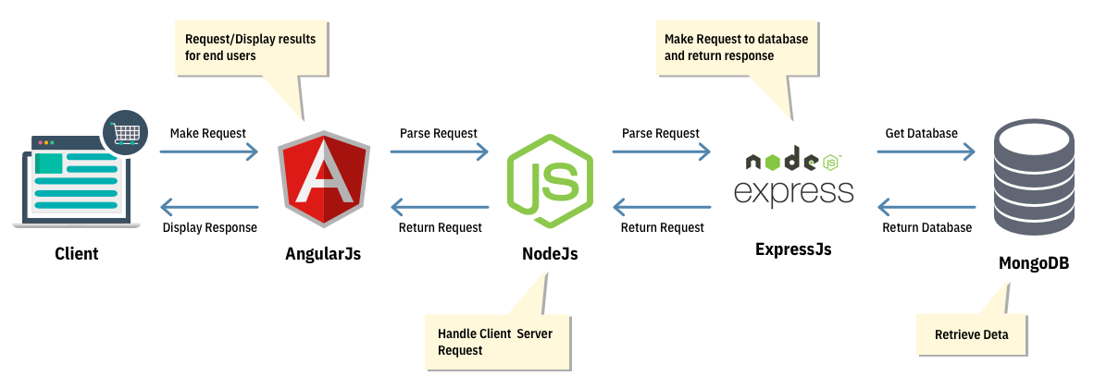
UI: data Flow
Ref: https://www.simform.com/blog/build-ecommerce-web-application-node-js/

Slide 5
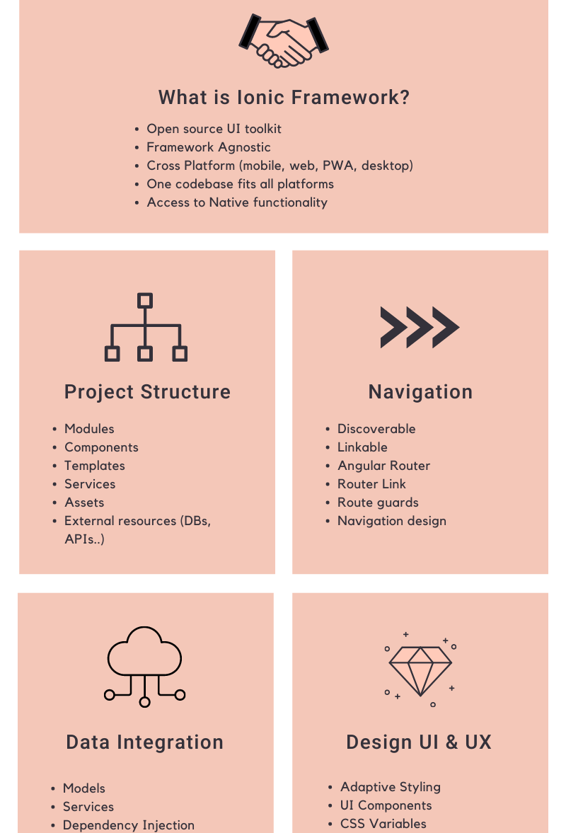
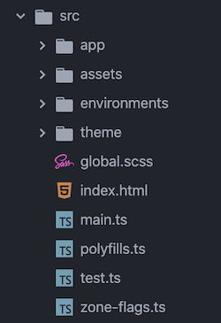
Progressive Web App: Ionic

Slide 6
UI: Bootstrap
Front-end
Back-end
Get to rest_apis (cd rest_apis)
Select the backend sub-project (cd <project-foldername>)
Run: nodemon start (or) node index.js
Clone the project using Git
Run: npm install; npm start
View at: http://localhost:4200/

Slide 7
Mirror
Data quality and Governance:
Validation
Traceability
Lineage

Slide 8
DQ: Advantages
Root Cause Analysis (RCA): Identifying the source of data errors
Impact Assessment (IA): Predict the impact of a change to the data system
Regulatory compliance + Data-driven decision-making
Data lineage map: Follows the flow of data assets - entry to exit
Data catalog: Tool for metadata management

Slide 9
DQ: ToolING
The DIAGNOSIS:
VALIDATION TOOLS
THE CURE:
RESOLUTION Tools
Validation based on Rules, Constraints, and Check routines
Check: type, range, code/cross-reference, structure, consistency
Pandera + Fugue on Spark/Databricks
Built-in validators for schema and values
Non-invasive to code – uses decorators
Great Expectations on Spark/Databricks
Context, Source, Profiling, Expectations, and Quality
DB Unity catalog – Data lineage
DB Autoloader
Infer and evolve schema automatically
DB Delta Live Tables
Built-in quality controls
Data quality monitoring
Automatic error handling

Slide 10
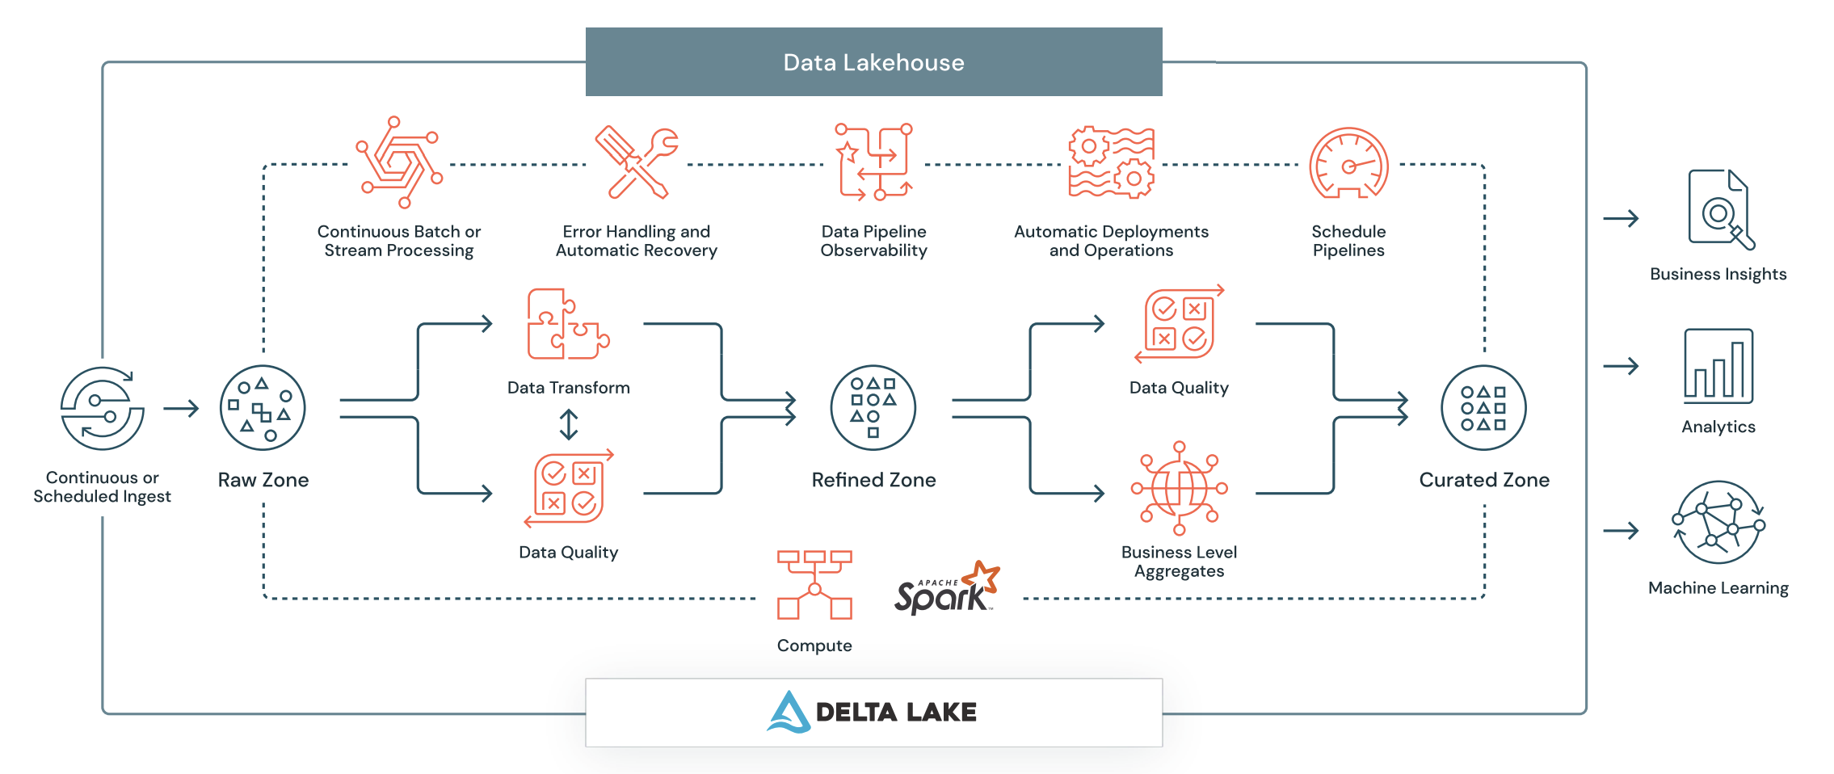
DQ: The Flow
Screen Shot 2022-10-06 at 3.00.12 AM.png

Slide 11
IB: REferences
IB Insync
https://github.com/erdewit/ib_insync
https://algotrading101.com/learn/ib_insync-interactive-brokers-api-guide/

Slide 12
DQ: References 2
DataBricks: DLTs, AutoLoader, and Expectations
https://www.databricks.com/blog/2021/09/08/5-steps-to-implementing-intelligent-data-pipelines-with-delta-live-tables.html
https://hevodata.com/learn/databricks-autoloader/

