Slide 1

Flight Prices Classification:
An Approach Using Random Forest, Decision Trees, and SVM
Team Name: Data Mining Developers
Vivek Ponnala, Maggie Qin, Hoai An Nguyen
CMPE 255 – Fall 2024

Slide 2
Introduction
Objective: Classify flight prices into three ranges (low, medium, high).
Motivation: To help travelers make informed booking decisions by understanding factors influencing flight prices.
Overview: Applying three different classification models on flight data for price categorization.

Slide 3
Dataset Overview
Source: Kaggle flight prices dataset (Expedia, April–October 2022).
Subset: Flights from SFO in May 2022 (~250,000 records).
Features: search date, destination, non-stop status, remaining seats, and travel distance.

Slide 4
Literature Review
Research and Techniques: Studies using Random Forest, SVMs, and Neural Networks for pricing and classification tasks.
Justification: Decision Tree, Random Forest, and X chosen for its interpretability and robustness with structured data.

Slide 5
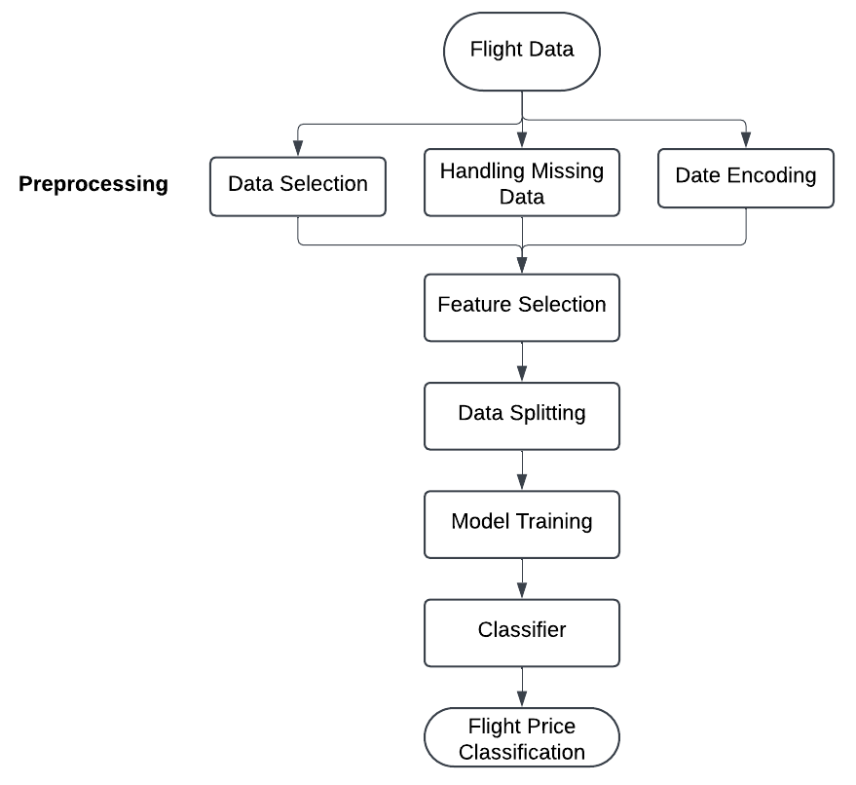
System Architecture
Data Pipeline Overview: Flowchart illustrating data loading, preprocessing, training, evaluation, and prediction phases.
Link to the chart: https://lucid.app/lucidchart/d42f76b8-181d-4aba-82cc-961d9210cbe3/edit?view_items=cgsqposmEN_K%2Cogsqnaz~Gupz%2C_lsqkk_tTvWs%2Cmmsq-xj5_1F8%2C5msqFYQqlyFn%2CSnsqiLxLoKj_%2CUnsq5sv3jzqS%2C6osq_6wIIg2i%2CjqsqWu3TLe0y%2CwqsqS-am0IrO%2CFqsq1~LpQ8fU%2CarsqrCE2D5E8%2Corsq2WW1hkj0%2CyrsqcLAsxAh0%2CDrsqzIJ13m-4%2CKrsqMqMkDI-r%2CMrsqcY7ApKbp%2Cissqi7TDxeXC%2C3ssqQTFsm-kQ%2C6ssq_R6UJwJp&invitationId=inv_a5ee1f3d-43e3-4231-95df-15c867c6668d

Slide 6
Data Preprocessing
Data filtering and selection.
Handling missing values by imputation.
Date conversion and creation of weekend indicator.
Creation of price categories for classification.

Slide 7
Feature Engineering
Key Features: searchDate (weekday vs. weekend), destinationAirport, isNonStop, seatsRemaining, totalTravelDistance.
Price Category: Grouped into quantiles (low, medium, high).

Slide 8
Model Selection: Decision Tree Classifier
Interpretability to get insights into why certain flights fall into specific price ranges
Handles Mixed Data Types Well
Non-Linear Relationships between features (for example, daysBeforeFlight might influence price differently depending on seatsRemaining).
Ranks feature Importance to reduce impurity (error) at each split
Robustness to Irrelevant Features
Computationally efficient and well-suited for dataset that we chose
But prone to overfitting

Slide 9
Model Selection: Random Forests Classifier
Interpretability similarly to Decision Tree Classifier
Typically has better accuracy on test data
Suited for capturing complex, non-linear patterns
Resilient to noisy or irrelevant features
Faster and more resource-efficient for larger datasets
Reduces Overfitting
But requires more computational resources

Slide 10
Model Selection: K-Nearest Neighbors
Interpretable and simple to understand, based on data point similarity
Works without assumptions about data distribution
Effective at capturing local patterns in data
Requires feature scaling due to sensitivity to distance
Depends heavily on the choice of K, often optimized through cross-validation
Computationally intensive for larger datasets
But computationally expensive for calculating distances and fine-tuning the optimal K

Slide 11
Model Training and Tuning
Training-Testing Split: 80% training, 20% testing.
Hyperparameters: Optimized through cross-validation.
Libraries: pandas, NumPy, scikit-learn.

Slide 12
Evaluation Metrics
Decision Trees
Accuracy (70%)
Precision (70%)
Recall (70%)
F1 Score (70%).
Random Forest
Accuracy (63%)
Precision (62%)
Recall (63%)
F1 Score (63%).
K-Nearest Neighbors
●Accuracy (62%)
●Precision (61%)
●Recall (62%)
●F1 Score (61%).

Slide 13
Results
Feature Importance: seatsRemaining, totalTravelDistance.
Confusion Matrix: Performance across price categories.
Comparing the results of three models, Decision Tree provides the best results

Slide 14
Discussion
Insights: Key features influencing flight prices.
Challenges: Balancing class distributions, tuning model parameters.
Future Improvements: Additional features, ensemble techniques.

Slide 15
Conclusion
Summary: Effective classification of flight prices into ranges.
Impact: Insights for travelers and industry.
Future Scope: Real-time predictions, advanced models.

Slide 16
Project Plan & Task Distribution
Vivek Ponnala: Setting up github, CI and all the branches, responsible for implementing Random Forest Classifier
Maggie Qin: Model training, parameter tuning, K-Nearest Neighbors Classifier
Hoai An Nguyen: Dataset extraction and preprocessing, Decision Tree Classifier

Slide 17
References and Acknowledgments
Dataset Source: Kaggle (Flight Prices Dataset)
Libraries: Python, pandas, NumPy, scikit-learn, matplotlib, seaborn
Special Thanks: Professor and classmates for feedback and guidance.

