Slide 1

Flight Prices Classification:
An Approach Using Random Forest, Decision Trees, and SVM
Team Name: Data Mining Developers
Vivek Ponnala, Maggie Qin, Hoai An Nguyen
CMPE 255 – Fall 2024

Slide 2
Introduction
Motivation: To help travelers make informed booking decisions by understanding factors influencing flight prices.
Objective: Classify flight prices into three ranges (low, medium, high).
Overview: Applying three different classification models on flight data for price categorization.

Slide 3
Dataset Overview
Source: Kaggle flight prices dataset (Expedia, April–October 2022).
Subset: Nonstop flights from different cities in the US from April to October 2022 (~207,000 records).
Features: search date, is basic economy, non-stop status, remaining seats, and travel distance.

Slide 4
Literature Review
Research and Techniques: Studies using Random Forest, SVMs, and Neural Networks for pricing and classification tasks.
Justification: Decision Tree, Random Forest, and KNN chosen for its interpretability and robustness with structured data.

Slide 5
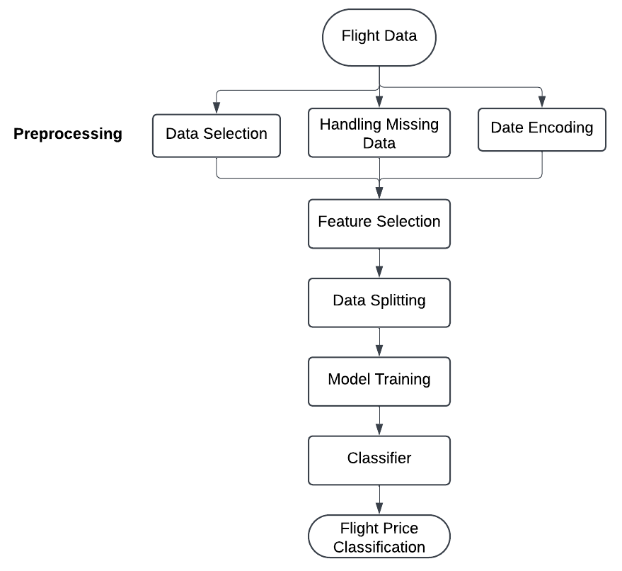
System Architecture
Data Pipeline Overview: Flowchart illustrating data loading, preprocessing, training, evaluation, and prediction phases.
Fig. 1 Architecture Diagram

Slide 6
Data Preprocessing
Data filtering
Feature selection
seatsRemaining: Represents the number of seats left, highlighting supply-demand trends.
searchDate: The date of the search, which can influence price based on seasonality.
totalTravelDistance: Total distance of the flight, directly correlated with ticket prices.
isBasicEconomy: A binary variable indicating whether the flight is a basic economy fare, a factor known to impact pricing.
Feature engineering
searchDate (weekday vs. weekend, searchDayOfWeek, daysBeforeFlight)
Creation of price categories for classification (low, medium, high).

Slide 7
Model Selection I: Decision Tree Classifier
Interpretability to get insights into why certain flights fall into specific price ranges
Handles Mixed Data Types Well
Non-Linear Relationships between features (for example, daysBeforeFlight might influence price differently depending on seatsRemaining).
Ranks feature Importance to reduce impurity (error) at each split
Robustness to Irrelevant Features
Computationally efficient and well-suited for dataset that we chose
But prone to overfitting

Slide 8
Model Selection II: Random Forests Classifier
Interpretability similarly to Decision Tree Classifier
Typically has better accuracy on test data
Suited for capturing complex, non-linear patterns
Resilient to noisy or irrelevant features
Faster and more resource-efficient for larger datasets
Reduces Overfitting
But requires more computational resources

Slide 9
Model Selection III: K-Nearest Neighbors
Interpretable and simple to understand, based on data point similarity
Works without assumptions about data distribution
Effective at capturing local patterns in data
Requires feature scaling due to sensitivity to distance
Depends heavily on the choice of K, often optimized through cross-validation
Computationally intensive for larger datasets
But computationally expensive for calculating distances and fine-tuning the optimal K

Slide 10
Model Training and Tuning
Training-Testing Split: 80% training, 20% testing.
Hyperparameters: Optimized through cross-validation.
Libraries: pandas, NumPy, scikit-learn.

Slide 11
Evaluation Metrics
Decision Tree
Accuracy (73%)
Precision (73%)
Recall (73%)
F1 Score (73%).
Random Forest
Accuracy (74%)
Precision (74%)
Recall (74%)
F1 Score (74%).
K-Nearest Neighbors
● Accuracy (65%)
● Precision (65%)
● Recall (65%)
● F1 Score (65%).

Slide 12
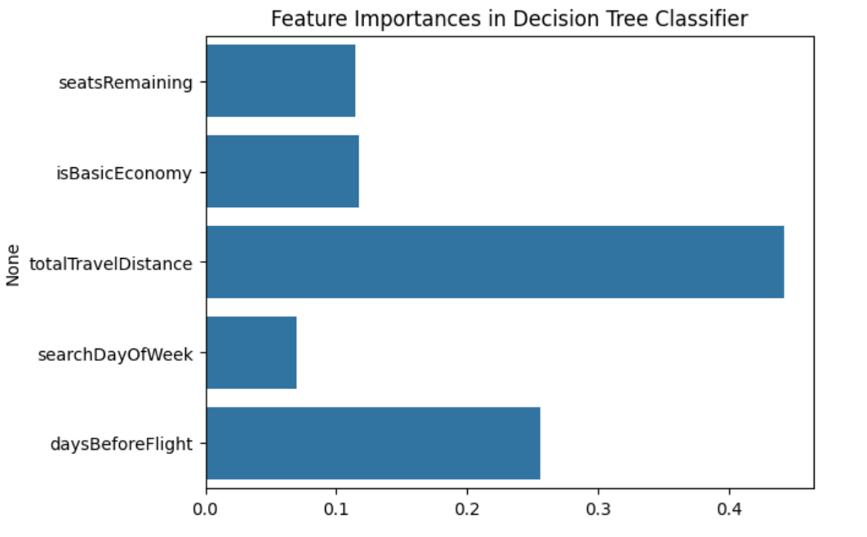
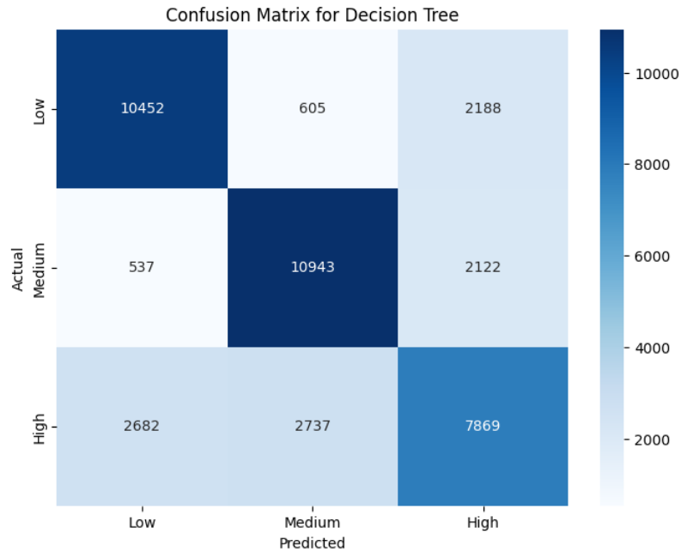
Results I: Decision Tree
Feature Importance: totalTravelDistance, daysBeforeFlight
Confusion Matrix: Performance across different price categories.
Fig. 2 Architecture Diagram
Fig. 3 Architecture Diagram

Slide 13
Results II: K-Nearest Neighbors
Feature Importance: seatsRemaining, totalTravelDistance.
Confusion Matrix: Performance across price categories.
Comparing the results of three models, Decision Tree provides the best results

Slide 14
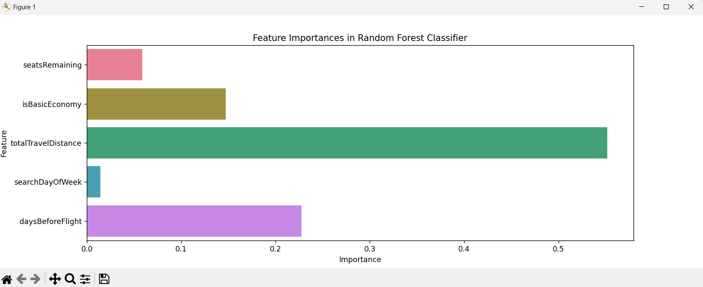
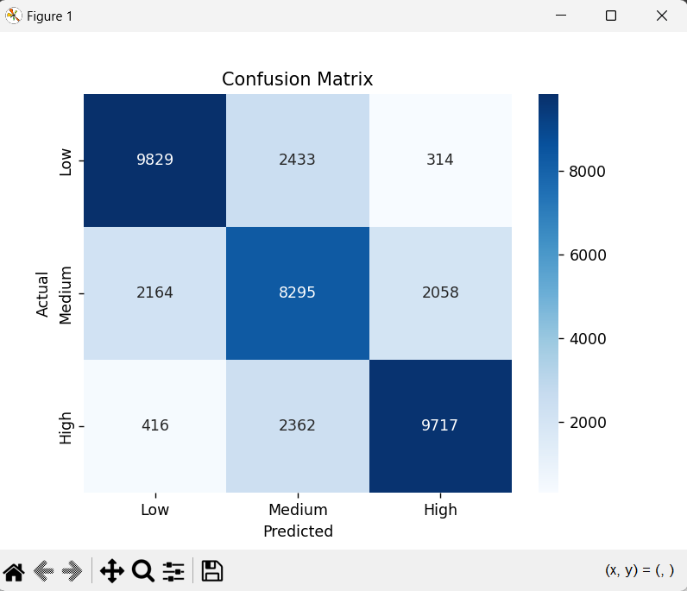
Results III: Random Forest
Feature Importance: seatsRemaining, totalTravelDistance.
Confusion Matrix: Performance across price categories.
Comparing the results of three models, Decision Tree provides the best results
Figure 1: Feature Importance Diagram
Figure 2: Confusion Matrix Diagram

Slide 15
Discussion
Insights: Key features influencing flight prices are total travel distance, days before the flight, and is basic economy
Challenges: Balancing class distributions, tuning model parameters.
Future Improvements: Additional features, ensemble techniques.

Slide 16
Conclusion
Summary: Effective classification of flight prices into ranges.
Impact: Insights for travelers and industry.
Future Scope: Real-time predictions, advanced models.

Slide 17
Project Plan & Task Distribution
We all worked on: data cleaning, feature engineering, data visualization, evaluation metrics, report documentation, presentation preparation
Vivek Ponnala: Setting up github, CI and all the branches, implementing Random Forest Classifier, Presentation and Report
Maggie Qin: K-Nearest Neighbors Classifier, Presentation and Report
Hoai An Nguyen: Decision Tree Classifier, Presentation and Report

Slide 18
References and Acknowledgments
Dataset Source: Kaggle (Flight Prices Dataset)
Libraries: Python, pandas, NumPy, scikit-learn, matplotlib, seaborn
Special Thanks: Professor and classmates for feedback and guidance.

