Slide 1
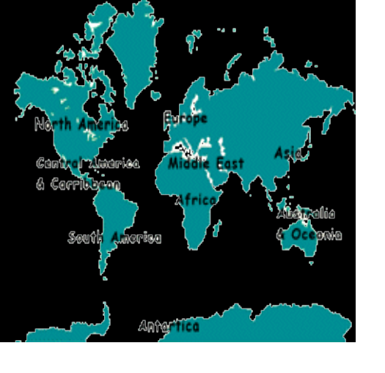

The Wonderful World of Travel
There is a destination to match everyone’s interest--where would you like to go?

Slide 2
There is something for
Everyone in Travel
Senior Travel
Singles
Special Needs
Spiritual/Religious
Study & Work Abroad
Women’s Travel

Slide 3




Travel Interests and Opportunities
Experience Medieval Village life
Central Switzerland Mountain Biking
Volunteer Vacation in Kenya
Gloria China
More than 3600 Learning Vacations and Creative Career Programs Worldwide.

Slide 4
Travel for Every Lifestyle
Budget and Backpacker
Business Travel
Ecotourism
Family Travel
Hitchhiking
Honeymoon and Romance
Motorcycles
Road Trips
and more---
1-800-451-5678
or e-mail at tratum@aol.com

