Slide 1
The Tudor Monarchs
An overview

Slide 2
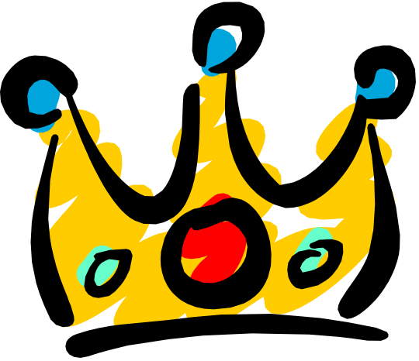
The Tudors
The Tudor family came to power in 1485 with the accession of Henry VII. There were six Tudor Kings and Queens. In 1486 Henry united by marriage the families of York and Lancaster.

Slide 3
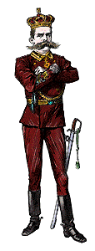
Henry VII
Henry VII was the first Tudor king. He reigned from 1485 to 1509 and did much to unite England. He formed a personal bodyguard called the Yeomen of the Guard.

Slide 4

Henry VIII
Henry VIII is famous for his six wives and for his establishment of the Church of England. He reigned from 1509 to 1547. Question: Why did Henry break with the Church of Rome?
Answer (click on button for answer)

Slide 5
He wanted to be divorced from Catherine of Aragon. The Church of England was established when he made the brake with Rome.
(Click on button to proceed to next slide)

Slide 6

Edward VI
Even though Edward VI was not physically strong, he reigned from 1547 to 1553. He was a bright lad who was fiercely Protestant. Because of him the Church of England was strong.
(Click on the back button if you wish to go back to the question about Henry VIII)

Slide 7
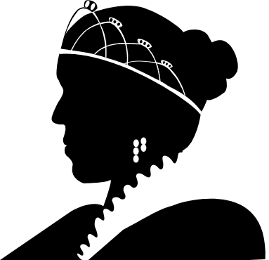
Lady Jane Grey
Lady Jane, a grand niece of Henry VIII, was queen for nine days because of her relationship to Henry VIII. But the country rallied in support of Mary, daughter of Henry VIII by Catherine of Aragon.

Slide 8
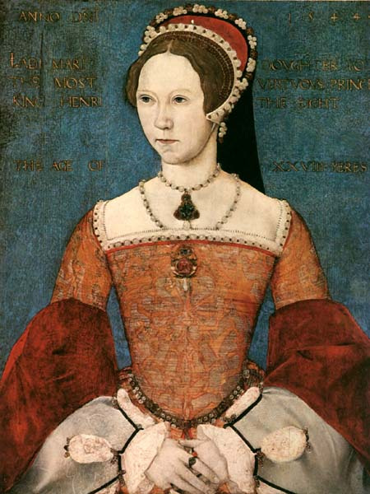
Mary I
Mary I was the first Queen Regnant of England, reigning from 1553 to 1558. In other words, she was the first Queen to reign in her own right,and not because she was married to a King. She died leaving no heir.

Slide 9
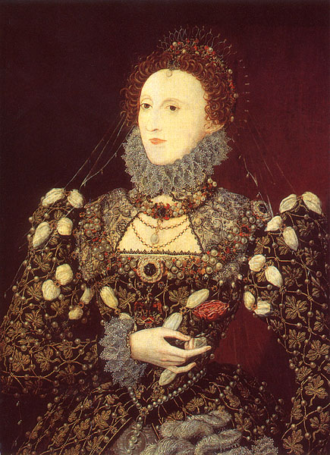
Elizabeth I
Elizabeth was the longest reigning English monarch. Her nickname was Queen Bess.

Slide 10
Acknowledgements
The information for this slide presentation was gathered from the following site on the World Wide Web:
http://tudorhistory.org/
The images came from both the above link and the following link:
http://www.goldenagedesigns.com/

