Slide 1
Age, Gender and Race prediction
Team Artificial Incoherence
Bálint Gergő
Medgyes Csaba
Virsinger Dominika

Slide 2
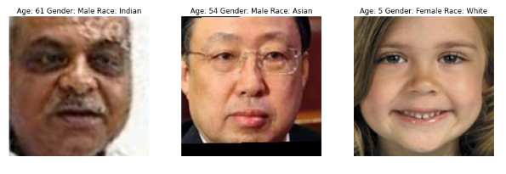
Introduction
Given face images age, gender, race prediction
Aim: a good performing model
Additional aim: illustrate predictions with a server-client application

Slide 3
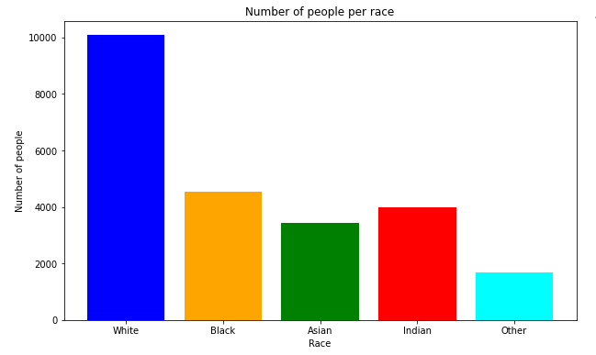
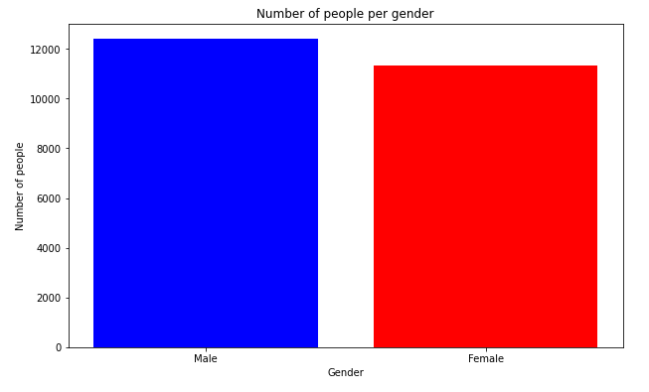
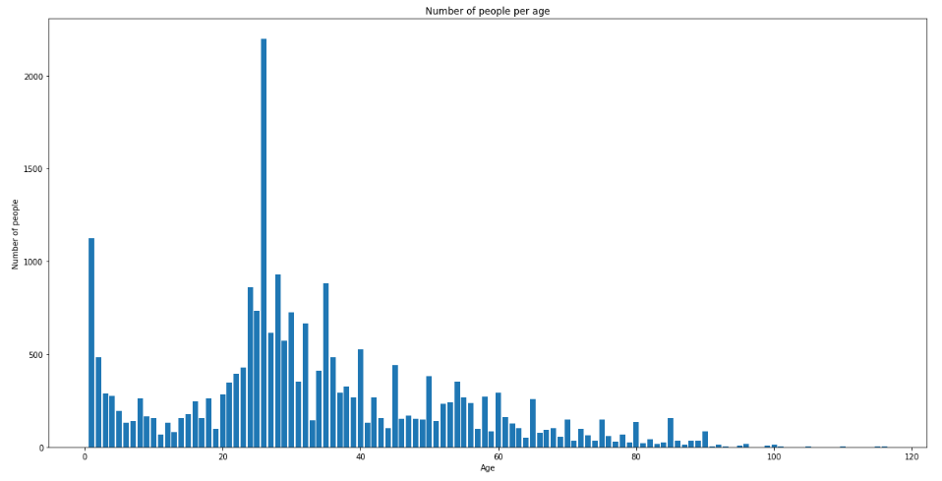
Data preparation
UTKface dataset from Kaggle, 20k+ pictures with labels
Data cleaning steps
Exploratory data analysis
Train-test split (0.8-0.2)
Normalizing X_train, X_test

Slide 4
models
CNN based, defined by us
Transfer learning
Xception based with ImageNet weights (we call this the Imagenet model)
InceptionV3 based model (we call this the inceptionv3 model)
MTCNN model for face detection

Slide 5
Hyperparameter optimization
Parameters we optimized:
Number of neurons in dense layers
Dropout values
Activation functions
Optimizer
Batch size
Weighted model
SMOTE

Slide 6
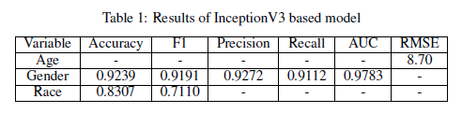
evaluation
Age: (continuous value) MSE, RMSE
Gender: (binary value) Accuracy, Precision, Recall, F1 score, Confusion matrix, ROC curve, AUC
Race: (multiclass variable) Accuracy, Macro F1 score, Confusion matrix
Best performing model: InceptionV3 based model
After hyperparameter optimization: still InceptionV3 is the best

Slide 7
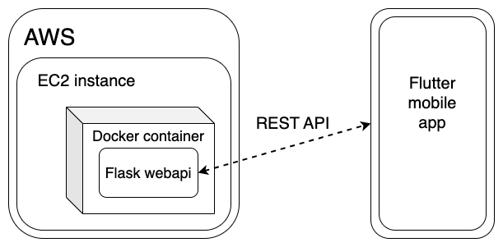
aPPlication

Slide 8

demo

