Slide 1
Insightful Classification of Crystal Structures using Deep Learning
Authors:
Angelo Ziletti, Devinder Kumar, Matthais Scheffler & Luca M. Ghiringhelli
Presented by:
Vir Karan (MM19B057)

Slide 2
Contents
Introduction and Motivation
Methods:
Feature descriptor: Two-dimensional diffraction fingerprint
Dataset
Convolutional Neural Network
Results and Discussion:
Performance on defected crystals, structure transformation pathways
Opening the black-box using Attentive response maps

Slide 3
Introduction
An effective way of classifying crystals is to find the group of all transformations under which the system is invariant; in three dimensions, these are described by the concept of space groups.
Currently, to determine the space group of a given structure, one first determines the allowed symmetry operations, and then compare them with all possible space groups to obtain the correct label.
This method works for ideal systems, but in reality there exist defects/impurities/noise in the data.
To address this, thresholds need to be set in order to define how loose one wants to be in classifying; different thresholds may lead to different classifications.

Slide 4
Objectives of this work
Introduce an automatic procedure to classify crystal structures starting from a set of atomic coordinates and lattice vectors.
Introduce a way to represent crystal structures (by means of images, i.e., two-dimensional maps of the three-dimensional crystal structures).
Present a classification model based on convolutional neural networks (ConvNets).
Unfold the internal behavior of the classification model through visualization.

Slide 5
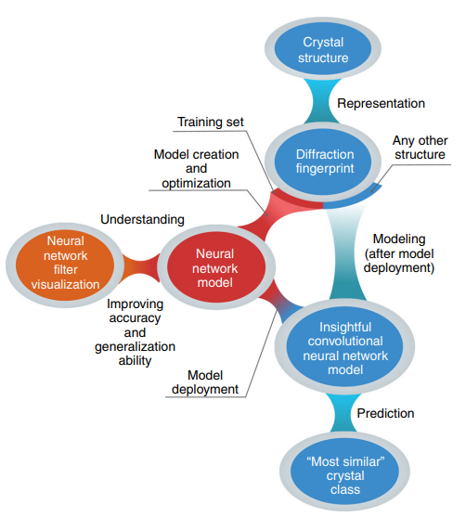
Workflow:

Slide 6
Feature Descriptor
The first necessary step to perform any machine learning is to represent the material under consideration in a way that is understandable for a computer. This representation should contain all the relevant information on the system needed for the desired learning task.
In the case of crystal structure recognition, however, it is essential that the descriptor captures system’s symmetries in a compact way, while being size invariant in order to reflect the infinite nature of crystals.
Periodicity and prevailing symmetries are evident in reciprocal space, hence switching to reciprocal coordinates is useful.

Slide 7

Feature Descriptor
The scattering of an incident plane wave through the crystal can be simulated, and then the diffraction pattern in the detector plane orthogonal to that incident wave is computed.
The amplitude Ψ, which originates from the scattering of a plane wave with wave vector k₀ by N_{a} atoms of species a at positions x_{j}^{(a)} in the material can be written as:
here r₀ is the Thomson scattering length, q = k₁ − k₀ is the scattering wave vector, x′ the corresponding position in the detector plane, and r=|x′|

Slide 8

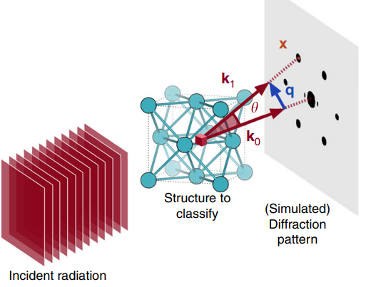
Feature Descriptor
Assuming elastic scattering, we have that |k₀| = |k₁| = 2π/λ, where λ is the wavelength of the incident radiation. The quantity f_{a}^{λ}(θ) is the X-ray form factor; it describes how an isolated atom of species a scatters incident radiation with wavelength λ and scattering angle θ.
where Ω(θ) is the solid angle covered by our (theoretical) detector, and A is a (inessential) constant determined by normalization with respect to the brightest peak

Slide 9
Feature Descriptor
For each structure we first construct the standard conventional cell. Then, we rotate the structure 45° clockwise and counterclockwise about a given crystal axis (e.g., x), calculate the diffraction pattern for each rotation, and superimpose the two patterns.
This procedure is then repeated for all three crystal axes. The final result is represented as one RGB image for crystal structure, where each color channel shows the diffraction patterns obtained by rotating about a given axis.
Each system is thus described as an image, and we term this descriptor two-dimensional diffraction fingerprint (D_{F}).
Notes:
A disadvantage of the two-dimensional diffraction fingerprint is that it is not unique across space groups. This is well known in crystallography: the diffraction pattern does not always determine unambiguously the space group of a crystal35, 36. This is primarily because the symmetry of the diffraction pattern is not necessarily the same as the corresponding real-space crystal structure; for example, Friedel’s law states that—if anomalous dispersion is neglected—a diffraction pattern is centrosymmetric, irrespective of whether or not the crystal itself has a center of symmetry. Thus, the diffraction fingerprint DF cannot represent non-centrosymmetric structures by construction.

Slide 10
Dataset
First, for each structure in the dataset (specified by a set of atomic coordinates and lattice vectors), we concatenate three random rotations around the three crystal axes to randomize the initial crystal orientation. Then, we construct the standard conventional cell.
This procedure is therefore completely independent from traditional symmetry approaches and robust against randomization of the initial crystal orientation. Finally, we replicate this standard cell in all three directions such that the resulting cluster contains a number of atoms which is as close as possible to a given target number (namely, 250). The size invariance of the diffraction peak locations guarantees that the results are independent from this choice, only the peak widths will slightly change,
Defective structures are then generated from these supercells by removing or randomly displacing atoms
we use a wavelength of λ = 5.0 × 10−12 m for the incident plane wave (Eq. (1)), a wavelength typically used in electron diffraction experiments. Indeed, the two-dimensional diffraction fingerprint bears resemblance to experimental scattering techniques such as single-crystal or selected-area electron diffraction;

Slide 11
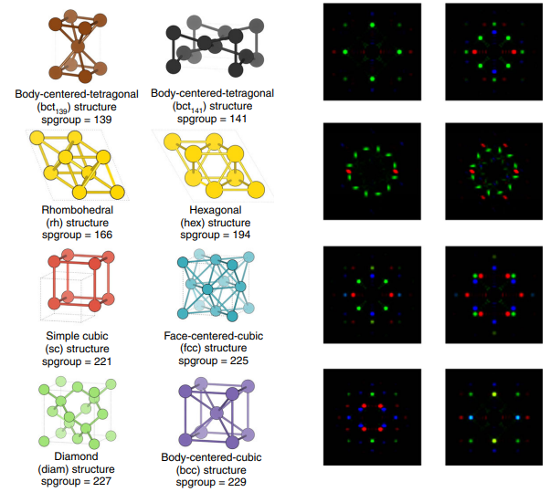
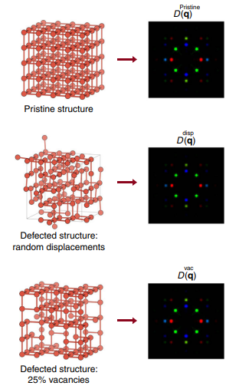

Slide 12
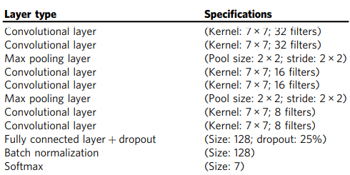
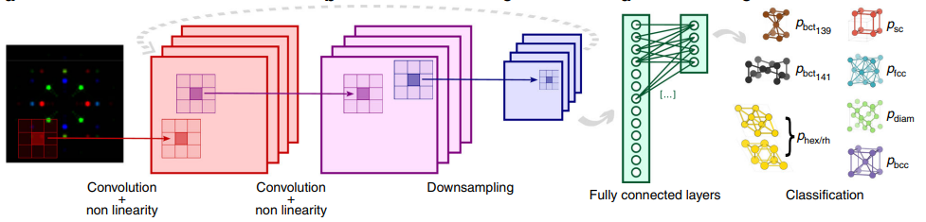
Classification Model - CNN
A Convolutional Neural Network (CNN) is used to classify the structures. The architecture is shown on the right.
Training was performed using an Adam optimizer with batches of 32 images for 5 epochs with a learning rate of 1e-3, with cross-entropy as the loss function.
The network attains 100% accuracy in classifying the train and test dataset.

Slide 13
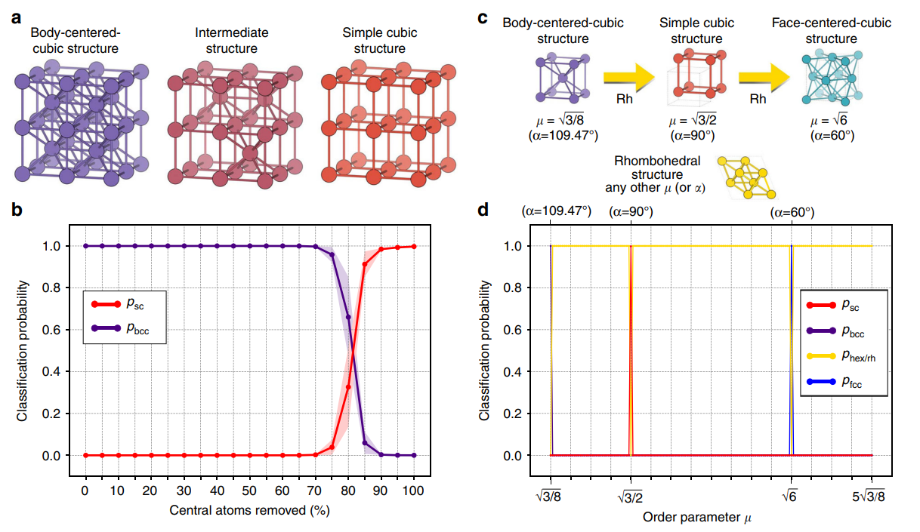
Predictions during structural transitions

Slide 14
Opening the “Black-Box”
To shed light on the ConvNet classification process, we resort to visualization: using the fractionally strided convolutional technique, we back-projects attentive response maps (i.e., filters) in image space.
Such attentive response maps identify the parts of the image which are the most important in the classification decision. The top four most activated (i.e., most important) filters from the first, third, and last convolutional layers for each of the three color channels for the sc class.
The complexity of the learned filters grows layer by layer, as demonstrated by the increasing number of diffraction peaks spanned by each motif. The sum of the last convolutional layer filters for each class is shown in Fig. 5b; they are class templates automatically learned from the data by the ConvNet.

Slide 15
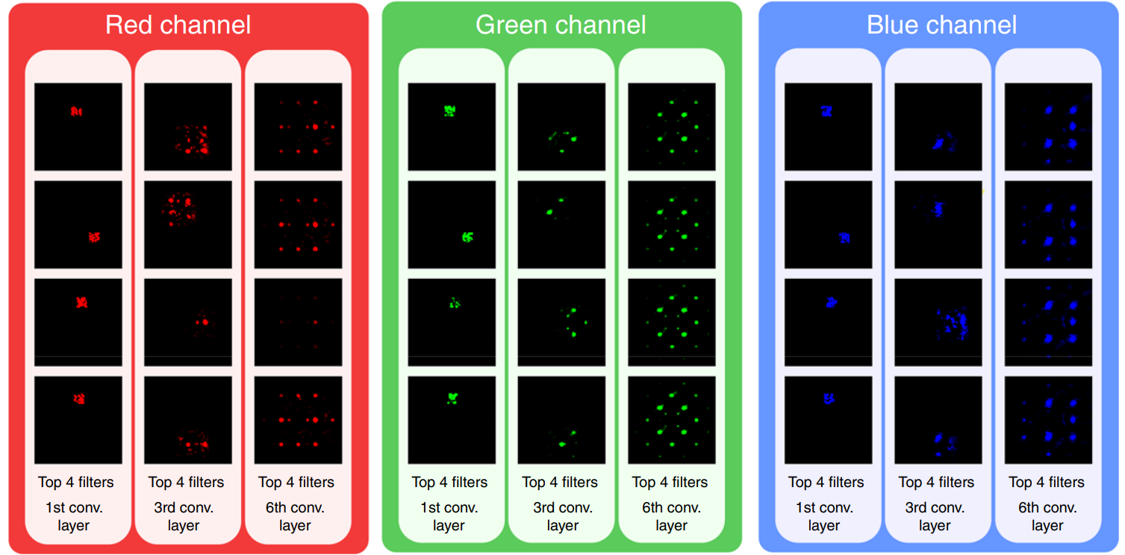
Attentive response maps from the top four most activated filters of the first, third and last convolutional layers for the simple cubic class. The brighter the pixel, the most important is that location for classification. Comparing across layers, we notice that the ConvNet filters are composed in a hierarchical fashion, increasing their complexity from one layer to another. At the third convolutional layer, the ConvNet discovers that the diffraction peaks, and their relative arrangement, are the most effective way to predict crystal classes

