Slide 1



Mondo Rescue:
A GPL disaster recovery solution
Bruno Cornec
Open Source and Linux Profession EMEA Lead

Slide 2


Introducting myself
Software engineering and Unices since 1988
    Mostly Configuration Management Systems (CMS), Build systems, quality tools, on multiple commercial Unix systems
  Discover Open Source & Linux (OSL) & first contributions in 1993
  Full time on OSL since 1995, first as HP reseller then @HP
Currently:
  Technology Architect on OSL for the HP/Intel Solution Center, Grenoble
  OSL HP Ambassador
  EMEA OSL HP Profession Lead
  Solutions Linux Conference board member
  MondoRescue, Dploy.org, Project-Builder.org project lead
  LinuxCOE, mrepo, tellico, rinse, fossology contributor
  Mandriva, Fedora packager

Slide 3

Definitions
Disaster Recovery Plan (DRP):
  Identifying, inventorying and classifying the critical systems and data in the enterprise (in relationship with their value for the enterprise) and consequent procedures, processes and systems to put in place to recover from a disaster.
  Balance between DRP implementation costs and downtime costs, or loss of data/services costs.
  Much more paper based than computer based. However tools are also needed as part of the plan. Also DR doesn't substitute itself to backups or archives.
  Today, among the systems to deal with, you'll have Linux systems.
Points to consider:
  Recovery of solutions: systems, network, storage, connectivity, HA configurations and coherency between those elements.
  Recovery of system configuration (BIOS, Stripe size, Block size, FS layout and options, Boot loader, OS data, users and application data, ...) and coherency between those elements.

Slide 4
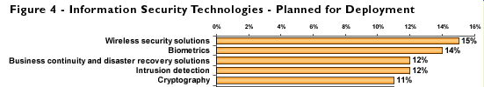
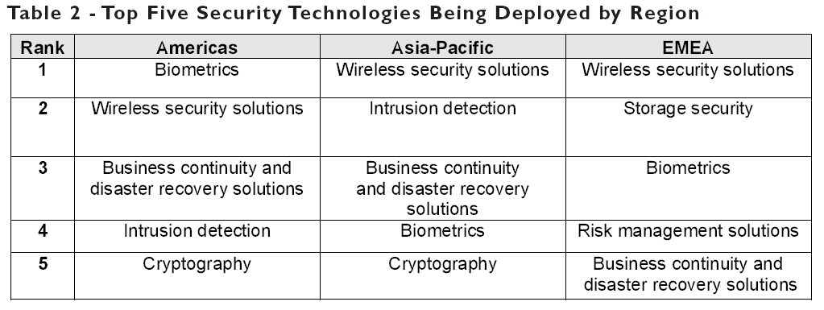
Disaster Recovery
Frost & Sullivan 2008 (ISC)2 Global information security Workforce Study
https://www.isc2.org/download/2008_Global_WF_Study.pdf

Slide 5


A GPL Disaster Recovery Solution
Distribution neutral (Mandriva, RedHat, Fedora, RHEL, OpenSuSE, SLES, Debian, Ubuntu, Gentoo, Slackware) – x86, x86_64, ia64
Supports most FS supported by the kernel (ext2/3/4, reiserfs, XFS, NTFS, [V]FAT, NFS, including dual boot systems) on any disk supported (IDE, SCSI, FC, HW Raid, SW Raid, LVM v1/2, DM, Multipath) and boot loader (lilo/grub/elilo)
Supports CD-R[W], DVD[-+]R[W], Tapes, USB disks/keys, NFS, local FS (ISO9660 files)
Uses mindi for mini-distro (live backup !)
Full or differential backups supported
CLI + curses based UI
System DR in minutes

Slide 6
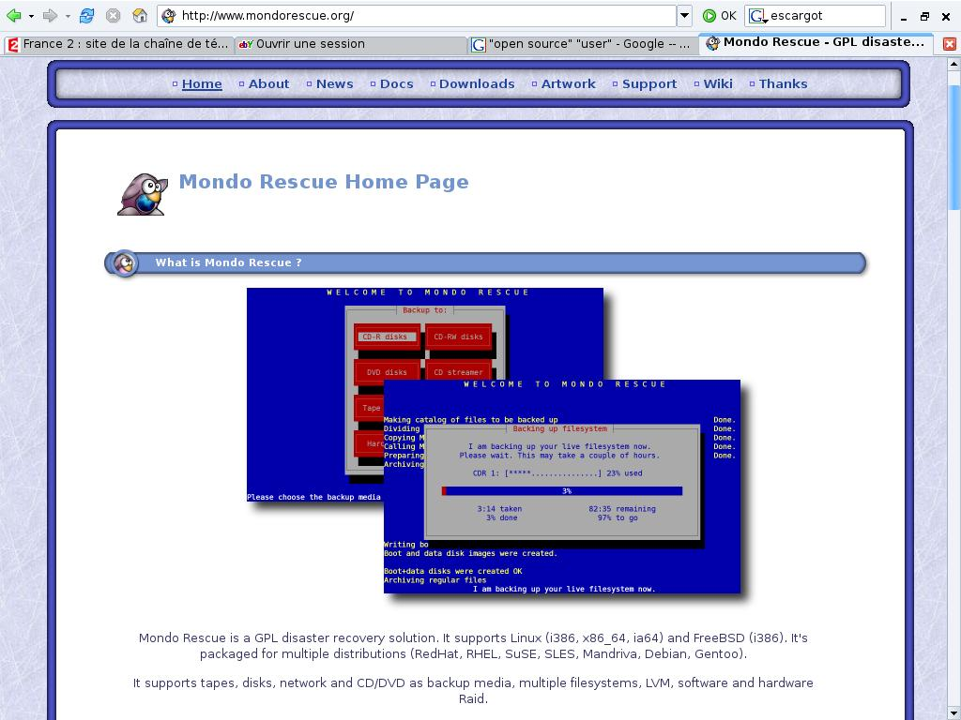

The user's view
Need for a Rescue CD for Linux pre-installed servers in 2000
2 choices: mkCDrec and Mondo Rescue
Mondo Rescue nearer to my initial needs
Developer happy to receive patches
-H option added

Slide 7
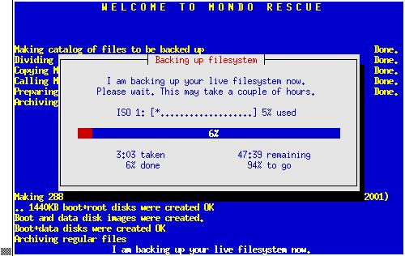
Archiving with mondoarchive
Uses either bzip2, gzip or lzo for data compression
Uses afio for reliable backup (supports compression on a file basis, ASCII headers, cpio comp.)
Generates bootable ISO images or burns media/creates tapes or USB disks, using running kernel + modules
Saves disk structure and content. Proliant HW information
Runs on a live system
/usr/sbin/mondoarchive -O -d /bkp -s 700M -p m1 -E "/usr/doc /usr/src" -N -T /tmp -n s1.hpintelco.org:/nfs

Slide 8
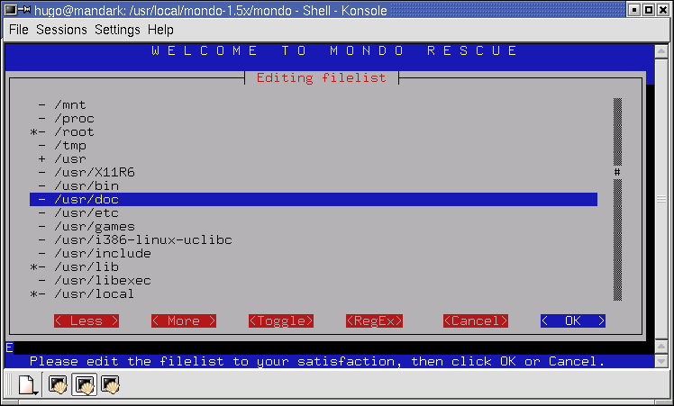
Restoring with mondorestore
From bootable physical media (CDs, tapes, OBDR since 2.2.6, USB devices), images on disks, network (PXE), virtual media (Proliant specific)
Interactive restore from image files under the OS
Proliant goodies support
Various modes: Automatic, Interactive, Expert, Compare
Ability to change FS type, layout, SW Raid, even HW configuration.
DR restore in minutes. But do it !

Slide 9

Cloning support
Requires knowledge of master and target platforms (potential different drivers)
All drivers should be part of the mindi image created (either used on master or forced in mindi)
Use -H if master and target are identical hardware platforms
In other cases, all functions are also available (partition resizing, filesystem type change ...) + hardware adaptation
Improvement for mindi to include all drivers - TBC

Slide 10

The contributor's view
First patch in Dec. 2000
First attempt of ia64 port not published back in 2001, then in Apr. 2004, and finally published in Nov. 2007
Proliant fixes in Nov. 2004
Then migration from CVS => SVN
PXE support added in Apr. 2005
Then no working SVN (1 year+)
Patched 2.04 version in Sep. 2005

Slide 11
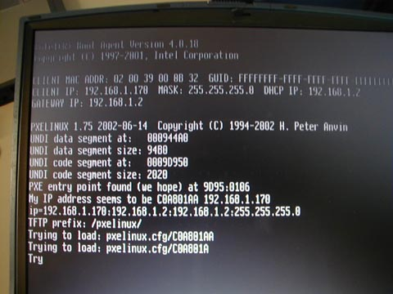
PXE Support
Using PXE boot ROM, ability to integrate MondoRescue images with a generic deployment server based on pxelinux.
Ability to boot from a (central) server hosting (all) ISO images without physical media.
label mondo
kernel kernel/vmlinuz-mondo
append root=/dev/ram rw pxe initrd=initrd/initrd-mondo.img ramdisk_size=32768 prefix=m1 load_ramdisk=1 prompt_ramdisk=0 ipconf=eth1:192.168.0.1:255.255.255.0:192.168.0.255:192.168.0.254 nfsmount=192.168.0.10:/mondo ping=5

Slide 12
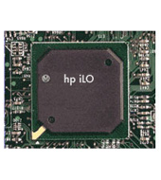
Proliant Features
With the iLO and Virtual Media function, ability to boot from a (central) server hosting (all) ISO images or a laptop through a Web interface without physical media.
Smart Array support
Proliant NIC support
Hardware info backup & recovery possible in a cloning approach (using hpacucli, hponcfg, conrep from SSSTK) – preliminary support in 2.2.5

Slide 13
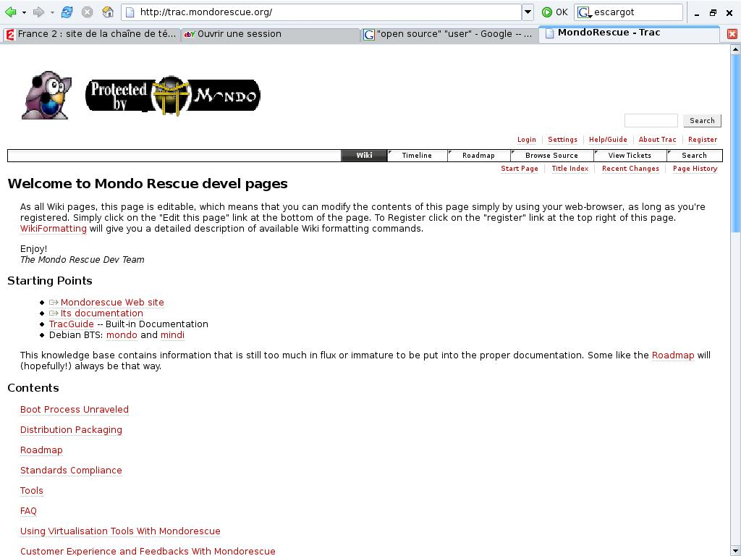

The Maintainer's View
Project Maintainer since Oct. 2005
New subversion repository (Thanks BerliOS – HP)
15 versions published with 2.2.8
New Build process (Generated pkgs => lead to project-builder.org)
60 distribution tuples (Thanks Qemu)
New Website (Thanks Ayo)
Trac (300+ Bugs declared – half fixed already)
Mondorescue HOWTO Rewritten
Mailing List activity

Slide 14
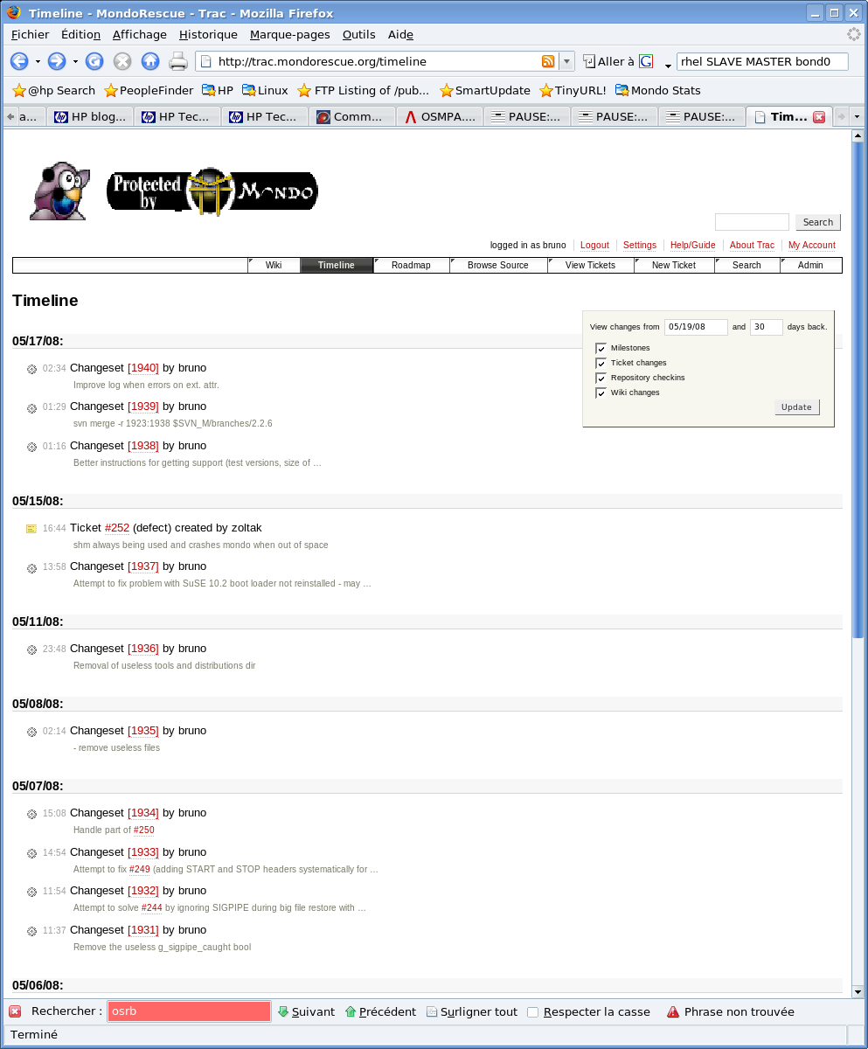
Project Lead: 2.2.5
bug fixes on 2.2.4
Better Ubuntu and Debian support
Proliant SSSTK support
ia64 support
USB key support
Udev support
Use Project Builder

Slide 15
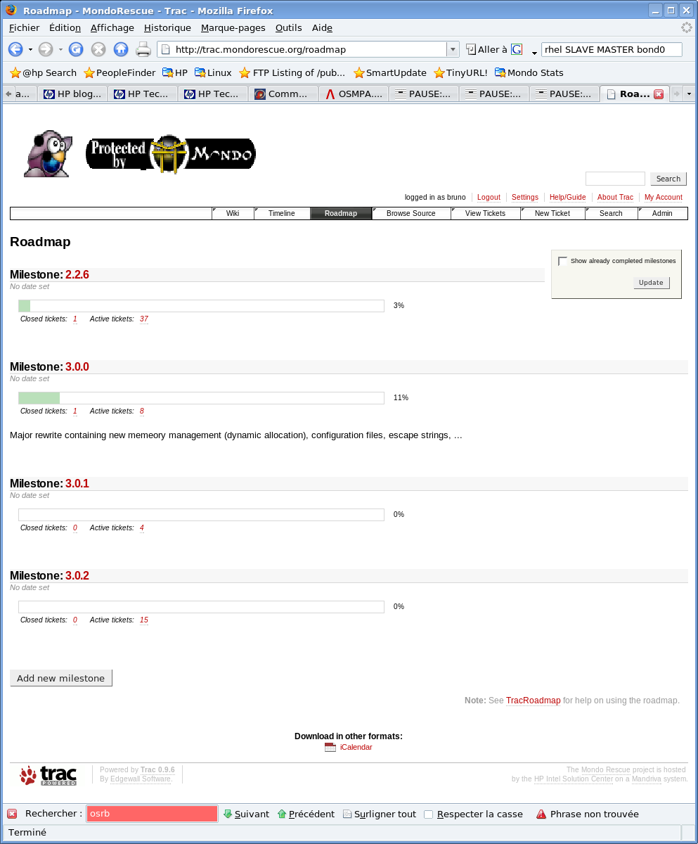
Project Lead: 2.2.6
bug fixes on 2.2.5
Gentoo x86_64 support
Better tape support (-G)
OBDR support
Remove floppy support
New cli params for mondorestore

Slide 16
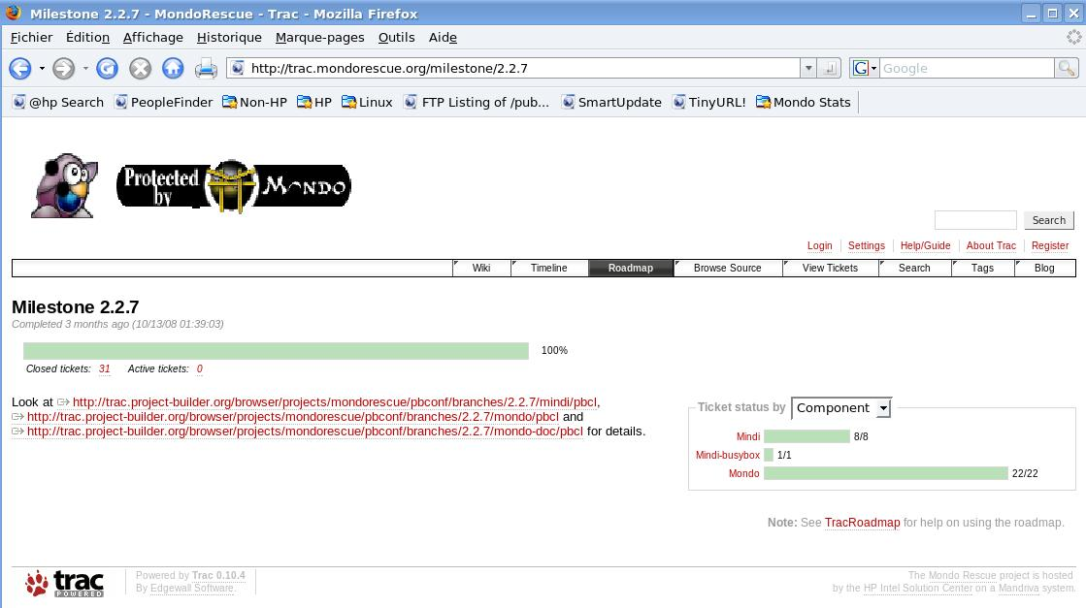
Project Lead: 2.2.7
bug fixes on 2.2.6
Improve USB support
Fix for debian x86_64
Support labeled reiserfs FS
Remove shm usage
OCFS2 preliminary support
-E/-I support devices

Slide 17
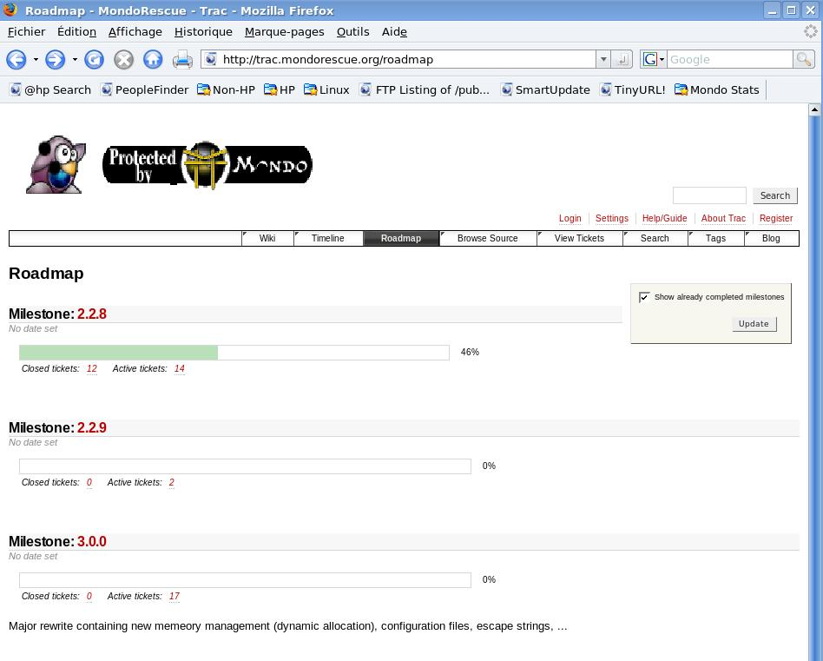
Project Lead: 2.2.8
bug fixes on 2.2.7
Ext4 support added
Fix OBDR on ia64
Adds 2.6.27 support
Adds multipath support
Adds RHAS 2.1 support

Slide 18
Project Lead: 2.2.9
bug fixes on 2.2.8
Pre and post scripts
Proliant DL160 G6 PXE (igb + e1000e, sata_via, ...)
Ia64 improvements (serial mode, parted2fdisk
SuSE ramdisk support
Increased mountlist limit
Inactive VGs not restored
Memory mangement improvements (some)
NFS user + mount support

Slide 19
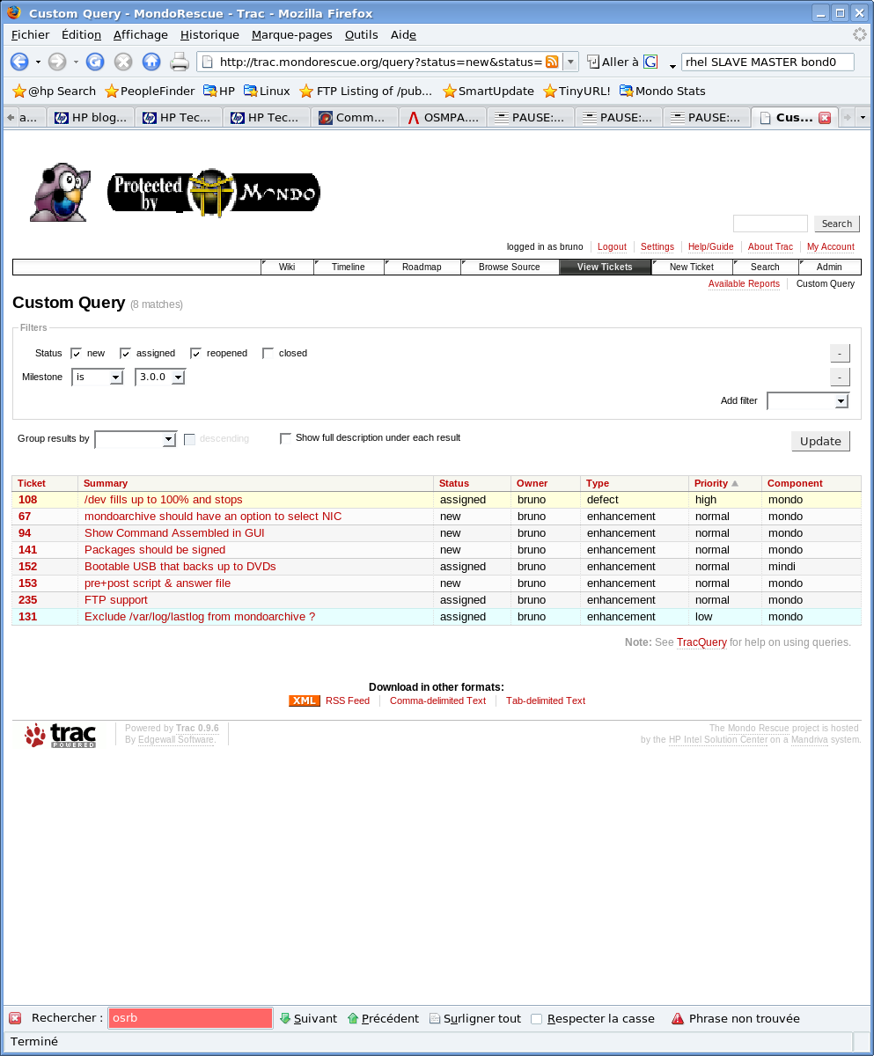
Project Lead: 3.0.0 / 2.2.10
Rewritten in perl (mindi first)
Busybox removal (2.2.10)
OS independance (FreeBSD)
Network protocol and setup independance
Internationalization (fr,us)
Configuration files
Support of all FS/LVM options
SElinux/EFIbootmgr support
Software Engineering (tests programs, splint, valgrind, fossology...)

Slide 20
And @HP ?
Used by various organizations (CMS, HP/Intel Solution Center, APJ ESS Competency Lab, AMA ASC TSG, GD)
Consultancy
HP support contract part #: HA158AC MNUSWRCZ (Since Sept. 2009)
Help Desk
L0: Call login
Local CCR
L1: First investigation
BSS CC
Linux VCC
L2: In deep troubleshooting
MondoRescue
L3: Bug fixing - Evolution

Slide 21
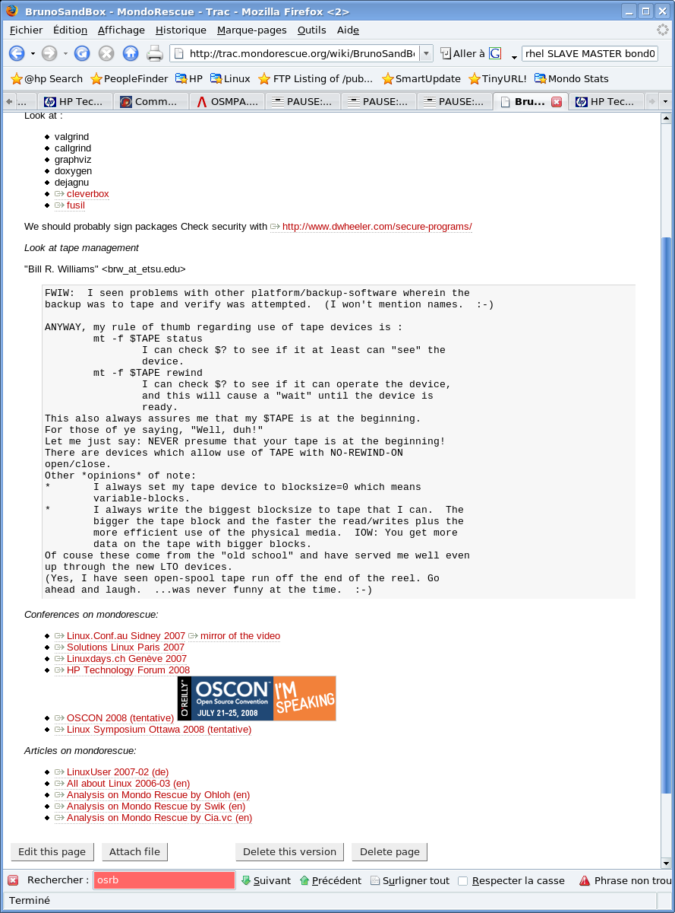
Web Resources
Mondorescue main site
http://www.mondorescue.org
Trac / Wiki
http://trac.mondorescue.org
Busybox
http://www.busybox.net
Project-Builder
http://trac.project-builder.org
Open Source at HP
http://opensource.hp.com
“The evolution of FLOSS
and the Internet are
tightly coupled”

Slide 22
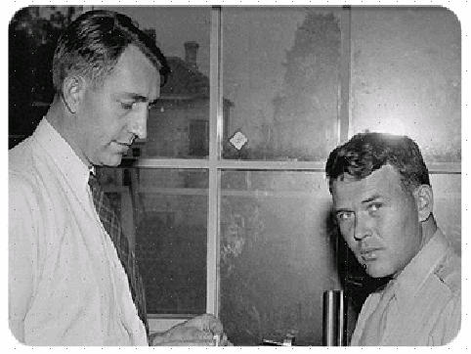

Contact - Thanks
Bruno.Cornec@hp.com
(Open Source and Linux Technology Architect at the HP/Intel Solution Center)
http://www.hp.com/linux
http://opensource.hp.com
Thanks goes to:
Linus Torvalds, Richard Stallman, Eric Raymond, Nat Makarevitch, René Cougnenc, Eric Dumas, Rémy Card, Hugo Rabson, Bdale Garbee, Bryan Gartner, Craig Lamparter, Lee Mayes, Gallig Renaud, Andree Leidenfrost, Phil Robb, Bob Gobeille, Martin Michlmayr among others, for their work and devotion to the Open Source Software cause... and my family for their patience :-)
”Changes are never easy to make.
There is comfort and safety in tradition, but change must come, no matter how painful or expensive it may be.”
Bill Hewlett

