Slide 1



Mondo Rescue:
A GPL disaster recovery and cloning solution
Bruno Cornec
Open Source and Linux Profession EMEA Lead

Slide 2


Introducting myself
Software engineering and Unices since 1988
  Mostly Configuration Management Systems (CMS), Build systems, quality tools, on multiple commercial Unix systems
  Discover Open Source & Linux (OSL) & first contributions in 1993
  Full time on OSL since 1995, first as HP reseller then @HP
Currently:
  Master Technology Architect on OSL for the HP/Intel Solution Center, Grenoble
  OSL HP Advocate
  EMEA OSL HP Profession Lead
  Solutions Linux Conference and OWF board member
  MondoRescue, Dploy.org, Project-Builder.org project lead
  LinuxCOE, mrepo, tellico, rinse, fossology, collectl contributor
  FOSSBazaar and OSL Governance enthusiast
  Mandriva, Mageia, Fedora packager

Slide 3
Definitions
Disaster Recovery Plan (DRP):
  Identifying, inventorying and classifying the critical systems and data in the enterprise (in relationship with their value for the enterprise) and consequent procedures, processes and systems to put in place to recover from a disaster.
  Balance between DRP implementation costs and downtime costs, or loss of data/services costs.
  Much more paper based than computer based. However tools are also needed as part of the plan. Also DR doesn't substitute itself to backups or archives.
  Today, among the systems to deal with, you'll have Linux systems.
Points to consider:
  Recovery of solutions: systems, network, storage, connectivity, HA configurations and coherency between those elements.
  Recovery of system configuration (BIOS, Stripe size, Block size, FS layout and options, Boot loader, OS data, users and application data, ...) and coherency between those elements.

Slide 4
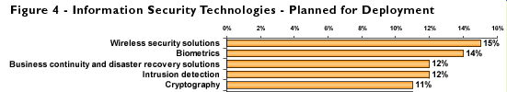
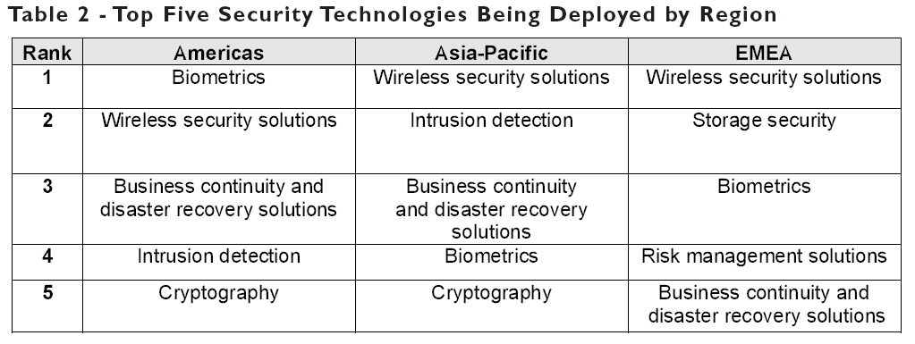
Disaster Recovery
Frost & Sullivan 2008 (ISC)2 Global information security Workforce Study
https://www.isc2.org/download/2008_Global_WF_Study.pdf

Slide 5
Disaster Recovery on Linux
MondoRescue (of course ;-) (http://mondorescue.org). Goal of the current presentation.
CloneZilla (http://clonezilla.org/) offline with partclone & multicast. No file restoration, nor multiple media support.
mkCDrec (http://mkcdrec.ota.be/) online with tar, sfdisk and busybox. Supports OBDR. Stopped with 1.0. No ext4
ReaR (http://rear.sourceforge.net/) successor of the precedent project, online with sfdisk. Young project. Less features yet than mkCDrec
Some other non FLOSS solutions are also available.

Slide 6

A GPL Disaster Recovery Solution
Distribution neutral (Mandriva, Mageia, RedHat, Fedora, RHEL, OpenSuSE, SLES, Debian, Ubuntu, Gentoo, Slackware, ...) – x86, x86_64, ia64
Supports most FS supported by the kernel (ext2/3/4, reiserfs, XFS, NTFS, [V]FAT, NFS, SSHFS, including dual boot systems) on any disk supported (IDE, SCSI, FC, HW Raid, SW Raid, LVM v1/2, DM, Multipath) and boot loader (lilo/grub/elilo)
Supports various backup media: CD-R[W], DVD[-+]R[W], Tapes, USB disks/keys, NFS, local FS (ISO9660 files)
Works live (on-line backup), supports SELinux
Full or differential backups supported
CLI + curses based UI
System DR in minutes

Slide 7
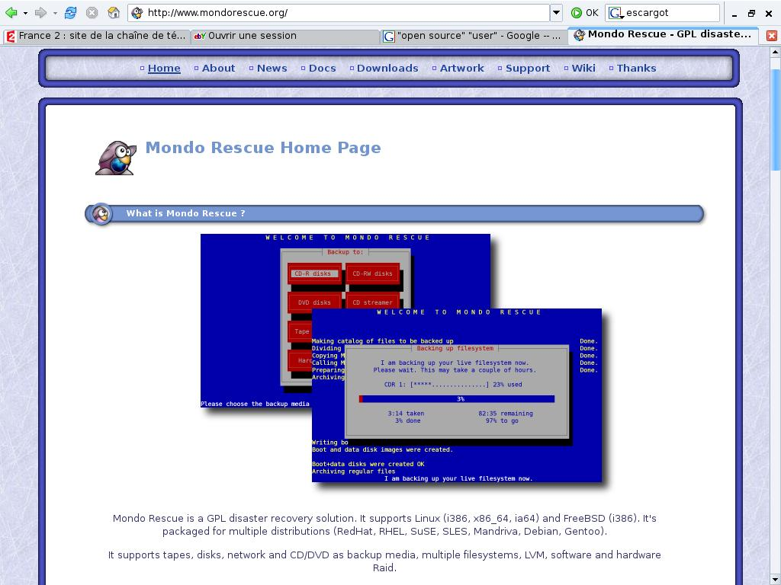
The user's view
Need for a Rescue CD for Linux pre-installed servers in 2000
2 choices: mkCDrec and Mondo Rescue
MondoRescue nearer to my initial needs
Project Lead happy to receive and integrate patches
-H option added

Slide 8
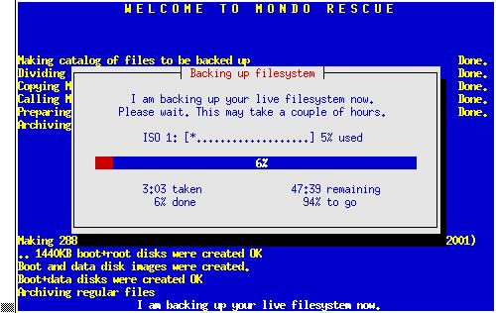
Archiving with mondoarchive
Uses either bzip2, gzip or lzo for data compression (lzma added in 2.2.10)
Uses afio for reliable backup (supports compression on a file basis, ASCII headers, cpio compatible) or star
Generates bootable ISO images or burns media/creates tapes or USB disks/keys, using running kernel + modules (supports multiple images)
Saves disk structure and content. ProLiant HW information
Runs on a live system
Uses mindi to generate
boot content
/usr/sbin/mondoarchive -O -d /bkp -s 700M -p m1 -E "/usr/doc /usr/src" -N -T /tmp -n s1.hpintelco.org:/nfs

Slide 9
mindi
Mindi is a separate tool called by mondoarchive
Mindi creates a standalone boot environment based on the distribution tools (including the kernel and modules provided) and a custom init script.
Possibility to point to another kernel + modules if needed
This mini-distribution is used to initiate from bare-metal the machine to restore
Uses a custom busybox version. (Removed in 2.2.10 to use all native tools)
Can be used as a rescue disk alone (customization through /etc/mindi/deplist.txt)
Mindi creates the FS/LVM infos used by mondorestore

Slide 10
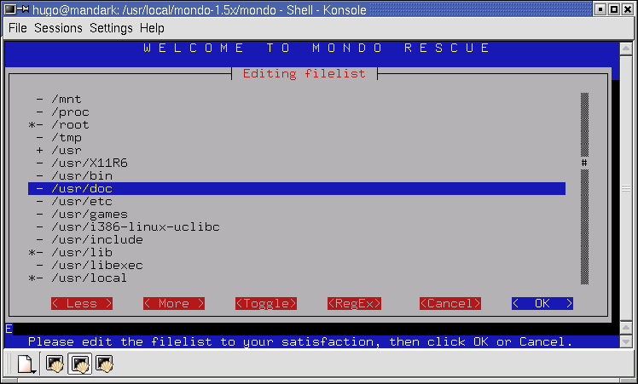
Restoring with mondorestore
From bootable physical media (CDs, tapes & OBDR since 2.2.6, USB devices), images on disks, network (PXE), virtual media (ProLiant specific)
Interactive restore from image files under the OS. Warning: MondoRescue is not a backup tool, but a DR one.
ProLiant goodies support
Various modes: Automatic, Interactive, Expert, Compare
Ability to change FS type, layout, SW Raid, even HW configuration.
DR restore in minutes. But test it !

Slide 11

Cloning support aka P2P
Requires knowledge of master and target platforms (potential different drivers)
All drivers should be part of the mindi image created (either used on master or forced in mindi)
Use -H if master and target are identical hardware platforms
In other cases, all functions are also available (partition resizing, filesystem type change ...) + hardware adaptation
Improvement for mindi to include all drivers – TBC
Side note: P2V is also available and documented

Slide 12

The contributor's view
First patch in Dec. 2000
First attempt of ia64 port not published back in 2001, then in Apr. 2004, and finally published in Nov. 2007
ProLiant fixes in Nov. 2004
Then migration from CVS => SVN
PXE support added in Apr. 2005
Then no working SVN (1 year+)
Patched 2.04 version in Sep. 2005

Slide 13
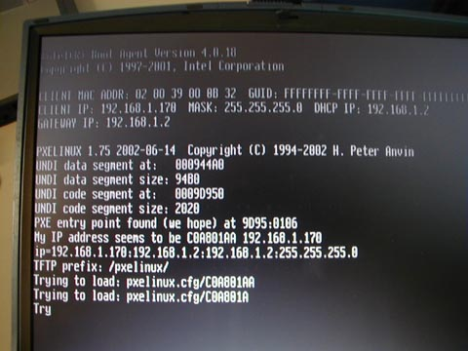
PXE Support
Using PXE boot ROM, ability to boot from a MondoRescue image content (kernel + initrd) without physical media and use remote ISO content through a network FS.
Ability to boot from a generic deployment server based on pxelinux and hosting MondoRescue ISO images.
label mondo
kernel kernel/vmlinuz-mondo
append root=/dev/ram rw pxe initrd=initrd/initrd-mondo.img ramdisk_size=32768 prefix=m1 load_ramdisk=1 prompt_ramdisk=0 ipconf=eth1:192.168.0.1:255.255.255.0:
192.168.0.255:192.168.0.254 nfsmount=192.168.0.10:/mondo ping=5

Slide 14
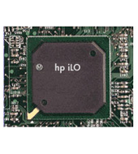
ProLiant Features
With the iLO and Virtual Media function, ability to boot from a machine hosting MondoRescue ISO images through a Web interface without physical media.
Smart Array support
Proliant NIC support
Hardware configuration info backup & recovery possible in a cloning approach (using hpacucli, hponcfg, conrep from SSSTK) – preliminary support in 2.2.5. Warning: can be dangerous so no automated.

Slide 15
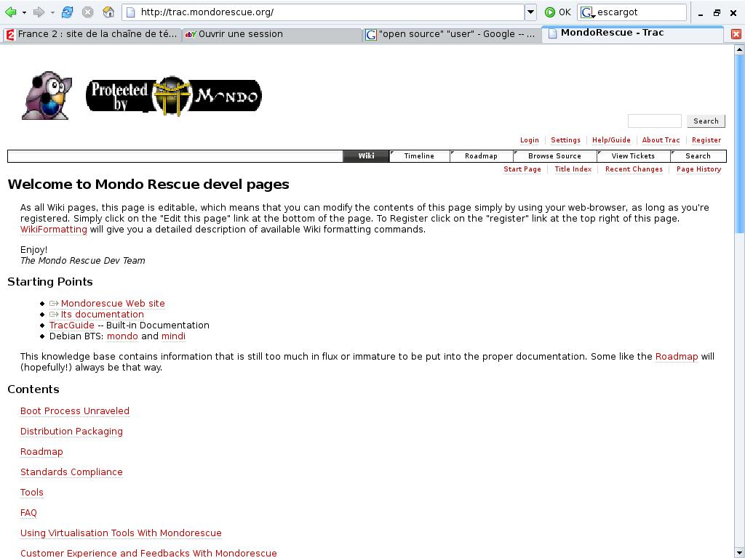

The Maintainer's View
Project Maintainer since Oct. 2005
New subversion repository (Thanks BerliOS – HP)
21 versions published with 2.2.9.4
New Build process (Generated pkgs => lead to project-builder.org)
65 distribution tuples (Thanks KVM)
New Website (Thanks Ayo)
Trac (400+ BR/ER declared – ¾ fixed already)
Mondorescue HOWTO Rewritten
Mailing List activity

Slide 16
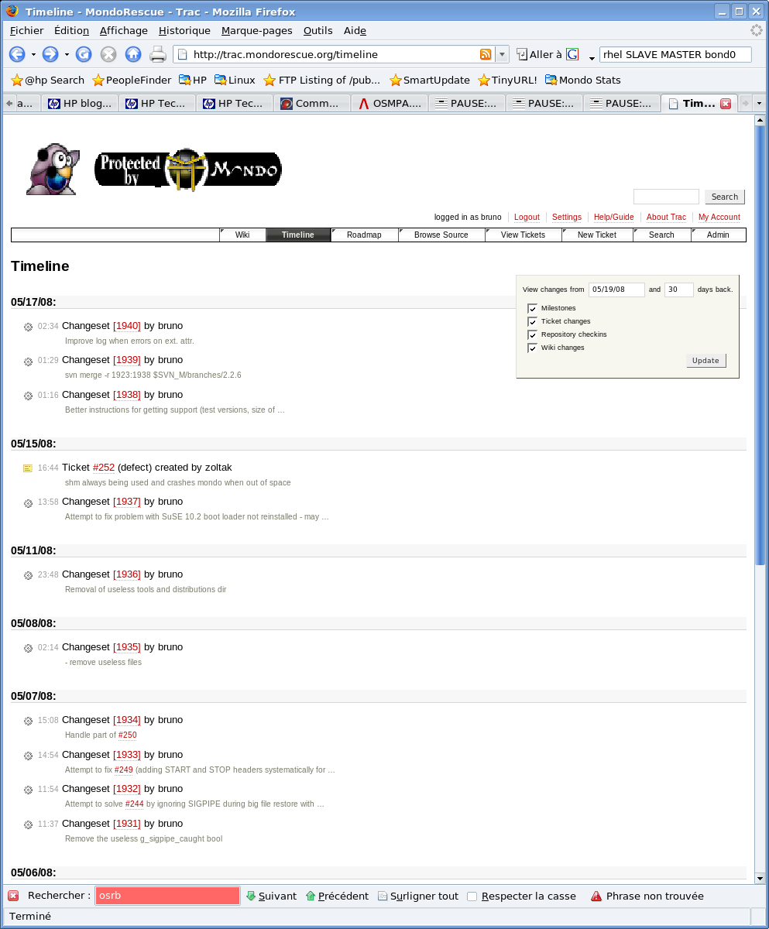

Project Lead: 2.2.5
bug fixes on 2.2.4
Better Ubuntu and Debian support
Proliant SSSTK support
ia64 support
USB key support
Udev support
Use Project Builder

Slide 17
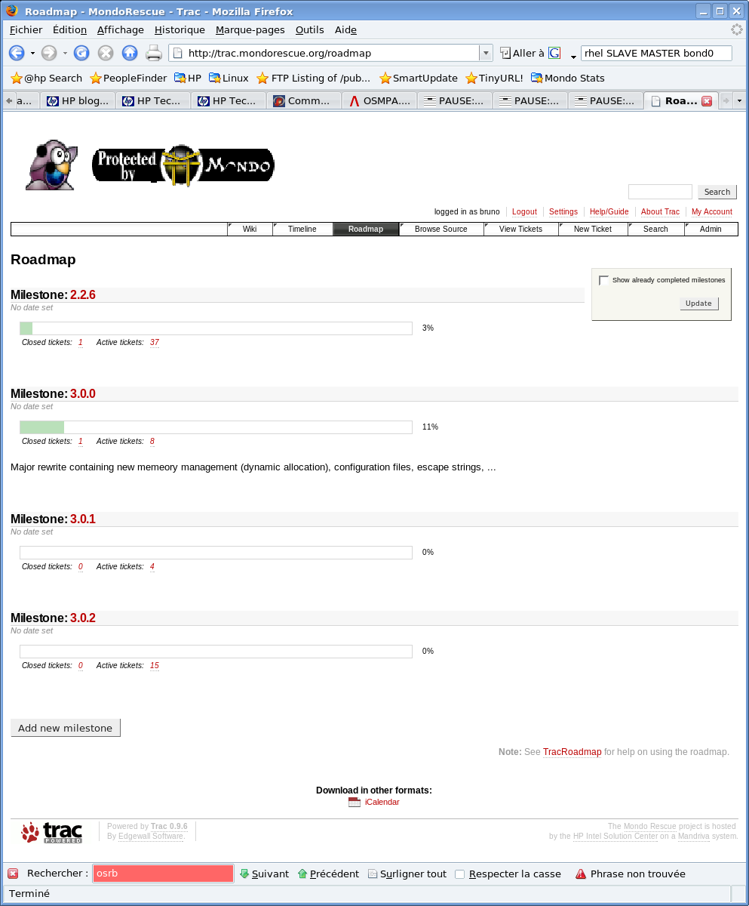
Project Lead: 2.2.6
bug fixes on 2.2.5
Gentoo x86_64 support
Better tape support (-G)
OBDR support
Remove floppy support
New cli params for mondorestore

Slide 18
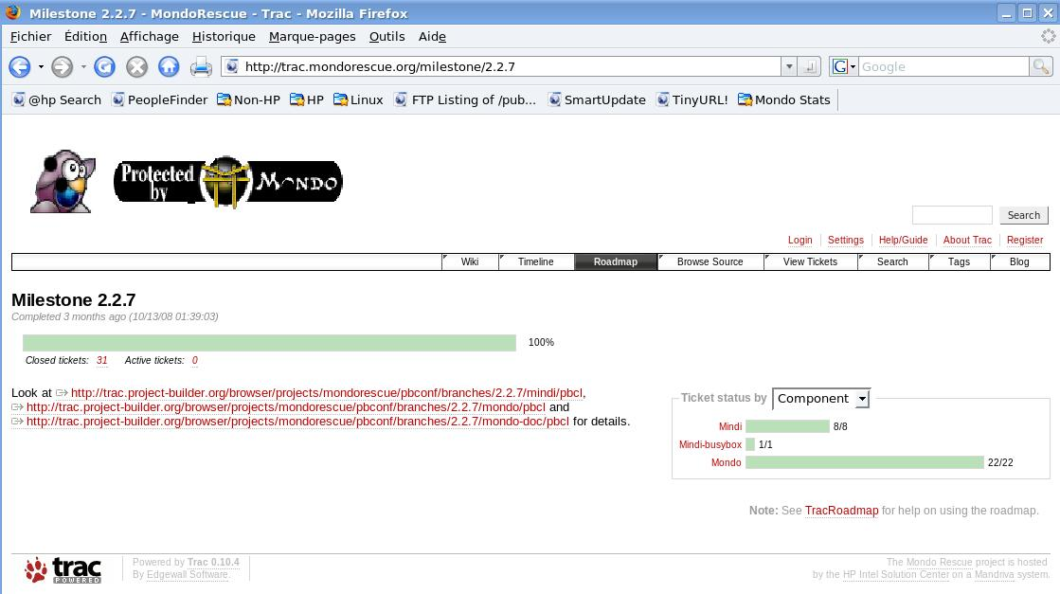
Project Lead: 2.2.7
bug fixes on 2.2.6
Improve USB support
Fix for debian x86_64
Support labeled reiserfs FS
Remove shm usage
OCFS2 preliminary support
-E/-I support devices

Slide 19
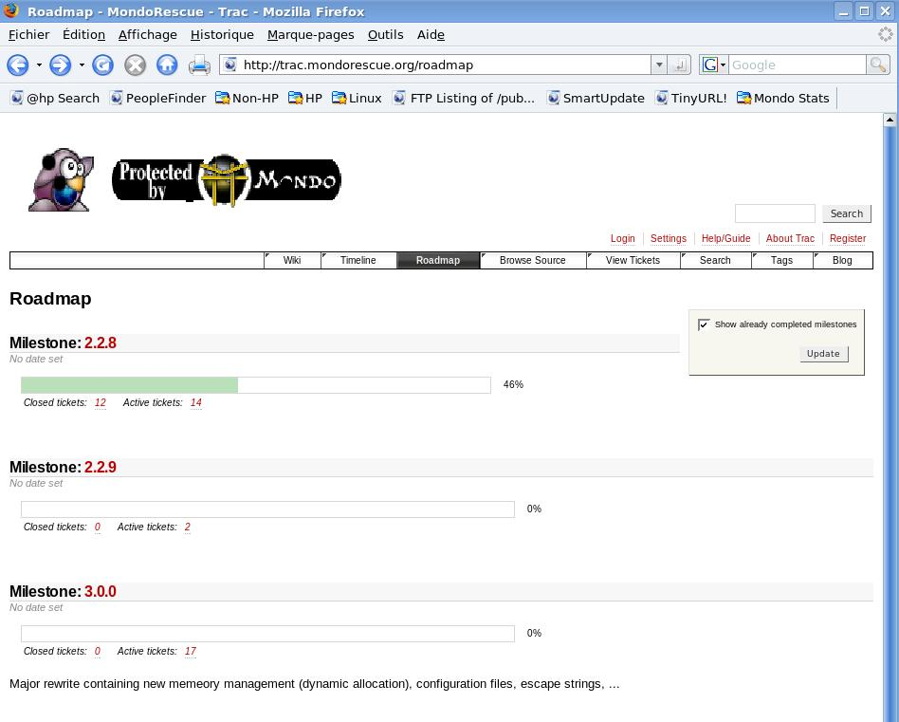
Project Lead: 2.2.8
bug fixes on 2.2.7
Ext4 support added
Fix OBDR on ia64
Adds 2.6.27 support
Adds multipath support
Adds RHAS 2.1 support

Slide 20
Project Lead: Stable branch
Long Time Support Version (2.2.9.x)
HW: Proliant DL160 G6 PXE (igb + e1000e, sata_via, …), Ia64 fixes
Kernel support: ext4, bzip2 initrd, multipath, SuSE ramdisk ...)
Memory management improvements (some), Increased mountlist limits
Features: NFS user + mount and SSHFS support, Pre and post scripts, SELinux support, USB key, OBDR, improved exclusion/inclusion support (LVM, device drivers, …)
Packages for RHAS 2.1, RHEL 6, Fedora 13/14, Mandriva 2010.1, OpenSuSE 11.3, SLES 11, Ubuntu 10.10 and urpmi/yum/apt related support

Slide 21
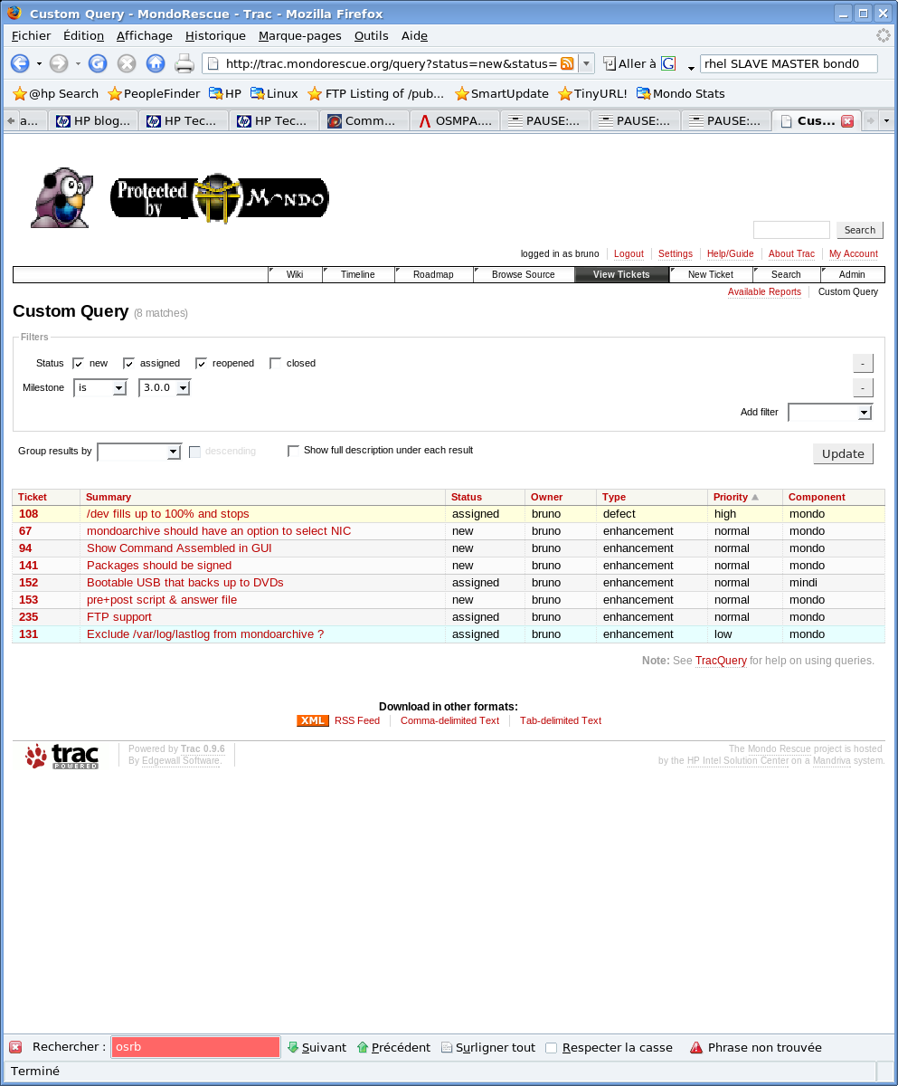
Project Lead: 3.0.0 / 2.2.10
Rewritten in perl (mindi first)
Busybox removal (2.2.10)
OS independance (FreeBSD)
Network protocol and setup independance
Internationalization (fr,us)
Configuration files
Support of all FS/LVM options
EFIbootmgr support
Software Engineering (test programs, splint, valgrind, fossology...)

Slide 22
And @HP ?
Used by various organizations (HP/Intel Solution Centers, CMS, APJ ESS Competency Lab, AMA ASC TSG, ES ITO, TS UK)
Consultancy
HP support contract part #: HA158AC MNUSWRCZ (Since Sept. 2009)
Help Desk
L0: Call login
Local CCR
L1: First investigation
BSS CC
Linux VCC
L2: In deep troubleshooting
MondoRescue
L3: Bug fixing - Evolution

Slide 23
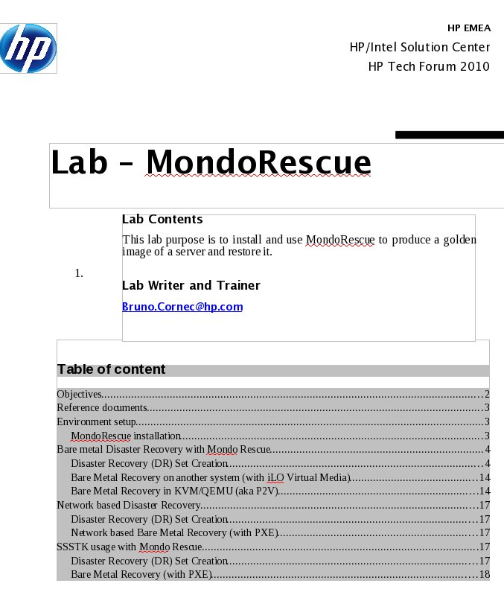
Learn MondoRescue
Start with the Lab (20 pages)
Use man (mondoarchive, mondorestore + mindi man pages)
Use the mailing-lists mondo-announce at https://lists.berlios.de/mailman/listinfo/mondorescue-announce and mondo-devel at http://lists.sourceforge.net/mailman/listinfo/mondo-devel
Look at the HOWTO: http://www.mondorescue.org/docs.shtml
Download and start using it from ftp://ftp.mondorescue.org

Slide 24

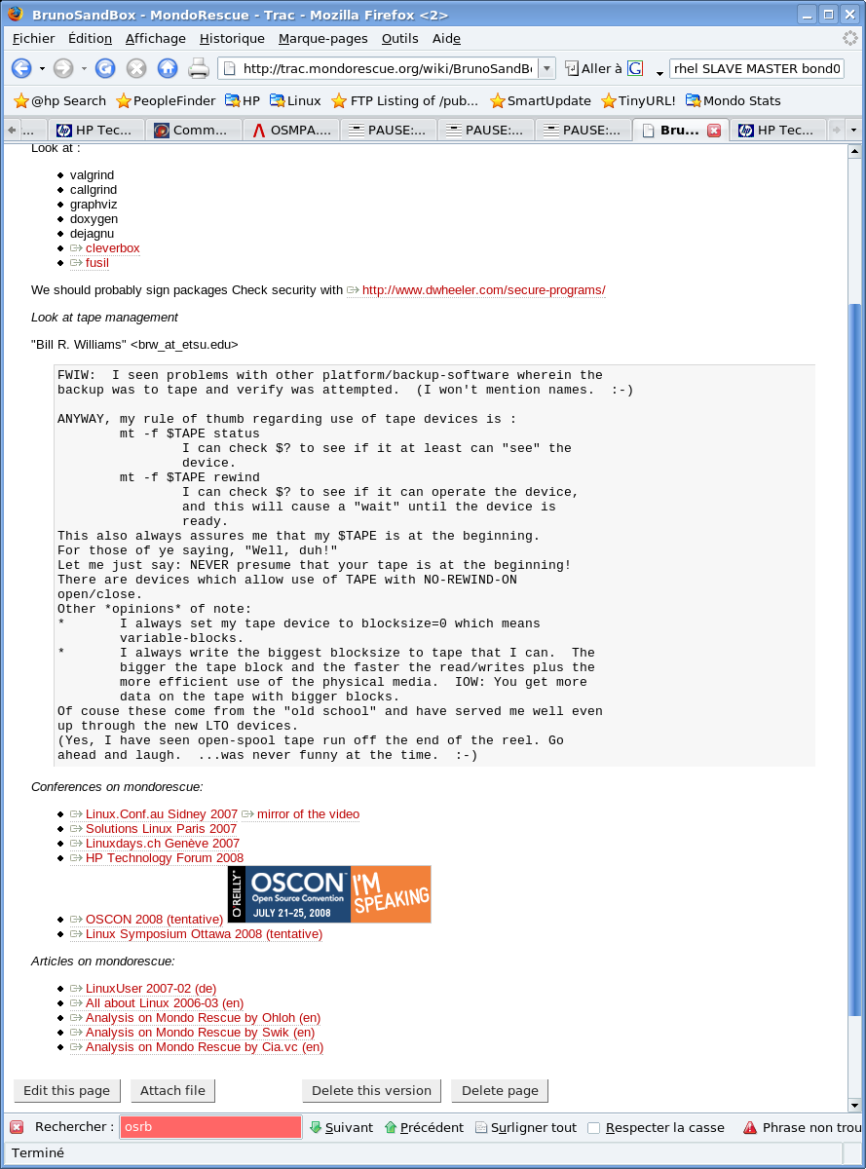
Web Resources
MondoRescue main site http://www.mondorescue.org
Trac / Wiki http://trac.mondorescue.org
Busybox http://www.busybox.net
Project-Builderhttp://trac.project-builder.org
Open Source at HPhttp://opensource.hp.com
ProLiant & Linux http://www.hp.com/go/proliantlinux
“The evolution of FLOSS
and the Internet are
tightly coupled”

Slide 25
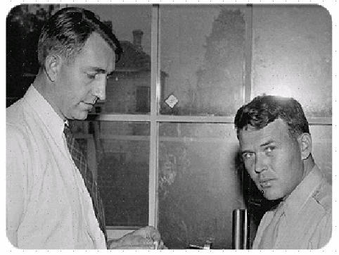

Contact – Thanks - Q&A
Bruno.Cornec@hp.com
(Open Source and Linux Technology Architect at the HP/Intel Solution Center)
http://www.hp.com/linux
http://opensource.hp.com
Thanks goes to:
Linus Torvalds, Richard Stallman, Eric Raymond, Nat Makarevitch, René Cougnenc, Eric Dumas, Rémy Card, Hugo Rabson, Bdale Garbee, Bryan Gartner, Craig Lamparter, Lee Mayes, Gallig Renaud, Andree Leidenfrost, Phil Robb, Bob Gobeille, Martin Michlmayr among others, for their work and devotion to the Open Source Software cause... and my family for their patience :-)
”Changes are never easy to make.
There is comfort and safety in tradition, but change must come, no matter how painful or expensive it may be.”
Bill Hewlett

