Slide 1
Presentation
Description and calling of function in Pascal & C.
Procedure.
The parameters : formal & actual.
Recursion.
Pointers & reference.

Slide 2
Description of Function
In Pascal
The definition of function/procedures is thus as such:
Function Func_Name(params...) : Return_Value;
Procedure Proc_Name(params...);
In C
In general, if we want to declare a function, we write:
type name(type1 arg1, type2 arg2, ...)
{
/* code */
}

Slide 3
Calling of Function
In Pascal
Function Bad(A, B, C : Integer) : Integer;
Bad := Add(Add(A,B),C);
In C
-- float f;
f = calculate_number();
-- int square_of_10;
square_of_10 = square(10);
-- say_hello();

Slide 4
Pascal Examples

Slide 5
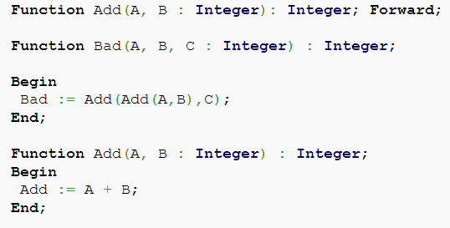
Example1
The function/procedure definition is usually followed by the local variables and the body. However, to provide prototypes, simply add a forward keyword behind the definition instead of the local variables and the body. Of course, the whole function must be defined somewhere else in the program.

Slide 6
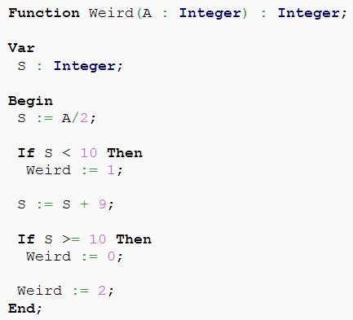
Example2
Note that unlike C or other languages, assigning a return value to a function does not return from the function. Thus, the function will continue executing.

Slide 7
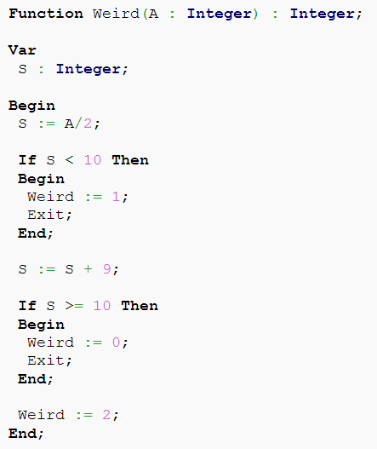
Example3
To mimic C style function returns, the exit statement must be used.
The exit statement in Pascal, unlike C, exits from the current block of code (in this case, the function), and NOT from the program.

Slide 8
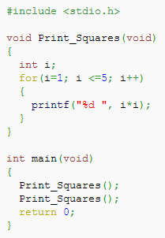
C Exampe
A function is often executed (called) several times, from several different places, during a single execution of the program.
After finishing a subroutine, the program will branch back (return) to the point after the call.

Slide 9
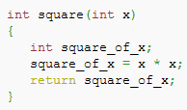
C Example
We have some terminology to refer to functions:
1) A function, call it f, that uses another function g, is said to call g.
2) A function's inputs are known as its arguments
3) A function g that gives some kind of answer back to f is said to return that answer.

Slide 10
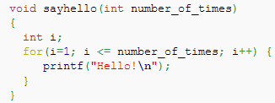
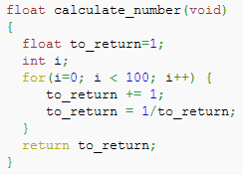
C Example
The function to return nothing:
A function that takes no arguments:

Slide 11
Procedure.
A procedure is set of instructions to be executed, with no return value.
In Pascal — procedure;
In C — void function;

Slide 12
The parameters : formal & actual.
Actual parameters.
The parameters, which we use to call the subprogram named ACTUAL.
Formal parameters.
The parameters, which we use in the description of subprogram is called FORMAL.

Slide 13
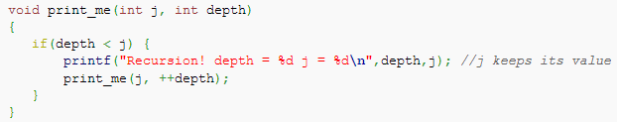
Recursion
A function calling itself is called recursion, and normally you will have a conditional that would stop the recursion after a small, finite number of steps.

Slide 14
Pointers & reference.
Pointers and references are complementary terms and are usually used to solved opposed problems.

Slide 15
Pointers in Pascal
There are three ways pointers are notated:
1) the "@" indicates the memory address of another type;
2) when "^" is placed before a name, you are asking for a pointer for a particular type, like a pointer to an integer or a char.
3) when "^" is placed after a name, you are asking for a dereference - for an existing pointer to return the variable it's referencing.

Slide 16
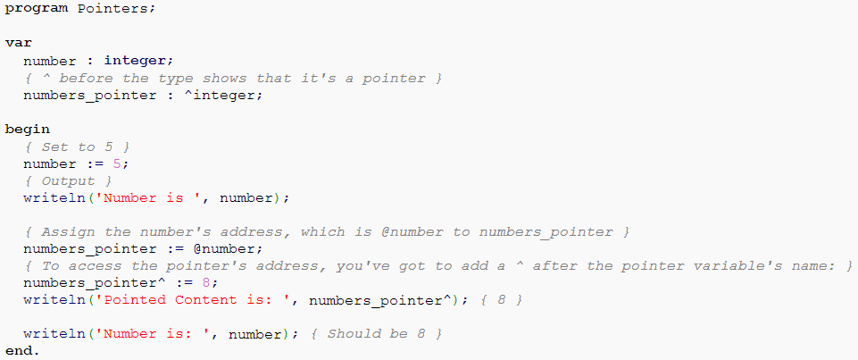
Example of using pointer in Pascal program

Slide 17
Pointers in C
There are four fundamental things you need to know about pointers:
1) How to declare them
2) How to assign to them
3) How to reference the value to which the pointer points (known as dereferencing) and
4) How they relate to arrays

Slide 18

1) How to declare them
In the following, line 1 declares var1 as a pointer to a long an var2 as a long and not a pointer to a long. In line 2, p3 is declared as a pointer to a pointer to an int.
The following shows how to declare a function which uses a pointer as an argument.

Slide 19
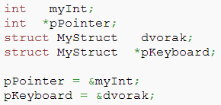
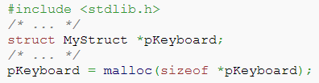
2) How to assign to them
To assign a pointer the address of a variable, the & or 'address of' operator is used.
Pointers can also be assigned to reference dynamically allocated memory.
The malloc() and calloc() functions are often what are used to do this.

Slide 20
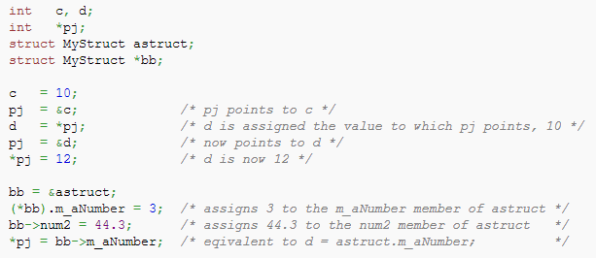
3) Pointer dereferencing
To access a value to which a pointer points, the * operator is used. Another operator, the -> operator is used in conjunction with pointers to structures.

Slide 21
4) How they relate to arrays
The interaction of pointers and arrays can be confusing but here are two fundamental statements about it:
1) A variable declared as an array of some type acts as a pointer to that type. When used by itself, it points to the first element of the array.
2) A pointer can be indexed like an array name.

Slide 22
Thank you for attantion
:) :) :)

