Slide 1
ASTRION OS
The AI runs inside the kernel.
A from-scratch operating system now runs its own neural network. On boot. Offline.
Milestone M7 · verified on a real boot · Jul 26 2026

Slide 2
WHAT JUST HAPPENED
The neural network runs in the OS itself —
not a cloud call, not a mock.
Astrion is a real x86-64 kernel written from scratch in C — no Linux underneath.
Today it loads a model at boot and generates text with it, entirely on the machine.
No internet. No floating point. Verified on a live boot this morning.

Slide 3
THE PROOF
Four things we watched happen — on a real boot, not a claim.
Loads at boot
The model is read straight from a boot module into the kernel.
It really computes
Different prompts pick different tokens — a real forward pass, not a canned reply.
Fully offline
No internet, no cloud. The whole model runs on the machine.
Safe & stable
Still asks before deleting a file. Zero crashes across the run.

Slide 4
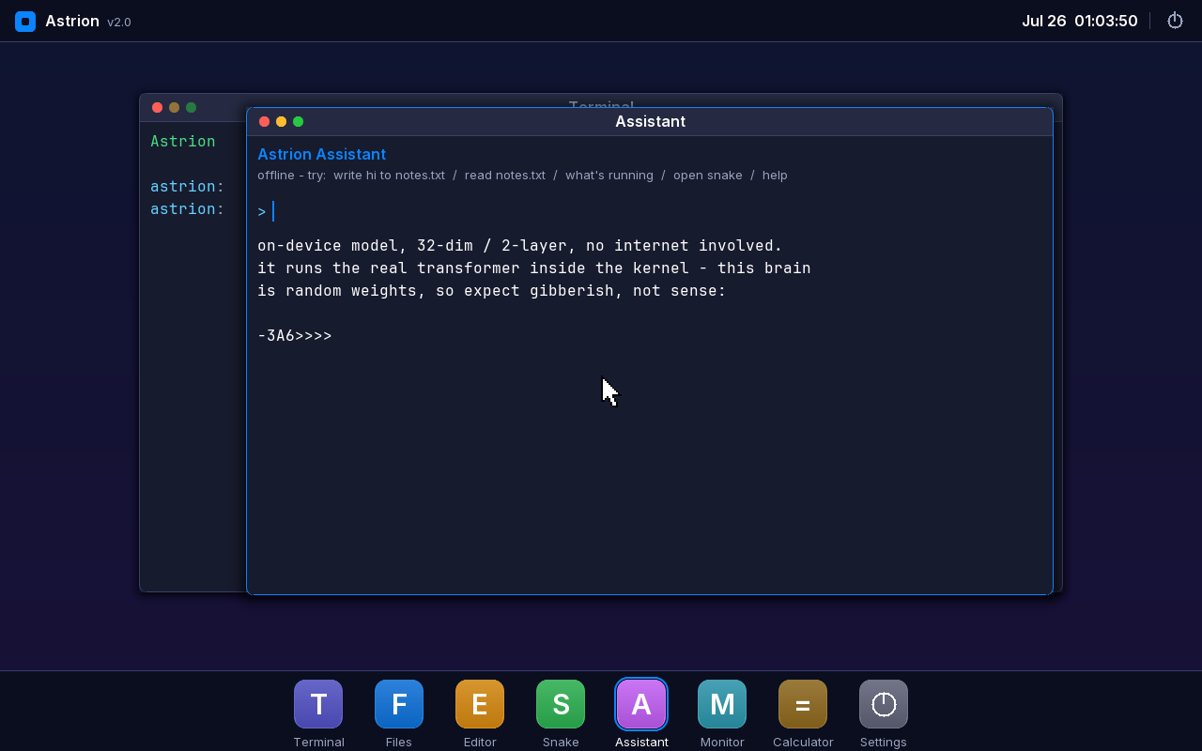
SEEN LIVE — THE ASSISTANT GENERATING IN THE OS
"on-device model … it runs the real transformer inside the kernel" — then live output.

Slide 5
WHY IT MATTERS
The AI is the product.
→ An AI-native OS where the AI actually lives in the OS — not bolted on top.
→ From-scratch kernel: we own every layer, top to bottom.
→ Offline by design — it physically doesn't need the internet.
→ Built by one 12-year-old developer.

Slide 6
WHAT'S NEXT
A real brain drops into the same slot.
Today's model is a tiny test brain — its words are gibberish on purpose. It proves the pipeline.
Ember — our own model — is pretraining now, and drops into this exact slot. The runway is built and checked end to end.

