Slide 1

GENOMICS × IMMUNO-ONCOLOGY
Predicting whether a tumor will
respond to immunotherapy
An interpretable, cancer-type-aware survival model that integrates tumor mutational burden with gene-level mutations — and a test of whether genes add value beyond TMB.
1,630
11
69
0.55 → 0.64
ICI-treated patients
cancer types
gene features
C-index: TMB → integrated
Data: Samstein et al., Nature Genetics 2019 · pulled live from the cBioPortal REST API
Notes:
Title. The clinical question: can we predict immunotherapy (immune checkpoint inhibitor) response from a tumor's DNA? We build an integrated, cancer-type-aware survival model on 1,630 ICI-treated patients and rigorously test whether gene-level data adds anything beyond tumor mutational burden (TMB).

Slide 2




THE PROBLEM
TMB is the FDA biomarker — but it is far from enough
Checkpoint inhibitors (anti–PD-1 / CTLA-4) transform outcomes — but only for some patients.
Tumor mutational burden (TMB ≥ 10 mut/Mb) is the FDA's tissue-agnostic biomarker, yet many high-TMB tumors still fail to respond (Rizvi 2015).
The literature points to a multi-signal, cancer-type-specific answer: TMB + neoantigens + resistance genes (B2M, JAK1/2) + cancer context.
1,630
patients treated with
immune checkpoint inhibitors
11
cancer types — pan-cancer,
not one tissue
RESEARCH QUESTION
Does integrating TMB with specific gene mutations and cancer-type context predict overall survival after immunotherapy better than TMB alone — and can gene context explain the high-TMB non-responders?
810
deaths (49.7%) — mature
overall-survival follow-up
ICIpredict · Samstein et al. 2019 (cBioPortal tmb_mskcc_2018, n = 1,630)
2
Notes:
The clinical problem and our question. TMB is approved but imperfect — high-TMB non-responders exist. We ask whether a multivariable, cancer-type-aware genomic model beats TMB alone on overall survival, using a large pan-cancer cohort.

Slide 3

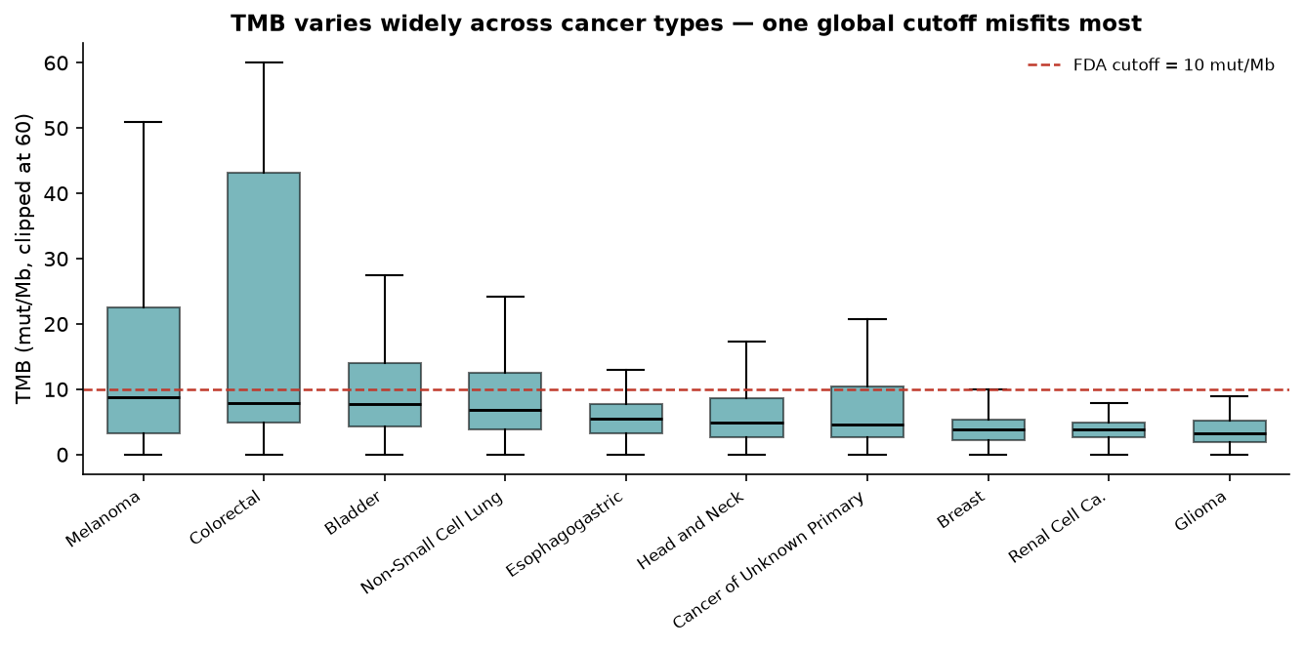
DATA & APPROACH
A reproducible, leakage-controlled survival pipeline
Cohort
Samstein 2019 (MSK-IMPACT), pulled live from the cBioPortal REST API; OS endpoint.
Features
log-TMB, age, sex, biopsy site, ICI drug class, cancer type, + 69 gene-mutation flags restricted to the IMPACT341 core (a 0 = wild-type, never “unsequenced”).
Models
Baselines (FDA cutoff, Samstein type-specific rule, Cox on TMB) vs integrated models (elastic-net Cox, random survival forest).
Rigor
Repeated stratified 5-fold CV; the elastic-net penalty is tuned inside each fold (nested CV); Harrell C, IPCW-C, time-AUC; paired bootstrap with Holm correction.
TMB spans orders of magnitude across cancer types — a single global cutoff misfits most. This is why cancer-type context matters.
ICIpredict · Samstein et al. 2019 (cBioPortal tmb_mskcc_2018, n = 1,630)
3
Notes:
Data and methods. Everything is pulled programmatically from cBioPortal for reproducibility. We restrict gene flags to the IMPACT341 core so a 0 truly means wild-type. Crucially, the elastic-net penalty is tuned inside each CV fold (nested CV) so the reported numbers carry no hyperparameter-selection optimism.

Slide 4
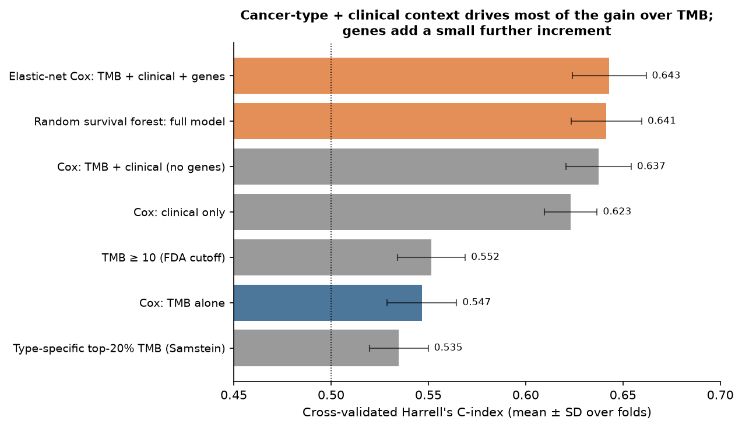
RESULT 1 — DISCRIMINATION
Integrated model beats TMB — but context, not genes, drives the gain
Cross-validated C-index
0.55 → 0.64
TMB alone → integrated model
TMB alone
0.55
+ clinical & cancer type
0.62
+ TMB on top
0.64
+ genes (full model)
0.64
Most of the lift over TMB is clinical + cancer-type context — an honest decomposition, not a black box.
ICIpredict · Samstein et al. 2019 (cBioPortal tmb_mskcc_2018, n = 1,630)
4
Notes:
Result 1. The integrated model lifts the C-index from 0.55 (TMB alone) to 0.64. But the decomposition is the honest story: clinical + cancer-type covariates already reach 0.62, TMB adds a bit, and genes add only a little more. We don't oversell the genomics.

Slide 5

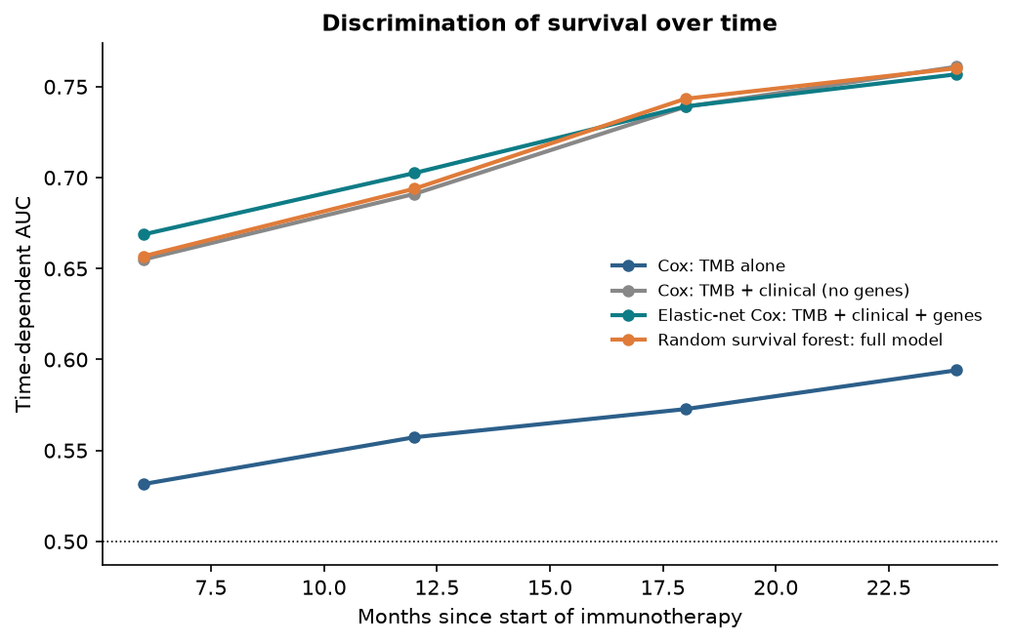

RESULT 2 — THE HONEST TEST
Do genes add value beyond TMB + clinical? Barely — and we say so.
Comparison (ΔC) | ΔC | 95% CI | Holm p | Verdict
Integrated vs TMB alone | +0.099 | [+0.08, +0.12] | 0.004 | robust ✓
Integrated vs TMB + clinical | +0.008 | [−0.003, +0.017] | 0.26 | not sig.
Forest vs TMB + clinical | +0.005 | [−0.005, +0.015] | 0.32 | null
Time-dependent AUC: integrated models lead at every horizon.
The win over TMB alone is real and robust. But the pure genomic increment over TMB + clinical is tiny (ΔC ≈ +0.008), its CI crosses zero, and it is not significant after multiplicity correction (a paired per-fold test detects a consistent but negligible +0.006).
On this cohort, gene flags add no robust gain beyond TMB + clinical + cancer type. Reporting that honestly — instead of overclaiming — is the scientifically correct call.
ICIpredict · Samstein et al. 2019 (cBioPortal tmb_mskcc_2018, n = 1,630)
5
Notes:
Result 2 is the honest test. We compare four model pairs with a paired bootstrap and Holm multiplicity correction. The big advantage over TMB alone is robust. The pure genomic increment over TMB+clinical is only ~+0.01, Coxnet-specific, and marginal — so we label it suggestive, not established.

Slide 6

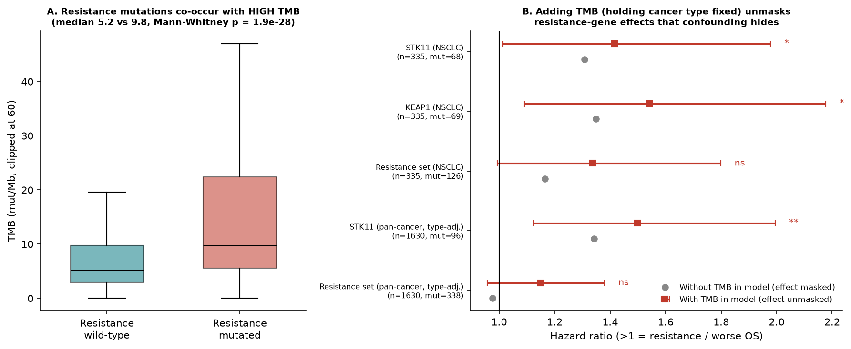
RESULT 3 — THE INTEGRATION INSIGHT
Why high-TMB non-responders evade the eye: TMB masks resistance genes
Resistance mutations hide inside high TMB
STK11/KEAP1/B2M mutations occur preferentially in high-TMB tumors (9.8 vs 5.2 mut/Mb, p≈10⁻²⁸). Because high TMB is favorable, their harm is masked.
Hazard ratio without → with TMB
STK11 (NSCLC)
1.31 → 1.42
p=0.041
KEAP1 (NSCLC)
1.35 → 1.54
p=0.014
STK11 (pan-cancer*)
1.34 → 1.50
p=0.006
Holding cancer type fixed and adding TMB unmasks STK11/KEAP1 as resistance markers — the mechanism behind “TMB necessary but not sufficient.” *type-adjusted
ICIpredict · Samstein et al. 2019 (cBioPortal tmb_mskcc_2018, n = 1,630)
6
Notes:
Result 3 — the novel insight. Rizvi 2015 saw high-TMB tumors that didn't respond but couldn't explain it by eye. We show why: resistance-gene mutations co-occur with high (favorable) TMB, so their harmful effect is masked by positive confounding. Hold cancer type fixed and add TMB to the model, and STK11/KEAP1 emerge as resistance markers (HR ~1.4-1.5). This is the mechanistic reason an integrated model can beat TMB alone.

Slide 7

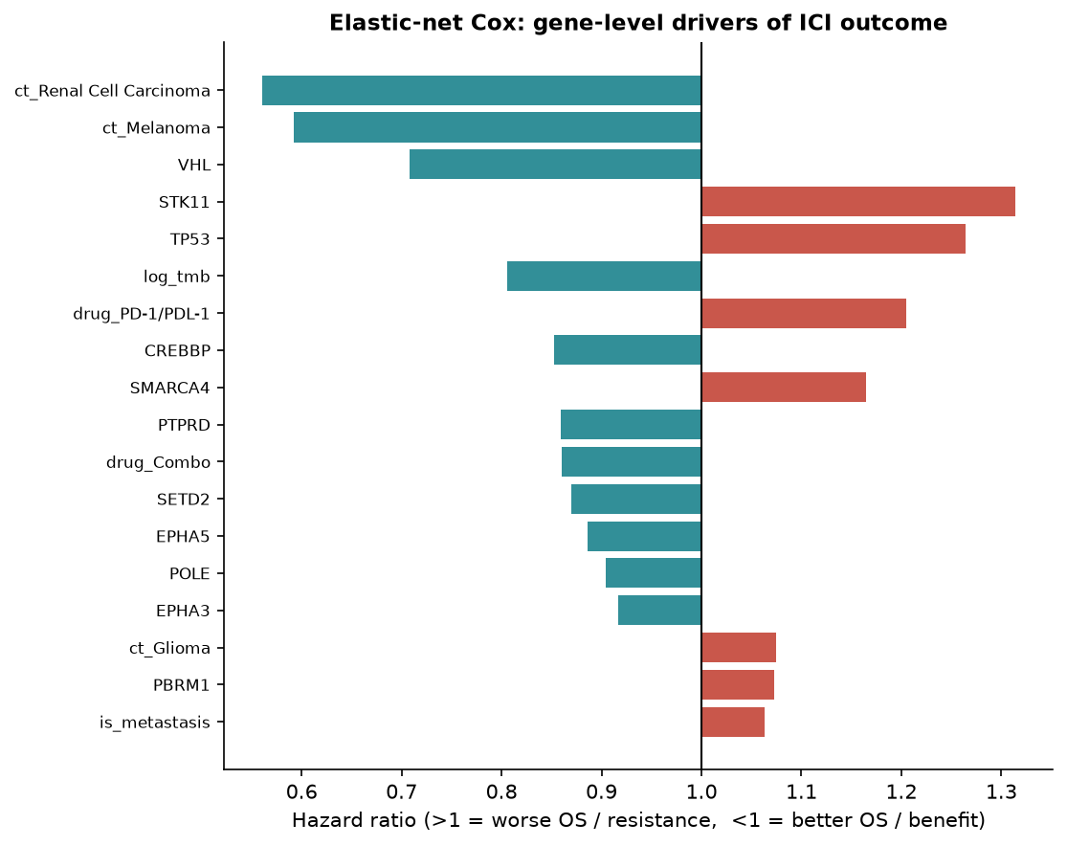

INTERPRETABILITY
What the model learned — and it lines up with the biology
Worse survival (resistance)
STK11 · KEAP1 · SMARCA4 · TP53 · glioma context — known cold-tumor / ICI-resistance biology.
Better survival (benefit)
Higher TMB · melanoma & renal-cell context · VHL — the most ICI-responsive settings in the clinic.
ICIpredict · Samstein et al. 2019 (cBioPortal tmb_mskcc_2018, n = 1,630)
7
Notes:
Interpretability. The elastic-net Cox coefficients are biologically sensible: STK11, KEAP1, SMARCA4, TP53 and glioma context push toward worse survival (resistance), while higher TMB, melanoma/renal context and VHL push toward benefit. The model recovers known immuno-oncology biology rather than memorizing noise.

Slide 8

SYNTHESIS
One model that ties the group's five sources together
Lee & Samstein — TMB
Rizvi — mutational landscape
Jamieson & Maker — resistance
We reproduce TMB's signal and show the FDA cutoff and Samstein's type-specific rule both under-perform a cancer-type-aware multivariable model.
POLE/MMR track benefit; and we give a concrete reason high-TMB non-responders evade the eye — masking by TMB and cancer type.
STK11/KEAP1 carry the expected resistance direction once TMB and type are modeled — consistent with acquired-resistance biology.
ICIpredict · Samstein et al. 2019 (cBioPortal tmb_mskcc_2018, n = 1,630)
8
Notes:
Synthesis. The project isn't a one-off model — it operationalizes the group's five annotated sources into a single tested hypothesis, reproducing TMB's signal, explaining Rizvi's non-responders, and recovering Jamieson & Maker's resistance genes.

Slide 9

HONESTY & NEXT STEPS
What this does not show — and where it goes next
Limitations
Next steps
Targeted panel, not whole-exome; no PD-L1, RNA / IFN-γ signature, or neoantigen calling.
Mutation flag = any non-silent variant present — not demonstrated functional loss.
OS, single institution (MSK), retrospective, no ICI-vs-control arm — can't separate predictive from prognostic.
Genomic increment is small and Coxnet-specific: suggestive, not established.
External validation on independent ICI whole-exome cohorts (Hugo, Van Allen, Liu).
Add PD-L1, IFN-γ expression signature, and neoantigen burden as features.
Strictly fold-local gene selection + functional (loss-of-function) annotation.
Per-cancer-type models where sample size allows (NSCLC, melanoma, bladder).
ICIpredict · Samstein et al. 2019 (cBioPortal tmb_mskcc_2018, n = 1,630)
9
Notes:
Limitations and next steps. We're explicit about what the data can't show: targeted panel, OS-only, single center, no control arm, and a small genomic increment. Next: external WES validation, richer features (PD-L1, RNA, neoantigens), fold-local + functional gene annotation, and per-cancer models.

Slide 10
KEY TAKEAWAYS
What we can — and cannot — claim
1
Integration beats TMB alone. C-index 0.55 → 0.64 — but most of that gain is clinical + cancer-type context, honestly decomposed.
2
Gene flags add almost nothing — and we say so. The increment over TMB + clinical is ~+0.008, CI crosses zero, not significant after multiplicity correction. We don't overclaim.
3
TMB masks resistance genes. STK11/KEAP1 only reveal their harm once TMB and cancer type are modeled jointly — explaining high-TMB non-responders.
Method, data, and figures are fully reproducible: python main.py → results/report.md
Notes:
Takeaways. Three honest claims: (1) integration beats TMB alone, mostly via clinical/cancer-type context; (2) the pure genomic increment is small and we don't oversell it; (3) the real conceptual contribution is showing TMB masks resistance genes, which explains the high-TMB non-responders. Everything reproduces from one command.

