Slide 1

HR Analytics for Employee Attrition using ML
Group: BE-A-18
Guide: Prof. Shamika Mule
Members:
Virag Hote
Vinay Hirap
Akshada Gupta
Deepak Battula

Slide 2
Problem Statement
Employee attrition is a major challenge for organizations, leading to reduced productivity and high hiring costs. Accurately predicting which employees might leave and developing effective strategies to retain them is essential for maintaining a stable and productive workforce, thus improving overall company performance.

Slide 3
Objective
Develop a machine learning model to predict employee attrition and design strategies to retain employees. This project aims to identify the key factors that lead to employees leaving and provide actionable insights to help create personalized retention plans, reducing overall turnover rates.

Slide 4
Scope
Real-time Attrition Prediction & Risk Assessment: Implements machine learning models for real-time employee attrition risk monitoring, dynamically adjusting to changes in employee behavior using reinforcement learning.
- Key Feature Identification & Data Preprocessing: Leverages Random Forest to identify critical attrition factors, with robust data cleaning techniques applied to ensure high-quality analysis from the IBM Employee dataset.
- Comprehensive Insights & Data Privacy: Integrates quantitative analysis with employee feedback, ensuring ethical data handling and compliance with privacy regulations throughout the project.

Slide 5
Research Paper Title & Year | Authors | Summary
Predicting Employee Attrition through HR Analytics: A Machine Learning Approach (2024) | Dr. Pooja Nagpa, Dr. Avinash Pawar, Dr. Sanjay. H.M | 1. The paper explores predicting employee attrition using HR analytics and ML techniques. 2. It evaluates ML algorithms like Decision Trees, Random Forests, and XGBoost. 3. XGBoost is found to be highly effective in improving attrition prediction accuracy for retention strategies.
Prediction of Employee Attrition Using Stacked Ensemble Method (2023) | Sanjay Gowdru, Suyash Kumar Dubli, Pooja Agarwal, Bhoomika | 1. The paper examines predicting employee attrition using HR analytics and various Machine Learning techniques. 2. It evaluates multiple ML algorithms like Decision Trees, Random Forests, CNNs, SVMs, and XGBoost for their prediction effectiveness. 3. XGBoost is identified as particularly effective in improving attrition prediction accuracy, aiding in targeted retention strategies.

Slide 6
Research Paper Title & Year | Authors | Summary
A New Approach for Employee Attrition Prediction (2022) | Lydia Douaidi, Hamamache Kheddouci | 1. The paper proposes a novel approach for predicting employee attrition using Machine Learning and bipartite graphs to model employee-company relationships. 2. It introduces interaction-based features derived from social connections between employees, enhancing prediction accuracy. 3. The study finds that tree-based classifiers like Random Forest and Gradient Boosting are highly effective, with social connection features playing a key role in attrition prediction.
Employee Attrition Prediction Using Deep Neural Networks (2021) | Salah Al-Darraji, Dhafer G. Honi, Francesca Fallucchi, Ayad I. Abdulsada | 1. The paper proposes using deep neural networks for employee attrition prediction, focusing on improving accuracy through preprocessing and balancing techniques. 2. The study analyzes the IBM HR dataset, identifying key features like overtime, job level, and monthly income as significant predictors of attrition. 3. The model achieves high prediction accuracy, outperforming other state-of-the-art methods, with results of 91.16% accuracy on the original dataset and 94.16% on a balanced version.

Slide 7
Research Paper Title & Year | Authors | Summary
An Improved Machine Learning Based Employees Attrition Prediction Framework with Emphasis on Feature Selection(2021) | Saeed Najafi-Zangeneh, Naser Shams-Gharneh, Ali Arjomandi-Nezhad | 1. The paper proposes an improved framework for predicting employee attrition using machine learning, emphasizing feature selection through the "max-out" algorithm. 2. Logistic regression is used for the prediction, with key features like "years since last promotion," "overtime," and "number of companies worked" identified as the most influential factors for attrition. 3. The framework shows enhanced prediction performance, particularly in F1-score, compared to previous methods, validating the model's stability through bootstrap analysis.
A Comparison of Machine Learning Approaches for Predicting Employee Attrition(2022) | Filippo Guerranti, Giovanna Maria Dimitri | 1. The study compares machine learning models for predicting employee attrition, focusing on accuracy and interpretability. 2. Logistic Regression and Random Forest models perform best, identifying factors like low job satisfaction and poor work-life balance as key reasons for attrition. 3. The research highlights the importance of model interpretability in understanding and addressing employee turnover.

Slide 8
Research Paper Title & Year | Authors | Summary
Comparative Analysis of Machine Learning Models on Employees’ Attrition Prediction(2024) | Christianah O. Akinduyite, Abiodun Oguntimilehin , Bukola Badeji-Ajisafe, Stephen E. Obamiyi | 1. The paper develops a machine learning-based system to predict employee attrition using data from Kaggle, aiming to help organizations identify potential turnover risks. 2. Four machine learning techniques—Decision Tree, Logistic Regression, Random Forest, and Naïve Bayes—were used to create predictive models, with the best-performing model integrated into a web application. 3. The system was built using Python and Django, and is intended to assist organizations in proactively managing employee attrition.
Employee Attrition Analysis Using XGBoost(2024) | Isha; Nitin Thapliyal, Sheetal Solanki | 1. The paper analyzes employee attrition using machine learning algorithms, including Random Forest, Logistic Regression, XGBoost, and ensemble stacking. 2. XGBoost was identified as the best-performing model with 88% accuracy and 89% precision. 3. Key factors contributing to attrition were identified as monthly income, age, and distance from home.

Slide 9
Research Paper Title & Year | Authors | Summary
Analyzing Employee Retention Factors using Machine Learning(2024) | Moshiur Rahman Md Rashedul Islam Partho Bala | 1.The proposal aims to analyze employee retention factors in software companies using machine learning techniques, leveraging Watson Analytics for advanced insights. 2.A predictive model will be developed to identify key factors influencing attrition, providing actionable recommendations for improving retention strategies. 3.The research seeks to create a data-driven, proactive approach to talent management, ultimately enhancing long-term organizational success by retaining top talent.
Classification and Prediction of Employee Attrition Rate using Machine Learning Classifiers(2024) | Umang Garg Neha Gupta Mahesh Manchanda | 1. The research analyzes employee attrition using machine learning algorithms, including Random Forest, Adaboost, XGBoost, and ensemble stacking. 2. Random Forest was identified as the most effective algorithm with an accuracy of 87.41% and precision of 88%. 3. The study highlights that factors like monthly income significantly influence employees' decisions to leave their jobs..

Slide 10
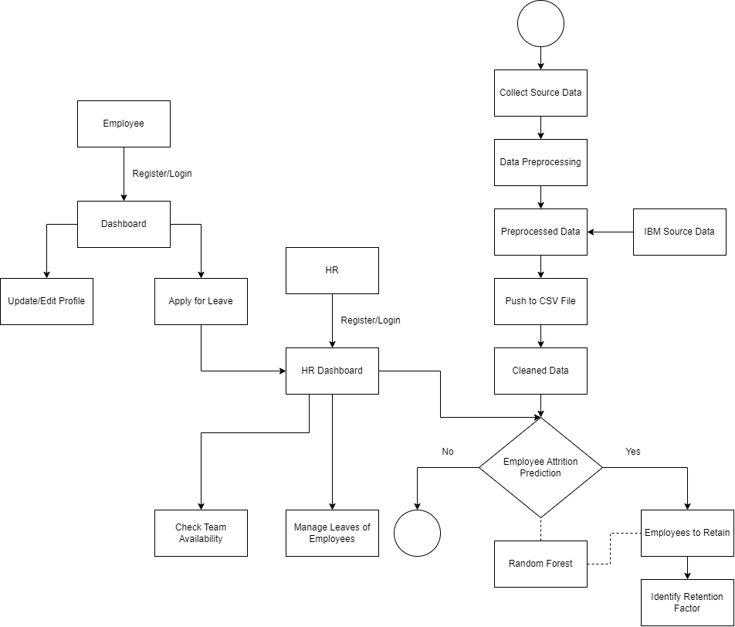
Architecture Diagram
Start

Slide 11
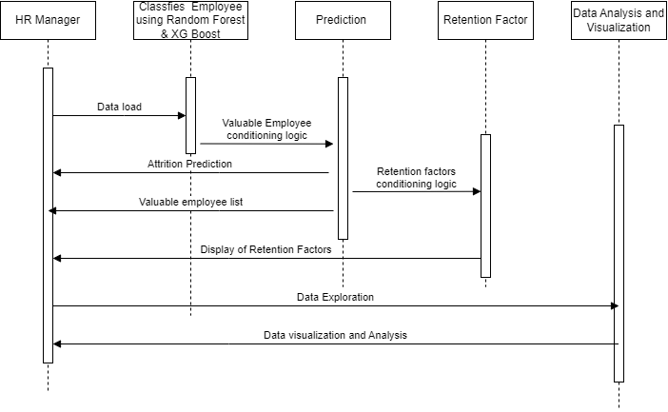
Sequence Diagram

Slide 12
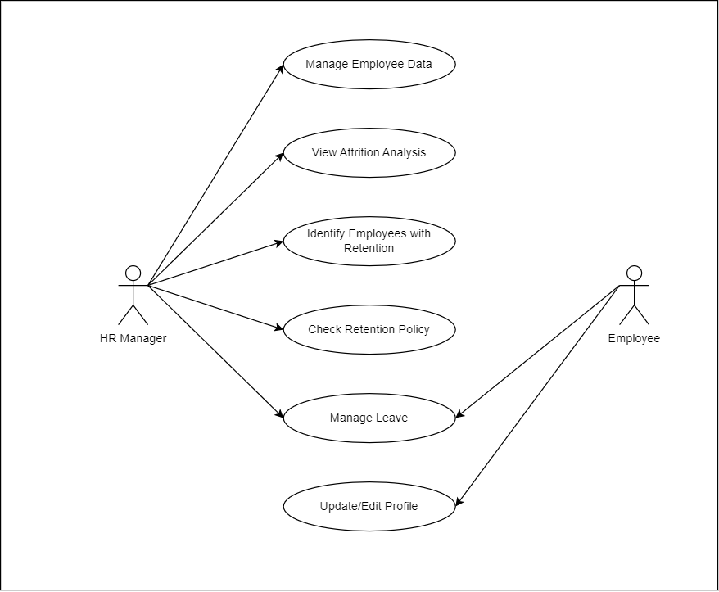
Use Case Diagram

Slide 13
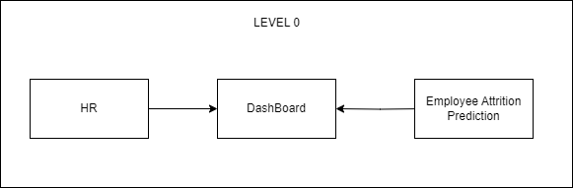
DFD Diagram

Slide 14
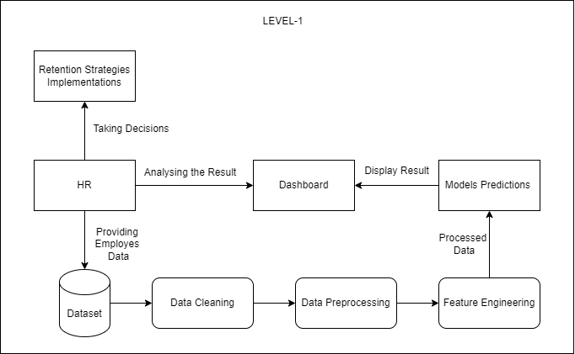

Slide 15
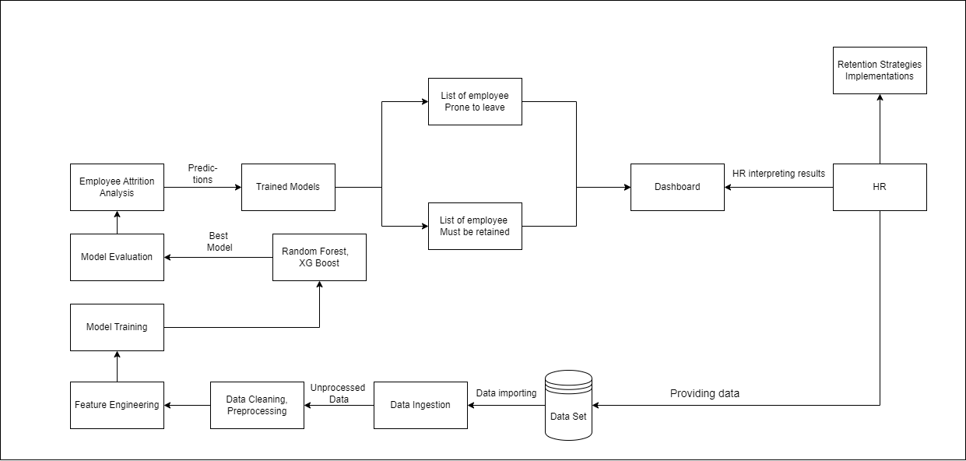
LEVEL-2

Slide 16
Dataset:
IBM HR Analytics Employee Attrition & Performance
https://www.kaggle.com/datasets/pavansubhasht/ibm-hr-analytics-attrition-dataset
Dataset Attributes:
01] Age
02] Attrition
03] BusinessTravel
04] DailyRate
05] Department
06] DistanceFromHome
07] Education
08] EducationField
09] EmployeeCount
10] EmployeeNumber
11] EnvironmentSatisfaction
12] Gender
13] HourlyRate
14] JobInvolvement
15] JobLevel

Slide 17
16] JobRole
17] JobSatisfaction
18] MaritalStatus
19] MonthlyIncome
20] MonthlyRate
21] NumCompaniesWorked
22] Over18
23] OverTime
24] PercentSalaryHike
25] PerformanceRating
26] RelationshipSatisfaction
27] StandardHours
28] StockOptionLevel
29] TotalWorkingYears
30] TrainingTimesLastYear
31] WorkLifeBalance
32] YearsAtCompany
33] YearsInCurrentRole
34] YearsSinceLastPromotion
35] YearsWithCurrManager

Slide 18
References
[1] Dr. Pooja Nagpa, Dr. Avinash Pawar, Dr. Sanjay. H.M (2024). Predicting Employee Attrition through HR Analytics: A Machine Learning Approach.
[2] Christianah O. Akinduyite, Abiodun Oguntimilehin, Bukola Badeji-Ajisafe, Stephen E. Obamiyi (2024) Comparative Analysis of Machine Learning Models on Employees’ Attrition Prediction.
[3] Isha Nitin Thapliyal, Sheetal Solanki (2024). Employee Attrition Analysis Using XGBoost.
[4] Moshiur Rahman, Md Rashedul Islam, Partho Bala (2024). Analyzing Employee Retention Factors using Machine Learning.
[5] Umang Garg, Neha Gupta, Mahesh Manchanda (2024). Classification and Prediction of Employee Attrition Rate using Machine Learning Classifiers.
[6] Sanjay Gowdru, Suyash Kumar Dubli, Pooja Agarwal, Bhoomika (2023). Prediction of Employee Attrition Using Stacked Ensemble Method.

Slide 19
Thank You!!!

