Slide 1

Hotel Survey Analysis:
Insights Based on Guest Expectations vs. Experiences
Overview:
Out of 47 guests, 42 responded to both check-in and check-out surveys. *Note: The remaining 5 guests are assumed not to have checked out yet and are therefore excluded from the analysis.
Each questionnaire included multiple-choice responses from the same 11 entries.
Objective: Analyze what persuaded guests to make reservations at the hotel vs. what impressed them after their stay. Evaluate marketing effectiveness and service performance.
Data cleaned, one-hot encoded (converted to binary responses), and visualized to extract insights.
1
May 2025
1

Slide 2
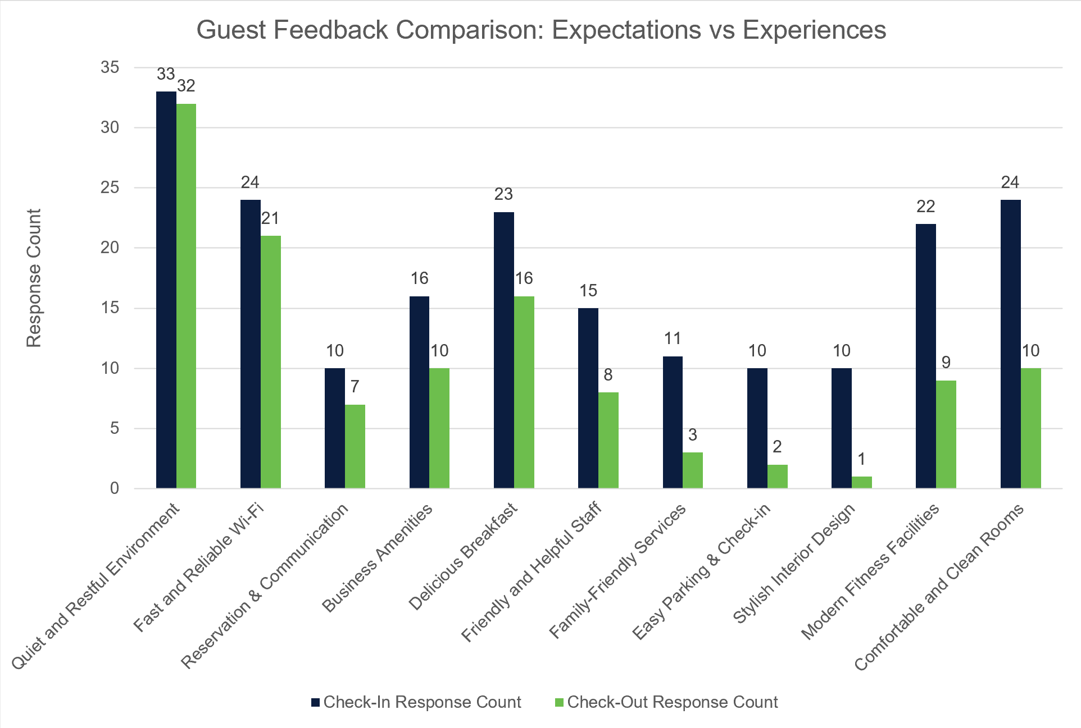
Response “Quiet and Restful Environment” Shows a Strong Positive Impact
- Mentioned by ~78% guests at check-in
- Appreciated by ~76% guests at check-out
*Only a 2% drop indicates a STRONG SATISFACTION – a feature both well-marketed and well-delivered
Responses “Comfortable and Clean Rooms” and “Modern Fitness Facilities” Indicate Missed Expectations
- “Comfortable and Clean Rooms”
- Mentioned by ~57% guests at check-in
- Appreciated by ~23% guests at check-out
- “Modern Fitness Facilities”
- Mentioned by ~52% guests at check-in
- Appreciated by ~21% guests at check-out
*Drop of 34% and 31%, respectively, signals a significant SERVICE GAP – these promoted features require improvement
“Fast and Reliable Wi-Fi” and “Delicious Breakfast” Are Appreciated but Not Marketed Enough
Key Findings

Slide 3
Recommendations for Hotel Management
Marketing & Messaging:
Emphasize “Quiet and Restful Environment” and “Wi-Fi Reliability” in marketing materials.
Reevaluate messaging around “Comfortable and Clean Rooms” and “Fitness Facilities” – expectations do not align with guest experience.
1
2
Operational Improvement:
Audit housekeeping protocols to ensure room comfort meets guest expectations.
Improve offerings for “Fitness Facilities”.
Amplify Hidden Strength:
Promote “Fast and Reliable Wi-Fi” and “Delicious Breakfast” more in ads and messaging – potential to drive high satisfaction
3
4
Continue Feedback Tracking:
Continuously collect guest feedback and analyze survey data quarterly to stay aligned with guest expectations

Slide 4
Thank You
Viraj Dhane
4
4

