Slide 1



What is Content Marketing?
Content marketing is the creation and distribution of valuable, relevant, and consistent content to attract and retain a clearly defined audience.
by Raj Palkar

Slide 2


Benefits of Content Marketing
1
Increased Brand Awareness
2
Stronger Customer Relationships
Reach a wider audience through organic content and online channels.
Build trust and loyalty by providing valuable insights and solutions.
3
Enhanced Lead Generation
4
Improved Website Traffic
Drive qualified leads through targeted content and calls to action.
Attract more visitors and improve search engine rankings.

Slide 3
Developing a Content Marketing Strategy
Define Target Audience
1
Identify demographics, interests, and online behavior.
2
Set Content Goals
Establish objectives for brand awareness, lead generation, or sales.
Choose Content Formats
3
Select relevant formats like blog posts, infographics, or videos.
4
Develop Content Calendar
Plan content creation and distribution across various channels.
Monitor and Evaluate
5
Track performance metrics and make adjustments as needed.

Slide 4


Creating Engaging Content
High-Quality Content
Compelling Storytelling
Provide valuable insights, research, and actionable information.
Connect with the audience through engaging narratives and personal experiences.
Visual Appeal
Promote Content
Use high-quality images, videos, and infographics to enhance visual engagement.
Share content on social media platforms and email newsletters.

Slide 5

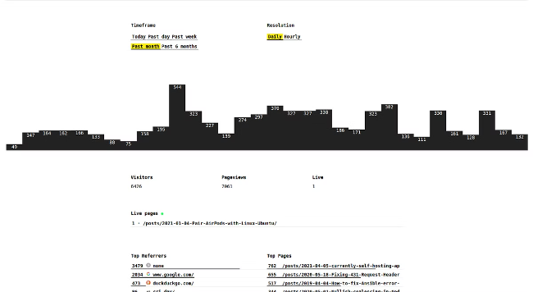
Measuring and Optimizing Content Performance
Metric
Description
Website Traffic
Number of visitors and page views.
Engagement
Likes, comments, shares, and time spent on content.
Lead Generation
Number of leads generated through content offers.
Conversion Rates
Percentage of visitors who complete a desired action.
Return on Investment (ROI)
Measure the financial impact of content marketing efforts.

