Slide 1




Driver Drowsiness Detection System
By
SE_IT_11_Burhanuddin Dilshad
SE_IT_16_Viraj Gholap

Slide 2
Problem Definition :-
Driver drowsiness is one of the main causes of road accidents
around the world.
Due to lack of sleep and tiredness , drowsiness can occur while driving.
The best way to avoid accidents caused by driver’s drowsiness
is to detect drowsiness of the driver and warn him before fall into sleep.

Slide 3
Objective of the project :-
To design a system that will detect drowsiness and
take necessary steps to avoid accidents.
To ensure the safety system.
The driver drowsiness detection system, being implemented in
this project aims at being easily available and
can be used with different types of vehicles.

Slide 4
About project ...
In this project , we have build a system using
Python , OpenCV and Keras which will alert the driver
when he feels sleepy.
In this system , we have used OpenCV for gathering
the images from webcam and feed them into
a Deep Learning model
which will classify whether the person’s eyes are
‘Open’ or ‘Closed’.

Slide 5
How our project works...
Step 1 – Take image as input from a camera.
Step 2 – Detect the face in the image and create a Region of Interest (ROI).
Step 3– Detect the eyes from ROI and feed it to the classifier.
Step 4 – Classifier will categorize whether eyes are open or closed.
Step 5 – Calculate score to check whether the person is drowsy.

Slide 6
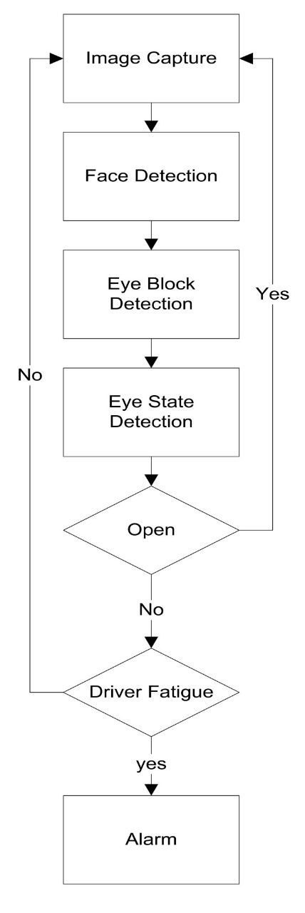
‹#›

Slide 7
Technology Requirements :-
Webcam
Python (3.6 Version)
Packages used -
OpenCV
TensorFlow
Keras
Pygame

Slide 8
Future Scope :-
The model can be improved by using other parameters like
blink rate, yawning, state of the car, etc.
Also by adding a sensor to track the heart rate of the driver
in order to prevent accidents
caused due to sudden heart attacks to drivers.

Slide 9
Conclusion :-
The drowsiness detection system developed
is capable of detecting drowsiness in a rapid manner.
The system can differentiate normal eye blink and
drowsiness which can prevent the driver from
entering the state of sleepiness while driving.

Slide 10
Thank you..

