Slide 1
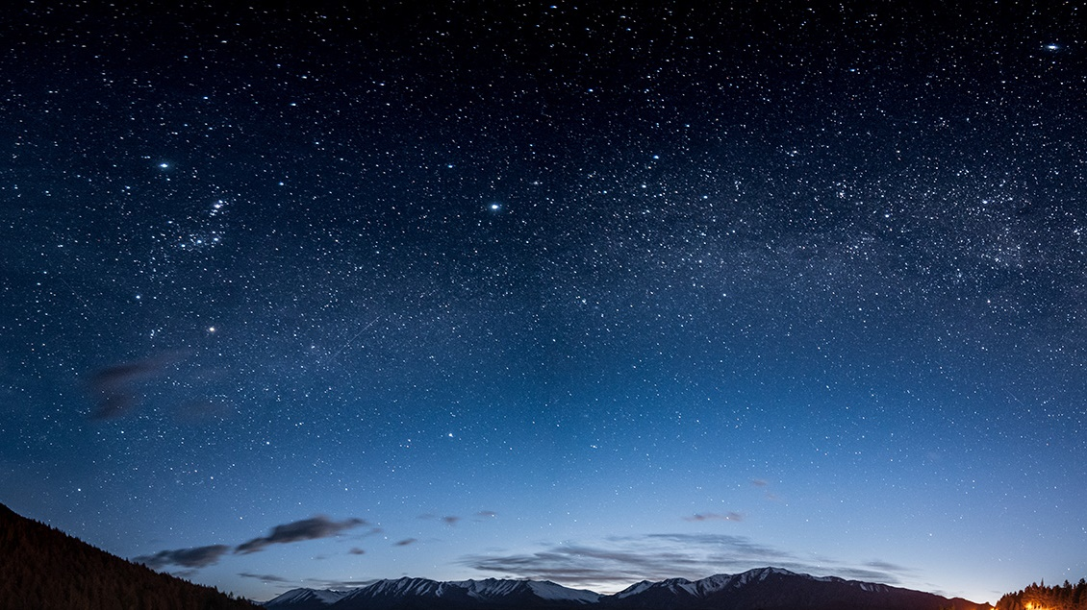
Artificial Intelligence
Past present and future of ai
StudyDoc

Slide 2
What is Artificial intelligence
artificial intelligence is by far one of the most fascinating and astounding creations ever made in the history of mankind. with the advent of its invention, there is still a large domain that is yet to be explored. in fact, its real-world application to date is probably the tip of the iceberg. in the past few years, there has been rapid growth in the domain of ai, making it one of the most lucrative industries.

Slide 3
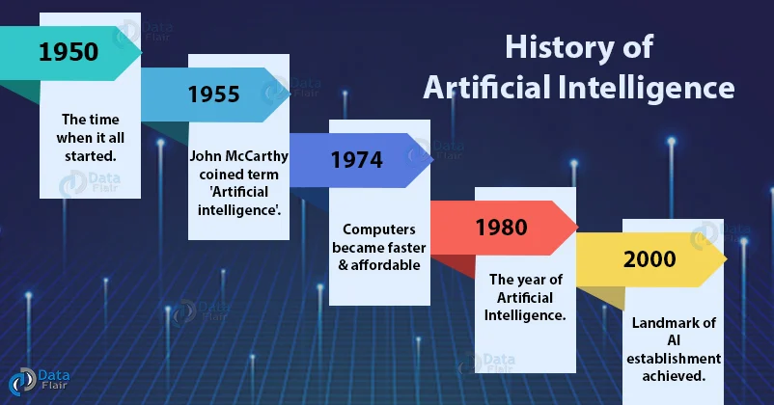
Overview on history of ai

Slide 4
Time line of AI
Maturation of Artificial Intelligence (1943-1952)
Year 1943: The first work which is now recognized as AI was done by Warren McCulloch and Walter pits in 1943. They proposed a model of artificial neurons.
Year 1949: Donald Hebb demonstrated an updating rule for modifying the connection strength between neurons. His rule is now called Hebbian learning.
Year 1950: The Alan Turing who was an English mathematician and pioneered Machine learning in 1950. Alan Turing publishes "Computing Machinery and Intelligence" in which he proposed a test. The test can check the machine's ability to exhibit intelligent behavior equivalent to human intelligence, called a Turing test.

Slide 5
The birth of AI
year 1955: an allen newell and herbert a. simon created the "first artificial intelligence program"which was named as "logic theorist". this program had proved 38 of 52 mathematics theorems, and find new and more elegant proofs for some theorems.
year 1956: the word "artificial intelligence" first adopted by american computer scientist john mccarthy at the dartmouth conference. for the first time, ai coined as an academic field.

Slide 6
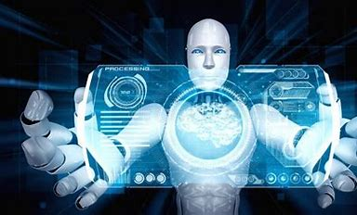
The golden years-Early enthusiasm
Year 1966
The researcher emphasize developing algorithm which solve mathematical problem Joseph Weizenbaum created first chatbot name ELIZA
Year 1972
The first intelligent humanoid was build in Japan which was named as WABOT-1

Slide 7
The first AI winter
The duration between years 1974 to 1980 was the first AI winter duration. AI winter refers to the time period where computer scientist dealt with a severe shortage of funding from government for AI researches.
During AI winters, an interest of publicity on artificial intelligence was decreased.

Slide 8
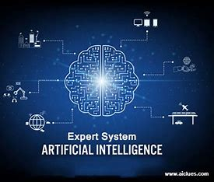
Remarkable (1980-1987)
year 1980: after ai winter duration, ai came back with "expert system". expert systems were programmed that emulate the decision-making ability of a human expert.
in the year 1980, the first national conference of the american association of artificial intelligence was held at stanford university.

Slide 9
The emergence of intelligent agents
1997
Year 1997: In the year 1997, IBM Deep Blue beats world chess champion, Gary Kasparov, and became the first computer to beat a world chess champion.
2002
Year 2002: for the first time, AI entered the home in the form of Roomba, a vacuum cleaner.
2006
Year 2006: AI came in the Business world till the year 2006. Companies like Facebook, Twitter, and Netflix also started using AI.

Slide 10
year 2011: in the year 2011, ibm's watson won jeopardy, a quiz show, where it had to solve the complex questions as well as riddles. watson had proved that it could understand natural language and can solve tricky questions quickly.
Year 2012: Google has launched an Android app feature "Google now", which was able to provide information to the user as a prediction.
Deep learning, big data and artificial general intelligence
Year 2014: In the year 2014, Chatbot "Eugene Goostman" won a competition in the infamous "Turing test.“
Year 2018: The "Project Debater" from IBM debated on complex topics with two master debaters and also performed extremely well.

Slide 11
Artificial Intelligence Technologies
Natural language generation
Speech recognition
Virtual agents
Decision management
Biometrics
Machine learning
Robotic process automation
Peer-to-peer network
Deep learning platforms

Slide 12
Is Future in safe hands or not?
Next, in AI history article, we will see whether the future is in safe hands or not. If AI is the future, then there is absolutely no doubt.
Starting from healthcare, education, e-commerce to water power, electricity and assembly lines, everything is automated. Such machines and technologies have helped humans to achieve efficiency and effectiveness.
There is a big shift in a way we live, work and relate to one another due to the adoption of cyber-physical systems, internet of things and the internet of systems.”
With self aware systems, human-like intelligence has been developed. With artificial superintelligence and AI algorithms, the machines are capable of outperforming the smartest of humans in every single domain.

Slide 13

Thank You!
StudyDoc

