Slide 1
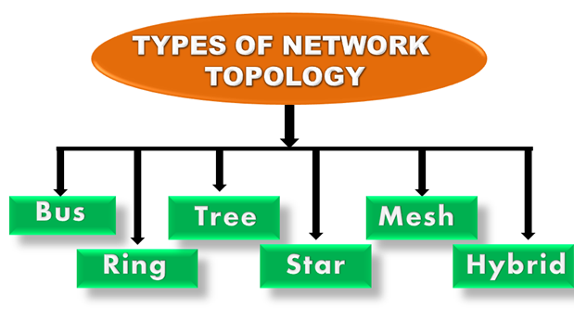
Network Topology

Slide 2
Network Topology
A Network Topology is the arrangement with which computer systems or network devices are connected to each other.
Topologies may define both physical and logical aspect of the network.
Network Topology represents a network arrangement consisting of several nodes, i.e. sender and receiver nodes, and the lines connecting them.

Slide 3
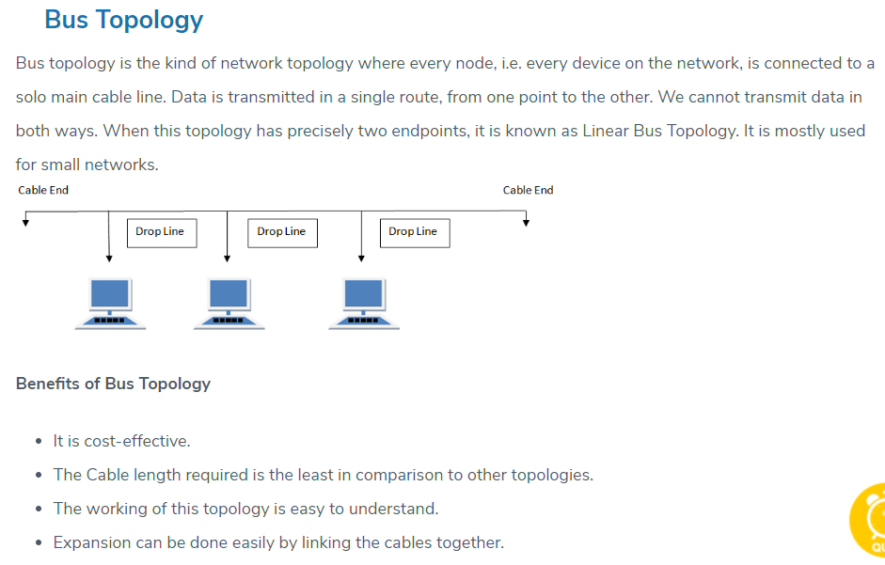

Slide 4
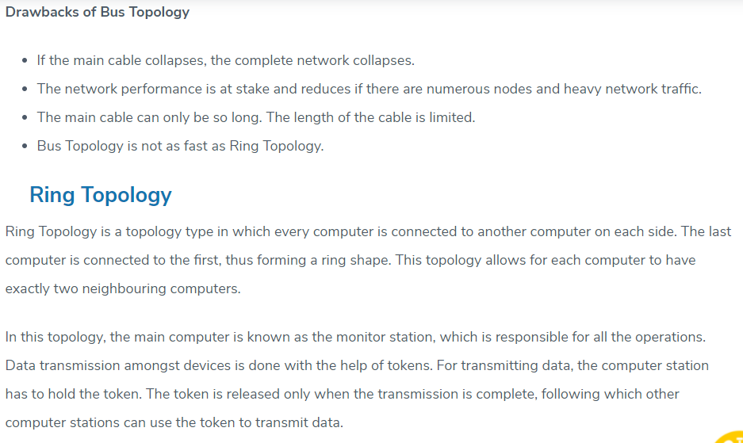

Slide 5
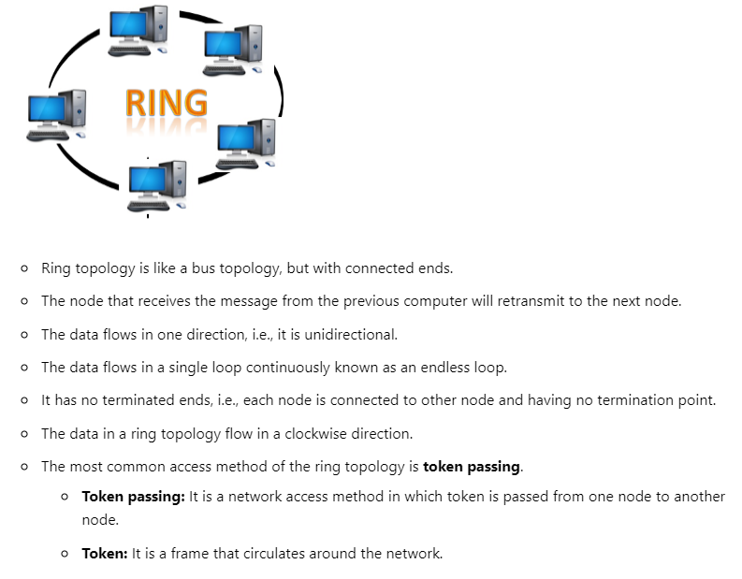

Slide 6
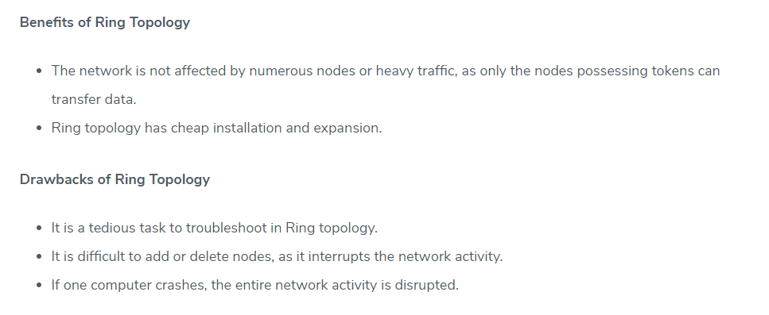

Slide 7
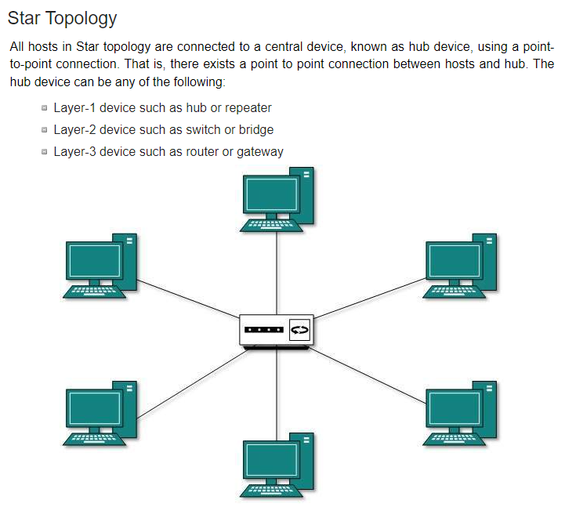

Slide 8
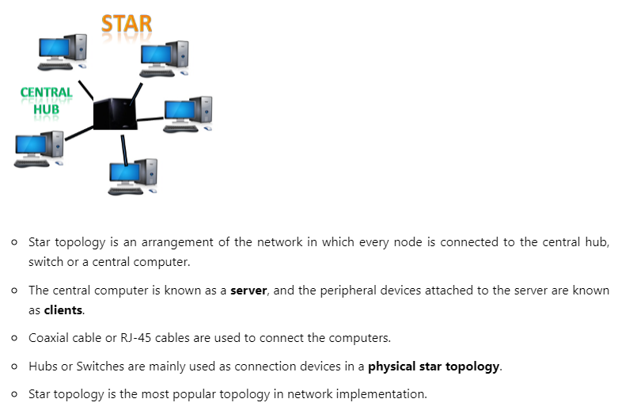

Slide 9
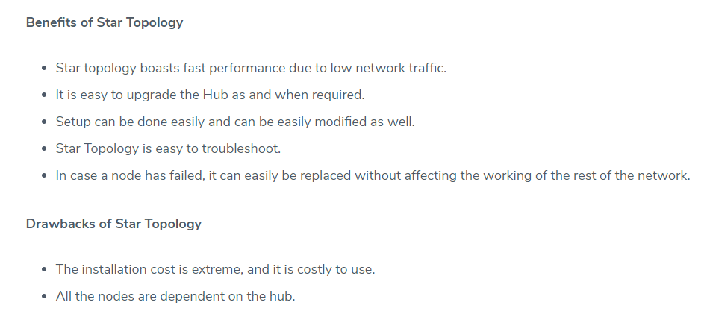

Slide 10
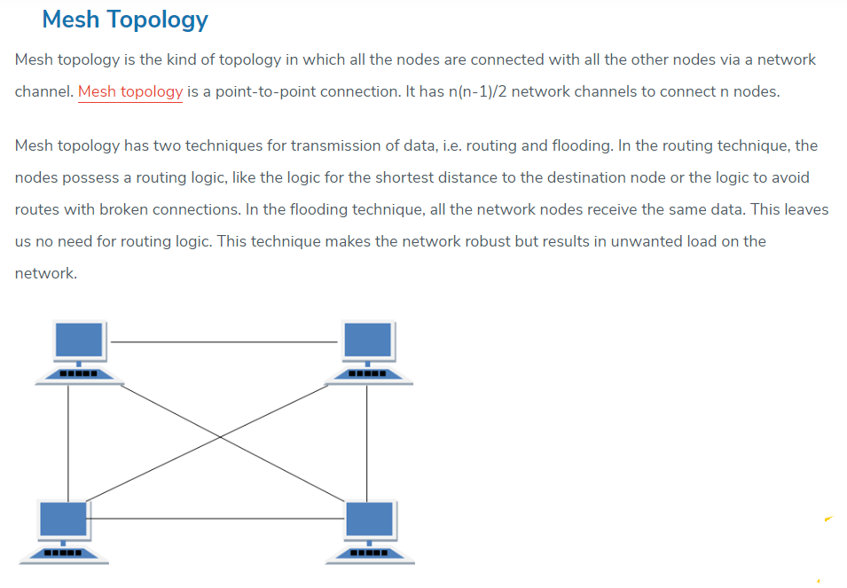

Slide 11
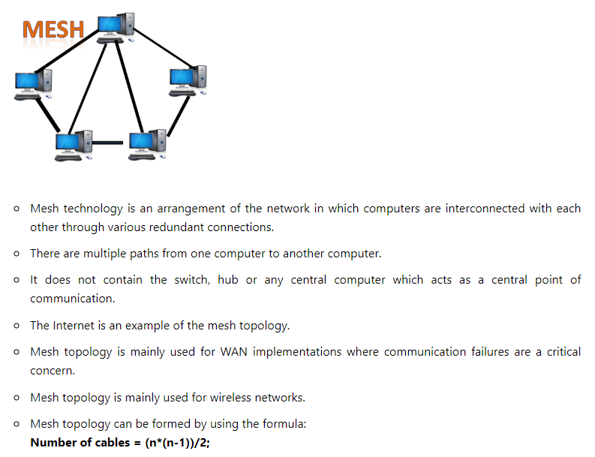

Slide 12
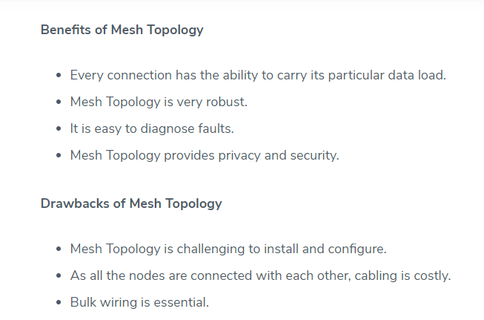

Slide 13
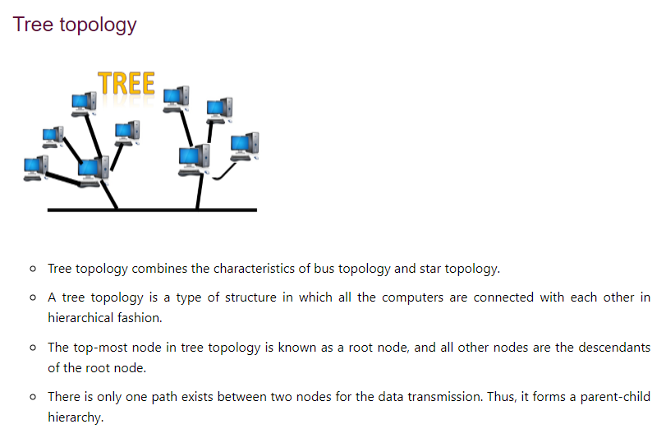
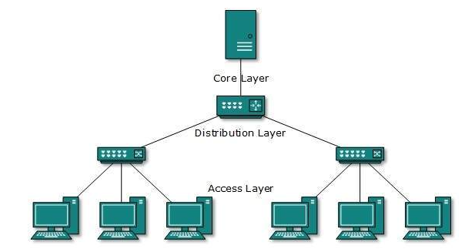

Slide 14
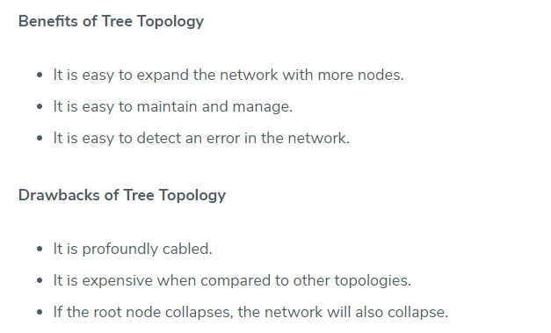

Slide 15
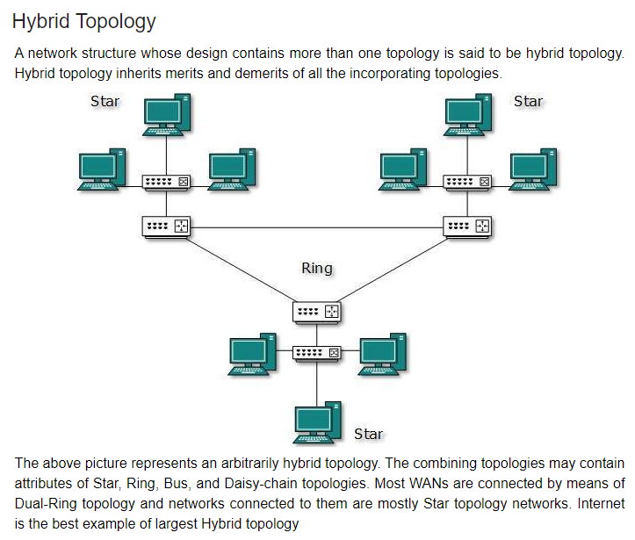

Slide 16
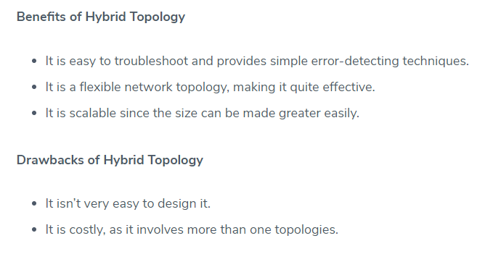

Slide 17
Network Interface Card (NIC)
Network Interface Card (NIC) is a hardware component that is present on the computer
It is used to connect different networking devices such as computers and servers to share data over the connected network
NIC is important for us to establish a wired or wireless connection over the network.
Network Interface Card is also known as Network Interface Controller, Network Adapter, Ethernet card, Connection card, and LAN (Local Area Network) Adapter
NIC is used to convert data into a digital signal.
NIC is a middleware between a computer/server and a data network.
NIC operates on both physical as well as the data link layer of the OSI model.
MAC address
MAC address is also referred to as a physical network address. It is a unique address that is present to the network interface card where ethernet packets are communicated with the computer.

Slide 18
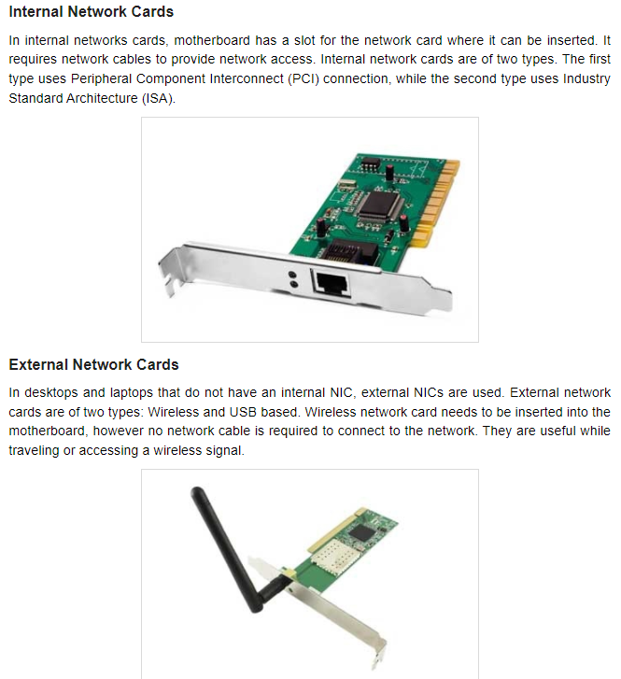

Slide 19
