Slide 1
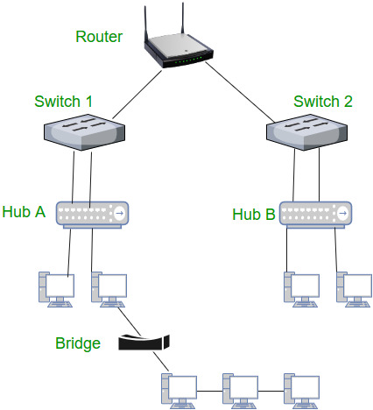
Network Devices

Slide 2
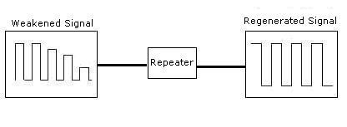
Repeater
A repeater operates at the physical layer
Its job is to regenerate the signal over the same network before the signal becomes too weak or corrupted so as to extend the length to which the signal can be transmitted over the same network
When the signal becomes weak, they copy the signal bit by bit and regenerate it at the original strength
It is a 2 port device

Slide 3
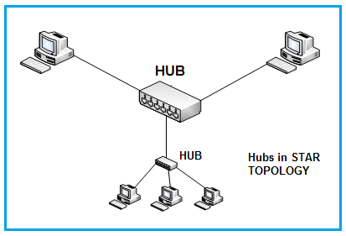
HUB
Physical Layer
Multiport Repeater
Hubs cannot filter data, so data packets are sent to all connected devices
Single collision domain
Single broadcast domain
they do not have the intelligence to find out the best path for data packets which leads to inefficiencies and wastage

Slide 4
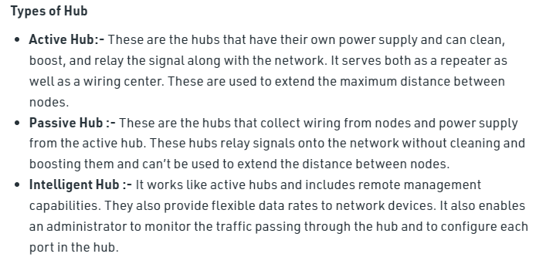

Slide 5
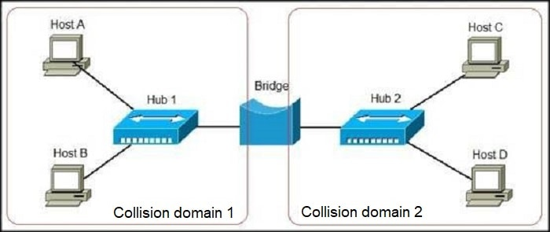
Bridge
Data link layer , Layer 2 device
Filtering content by reading the MAC addresses of source and destination
It is also used for interconnecting two LANs working on the same protocol
It has a single input and single output port, thus making it a 2 port device

Slide 6
Bridge
Multiple Collision Domain
Single Broadcast Domain
packets are filtered and forwarded by physical address through a Bridge

Slide 7
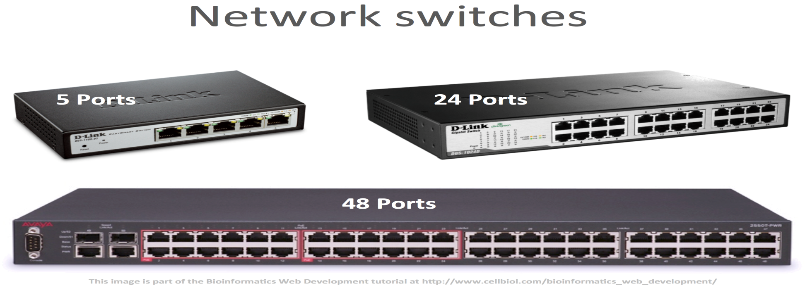
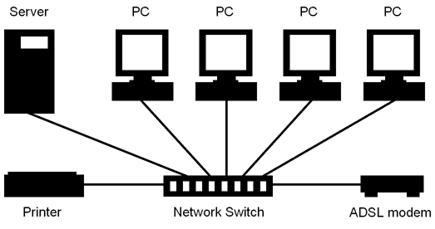
Switch

Slide 8
Switch
Data Link Layer, Layer 2
Multiport Bridge
It is designed with a buffer.
It forwards data, but before doing that, it checks errors. This makes it more efficient and improves its performance, as it forwards the good and efficient packet to the correct port only, which doesn’t have errors.
It uses packet switching technique to receive, store and forward data packets
Switch divides the collision domain of hosts, but broadcast domain remains the same

Slide 9
Modem
Modem is a device that enables a computer to send or receive data over telephone or cable lines
The data stored on the computer is digital whereas a telephone line or cable wire can transmit only analog data
The main function of the modem is to convert digital signal into analog and vice versa
Modem is a combination of two devices − modulator and demodulator
The modulator converts digital data into analog data when the data is being sent by the computer
The demodulator converts analog data signals into digital data when it is being received by the computer

Slide 10
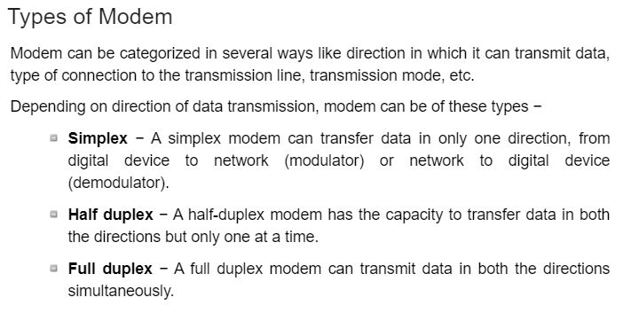

Slide 11
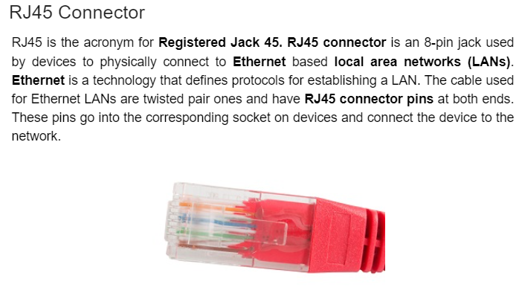

Slide 12
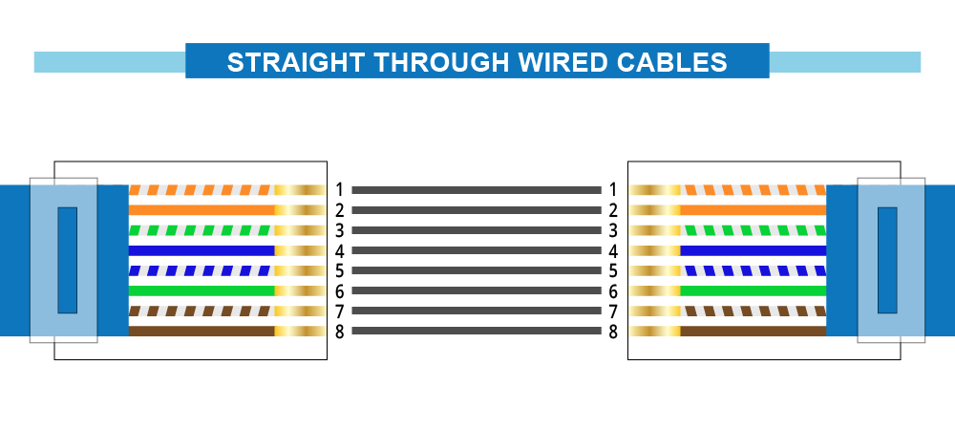

Slide 13
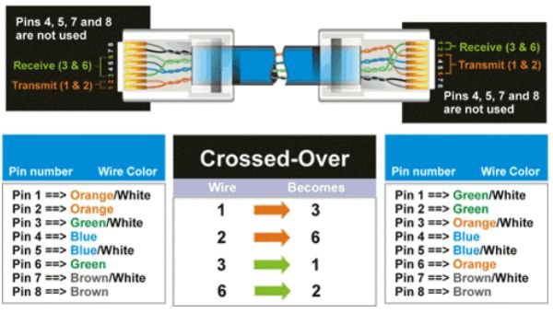

Slide 14
Router
Layer 3 Device
Network Device
Separates Networks
Multiple Collision Domains
Multiple Broadcast Domains
Can Modify Packets
Can Generate Packets

Slide 15
 | Collision Domain | Broadcast Domain
HUB/Repeater | single | single
SWITCH/Bridge | Multiple | single
ROUTER/Gatway | Multiple | Multiple

