Slide 1
Ethernet, NAT, DHCP

Slide 2
Ethernet
Ethernet is the technology that is commonly used in wired local area networks (LANs)
Ethernet is a network protocol that controls how data is transmitted over a LAN and is referred to as the IEEE 802.3 protocol
The Ethernet standard was first developed by the Xerox Corporation in the 1970, Using a Carrier Sense Multiple Access / Collision Detect (CSMA/CD) protocol to allow multiple users share medium
Ethernet describes how network devices format and transmit data so other devices on the same LAN can recognize, receive and process the information.
An Ethernet cable is the physical, encased wiring over which the data travels

Slide 3
Ethernet
Ethernet's original 10 megabits per second throughput increased tenfold to 100 Mbps in the mid-1990s
Working:
When a machine on the network wants to send data to another, it senses the carrier, which is the main wire connecting the devices
If it is free, meaning no one is sending anything, it sends the data packet on the network, and the other devices check the packet to see whether they are the recipient
The recipient consumes the packet
If there is a packet on the highway, the device that wants to send holds back for some thousandths of a second to try again until it can send

Slide 4
What You Need in an Ethernet LAN
Computers and devices to connect
Network interface cards in the devices
A router, hub, switch, or gateway to connect devices
Cables: UTP (Unshielded Twisted Pair)
relatively low cost, generally resistant to noise
good data transfer quality, speed, reliability
intended for smaller, shorter distance networks, limited mobility, speeds decrease with increased traffic

Slide 5
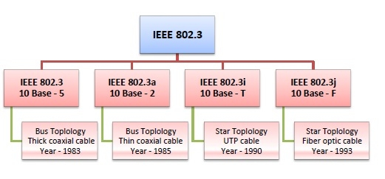
IEEE 802.3
IEEE 802.3 is a set of standards and protocols that define Ethernet-based networks
IEEE 802.3 defines the physical layer and the medium access control (MAC) sub-layer of the data link layer for wired Ethernet

Slide 6
Ethernet version numbering
The first number (typically one of 10, 100, or 1000) indicates the transmission speed in megabits per second
The second term indicates transmission type: BASE = baseband; BROAD = broadband.
The last number indicates segment length. A 5 means a 500-meter (10BASE-5)
Recent versions of the IEEE 802.3 standard, letters replace numbers (10BASE-T)
IEEE - Institute of Electrical and Electronics Engineers

Slide 7
IEEE 802.3: original standard 10BASE-5
It used a thick single coaxial cable into which a connection can be tapped by drilling into the cable to the core
Here, 10 is the maximum throughput, i.e. 10 Mbps
BASE denoted use of baseband transmission
5 refers to the maximum segment length of 500m
IEEE 802.3a: standard for thin coax - 10BASE-2
Thinner variety where the segments of coaxial cables are connected by BNC connectors
The 2 refers to the maximum segment length of about 200m (185m to be precise)
IEEE 802.3i: Standard for twisted pair 10BASE-T
Uses unshielded twisted pair (UTP) copper wires as physical layer medium
The further variations were given by IEEE 802.3u for 100BASE-TX, 100BASE-T4 and 100BASE-FX.
IEEE 802.3j: Standard for Ethernet over Fiber 10BASE-F
fiber optic cables as medium of transmission.

Slide 8
802.3u – 1995, 100Base-T, Fast Ethernet
802.3x - 1997, Full duplex
802.3z - 1998, 1000Base-X (Gigabit Ethernet)
802.3ab - 1999, 1000Base-T (Gigabit Ethernet over twisted pair), 1 Gbps
802.3ae – 2002,10-Gigabit Ethernet
802.3af - 2003, Power over Ethernet

Slide 9
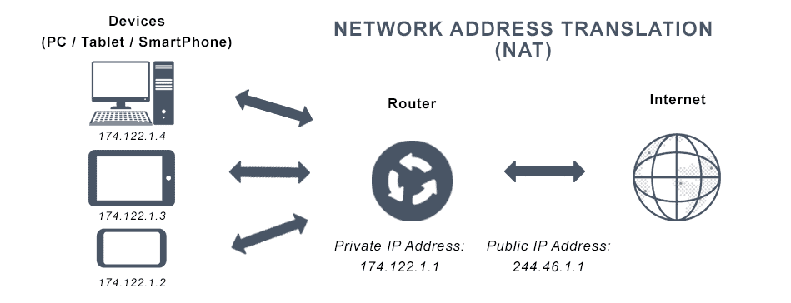
NAT – Network Address Translation
To access the Internet, one public IP address is needed, but we can use a private IP address in our private network
The idea of NAT is to allow multiple devices to access the Internet through a single public address.

Slide 10
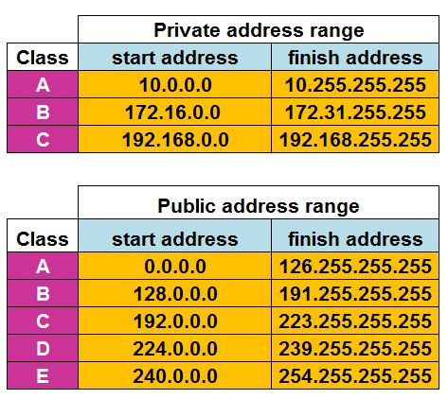
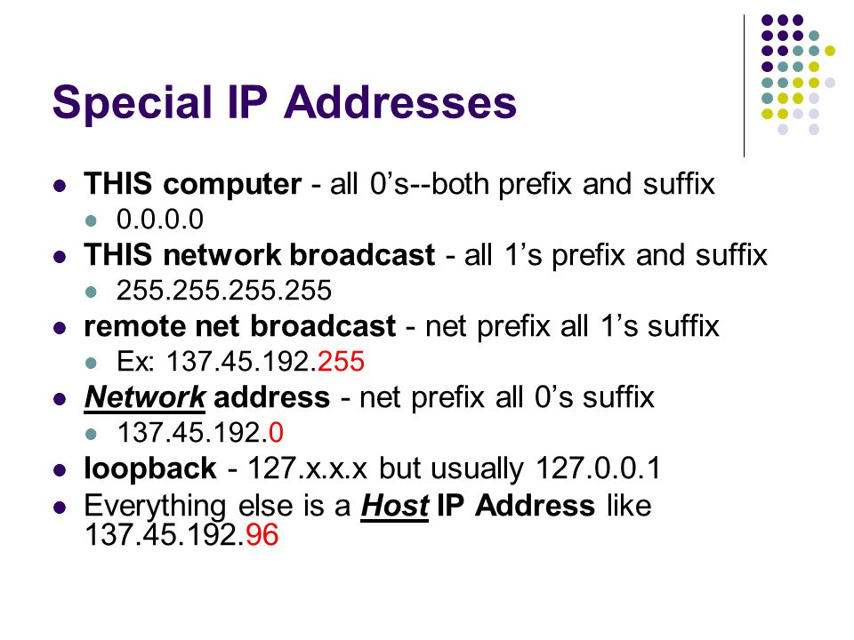

Slide 11
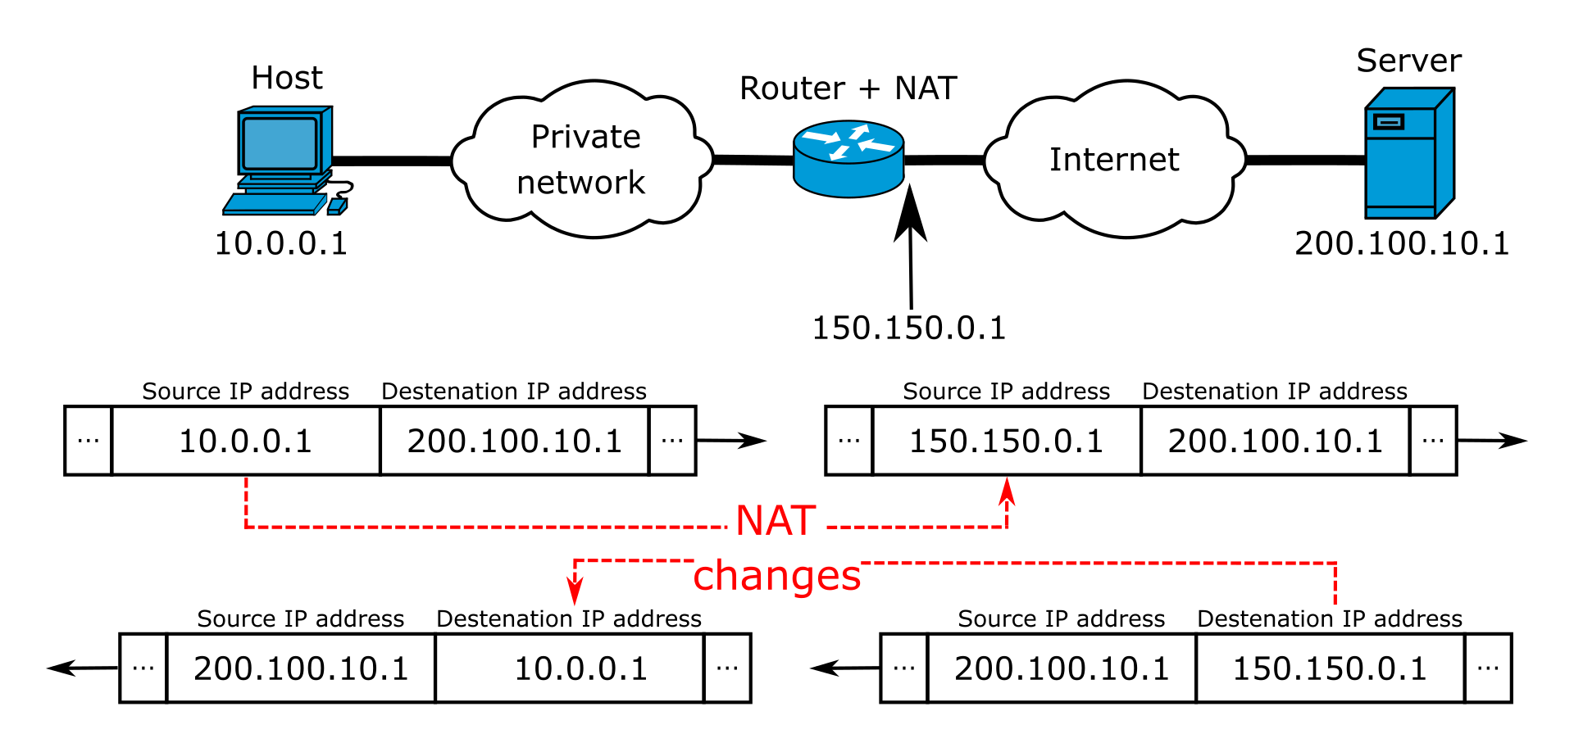

Slide 12
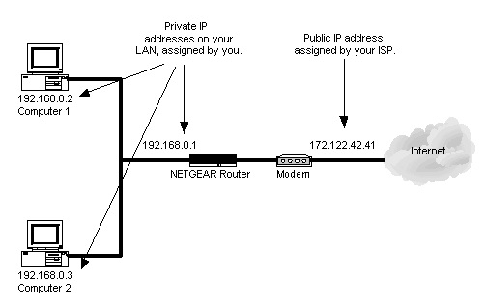

Slide 13
Working of NAT
Usually we used gateway router / Border devices used for NAT configuration. One of the interfaces for that device is connected to the local Area network (INSIDE) and one of the interfaces for this device connected to the outside network (OUTSIDE).
When we have received a request from our local machine it will hit the configuration pool then that Private IP will convert it into Public IP address and vice versa.

Slide 14
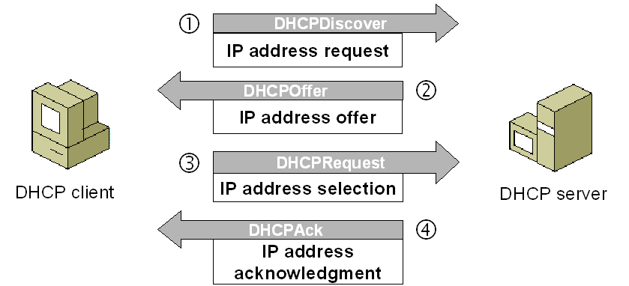
Dynamic Host Configuration Protocol
a network management protocol used to dynamically assign an IP address to nay device, or node
DHCP automates and centrally manages IP configurations
There is no need to manually assign IP addresses to new devices
DHCP can be implemented on local networks as well as large enterprise networks
DHCP is also called RFC (Request for comments) 2131

Slide 15
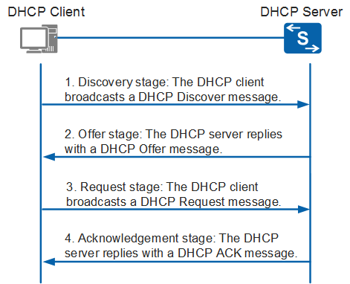

Slide 16
DHCP
DHCP manages the provision of all the nodes or devices added or dropped from the network.
DHCP maintains the unique IP address of the host using a DHCP server.
It sends a request to the DHCP server whenever a client/node/device, which is configured to work with DHCP, connects to a network. The server acknowledges by providing an IP address to the client/node/device.

Slide 17
DHCP runs at the application layer of the TCP/IP protocol stack to dynamically assign IP addresses to DHCP clients/nodes
Allocate TCP/IP configuration information to the DHCP clients
Information includes subnet mask information, default gateway, IP addresses and domain name system addresses
DHCP is based on client-server protocol in which servers manage a pool of unique IP addresses, as well as information about client configuration parameters, and assign addresses

Slide 18
The DHCP lease process
DHCP clients request an IP address. Typically, client broadcasts a query for this information
DHCP server responds to the client request by providing IP address and other configuration information
This configuration information also includes time period, called a lease, for which the allocation is valid
When refreshing configuration, a DHCP clients request the same parameters, but the DHCP server may assign a new IP address

Slide 19
Benefits of DHCP
Centralized administration of IP configuration
Dynamic host configuration
Seamless IP host configuration
Flexibility and scalability

