Slide 1
Floating Point Numbers
Why do we lose precision?

Slide 2
Floating point errors bothered me a lot when I was taking my Java AP class. I wanted to get to the bottom of it but never got time.
In my junior year and in summer of 2022, I had been reading about it and could not find a good place to start. Not much information is there on Google that can explain high school students why one gets non intuitive errors when using floating point numbers in simple terms.
Special thanks to the following people who helped in different ways in my journey to explore Floating Point numbers.
Mrs. Graciela Elia (my high school computer science teacher at Princeton High School, Princeton, NJ)
Harleen Kaur & Sunny Singh (my parents)
Simran Kaur (my sister)
Hope this helps the wider community at large to understand Floating Point numbers which I have attempted to explain in a simple way.

Slide 3
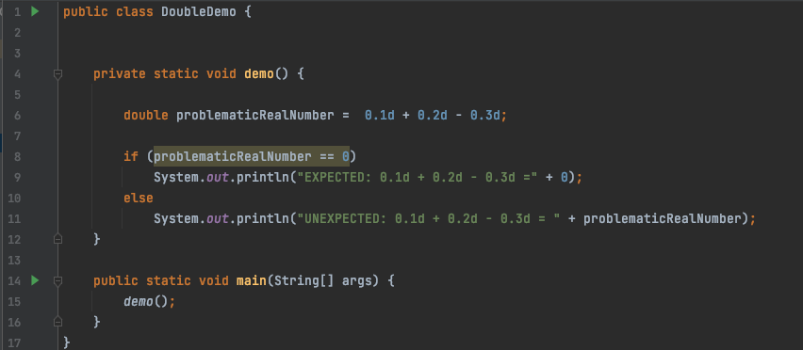
Why double math (0.1d + 0.2d -0.3d) != 0?

Slide 4
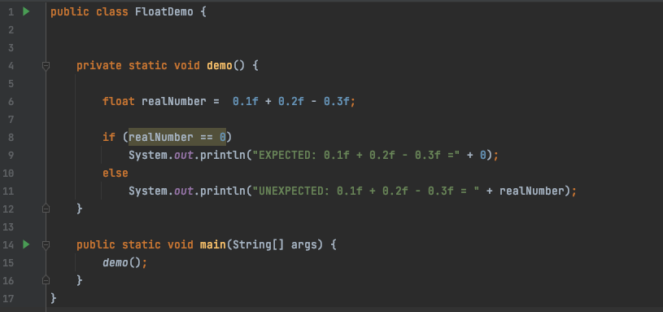

Whereas float math (0.1f + 0.2f -0.3f) = 0?

Slide 5
Single Precision Floating Point (32 bits)
Sign bit
8 bits for exponent
23 bits for Significand
float has 23 bits for precision.
In decimal base 10, float can provide precision up to log10(2^23) digits = 6.92 digits (approx.) = 6 to 7 decimal digits of precision

Slide 6
Double Precision Floating Point (64 bits)
Sign bit
11 bits for exponent
52 bits for Significand
Double has 52 bits for precision.
In decimal base 10, double can provide precision up to log10(2^52) digits = 15.65355977452702 digits (approx.) = 15 to 16 decimal digits of precision

Slide 7
Understanding Floating Point Numbers
8 bits are too small to be practical to represent floating point numbers. But we will start with 8 bits, as it becomes easy to understand. Then we can extrapolate to 32 and 64 bit floating point numbers thereafter
Sign bit
3 bits for exponent
4 bits for Significand

Slide 8
Understanding Floating Point Numbers
Any number that cannot be written as a sum of +ve or –ve powers of 2 CANNOT be exactly represented as a floating-point number e.g. 1/3, 1/5
Other constraints are the number of exponent and significand bits. We will see this shortly
Sign bit
3 bits for exponent
4 bits for Significand

Slide 9
Why Floating-Point Numbers?
If we have integers, why do we need a new type called float or double?
Integers represent numbers like -3, -1, 0, 1, 3, 6, 2342, …..
Integer division results in an integer. Real numbers between integers cannot be represented by integers
We need a way to represent all real numbers for e.g. 3.334 or 5.0667 and so on
FLOAT and DOUBLE are the 2 floating point numbers that are used by computer systems to represent real numbers

Slide 10
Difficulty representing all real numbers?
Representing numbers in computers takes memory
An 8-bit memory could represent 2^8 different numbers. If the numbers were signed: we can represent -128 (-2^7) to 127 (2^7 - 1) discrete values
We have infinite real numbers between two integers how do we represent them then? – But we have finite number of bits to represent them

Slide 11
Difficulty representing all real numbers
Integers
-9 -8 -7 -6 -5 -4 -3 -2 -1 0 1 2 3 4 5 6 7 8 9
Real Numbers
If the number of bits is limited and if we use the same number of bits to represent real numbers, the number of real numbers will be limited
We need real numbers with high precision for shorter distances and not for very large numbers like distance from Earth to the sun.
We need a way to represent very large numbers much bigger than INT.MAX_VALUE
=> As the total number of numbers that a fixed set of bits can represent, we should design a way to represent real numbers very close to each other for higher precision near 0 and more gap between real numbers in computers that are farther away from 0.
Viraj was greatly impacted by COVID in that he and our family was under enormous stress and grief due to the toll Covid had on extended family members.

Slide 12
Difficulty representing all real numbers
Integers
-9 -8 -7 -6 -5 -4 -3 -2 -1 0 1 2 3 4 5 6 7 8 9
Real Numbers
Can you see why there is loss of precision involving real numbers?
Viraj was greatly impacted by COVID in that he and our family was under enormous stress and grief due to the toll Covid had on extended family members.

Slide 13
Difficulty representing all real numbers
Integers
-9 -8 -7 -6 -5 -4 -3 -2 -1 0 1 2 3 4 5 6 7 8 9
Real Numbers
At a high level - Can you see why there is loss of precision involving real numbers?
WE CAN NOT REPRESENT ALL DISCRETE REAL NUMBERS, AS THERE ARE INFINITE REAL NUMBERS BETWEEN 2 INTEGERS AND WE HAVE FINITE BITS. THIS IS THE REASON FOR THE LOSS OF PRECISION
Viraj was greatly impacted by COVID in that he and our family was under enormous stress and grief due to the toll Covid had on extended family members.

Slide 14
Difficulty representing all real numbers
Sign bit
3 bits for exponent
4 bits for Significand
Max Value??
X
0 | 1 | 1 | 1 | 1 | 1 | 1 | 1
All 1’s in exponent is reserved as Infinity by IEEE

Slide 15
Difficulty representing all real numbers
Sign bit
3 bits for exponent
4 bits for Significand
Max Value??
X
0 | 1 | 1 | 1 | 1 | 1 | 1 | 0
This is reserved as NaN (Not a real number) by IEEE
NaN numbers are for example: squareroot(-15), 0/0

Slide 16
How is exponent saved? (for normalized floating-point representation)
Sign bit
3 bits for exponent
4 bits for Significand
Saved exponent = 111 is reserved for infinity
3 bits for the exponent => 2^3 = 8 numbers that can be represented as exponents.
Given that one of the numbers = 111 (binary) is reserved, the number of exponents = 7
Middle
 | 000 | 001 | 010 | 011 | 100 | 101 | 110 | 111
Saved Exponent | 0 | 1 | 2 | 3 | 4 | 5 | 6 | 7
Mapped Signed Exponents equally mapped around the Middle of the saved exponent | -3 | -2 | -1 | 0 | 1 | 2 | 3
Bias = 2 ^ (#bits -1) – 1 = value that can be added to signed bit to get a saved exponent | 3 | 3 | 3 | 3 | 3 | 3 | 3

Slide 17
How is exponent saved? (for normalized floating-point representation)
 | e3 | e2 | e1 | s4 | s3 | s2 | s1
Middle
 | 000 | 001 | 010 | 011 | 100 | 101 | 110 | 111
Saved Exponent | 0 | 1 | 2 | 3 | 4 | 5 | 6 | 7
Mapped Signed Exponents equally mapped around the Middle of the saved exponent | -3 | -2 | -1 | 0 | 1 | 2 | 3
Bias = 2 ^ (#bits -1) – 1 = value that can be added to signed bit to get a saved exponent | 3 | 3 | 3 | 3 | 3 | 3 | 3

Slide 18
How is exponent saved? (for normalized floating-point representation)
In normalized representation there is an assumed binary 1 before the decimal point which is not stored in the floating point
 | e3 | e2 | e1 | s4 | s3 | s2 | s1
 | 1.0000 x (2 ^ (-3)) = 0.125
 | 1.0000 x (2 ^ (-2)) = 0.25
 | 1.0000 x (2 ^ (-1)) = 0.5
 | 1.0000 x (2 ^ ( 0)) = 1.0
 | 1.0000 x (2 ^ (+1)) = 0.5
 | 1.0000 x (2 ^ (+2)) = 0.5
 | 1.0000 x (2 ^ (+3)) = 0.5
0 | 0 | 0 | 0 | 0 | 0 | 0 | 0
There are 2^4 real numbers that can be represented between any two rows by the floating-point math that has 4 bits for the significand (though there are inifinite real numbers between the two rows
0 | 0 | 0 | 1 | 0 | 0 | 0 | 0
0 | 0 | 1 | 0 | 0 | 0 | 0 | 0
0 | 0 | 1 | 1 | 0 | 0 | 0 | 0
0 | 1 | 0 | 0 | 0 | 0 | 0 | 0
0 | 1 | 0 | 1 | 0 | 0 | 0 | 0
0 | 1 | 0 | 1 | 0 | 0 | 0 | 0

Slide 19
How is exponent saved? (for normalized floating-point representation)
In normalized representation there is an assumed binary 1 before the decimal point which is not stored in the floating point
 | e3 | e2 | e1 | s4 | s3 | s2 | s1
 | 1.0000 x (2 ^ (-3)) = 0.125
 | 1.0000 x (2 ^ (-2)) = 0.25
 | 1.0000 x (2 ^ (-1)) = 0.5
 | 1.0000 x (2 ^ ( 0)) = 1.0
 | 1.0000 x (2 ^ (+1)) = 0.5
 | 1.0000 x (2 ^ (+2)) = 0.5
 | 1.0000 x (2 ^ (+3)) = 0.5
0 | 0 | 0 | 0 | 0 | 0 | 0 | 0
0 | 0 | 0 | 1 | 0 | 0 | 0 | 0
There are 2^4 real numbers that can be represented between any two rows by the floating-point math that has 4 bits for the significand (though there are infinite real numbers between the two rows
WAIT
We are unable to represent 0 or real numbers between 0 and 0.125. Now What?
We solve this by storing the floating point in the de-normalized form if the saved exponents are all 000
We do not assume there is an assumed binary 1 before the decimal point and the mapped exponent for e3e2e1=000 and e3e2e1=001 are both (1-Bias) = -2
if e3e2e1 = 000, then the floating-point value = 0.s4s3s2s1 x 2 ^ (-2)
And
If e3e2e1 = 001, then the floating point value = 1.s4s3s2s1 x 2 ^ (-2)
0 | 0 | 1 | 0 | 0 | 0 | 0 | 0
0 | 0 | 1 | 1 | 0 | 0 | 0 | 0
0 | 1 | 0 | 0 | 0 | 0 | 0 | 0
0 | 1 | 0 | 1 | 0 | 0 | 0 | 0
0 | 1 | 0 | 1 | 0 | 0 | 0 | 0

Slide 20
How is exponent saved?
In normalized representation there is an assumed binary 1 before the decimal point which is not stored in the floating point
 | e3 | e2 | e1 | s4 | s3 | s2 | s1
 | 0.0000 x (2 ^ (-2)) = 0
 | 1.0000 x (2 ^ (-2)) = 0.25
 | 1.0000 x (2 ^ (-1)) = 0.5
 | 1.0000 x (2 ^ ( 0)) = 1.0
 | 1.0000 x (2 ^ (+1)) = 0.5
 | 1.0000 x (2 ^ (+2)) = 0.5
 | 1.0000 x (2 ^ (+3)) = 0.5
0 | 0 | 0 | 0 | 0 | 0 | 0 | 0
There are 2^4 real numbers that can be represented between any two rows by the floating-point math that has 4 bits for the significand (though there are inifinite real numbers between the two rows
0 | 0 | 0 | 1 | 0 | 0 | 0 | 0
0 | 0 | 1 | 0 | 0 | 0 | 0 | 0
0 | 0 | 1 | 1 | 0 | 0 | 0 | 0
0 | 1 | 0 | 0 | 0 | 0 | 0 | 0
In de-normalized representation when saved exponent e3e2e1 = 000, there is NO assumed binary 1 before the decimal and the mapped exponent = (1 – bias) = -2
0 | 1 | 0 | 1 | 0 | 0 | 0 | 0
0 | 1 | 0 | 1 | 0 | 0 | 0 | 0

Slide 21
How are 3 bits of the exponent in 8 bits real number representation saved?
The exponent is not stored in 1s or 2s complement
Bias = 2^(n-1) – 1. (where n = number of exponent bits)
Saved Exponent | Bias | Exponent | Real #
7 (111) | Reserved for infinity
6 (110) | 3 | 6 – 3 = 3 | 1.SSSS * (2 ^ 3)
5 (101) | 3 | 5 – 2 = 2 | 1.SSSS * (2 ^ 2)
4 (100) | 3 | 4 – 3 = 1 | 1.SSSS * (2 ^ 1)
3 (011) | 3 | 3 – 3 = 0 | 1.SSSS * (2 ^ 0)
2 (010) | 3 | 2 – 3 = -1 | 1.SSSS * (2 ^ -1)
1 (001) | 3 | 1 – 3 = -2 | 1.SSSS* (2 ^ -2)
0 (000) | 3 | 1 – 3 = -2 | 0.SSSS * (2 ^ -2)
000 001 010 011 100 101 110 111
-3 -2 -1 0 1 2 3 4 5 6 7
-3 + 1
-3
-3
-3
-3
-3
-3
If saved exponent is NOT 000, “mapped exponent” = (“saved exponent” – Bias)
+ floating-point representation is “normalized” => it starts with bit value “1” before the decimal
If saved exponent is 000, “mapped exponent” = (1 – Bias)
+ floating-point representation is “de-normalized” => it starts with bit value “0” before the decimal
This helps in the representation of real numbers between 0 and 1.SSSS x ( 2 ^ -2)

Slide 22
How is 0.1 decimal represented in 32-bit single precision Java float floating point?
Sign bit
8 bits for exponent
23 bits for Significand
0 | 0 | 1 | 1 | 1 | 1 | 0 | 1 | 1 | 1 | 0 | 0 | 1 | 1 | 0 | 0 | 1 | 1 | 0 | 0 | 1 | 1 | 0 | 0 | 1 | 1 | 0 | 0 | 1 | 1 | 0 | 0
0.1 decimal = 0.000110011001100110011001100 in binary ---------→
In Normalized form:
1.10011001100110011001100 x 2 ^ (-4)
For 32 bit floating point:
Significand (23 bits) = 10011001100110011001100
Saved exponent – Bias = Exponent
Saved Exponent = Exponent + Bias = -4 + (2^(8-1) - 1) = 123 decimal = 1111011
0.1 * 2 = 0.2 => 0 = 1st digit in binary after the decimal
0.2 * 2 = 0.4 => 0 = 2nd digit in binary after the decimal
0.4 * 2 = 0.8 => 0 = 3rd digit in binary after the decimal
0.8 * 2 = 1.6 => 1 = 4th digit in binary after the decimal
0.6 * 2 = 1.2 => 1 = 5th digit in binary after the decimal
0.2 * 2 = 0.4 => 0 = 6th digit in binary after the decimal
0.4 * 2 = 0.8 => 0 = 7th digit in binary after the decimal
0.8 * 2 = 1.6 => 1 = 8th digit in binary after the decimal
0.6 * 2 = 1.2 => 1 = 9th digit in binary after the decimal
0.2 * 2 = 0.4 => 0 = 10th digit in binary after the decimal
0.4 * 2 = 0.8 => 0 = 11th digit in binary after the decimal
0.8 * 2 = 1.6 => 1 = 12th digit in binary after the decimal

Slide 23
Difficulty representing all real numbers
What is the Max real value we can represent using 8 bits?
0 | 1 | 1 | 0 | 1 | 1 | 1 | 1
Exponent + Bias = (110)binary
=> Exponent = (110)binary – Bias = 6 – Bias
=> Bias = 2 ^ (3 – 1) – 1 = 3
Max Value is (1.1111)binary x 2 ^ (6 – 3)
((1*2^0) + (1* 2^-1) + (1* 2^-2) + (1* 2^-3) + (1* 2^-4)) * 2 ^ 4
(1+0.5 + 0.25 + 0.125 + 0.0625) * 8 = 1.9375 * 8 = 15.5
15.5 is not that big a real value
This is the reason why
float has 7 bits for the exponent to have bigger MAX values
double has 11 bits for the exponent to have even bigger MAX values
Similar reasoning can be applied why
float has 23 bits for the significand to have higher precision (5 or 6 decimal digits of precision)
double has 52 bits for the significand to have even higher precision (15 or 16 decimal digits of precision)

Slide 24
Difficulty representing all real numbers
What is the Min Positive Real Value after zero?
0 | 0 | 0 | 0 | 0 | 0 | 0 | 0
Bias = 2 ^ (3 – 1) – 1 = 3 (we have 3 bits for the exponent)
Exponent + Bias = (1)binary if above 3 bits are 0 (exponent is NOT stored in Scientific form when it is 0)
=> Exponent = (1)binary – Bias = 1 – 3 = -2
The above number = (0)binary * 2 ^(-2) = 0
Next Positive value:
0 | 0 | 0 | 0 | 0 | 0 | 0 | 1
= (0.0001)binary * 2 ^(-2) = (0.0625) * (1/4) = 0.015625
Next Positive value:
0 | 0 | 0 | 0 | 0 | 0 | 1 | 0
= 0.125 * (1/4) = 0.03125

Slide 25
Difficulty representing all real numbers
Next Positive value:
0 | 0 | 0 | 0 | 0 | 0 | 1 | 1
= (0.0011)binary * (1/4) = (0.125 + 0.0625) * 1/4 = 0.046875
Next Positive value:
0 | 0 | 0 | 0 | 0 | 1 | 0 | 0
= (0.01)binary * (1/4) = (0.25) * 1/4 = 0.0625
Next Positive value:
0 | 0 | 0 | 0 | 0 | 1 | 0 | 1
= (0.0101)binary * (1/4) = (0.25 + 0.0625) * 1/4 = 0.078125
Max Positive value when saved exponent = 000:
0 | 0 | 0 | 0 | 1 | 1 | 1 | 1
= (0.1111)binary * (1/4) = (0.5+ 0.25 + 0.125 + 0.0625) * 1/4 = 0.234375

Slide 26
Difficulty representing all real numbers
What is the Min Positive Real Value when saved exponent = 1?
0 | 0 | 0 | 1 | 0 | 0 | 0 | 0
Bias = 2 ^ (3 – 1) – 1 = 3 (we have 3 bits for the exponent)
Exponent + Bias = saved exponent = 1(exponent is stored in Scientific form => the binary number before decimal point = 1 )
=> Exponent = (1)binary – Bias = 1 – 3 = -2
The above number = (1.0000)binary * 2 ^(-2) = 0.25
Next Positive value:
0 | 0 | 0 | 1 | 0 | 0 | 0 | 1
= (1.0001)binary * 2 ^(-2) = (1.0 + 0.0625) * (1/4) = 0.265625
Next Positive value:
0 | 0 | 0 | 1 | 0 | 0 | 1 | 0
= 1.0 + 0.125 * (1/4) = 0.28125

Slide 27
Difficulty representing all real numbers
Next Positive value:
0 | 0 | 0 | 1 | 0 | 0 | 1 | 1
= (1.0011)binary * (1/4) = (1.0 + 0.125 + 0.0625) * 1/4 = 0.296875
Next Positive value:
0 | 0 | 0 | 1 | 0 | 1 | 0 | 0
= (1.01)binary * (1/4) = (1.0 + 0.25) * 1/4 = 0.3125
Next Positive value:
0 | 0 | 0 | 1 | 0 | 1 | 0 | 1
= (1.0101)binary * (1/4) = (1.0 + 0.25 + 0.0625) * 1/4 = 0.328125
Max Positive value when saved exponent = 001:
0 | 0 | 0 | 1 | 1 | 1 | 1 | 1
= (1.1111)binary * (1/4) = (10 + 0.5+ 0.25 + 0.125 + 0.0625) * 1/4 = 0.484375

Slide 28
Difficulty representing all real numbers
What is the Min Positive Real Value when saved exponent = 1?
0 | 0 | 1 | 0 | 0 | 0 | 0 | 0
Bias = 2 ^ (3 – 1) – 1 = 3 (we have 3 bits for the exponent)
Exponent + Bias = saved exponent = 1(exponent is stored in Scientific form => the binary number before decimal point = 1 )
=> Exponent = (10)binary – Bias = 2 – 3 = -1
The above number = (1.0000)binary * 2 ^(-1) = 0.5
Next Positive value:
0 | 0 | 1 | 0 | 0 | 0 | 0 | 1
= (1.0001)binary * 2 ^(-1) = (1.0 + 0.0625) * (1/2) = 0.53125
Next Positive value:
0 | 0 | 1 | 0 | 0 | 0 | 1 | 0
= 1.0 + 0.125 * (1/2) = 0.5625

Slide 29
Difficulty representing all real numbers
Next Positive value:
0 | 0 | 1 | 0 | 0 | 0 | 1 | 1
= (1.0011)binary * (1/2) = (1.0 + 0.125 + 0.0625) * 1/2 = 0.59375
Next Positive value:
0 | 0 | 1 | 0 | 0 | 1 | 0 | 0
= (1.01)binary * (1/2) = (1.0 + 0.25) * 1/2 = 0.625
Next Positive value:
0 | 0 | 1 | 0 | 0 | 1 | 0 | 1
= (1.0101)binary * (1/2) = (1.0 + 0.25 + 0.0625) * 1/2 = 0.65625
Max Positive value when saved exponent = 010:
0 | 0 | 1 | 0 | 1 | 1 | 1 | 1
= (1.1111)binary * (1/2) = (10 + 0.5+ 0.25 + 0.125 + 0.0625) * 1/2 = 0.96875

Slide 30
Difficulty representing all real numbers
What is the Min Positive Real Value when saved exponent = 1?
0 | 0 | 1 | 1 | 0 | 0 | 0 | 0
Bias = 2 ^ (3 – 1) – 1 = 3 (we have 3 bits for the exponent)
Exponent + Bias = saved exponent = 1(exponent is stored in Scientific form => the binary number before decimal point = 1 )
=> Exponent = (10)binary – Bias = 3 – 3 = 0
The above number = (1.0000)binary * 2 ^(0) = 1.0
Next Positive value:
0 | 0 | 1 | 1 | 0 | 0 | 0 | 1
= (1.0001)binary * 2 ^(0) = (1.0 + 0.0625) = 1.0625
Next Positive value:
0 | 0 | 1 | 1 | 0 | 0 | 1 | 0
= 1.0 + 0.125 = 1.125

Slide 31
Difficulty representing all real numbers
Next Positive value:
0 | 0 | 1 | 1 | 0 | 0 | 1 | 1
= (1.0011)binary * (1) = (1.0 + 0.125 + 0.0625) = 1.1875
Next Positive value:
0 | 0 | 1 | 1 | 0 | 1 | 0 | 0
= (1.01)binary * (1) = (1.0 + 0.25) = 1.25
Next Positive value:
0 | 0 | 1 | 1 | 0 | 1 | 0 | 1
= (1.0101)binary * (1) = (1.0 + 0.25 + 0.0625) = 1.3125
Max Positive value when saved exponent = 010:
0 | 0 | 1 | 1 | 1 | 1 | 1 | 1
= (1.1111)binary * (1) = (1.0 + 0.5+ 0.25 + 0.125 + 0.0625) = 1.9375

Slide 32
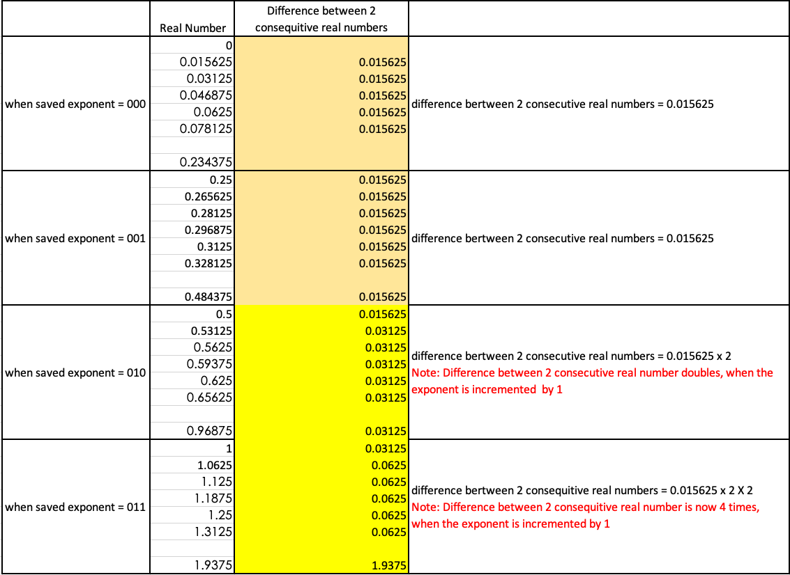
Difficulty representing all real numbers: Difference between two consecutive real numbers doubles when the exponent is incremented by 1

Slide 33
Difficulty representing all real numbers:
If 8 bits are used to represent real numbers, the total number of real numbers = 2^8
The numbers near to zero are closer and the distance between the two numbers doubles with every increment of the exponent. Numbers farther away from 0 are further away. Max number as shown before using 8-bit for real numbers cannot go beyond 15.5 though
15.5 is not that big a real value and is the MAX one can represent using 8 bits
This is the reason why
float has 7 bits for the exponent to have bigger MAX values
double has 11 bits for the exponent to have even bigger MAX values
Similar reasoning can be applied why
float has 23 bits for the significand to have higher precision
double has 52 bits for the significand to have even higher precision

Slide 34
Why double math (0.1d + 0.2d -0.3d) != 0?

Slide 35
Why double math (0.1d + 0.2d -0.3d) != 0?
double 0.1= 11111110111001100110011001100110011001100110011001100110011010
[+] [Saved Exponent = 1111111011] [Significand = 1001100110011001100110011001100110011001100110011010]
double 0.2= 11111111001001100110011001100110011001100110011001100110011010
[+] [Saved Exponent = 1111111100] [Significand = 1001100110011001100110011001100110011001100110011010]
0.1d + 0.2d = 0.30000000000000004d = 11111111010011001100110011001100110011001100110011001100110100
[+] [Saved Exponent = 1111111101] [Significand = 0011001100110011001100110011001100110011001100110100]
Why 0.1d + 0.2d = 0.30000000000000004d ?
0.1d Significand = 1001100110011001100110011001100110011001100110011010
0.2d Significand = 1001100110011001100110011001100110011001100110011010
+ __________________________________________________________
0011001100110011001100110011001100110011001100110100
__________________________________________________________
Since the saved exponent is NOT Zero, the number is in normalized form => Exponent = (save exponent - Bias)
Bias = 2^(#of bits for exponent in double – 1) -1 = 2^(11 – 1) -1 = (2^10 -1) => Exponent = (1111111101 – (2^10 -1))= 1021 – 1023 = -2
1.0011001100110011001100110011001100110011001100110100 * (2 ^ (-2)) = 1.20000000000000017764 / 4 = 0.30000000000000004d
Since double provides 16 digits of decimal precision, the sum is 0.30000000000000004d
Carry 1 lost

Slide 36
Whereas float math (0.1f + 0.2f -0.3f) = 0?

Slide 37
Why float math (0.1d + 0.2d -0.3d) = 0?
float 0.1= 111101110011001100110011001101
[+] [Saved Exponent = 1111011] [Significand = 10011001100110011001101]
float 0.2= 111110010011001100110011001101
[+] [Saved Exponent = 1111100] [Significand = 10011001100110011001101]
0.1f + 0.2f = 0.3d = 111110100110011001100110011010
[+] [Saved Exponent = 1111101] [Significand = 00110011001100110011010]
Why 0.1d + 0.2d = 0.3d ?
0.1d Significand = 10011001100110011001101
0.2d Significand = 10011001100110011001101
+ __________________________________________________________
00110011001100110011010
__________________________________________________________
Since the saved exponent is NOT Zero, the number is in normalized form => Exponent = (save exponent - Bias)
Bias = 2^(#of bits for exponent in float – 1) -1 = 2^(8 – 1) -1 = (2^7 - 1) => Exponent = (1111101 – (2^7 -1))= 125 – 127 = -2
1.00110011001100110011010 * (2 ^ (-2)) = 1.20000004768371582031 / 4 = 0.30000000000000004d
Since float provides 6 digits of decimal precision, the sum is 0.3 and not 0.30000000000000004
Carry 1 lost

Slide 38
Real-world numerical catastrophes. https://introcs.cs.princeton.edu/java/91float/
Ariane 5 rocket. Ariane 5 rocket exploded 40 seconds after being launched by European Space Agency. Maiden voyage after a decade and 7 billion dollars of research and development. The sensor reported acceleration that so was large that it caused an overflow in the part of the program responsible for recalibrating inertial guidance. 64-bit floating point number was converted to a 16-bit signed integer, but the number was larger than 32,767 and the conversion failed. The unanticipated overflow was caught by a general systems diagnostic and dumped debugging data into an area of memory used for guiding the rocket's motors. Control was switched to a backup computer, but this had the same data. This resulted in a drastic attempt to correct the nonexistent problem, which separated the motors from their mountings, leading to the end of Ariane 5.
Patriot missile accident. On February 25, 1991 an American Patriot missile failed to track and destroy an Iraqi Scud missile. Instead it hit an Army barracks, killing 26 people. The cause was later determined to be an inaccurate calculation caused by measuring time in tenth of a second. Couldn't represent 1/10 exactly since used a 24-bit floating point. The software to fix the problem arrived in Dhahran on February 26. Here is more information.
Intel FDIV Bug Error in Pentium hardwire floating point divide circuit. Discovered by Intel in July 1994, and rediscovered and publicized by math professor in September 1994. Intel recall in December 1994 cost $300 million. Another floating point bug discovered in 1997.
Sinking of Sleipner oil rig. Sleipner A $700 million platform for producing oil and gas sprang a leak and sank in the North Sea in August, 1991. Error in inaccurate finite element approximation underestimate shear stress by 47% Reference.
Vancouver stock exchange. Vancouver stock exchange index was undervalued by over 50% after 22 months of accumulated roundoff error. The obvious algorithm is to add up all the stock prices Instead a "clever" analyst decided it would be more efficient to recompute the index by adding the net change of stock after each trade. This computation was done using four decimal places and truncating (not rounding) the result to three. Reference

Slide 39
Lessons https://introcs.cs.princeton.edu/java/91float/
Use double instead of float for accuracy.
Use float only if you really need to conserve memory and are aware of the associated risks with accuracy. Usually, it doesn’t make things faster, and occasionally makes things slower.
Be careful of calculating the difference between two very similar values and using the result in a subsequent calculation.
Be careful about adding two quantities of very different magnitudes.
Be careful about repeating a slightly inaccurate computation many many times. For example, calculating the change in the position of planets over time.
Designing stable floating point algorithms is highly nontrivial. Use libraries when available.

