Slide 1
Everysecnews
DATE:
18/09/2021
Prepared By :-
20IT057 VIRAJ KORADIA
20IT069 KAMAL MER Guided by : Prof. Priyanka Patel

Slide 2
Contents
Introduction
Problem Statements
Flow diagram
Module of Projects
Future Scope
References
Conclusion

Slide 3
Introduction
As per as the increasing internet of the day by day the people willingness to know the information is increasing.
So EverysecNews would provide the detail information about news , surveys , reports and about many more things .

Slide 4
Problem Statements
We are designing a website that contains news and information like national , international , sports and many more.
The purpose of the website to provides the news and the information at every people at any corner of the world.
Our priority is to provide fully correct news and information.
There are many users visiting the news portal so EverysecNews provide the strong ,responsive and user friendly news website.
At last also user can save the news for the future purposes

Slide 5
PROGRAMMING LANGUAGES USED IN THE PROECT
There are many programmimg languages used to create website and apps. But we are using not all of that , So the programming languages used by us are as follows:
HTML
JAVA SCRIPT
CSS

Slide 6
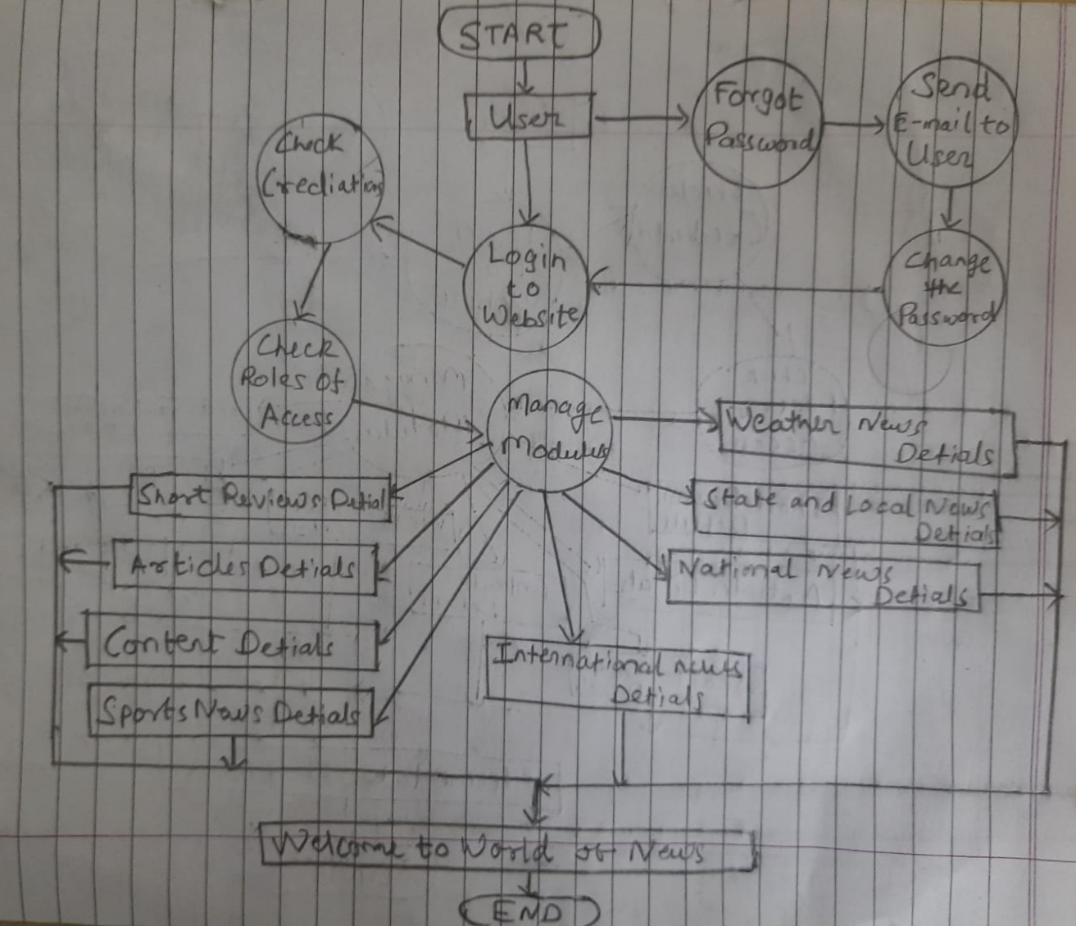
Flow Diagram

Slide 7
Modules of the Project
User
Sign In
Short reviews
Sports
National
International
Weather
Science

Slide 8
Future Scope
We would also add the more functionality as per as requirement for the better outcomes.
We would try to make the Live news video and the audio search to our website.

Slide 9
References
https://news.google.com/topstories?hl=en-IN&gl=IN&ceid=IN:en
https://news.yahoo.com/

Slide 10
Conclusion
By using of programming languages we can develop news website which provide the news and the information to all the people.
So By concluding this presentation the programming languages are the base of the all website , so all should try to learn the programming languages.

Slide 11
THANK YOU

